Slide 1


JavaScript Basic Functions
WHY FUNCTIONS?

Slide 2
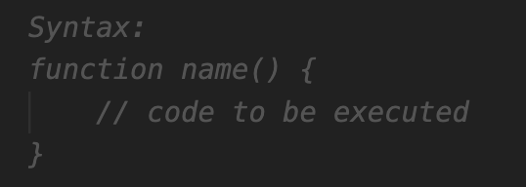
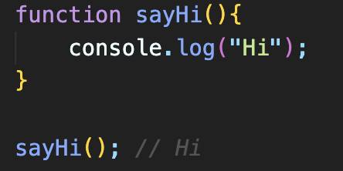
Functions in JavaScript
A function is a block of code that performs a specific task
Functions are also known as methods or behaviors of the class
A JS function is defined with the function keyword, followed by a name, and by parentheses ().
The parentheses may include parameter-argument names separated by commas.

Slide 3
Function Components
name- It is an identifier that is used to refer to the function in a program, could be any name but should be meaningful to increase readability of your code.
function body - It includes the programming statements that are used to perform some tasks. The function body is enclosed inside the curly braces { }.
function parameters – Arguments that we pass inside the function parentheses.
return - used to return a value from function which can be used later outside the function. return will terminate the function.

Slide 4
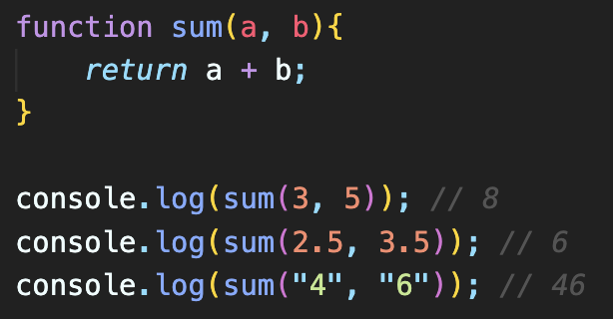
Function Parameters
A function parameter is a value accepted by the function.
A function can have any number of parameters.
Parameters act as variables inside the function.

Slide 5
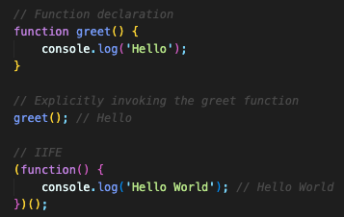

IIFE - Immediately Invoked Function Expression
IIFE stands for "Immediately Invoked Function Expression."
It is a common JavaScript design pattern used to create a function expression and execute it immediately after its declaration.
IIFE is typically wrapped in parentheses to distinguish it as an expression and to prevent its variables from polluting the global scope.

