Slide 1

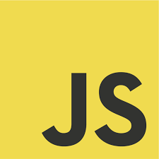
JavaScript Conditional (Flow Control) Statements
IF ELSE

Slide 2

if statement
if statement is used to test the condition.
It controls the flow of the program based on the condition and executes the statement if condition is truthy (true).

Slide 3
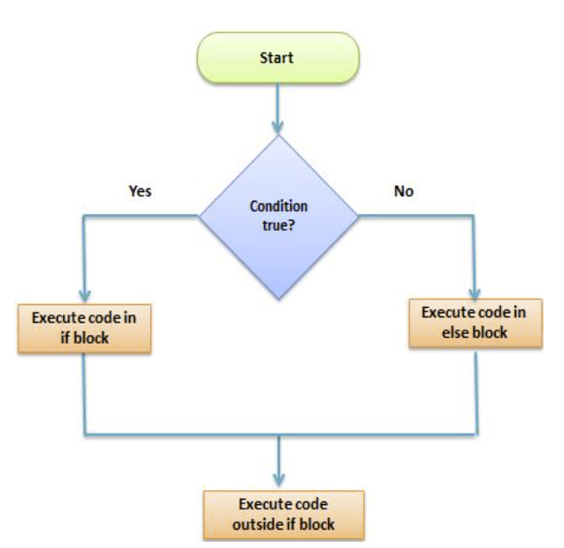
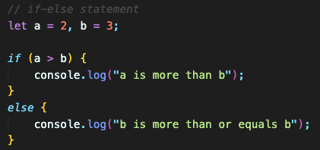
if-else statement
if statement is used to test the condition.
It controls the flow of the program based on the condition and executes the statement if condition is truthy (true).
else block will be executed if the condition is falsy (false).

Slide 4
if-else statement in the real life
if today is Saturday or Sunday, then it is a weekend day.
else it is a weekday.
if a number is dividable by 2, then the number is even number.
else the number is odd.
if there is a soccer game tonight, then I will watch the game.
else I will go out.

Slide 5
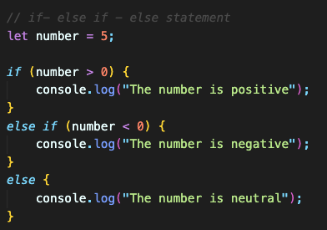
if-else if – else ladder statement
If else if statements are used when there are multiple cases
Only one of the blocks will be executed.

Slide 6
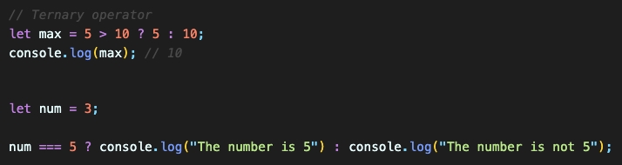
Ternary operator
Ternary operator can be used instead of if-else statements.
It can be considered as short version of if-else statement and commonly used in programming languages.

Slide 7
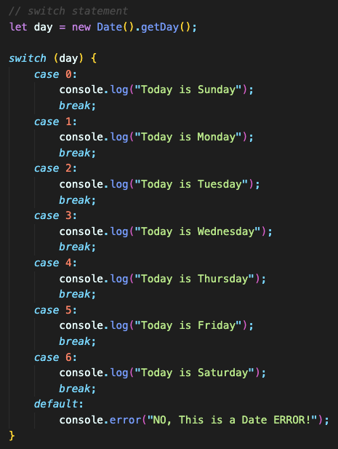
switch statement
It is like if else statement but based on cases instead of conditions.
NOTE: Switch cases use strict comparison (===).
The values must be of the same type to match.
A strict comparison can only be true if the operands are of the same type.
It allows to have any number of case statements within a switch.
Each case is followed by colon (:).
The statement for a case will execute until a break statement is reached.
When a break statement is reached, the switch terminates.
Using break is optional. If no break appears, the flow of control continue until a break is reached.
A switch statement can have an optional default case, which must be at the end of the switch. The default case can be used for performing a task when none of the cases is true. No break is needed in the default case.

Slide 8
break statement
In JavaScript, break statement is used for the termination.
It is used with switch statements and loop statements.
Syntax:
break;

Slide 9
Truthy vs Falsy values
Falsy Values:
These are values that are considered "false" when evaluated in a boolean context. Common examples of falsy values include:
The number 0.
An empty string ("").
null.
undefined.
NaN (Not-a-Number).
The boolean value false
Truthy Values:
These are values that are considered ”true" when evaluated in a boolean context. In most programming languages, values that are not specifically considered "false" are treated as truthy. Common examples of truthy values include:
Numbers other than 0.
Non-empty strings.
Objects and arrays, which are considered true even if they are empty.
Functions.
The boolean value true

