Slide 1


JavaScript Loops
REPEATING CODE

Slide 2
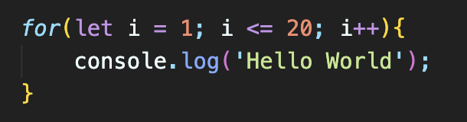
Why Loops?
Write a JavaScript program to output Hello 5 times.
Now, output it 20 times.
Now, add World to your outputs.
DO NOT DUPLICATE! USE LOOPS!

Slide 3
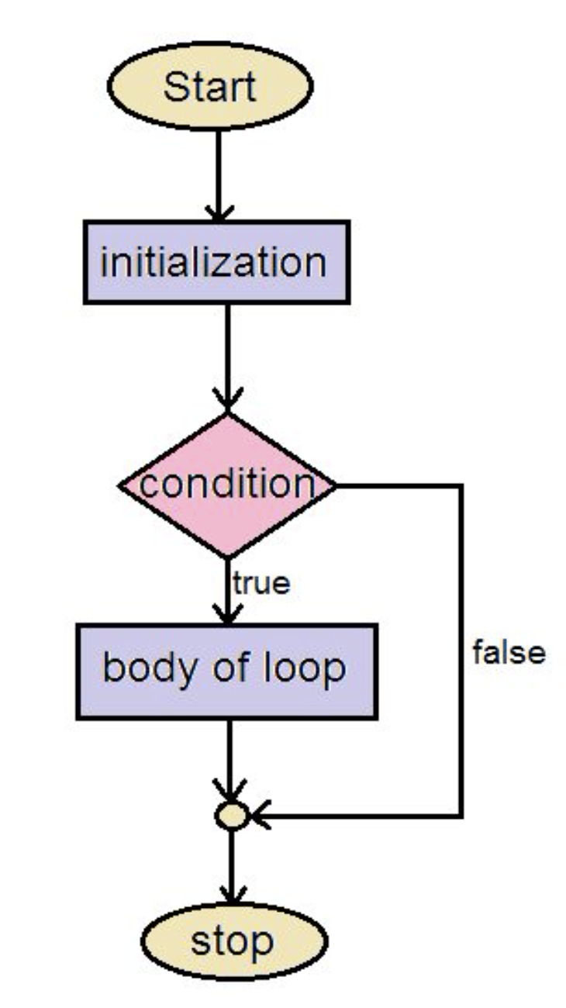
JS Loops
JS loops are used to execute a block of code repeatedly.
Loops will execute until a termination condition is met.
Loops are helpful to eliminate duplicating codes and time-effort saving.
JS supports different kinds of loops:
for - loops through a block of code a number of times.
for/in - loops through the properties of an object.
for/of - loops through the values of an iterable object.
while - loops through a block of code while a specified condition is true.
do/while - also loops through a block of code while a specified condition is true.

Slide 4
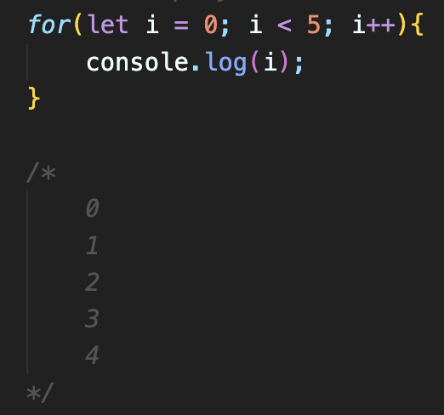
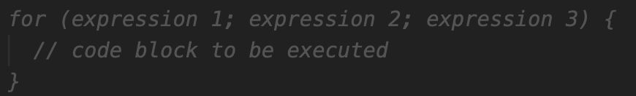
For loop
The for statement creates a loop with 3 expressions:
Expression 1 is executed (one time) before the execution of the code block.
Expression 2 defines the condition for executing the code block.
Expression 3 is executed (every time) after the code block has been executed.

Slide 5
Practice
Write JavaScript programs to output the given results.
Output the numbers from 1 to 10 (both inclusive) -> 1 2 3 4 5 ….
Output the numbers from 100 to 0 (both inclusive) –> 100 99 98 97 96 ….
Output all the even numbers from 0 to 50 (both inclusive) -> 0 2 4 6 8 ….
Output all the numbers divisible by 5 from 0 to 50 (both inclusive) -> 0 5 10 ….
Find sum of the numbers from 1 to 5 (both inclusive) -> 15
Find sum of the numbers from 10 to 15 (both inclusive) -> 75
Output each character from TechGlobal School -> T e c h G l o b a l S c h o o l
Count the total occurrences of letter o in TechGlobal School -> 3
Output all the odd numbers from 1 to Random Number (both inclusive) -> 1 3 5 7 9 ….

Slide 6
Practice – Let’s play the below game
Write JavaScript program to play the game ☺
Assume that we are playing a game and one person in the class is just writing a number on a paper and others are trying to guess the number
NOTE: number can only be between 1 to 10 ( 1 and 10 are included)
See how many attempts it is going to take to find the number?

Slide 7
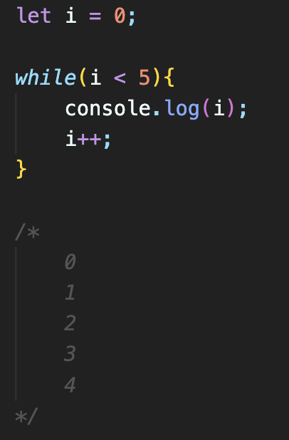
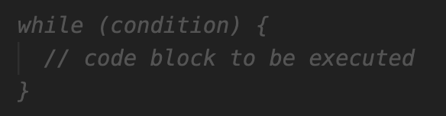
While loop
The while loop loops through a block of code as long as a specified condition is true.
You can do any task you did with for loop using while loop.

Slide 8
Practice
Write JavaScript programs to output the given results.
This cases makes sense to use while loop.
Generate a random number in any range till you got a 7.
Generate a random number in any range till you get an even or odd number.
Get a random name from some libraries till you get a name that starts with A.
Get a random name from some libraries till you get a name that has length of 6.

Slide 9
While vs For loops
For loop is used to execute a block of code and preferred when we know the exact number of iterations.
While loop is used to execute a block of based on a condition and total number of iteration is not certain (dynamic).
While loop can be used instead of for loop and visa versa.

Slide 10
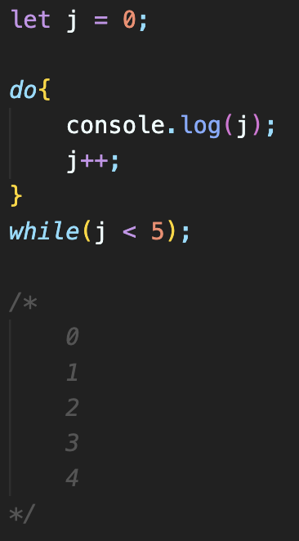
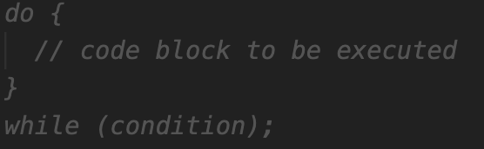
Do-While loop
The do-while loop is a variant of the while loop.
This loop will execute the code block once, before checking if the condition is true, then it will repeat the loop as long as the condition is true.

Slide 11
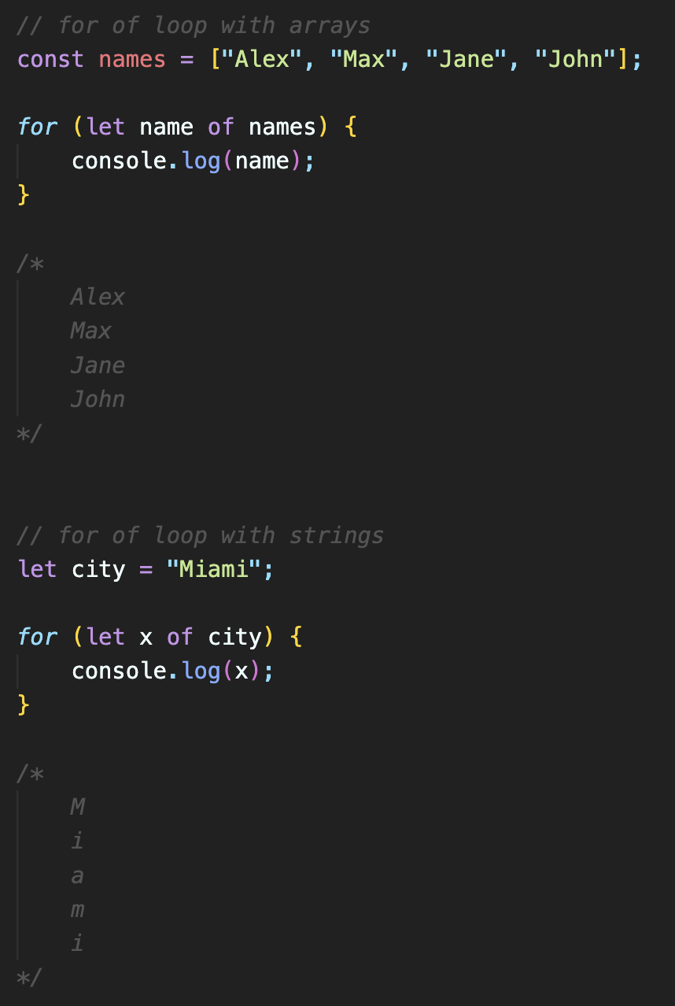
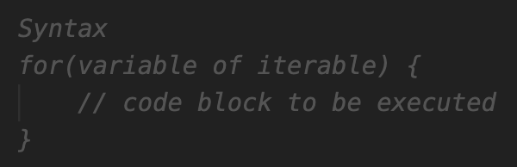
For-of loop
The for of loop is used to loop through the values of an iterable object such as Arrays, Strings, Maps and more.

Slide 12
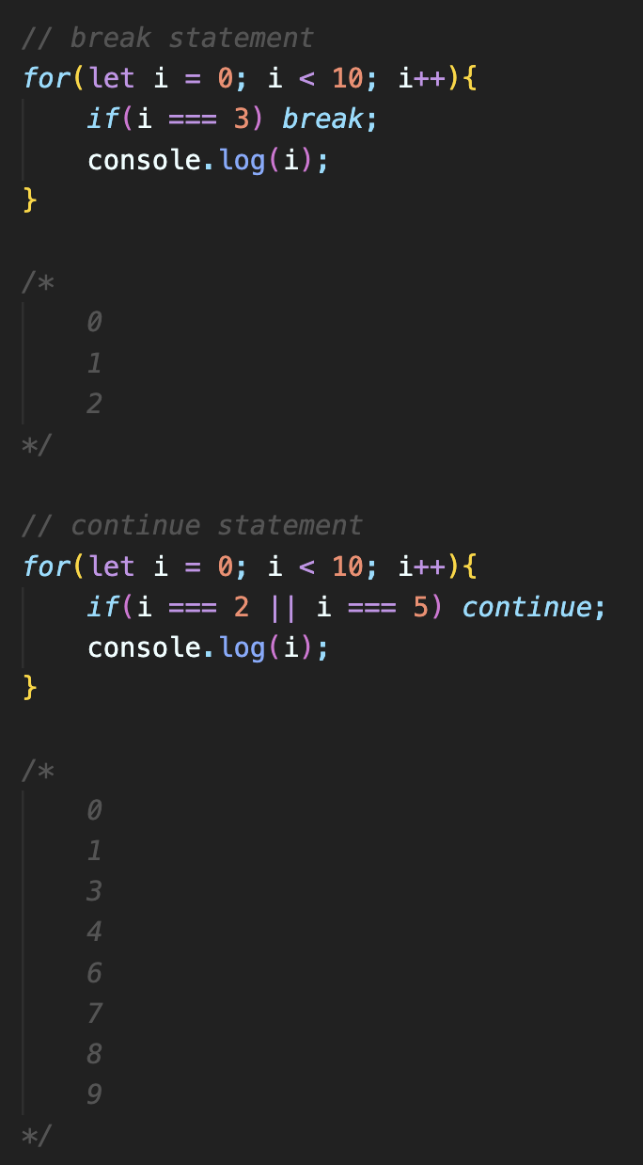
Loop Control Statements
break;
break is used to terminate the loop.
continue;
continue is used to skip only current iteration if a specified condition occurs and continues with the next iteration in the loop.

Slide 13
Nested Loops
Any loop statement can be used in another loop.
Executing a loop inside another loop is known as nested loops.
The first loop is known as outer loop, and the second one which is used inside the first one is known as inner loop.
NOTE: we will cover for in loop once we learn JS Objects as it is used with objects.

