Slide 1


JavaScript Objects
PROPERTIES: KEY VALUE PAIRS

Slide 2
Data Types in JavaScript
Primitive Data Types
There are 7 primitives: String, Number, Bigint, Boolean, Undefined, Null, Symbol
A primitive data type is data that has a primitive value.
Reference Data Types (non-primitives) - Objects
The object data type can contain arrays, objects, collections, etc.

Slide 3
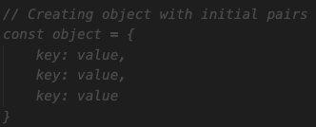
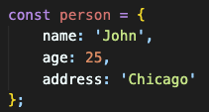
JS Objects
JS Objects are collections of properties. They are also variables at the same time.
Property: key-value pair
* All keys are converted to strings (except symbols).
We can access the data using custom keys not the indexes.
We can create an object using object literals {} or object constructor as below
const obj1 = {}; // empty object
const obj2 = new Object();
NOTE: It is a common practice to declare objects with the const keyword.

Slide 4
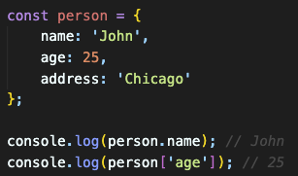
JS Object – Accessing properties
We can use object.key syntax to access to the value of the specified key. (dot notation)
We can also use object['key'] if the key is not a valid identifier. (bracket notation)
object.key
or
object['key']

Slide 5
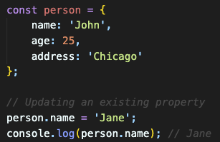
JS Object – Updating properties
We can access and update any property values of an object as below;
object.key = newValue;
or
object['key'] = newValue;

Slide 6
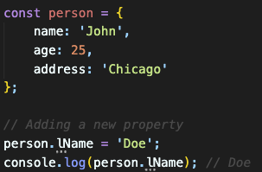
JS Object – Adding properties
We can add new property to an object as below;
object.newKey = newValue;
or
object[‘newKey'] = newValue;

Slide 7
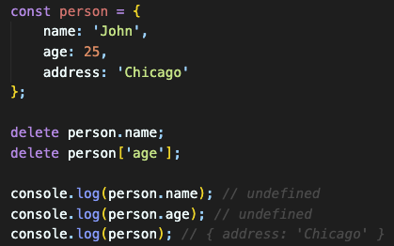
JS Object – Removing properties
We can remove a property of an object using delete keyword as below;
delete object.newKey;
or
delete object[‘newKey'];

Slide 8
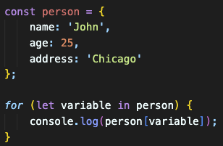

JS Object – for…in loop
We can loop through object properties using for...in loop
JavaScript for...in Loop
The JavaScript for...in statement loops through the properties of an object.
The block of code inside of the for...in loop will be executed once for each property.
NOTE: You must use person[x] in the loop. (bracket notation)
person.x will not work because x is a variable.

Slide 9
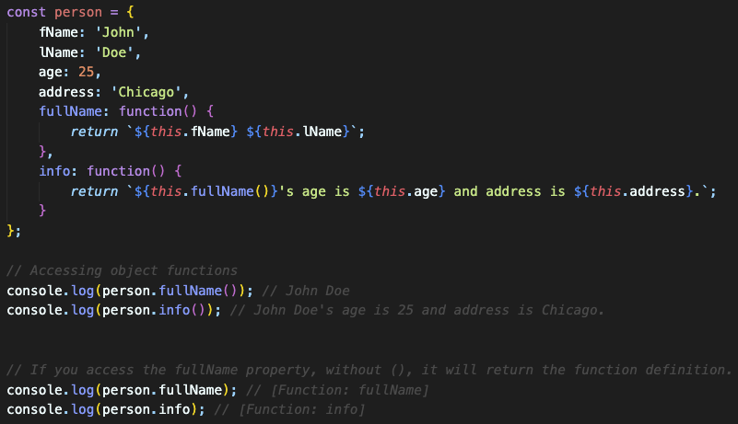
JS Object – property functions
JavaScript objects can also have functions.
These are actions that can be performed on objects and its properties.
this keyword
In JavaScript, this keyword refers to an object.
We will learn more about this keyword later.

Slide 10
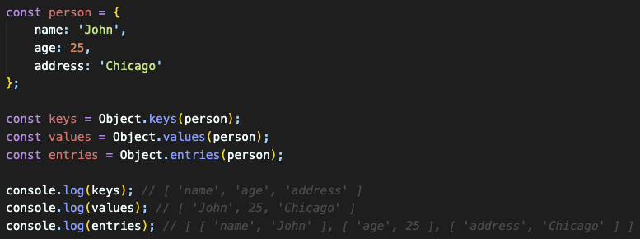
JS Object – pre-built functions
JavaScript object keys and values can be converted to arrays.
Object.keys(obj) - returns an array of a given object's property keys.
Object.values(obj) - returns an array of a given object's property values.
Object.entries(obj) - returns an array of a given object's property key-value pairs.

Slide 11
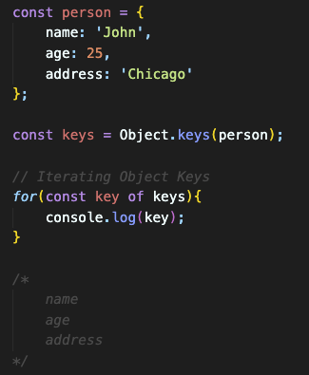
JS Object – Iterating Object Keys
JavaScript object keys and values can be converted to arrays.
Object.keys(obj) - returns an array of a given object's property keys.

Slide 12
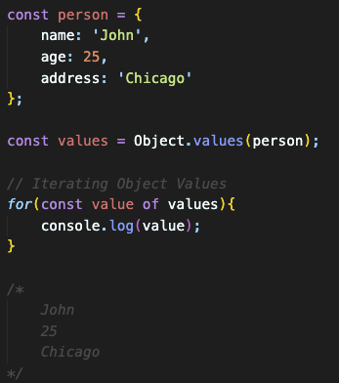
JS Object – Iterating Object Values
JavaScript object keys and values can be converted to arrays.
Object.values(obj) - returns an array of a given object's property values.

Slide 13
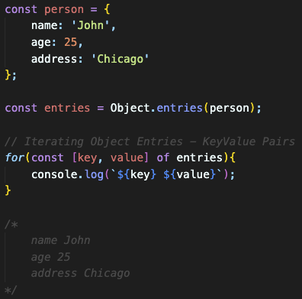
JS Object – Iterating Object Entries
JavaScript object keys and values can be converted to arrays.
Object.entries(obj) - returns an array of a given object's property key-value pairs.

Slide 14
Destructuring in JavaScript
Destructuring allows us to extract values from arrays, objects, or other iterable data structures and assign them to variables in a more concise and readable way.

Slide 15
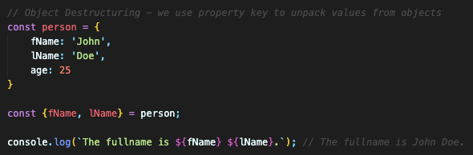
Destructuring Objects
To destructure an object, we use curly braces {} on the left side of an assignment, and within those braces, we specify the variables where we want to store the values from the object.
NOTE: It allows a short and clean syntax to unpack values from the object.

Slide 16
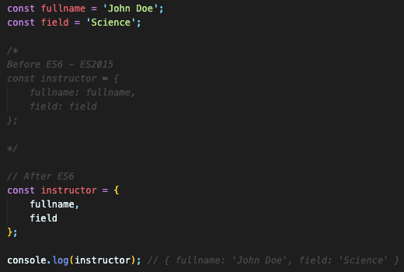
Enhanced Object Literals
In JavaScript, enhanced object literals were introduced in ECMAScript 6 (ES6) to make working with objects more concise and convenient.

Slide 17
Reference
See more functions https://developer.mozilla.org/en-US/docs/Web/JavaScript/Reference/Global_Objects/Object

