Slide 1


JavaScript Arrays
CALLBACK FUNCTIONS

Slide 2
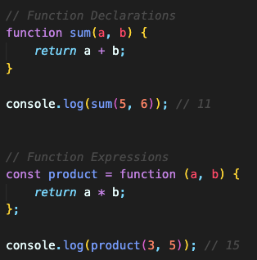

JS Function Expressions
A function is a block of code that performs a specific task.
A JavaScript function can also be defined using an expression and this expression can be stored in a variable.
Functions are also JavaScript objects even though the typeof operator in JavaScript returns "function" for functions.
The function above is actually an anonymous function (a function without a name).
Functions stored in variables do not need function names. They can be invoked (called) using the variable name.

Slide 3
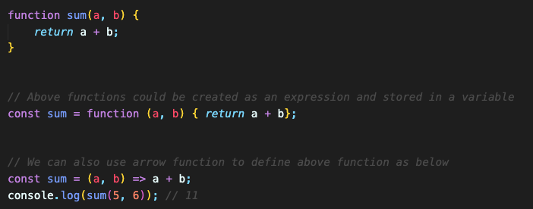
JS Arrow Functions
JavaScript arrow functions allows a short syntax for writing function expressions.
We don't need the function keyword, the return keyword, and the curly brackets.
Using const is safer and preferred, because a function expression is always constant value.
We can only omit the return keyword and the curly brackets if the function body has a single statement.
We can skip the parentheses if we have only one parameter.

Slide 4
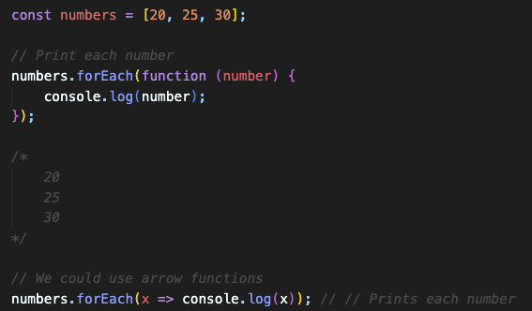
JS Array Callback Functions – forEach()
forEach() - executes a provided function once for each array element.

Slide 5
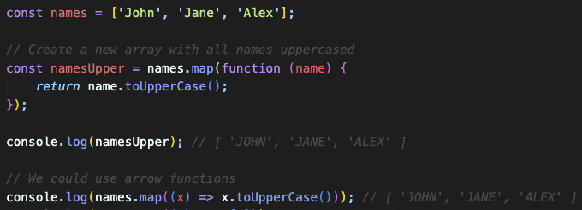
JS Array Callback Functions – map()
map() - creates a new array populated with the results of calling a provided function on every element in the calling array.
The map() creates a new array by performing a function on each array element.
It does not execute the function for array elements without values.
It does not change the original array.

Slide 6
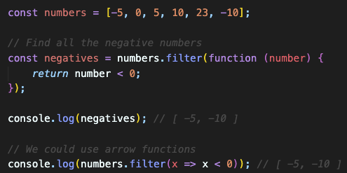
JS Array Callback Functions – filter()
filter() - creates a shallow copy of a portion of a given array, filtered down to just the elements from the given array that pass the test implemented by the provided function.
Simply, the filter() creates a new array with array elements that pass a test.

Slide 7
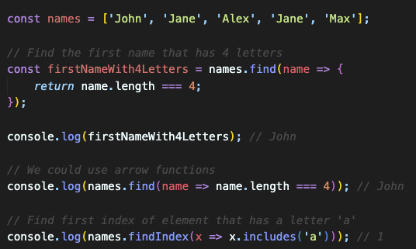
JS Array Callback Functions – find()
find() - returns the first element in the provided array that satisfies the provided testing function. If no values satisfy the testing function, undefined is returned.
findLast() - iterates the array in reverse order and returns the value of the first element that satisfies the provided testing function. If no elements satisfy the testing function, undefined is returned.
findIndex() - returns the index of the first element in an array that satisfies the provided testing function. If no elements satisfy the testing function, -1 is returned.
findLastIndex() - iterates the array in reverse order and returns the index of the first element that satisfies the provided testing function. If no elements satisfy the testing function, -1 is returned.

Slide 8
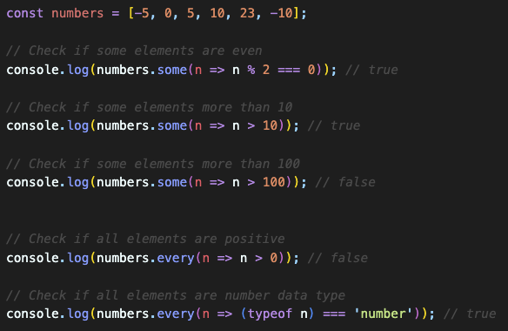
JS Array Callback Functions – some() & every()
some() - tests whether at least one element in the array passes the test implemented by the provided function.
It returns true if, in the array, it finds an element for which the provided function returns true.
Otherwise, it returns false. It doesn't modify the array.
Simply, the some() checks if some array values pass a test.
every() - tests whether all elements in the array pass the test implemented by the provided function.
It returns a boolean value.
Simply, the every() method checks if all array values pass a test.

Slide 9
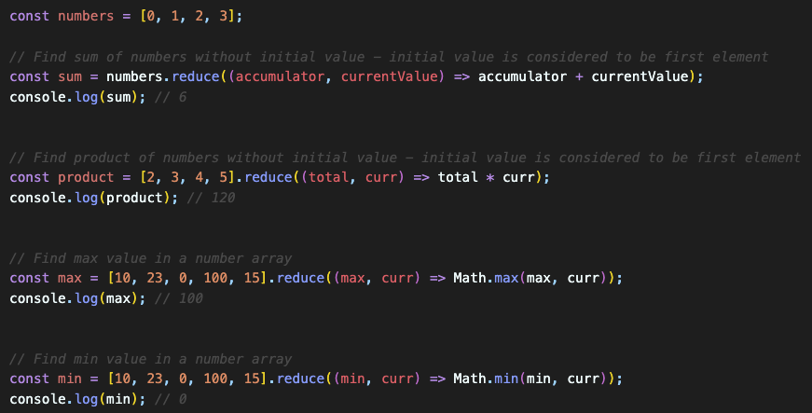
JS Array Callback Functions – reduce()
reduce() - executes a user-supplied "reducer" callback function on each element of the array, in order, passing in the return value from the calculation on the preceding element.
The final result of running the reducer across all elements of the array is a single value.
The first time that the callback is run there is no "return value of the previous calculation".
If supplied, an initial value may be used in its place.
Otherwise the array element at index 0 is used as the initial value and iteration starts from the next element (index 1 instead of index 0).
Simply, the reduce() runs a function on each array element to produce (reduce it to) a single value.
It works from left-to-right in the array.
It does not reduce the original array.
reduceRight() – similar to reduce() but works from right-to-left.

Slide 10
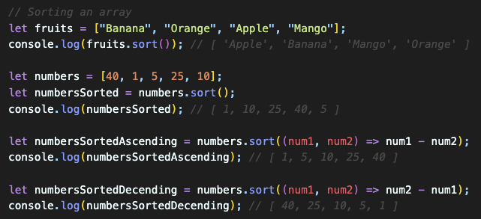
JS Arrays – Sorting Arrays
sort() -> sorts an array alphabetically - be careful with the numbers!
This functions performs a lexicographic (dictionary) sort by default, treating numbers as strings. This means it compares the characters in the number as strings, which can lead to unexpected results.
We can solve this issue with a callback function!

Slide 11
Reference
See more functions https://developer.mozilla.org/en-US/docs/Web/JavaScript/Reference/Global_Objects/Array
https://www.w3schools.com/jsref/jsref_obj_array.asp

