Slide 1


JavaScript apply-call-bind currying
GOOD TO KNOW

Slide 2
JavaScript | call-apply-bind
The call(), apply(), and bind() methods are used to set the value of the 'this' keyword.
'this' keyword refers to the object that the function is being called on.
By using these methods, you can change the value of 'this' to be whatever you want, even if it is not the object that the function is actually associated with.
The call(), apply(), and bind() methods are all very useful for controlling the behavior of functions in JavaScript.

Slide 3
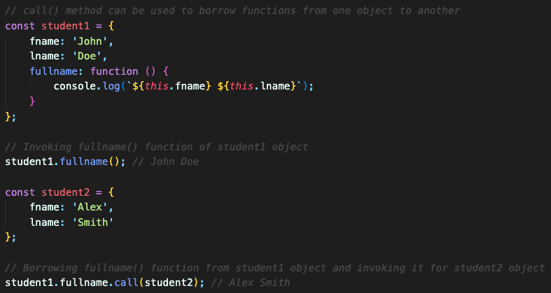
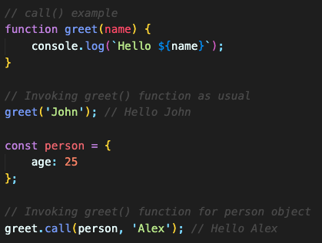
JavaScript | call() method
call() method; is used to invoke a function with a specified 'this' value and individual arguments.

Slide 4
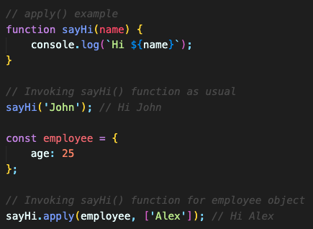
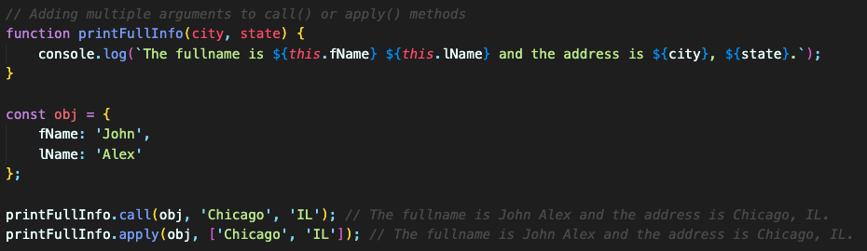
JavaScript | apply() method
apply() method; is similar to call() method.
But it accepts an array or an array-like object as the second argument, which represents the arguments passed to the function.

Slide 5
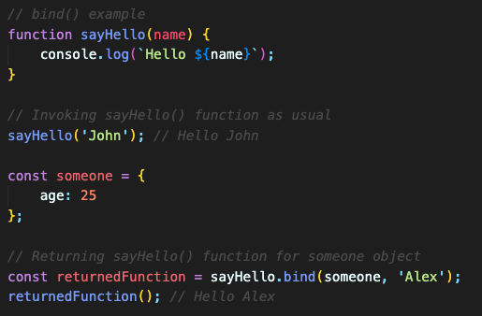
JavaScript | bind() method
bind() method; returns a new function with a specified this value and initial arguments.
Unlike call() and apply(), bind() does not invoke the function immediately but rather returns a new function that you can invoke later.

Slide 6
JavaScript | call-apply-bind | Key Differences
call() and apply() invoke the function immediately, while bind() returns a new function.
call() and apply() accept a various number of arguments, while bind() accepts a fixed set of arguments when creating the new function.
All three methods allow you to explicitly set the value of 'this' in a function.

Slide 7
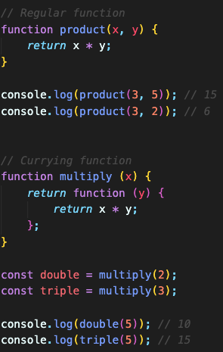
JavaScript | currying
Currying is a functional programming technique where a function that takes multiple arguments is transformed into a series of functions, each taking one argument.
It allows you to partially apply a function by providing one argument at a time.
Currying is useful for creating reusable functions and for building more specialized functions from general ones.
It's a powerful technique in functional programming.

