Slide 1


JSON – JavaScript Object Notation
JSON

Slide 2
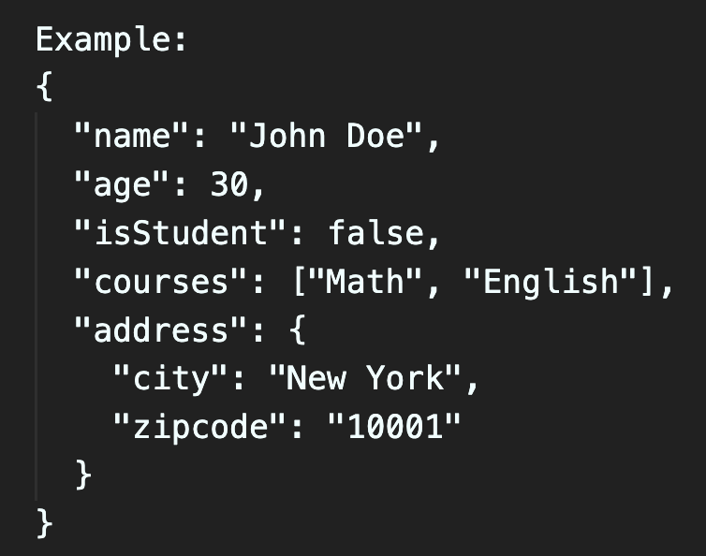
JSON
It stands for JavaScript Object Notation.
It is a lightweight data interchange format that is easy for humans to read and write, and easy for machines to parse and generate.
In JavaScript, JSON is a common way to represent and exchange data between a server and a web application, or between different parts of a web application.
It is language independent and universally used for transporting data between server and browser.
Syntax:
JSON is a text format that uses a specific syntax to represent data as key-value pairs. Keys are always strings, and values can be strings, numbers, objects, arrays, booleans, or null.

Slide 3
Data Types Supported in JSON
Strings: "Hello, World!"
Numbers: 42 or 3.14
Booleans: true or false
Arrays: ["apple", "banana", "orange"]
Objects: {"key": "value", "age": 25}
Null: null

Slide 4
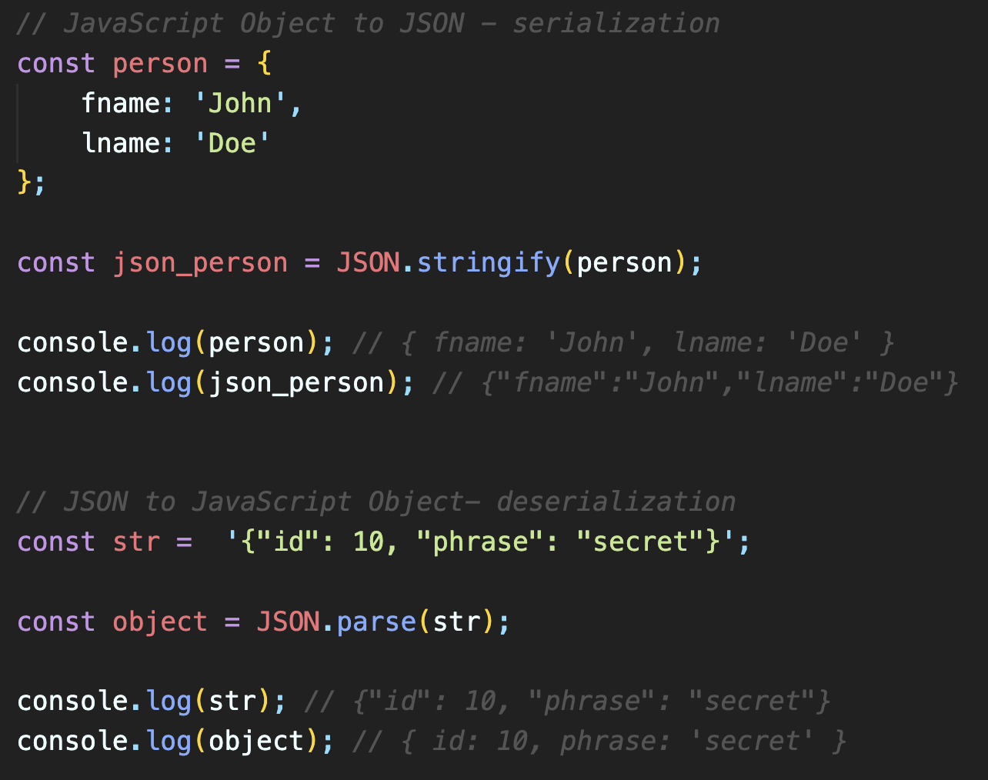
Serialization vs Deserialization
Serialization is the process of converting a JavaScript object into a JSON string using JSON.stringify(). This is useful when sending local object as text to database or server.
Deserialization is the process of converting a JSON string into a JavaScript object using JSON.parse(). This allows us to use JSON data in our JavaScript code.
NOTE: JSON shares a similar syntax with JavaScript object literals, making it easy to convert between JSON and JavaScript objects.

Slide 5
Deep Copy vs Shallow Copy
Deep Copy: A deep copy, on the other hand, creates a completely independent duplicate of the original object or array,
including all nested objects or arrays. Changes made to the copy won't affect the original.
Shallow Copy: A shallow copy of an object or array creates a new instance of the top-level object or array, but it doesn't duplicate nested objects or arrays. Instead, it references them. Modifying nested objects will affect both the original and the copied object.

Slide 6
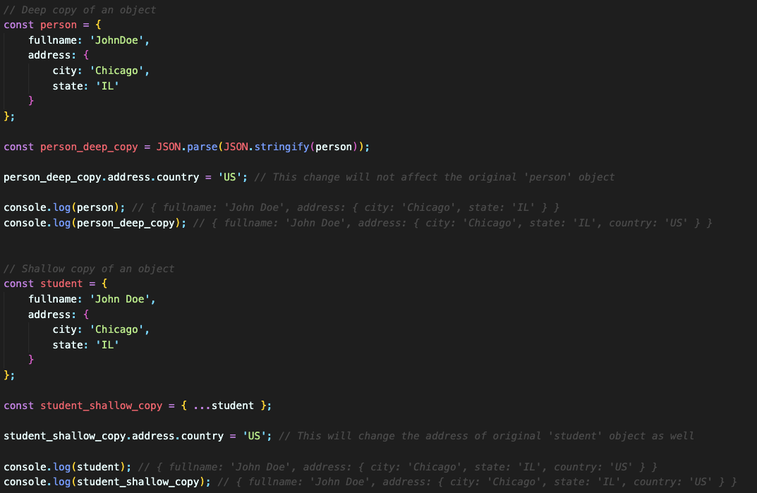
Deep Copy vs Shallow Copy
Deep Copy: using JSON.parse() and JSON.stringfy()
Shallow Copy: using spread operator.
NOTE: Because a deep copy shares no references with its source object, any changes made to the deep copy do not affect the source object.

Slide 7
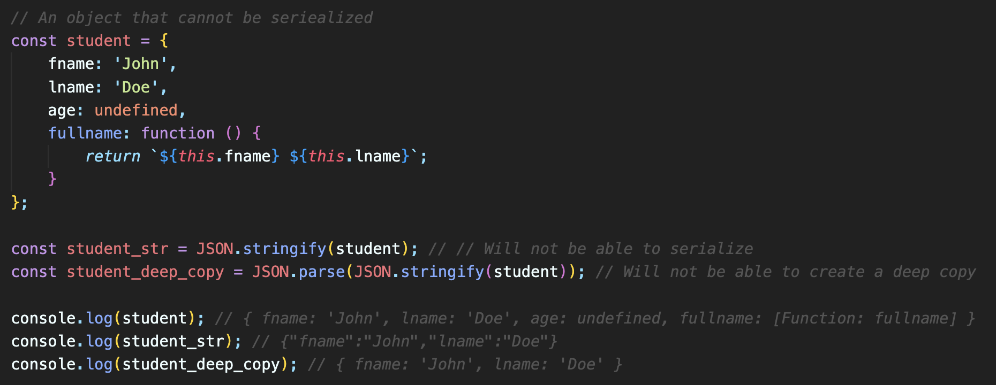
Not Serializable Objects
Functions,
Symbols,
undefined
Objects that represent HTML elements in the HTML DOM API,
Recursive data, and many other cases.
Calling JSON.stringify() to serialize the objects in those cases will fail. So, there's no way to make deep copies of such objects.

