Slide 1


JavaScript Immutability
MUTABLE | IMMUTABLE

Slide 2
Immutability
Immutability in JavaScript refers to the concept that once an object (like an array or an object) is created, its state cannot be changed.
Any operation that appears to modify the object creates a new object with the desired changes.
Immutability is a core concept in functional programming and has become increasingly popular in modern JavaScript development.
Mutable: can be changed.
Immutable: cannot be changed.

Slide 3
Key Aspects of Immutability
All the primitive values are immutable by nature.
Ex: strings, numbers, booleans, null and undefined
Arrays in JavaScript are mutable by default.
However, various array methods can be used to create new arrays without modifying the original.
Objects in JavaScript are mutable.
However, their immutability can be achieved by creating new objects with the desired changes.

Slide 4
Benefits of Immutability
Predictability: With immutable data, the state of an object at any given time is clear and predictable. This can help in reasoning about the behavior of the code.
Concurrency: In a multi-threaded environment, immutable data structures simplify the management of shared data, as there are no concerns about simultaneous modifications.
Undo/Redo Functionality: Immutability simplifies the implementation of undo and redo functionalities in applications, as each state change creates a new, distinct object.
Debugging: Debugging is often easier with immutable data since you can trace the origin of a value more consistently.

Slide 5
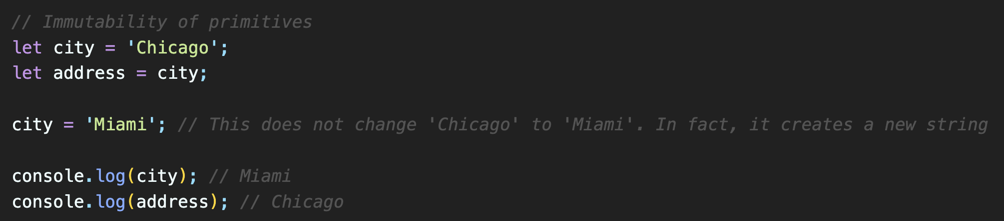
Immutability of Primitives
All the primitive values are immutable by nature.
Ex: strings, numbers, booleans, null and undefined

Slide 6
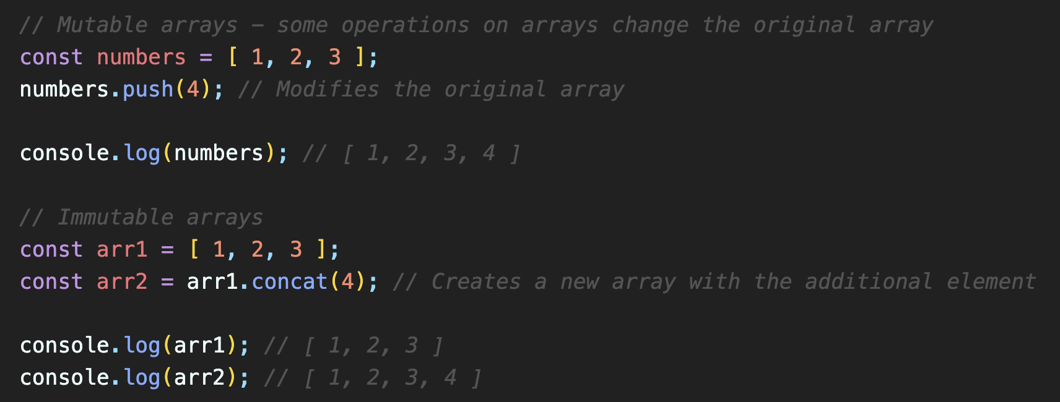
Mutability – Immutability of Arrays
Arrays in JavaScript are mutable by default.
However, various array methods can be used to create new arrays without modifying the original.

Slide 7
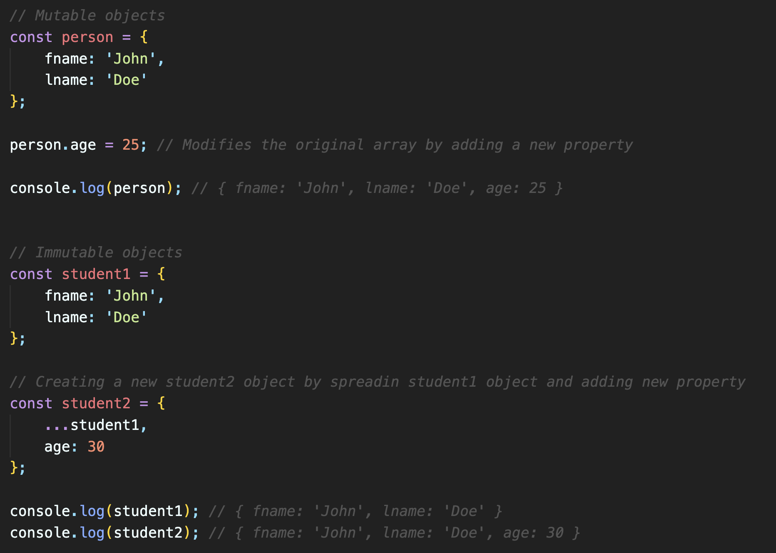
Mutability – Immutability of Objects
Objects in JavaScript are mutable.
However, their immutability can be achieved by creating new objects with the desired changes.

