Slide 1


JavaScript ES6
NEW FEATURES

Slide 2
EcmaScript
ES stands for ECMAScript which is the language standard of JavaScript.
ES2015 was released in...2015!
It is commonly called ES6, and it was a revolutionary update to JavaScript.
ES6 = ES2015
ECMA-262, 1st edition, June 1997
ECMA-262, 2nd edition, August 1998
ECMA-262, 3rd edition, December 1999
ECMA-262, 4th edition (not existing)
ECMA-262, 5th edition, December 2009
ECMA-262, 5.1th edition, June 2011
ECMA-262, 6th edition, June 2015
ECMA-262, 7th edition, June 2016
ECMA-262, 8th edition, June 2017
ECMA-262, 9th edition, June 2018
ECMA-262, 10th edition, June 2019
ECMA-262, 11th edition, June 2020
ECMA-262, 12th edition, June 2021
ECMA-262, 13th edition, June 2022

Slide 3
ES6 – New Features
The let keyword
The const keyword
Arrow Functions
The ... Operator
For/of
String.includes()
String.startsWith()
String.endsWith()
New Math Methods
New Number Properties
New Number Methods
New Global Methods
Array.from()
Array keys()
Array find()
Array findIndex()
Object entries
Map Objects
Set Objects
Classes
Promises
Symbol
Default Parameters
Function Rest Parameter
JavaScript Modules

Slide 4
let - const
Historical Context:
The var keyword has been a staple in JavaScript since its inception in 1995 and was the primary method for variable declaration until 2015.
var name = ”John";
Introduction of let and const:
In 2015, with the introduction of ECMAScript 6 (ES6), the let and const keywords were added, providing more flexible and modern alternatives.
let name = ”John";
const pi = 3.14;

Slide 5
let – const | Reassignment and Immutability
let variables can be reassigned after declaration.
That tells, let variables are mutable.
let name = ”John";
name = ”James"; // allowed
Mutable: can be modified after their creation. This means that you can change their properties, add or remove elements, and the object's identity remains the same.
Examples of mutable data types in JavaScript include arrays and objects.
const variables, once assigned, cannot be reassigned after declaration.
That tells, const variables are immutable.
const pi = 3.14;
pi = 5; // Throws an error
Immutable: cannot be changed once they are created. Any operation that appears to modify the object actually creates a new object with the desired changes.
Examples of immutable data types in JavaScript include strings, numbers and other primitives.

Slide 6
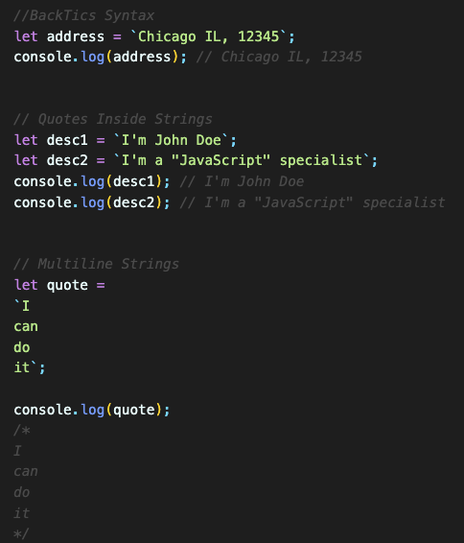
String Templates
String templates terminology is also known as template strings, template literals or backticks syntax.
String templates use backticks (``) rather than single or double quotes to define a string.
Template literals makes it easy to embed single or double quotes into your string.
Template literals allows to create multiline strings.

Slide 7
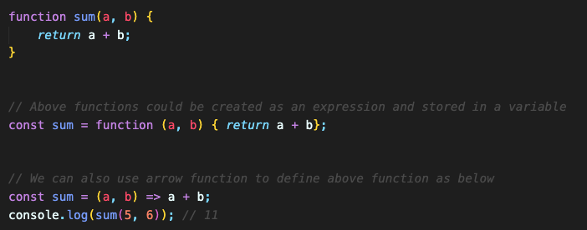
JS Arrow Functions
JavaScript arrow functions allows a short syntax for writing function expressions.
We don't need the function keyword, the return keyword, and the curly brackets.
Using const is safer and preferred, because a function expression is always constant value.
We can only omit the return keyword and the curly brackets if the function body has a single statement.
We can skip the parentheses if we have only one parameter.

Slide 8
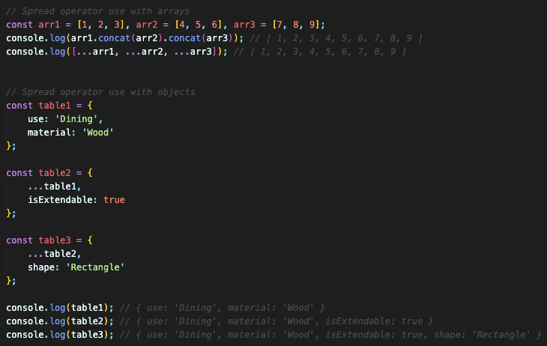
Spread Operator
The Spread (...) operator expands an iterable (like an array) into its individual elements.
The Spread (...) operator can be used to expand an iterable into more arguments for function calls.

Slide 9
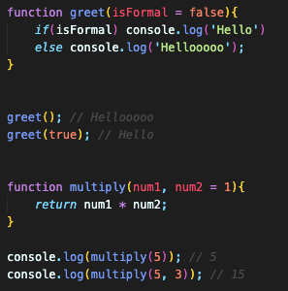
Default Parameters
Default parameters in programming languages allow you to assign a default value to a function parameter if no argument is provided when the function is called.
This feature is especially useful when you want to make your functions more flexible and provide sensible default behavior.
NOTE: Default parameters must be used as last arguments.

Slide 10
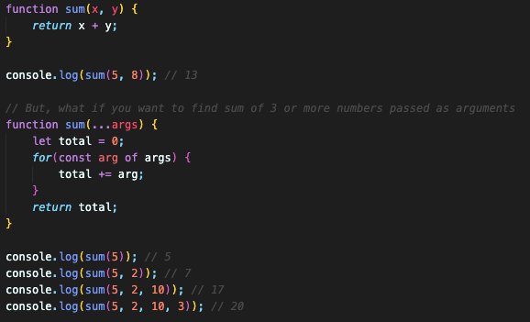
The Rest (…) Parameters
The rest parameter (...) allows a function to treat an indefinite number of arguments as an array.
It's a powerful tool for working with functions that can accept an arbitrary number of inputs.
NOTE: The rest parameter must be used as the last argument.

Slide 11
Destructuring in JavaScript
Destructuring allows us to extract values from arrays, objects, or other iterable data structures and assign them to variables in a more concise and readable way.

Slide 12
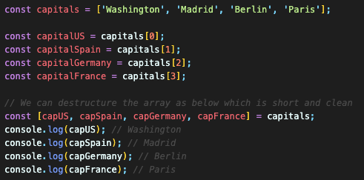
Destructuring Arrays
To destructure an array, we use square brackets [ ] on the left side of an assignment, and within those brackets, we specify the variables where we want to store the values from the array.
NOTE: It allows a short and clean syntax to unpack elements.

Slide 13
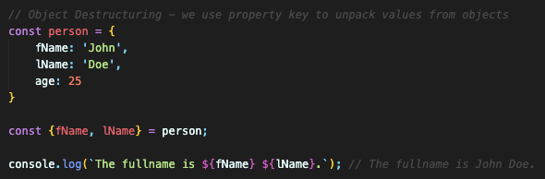
Destructuring Objects
To destructure an object, we use curly braces {} on the left side of an assignment, and within those braces, we specify the variables where we want to store the values from the object.
NOTE: It allows a short and clean syntax to unpack values from the object.

Slide 14
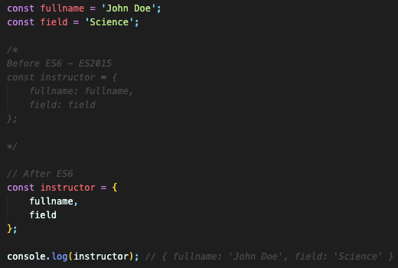
Enhanced Object Literals
In JavaScript, enhanced object literals were introduced in ECMAScript 6 (ES6) to make working with objects more concise and convenient.

