Slide 1


Introduction to JavaScript
WHY JAVAscript?

Slide 2

Computer
A computer is an electronic machine that is used to input, process, and then output data, typically in binary form, according to instructions given to it in a variable program.

Slide 3
Binary
Binary (or base-2) a numeric system that only uses two digits, 0 and 1
Computers operate in binary, meaning they store data and perform calculations using only zeros and ones
Binary vs Decimal
Base-2 vs base-10
Binary Code
It is a base 2 number system where numeric values are represented by different combinations of 0 and 1, also known as OFF or ON
Every data is stored in the computers as 1s and 0s
Letters, numbers, symbols, shapes, images, sounds
Computer understands only 1s and 0s

Slide 4
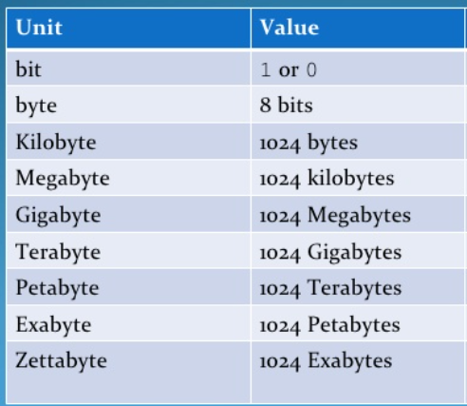
Binary Units – Storage capacities
The smallest unit of data which can be represented on a computer system is a binary digit or bit .
A bit can have either the value 1 or 0
Bits are often represented in groups of 8, known as a byte
A collection of 1024 bytes is known as a kilobyte

Slide 5
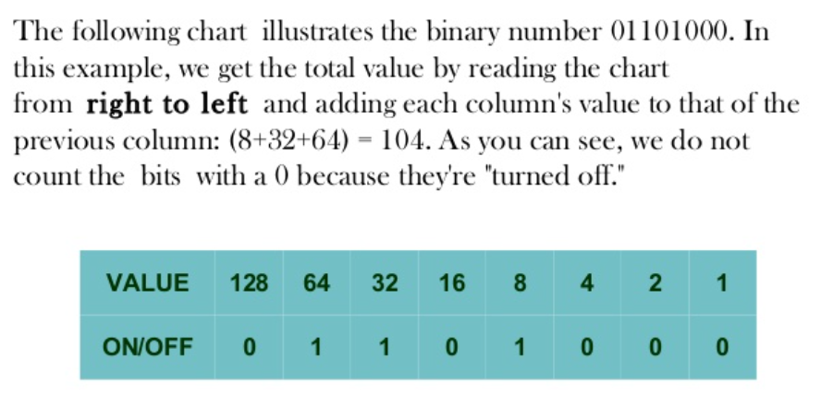
Reading Binary Code

Slide 6
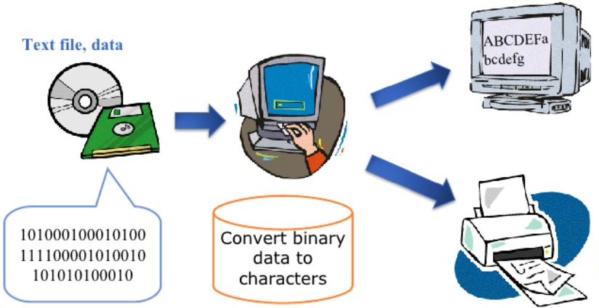
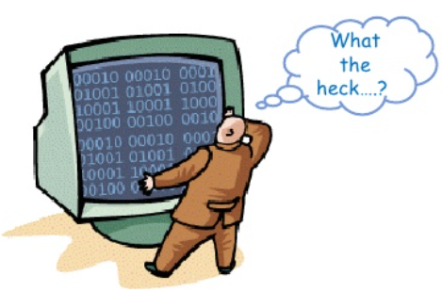
Converting text into a Binary Code
With ASCII
ASCII Code – American Standard Code for Information Interchange
ASCII can be used to convert each letter into Binary Code and visa versa
Every letter, number, and special characters are represented by numbers in ASCII code
Without ASCII

Slide 7
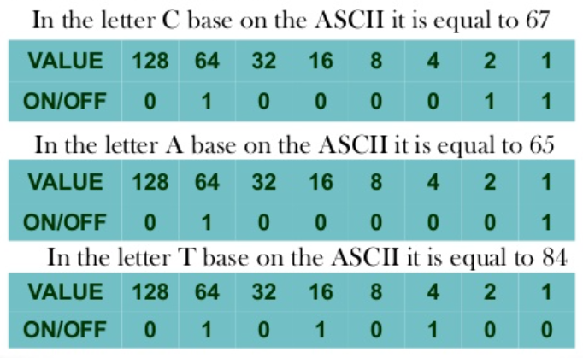
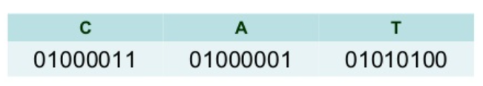
Example: CAT
How to convert “CAT” text to Binary Code using ASCII?
First, we must find the numeric representation of each letter in the ASCII code
Then, we will convert each numeric representation of letters of “CAT” into binary code
Lastly, we will combine binary codes of each letter

Slide 8
There are “1 0” types of people!
The ones who can read the binary code and the ones who cannot!

Slide 9
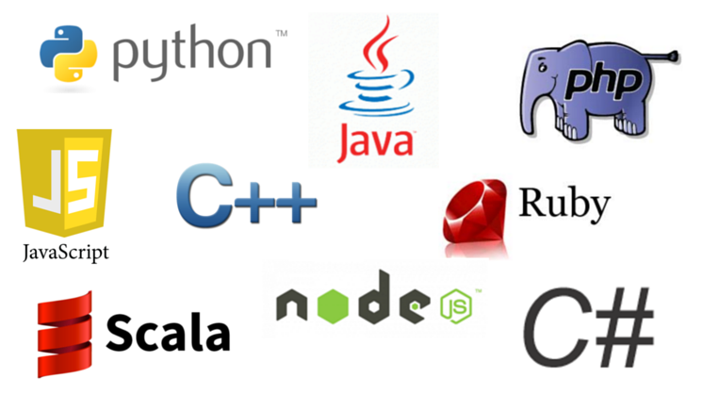
Programming Languages
Set of rules to tell computer what to do
Natural language vs programming language
Natural language has grammar rules
Programing language also has grammatical rules – syntax
Both natural and programming languages requires to learn vocabulary, and grammar(syntax)

Slide 10
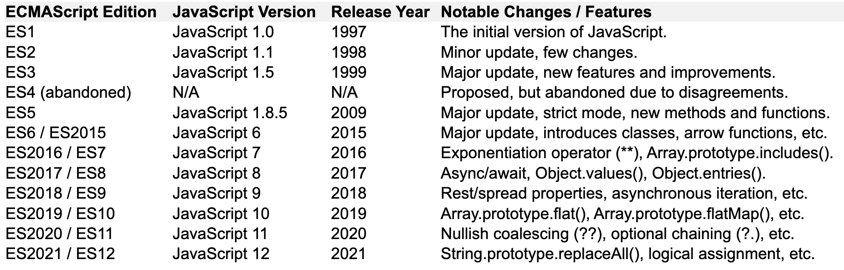
JavaScript
Early programming languages in 1950s.
C is developed in 1970s, then C++
JavaScript was released in 1997.
It is also known as ECMAScript.
It is a scripting language and was essentially used to build web applications.
It is also a full-featured Object-Oriented Programming (OOP) language.
Its syntax is different than other languages, but the concepts are same or similar.

Slide 11
JavaScript-reasons to learn?
JavaScript is a high-level programming language primarily used to build web applications.
It is not limited to the web; it can also be used for the backend development with technologies like Node.js.
It uses a syntax like other programming languages and easy to learn.
It is open source and has a huge community support, which means there are plenty of resources and support available for learning.
***JavaScript is reported to be the most used programming language in the world!

Slide 12
JavaScript-differences?
JavaScript is mainly used for web development and has unique features like a loose typing system, dynamic runtime, and closures.
Unlike some other languages, JavaScript is primarily used to manipulate web page elements, handle events, and perform asynchronous operations.
***JavaScript is an interpreted language. Unlike compiled languages, JavaScript does not require a separate compilation step.
The JavaScript code is executed line by line by the JavaScript engine of the browser or runtime environment.

Slide 13
JavaScript vs Java?
Despite the similar names, Java and JavaScript are two entirely different programming languages:
Java is a statically typed, object-oriented programming language, primarily used for server-side development and standalone applications.
JavaScript is a dynamically typed, scripting language, primarily used for web development to add interactivity and functionality to web pages.

Slide 14

JavaScript-role in automation testing!
JavaScript is one of the most used programming language for automation of software tests.
It is commonly used with testing tools like Selenium and Cypress.
It allows Software Testers to write scripts that automates tasks such as clicking buttons, filling out forms, navigating through web pages and more.
It provides ability to validate expected software behaviors to ensure the software is functioning correctly.
***JavaScript & Cypress offer enhanced compatibility and faster execution compared to other automation tools.
***The demand for JavaScript & Cypress has increased significantly in recent years within the IT industry!

Slide 15
Set up & First Program!
Download Visual Studio Code (code editor) at https://code.visualstudio.com
Open Visual Studio Code and create a new folder called as js-intro-8
Create a new file called as first-program.js and add the code snipped below!
HOW TO RUN?
Download node.js at https://nodejs.dev/en/download/ and make sure it is downloaded
Go to Extensions
Install Code Runner
Run the code with control+option+N (MAC) or ctrl+alt+N (Windows)

