Slide 1



GIT - VCS
Version Control System

Slide 2
Install GIT
Terminal or command prompt is known as apps to get the work done with commands
Go to https://git-scm.com/
Install GIT for your OS
Check if GIT is installed with git –-version
https://git-scm.com/book/en/v2/Getting-Started-First-Time-Git-Setup

Slide 3
GIT – VCS (Version Control System)
GIT (Global Information Tracker)
GIT is a software for tracking changes in any set of files, and usually used for coordinating work among programmers to collaboratively develop the source code.
VCS (Version Control System)
Version control is a system that records changes to a file or set of files over time so that you can recall specific versions later.
Version Control Types 1. Centralized - one central server and many users 2. Distributed - local repositories added for each user

Slide 4
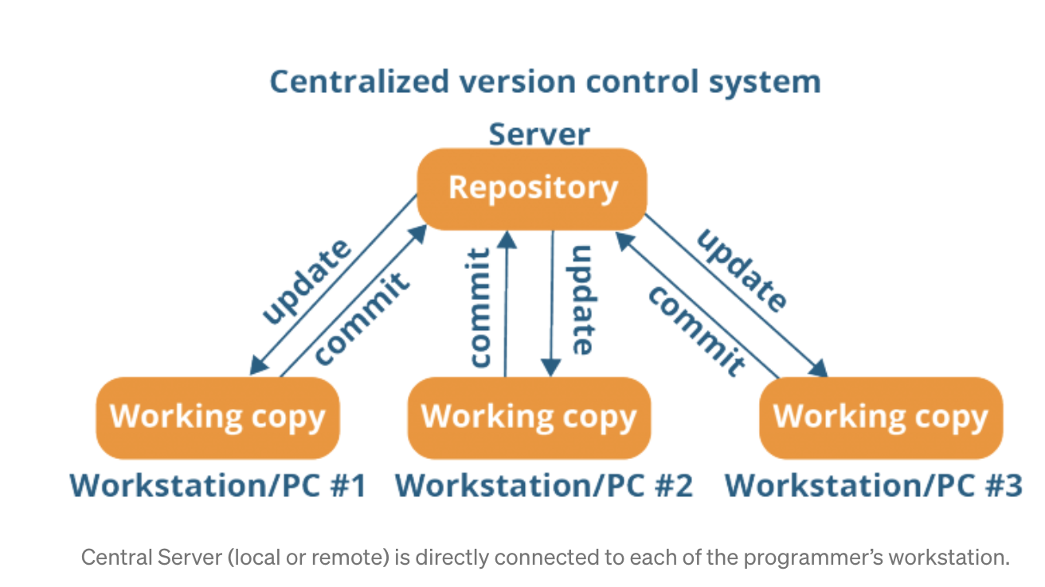
VCS - Centralized
It uses a central server to store all files and enables team collaboration.
Repository is not locally available and always need to be connected to a network to perform any action.
Since everything is centralized, in any case of the central server getting crashed or corrupted will result in losing the entire data of the project.
REPOSITORY (FOLDER OR PROJECT) IS NOT IN YOUR LOCAL.
You need to be online all the time while working on the task.

Slide 5
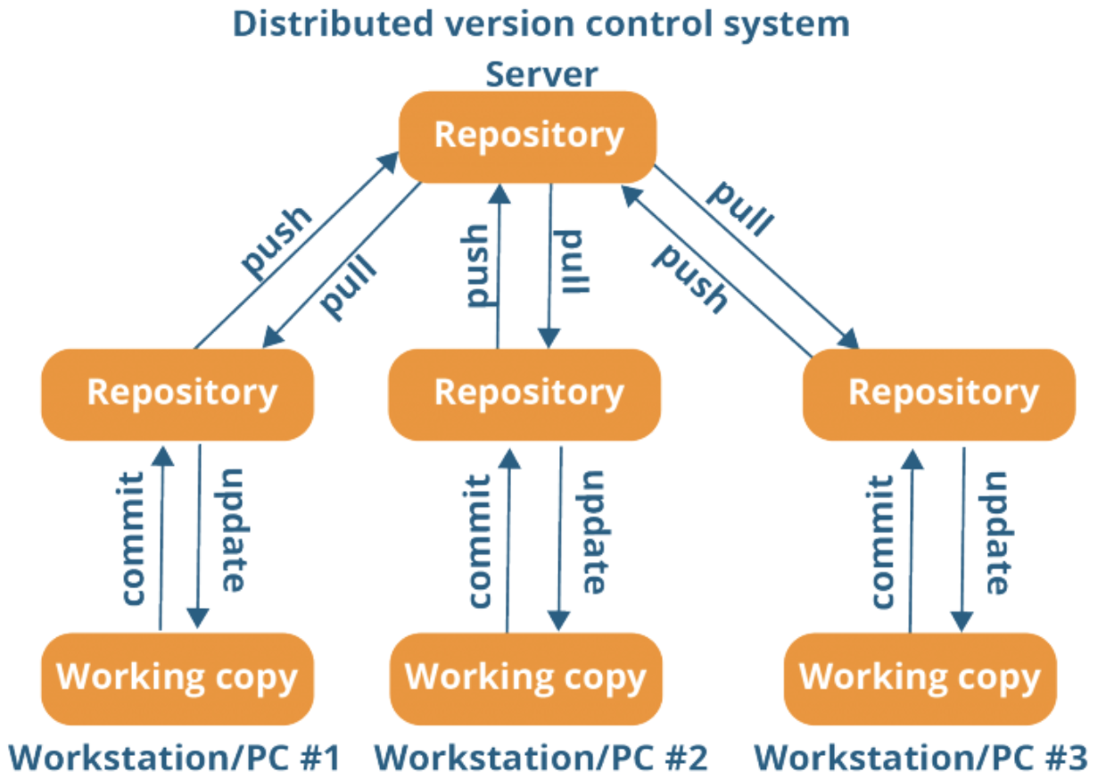
VCS - Distributed
It provides each contributor (user) a local copy or “clone” of the main repository.
Programmer can commit and update their local repository without any interference with main repository.
Programmer can update their local repositories with new data from the central server by an operation called “pull” and affect changes to the main repository by an operation called “push” from their local repository.
REPOSITORY (FOLDER OR PROJECT) IS IN YOUR LOCAL.
You do NOT need to be online all the time. You need to be online only when you push or pull the changes.

Slide 6
Advantages of using GIT
GIT allows
- team members to collaborate - track and revert changes
It is also an open-source tool.

Slide 7
GIT vs GitHub
GIT is a software for tracking changes in any set of files, and usually used for coordinating work among programmers to collaboratively develop the source code.
GIT is an open-source tool that allows
- team members to collaborate - track and revert changes
GitHub is a website where developers store their projects as repositories and have additional features to help them to collaborate to develop projects.
Similar hosting websites: GitLab, Bitbucket

Slide 8
GIT - User Global Information
Check your username and email for your GitHub account and define them with GIT using below commands
git config --global user.name “xxxx”
git config --global user.name
git config --global user.email “xxxx”
git config --global user.email
git config --global --list

Slide 9
Creating a GitHub Repository
Go to https://github.com/
Login with your account
Create a new repository with a proper name
Link this repository with your existing project on your local BUT
First make sure default branches are same
Generate SSH Key using CLI to ease your work with GitHub
https://docs.github.com/en/repositories/configuring-branches-and-merges-in-your-repository/managing-branches-in-your-repository/changing-the-default-branch
https://docs.github.com/en/repositories

Slide 10
SSH Key
An SSH key is an alternative way to identify yourself that doesn't require you to enter username and password every time.
SSH keys come in pairs, a public key that gets shared with services like GitHub, and a private key that is stored only on your local.
If the keys match, you're granted access.
https://docs.github.com/en/authentication/connecting-to-github-with-ssh/about-ssh
Generating the SSH Key
Run the command ssh-keygen in the Terminal or cmd and generate public and private key pairs of SSH in the default folder.
Go to GitHub Settings and add new SSH Key (public key).
Copy and paste your public key from local to GitHub with a proper name.

Slide 11
First Push to GitHub Repository
Make sure that you have a project created on your local and a GitHub repo created to host your local project.
Initialize and link your local project with remote repo using command below.
git init
git remote add origin <URL>
Now, your project is linked to remote repo and ready push some changes to GitHub.
Make sure that you tracked and committed changes to your local branch, then push with below commands.
git add .
git commit –m “commit message”
git push –u origin <branch> or git push

Slide 12
GIT Branching
Allows developing different code on the same base.
Makes it easy to work together and collaborate with team members.
git branch -> list the existing branches.
git branch <branch-name> -> create a new branch with the specified name.
git checkout <branch-name> -> switch to the specified branch
git checkout -b <branch-name> -> create and switch to the created branch.
git branch –d <branch-name> -> delete the specified branch.

