Slide 1


JavaScript Arrays
ARRAYS INTRODUCTION

Slide 2
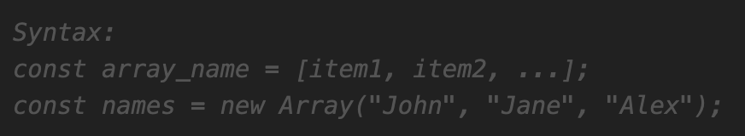
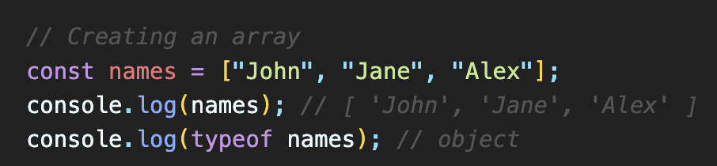
Arrays in JavaScript
JS Arrays are used to store multiple values in a single variable, instead of declaring separate variables for each value.
JS Array can be created using an array literal.
The two examples given do exactly the same but there is no need to use new Array().
For simplicity, readability and execution speed, use the array literal method.
Arrays are a special type of objects. The typeof operator in JavaScript returns "object" for arrays.

Slide 3
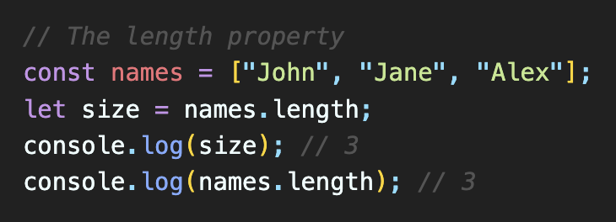
The length of an Array
length property - returns the length (size) of an array.
It returns the total number of elements stored in the array.

Slide 4
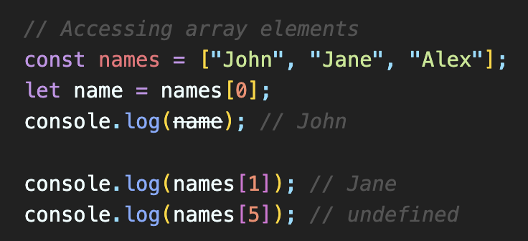
Accessing Array Elements
You can access an array element by referring to the index of the item.
Note: Array indexes start with 0.

Slide 5
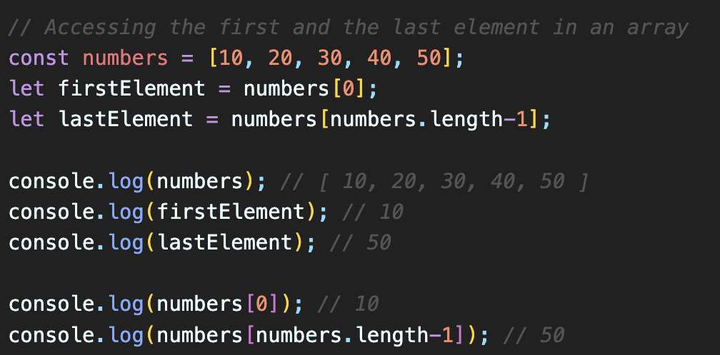
Accessing the First and Last Array Elements
You can access to first and last elements in an array using the indexes and length property.
Note: Array indexes start with 0.

Slide 6
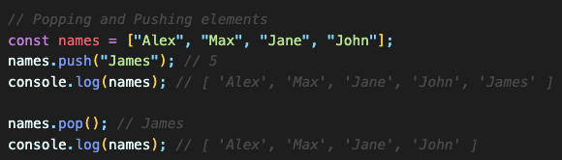
JS Arrays - Popping and Pushing elements
pop() - removes and returns the last element from an array.
push() - adds a new element to an array (at the end) and returns the new array's length.

Slide 7
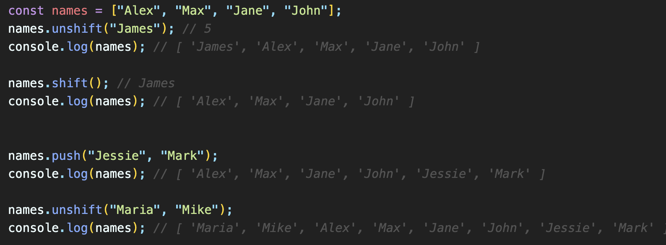
JS Arrays - Shifting and Unshifting elements
shift() - removes the first array element and "shifts" all other elements to a lower index. It also returns the removed element.
unshift() - adds a new element to an array (at the beginning), and "unshifts" older elements. It also returns the new array's length.

Slide 8
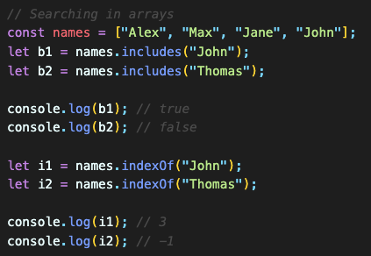
JS Arrays – Searching elements
indexOf() - returns the first index at which a given element can be found in the array, or -1 if it is not present.
includes() - checks the array if it includes a certain value and returns a boolean.
lastIndexOf() - returns the last index at which a given element can be found in the array, or -1 if it is not present.

Slide 9
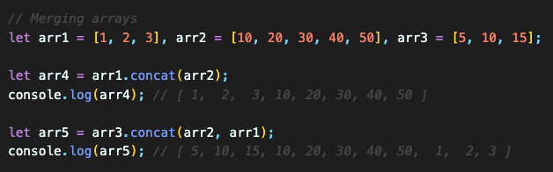
JS Arrays – Merging Arrays
concat() -> creates a new array by merging (concatenating) existing arrays.

Slide 10
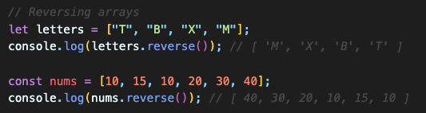
JS Arrays – Reversing Arrays
reverse() -> reverses an array.

Slide 11
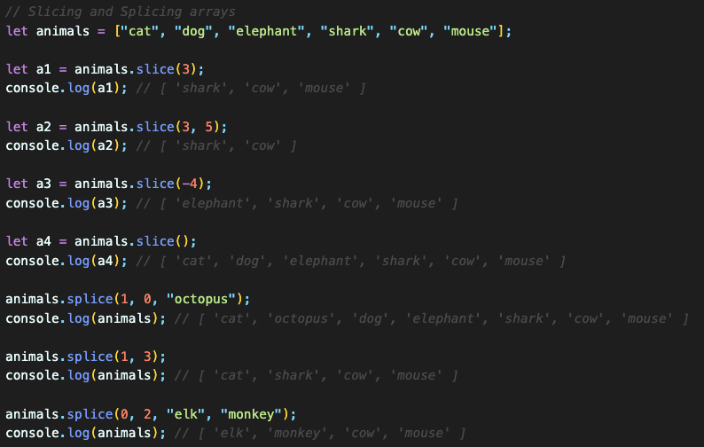
JS Arrays – Slicing and Splicing Arrays
slice() -> slices out a piece of an array and returns a new array.
splice() -> adds new items to an array.
first argument that defines the position where new elements should be added (spliced in).
second argument defines how many elements should be removed.
rest of the arguments define the new elements to be added.

Slide 12
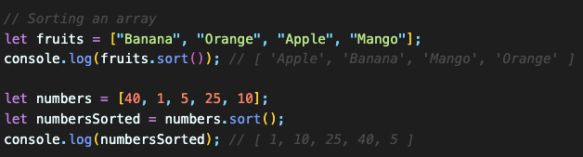
JS Arrays – Sorting Arrays
sort() -> sorts an array alphabetically - be careful with the numbers!
This functions performs a lexicographic (dictionary) sort by default, treating numbers as strings. This means it compares the characters in the number as strings, which can lead to unexpected results.
We will solve that issue later!

Slide 13

JS Arrays – Flattening Arrays
flat() -> reduces the dimensionality of an array and creates a new array with sub-array elements concatenated to a specified depth.

Slide 14
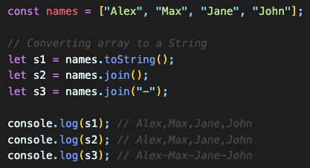
JS Arrays – Converting Arrays to String
toString() -> converts an array to a string of (comma separated) array values.
join() -> joins all array elements into a string. we can specify the separator.

Slide 15
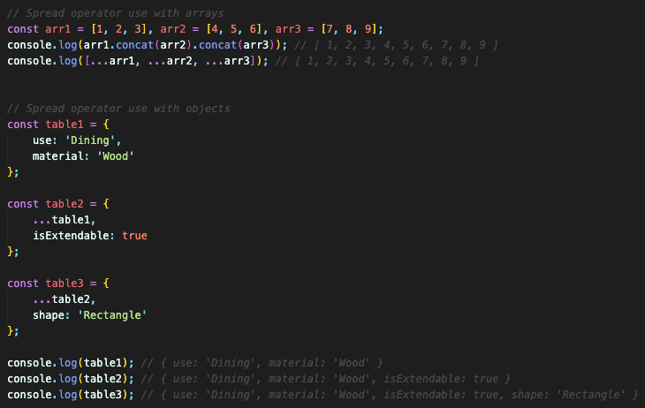
Spread Operator
The Spread (...) operator expands an iterable (like an array) into its individual elements.
The Spread (...) operator can be used to expand an iterable into more arguments for function calls.

Slide 16
Destructuring in JavaScript
Destructuring allows us to extract values from arrays, objects, or other iterable data structures and assign them to variables in a more concise and readable way.

Slide 17
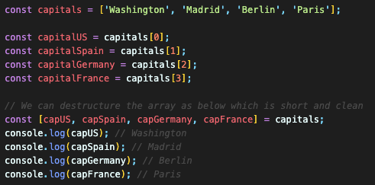
Destructuring Arrays
To destructure an array, we use square brackets [ ] on the left side of an assignment, and within those brackets, we specify the variables where we want to store the values from the array.
NOTE: It allows a short and clean syntax to unpack elements.

Slide 18
Reference
See more functions https://developer.mozilla.org/en-US/docs/Web/JavaScript/Reference/Global_Objects/Array

