Slide 1


JavaScript OOP
OBJECT-ORIENTED PROGRAMMING

Slide 2



What is OOP?
The entire idea of object-oriented programming is to implement real-world characteristics in terms of objects that contain data and code.
Main advantages of OOP;
easy code maintenance
code reusability with inheritance
simplicity
Some OOP programming languages: Java, C++, C#, Kotlin…

Slide 3
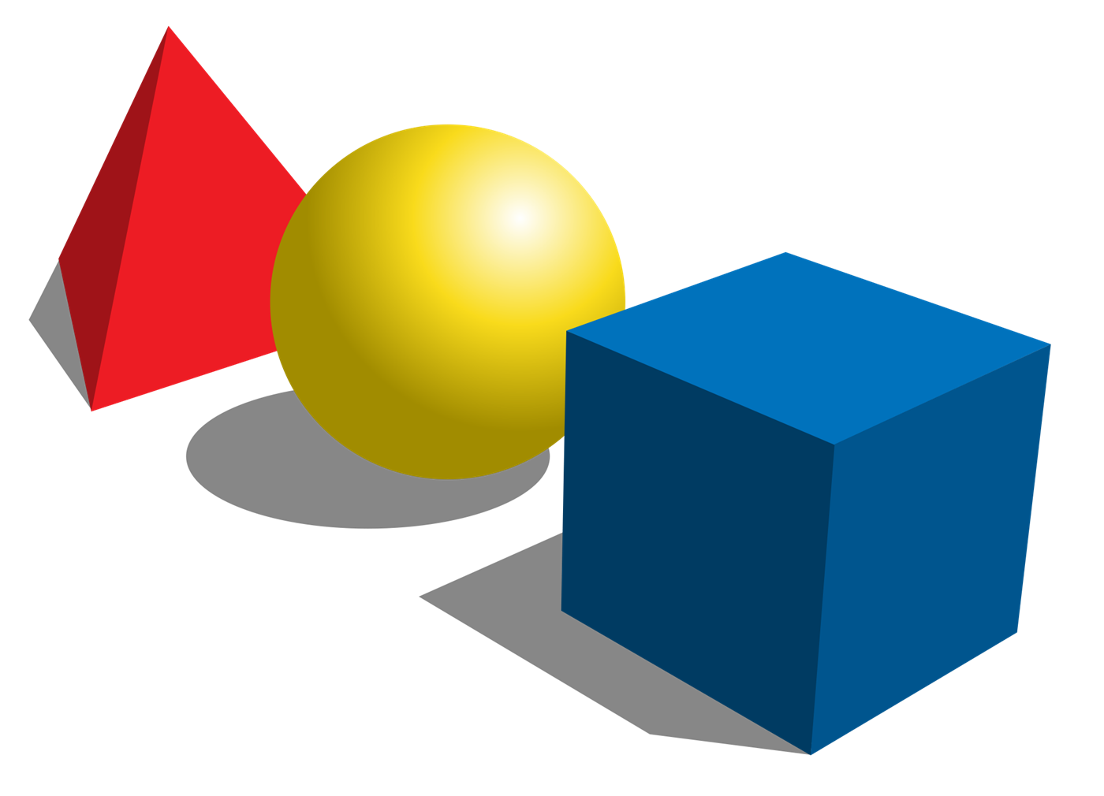
JavaScript | OOP
OOP in other languages;
Objects (instances) are instantiated from a class.
Class-based programming.
OOP in JavaScript;
Objects are linked to a prototype object.
Prototype-based programming.
NOTE: Class or prototype is a blueprint or template from which many objects are created.

Slide 4
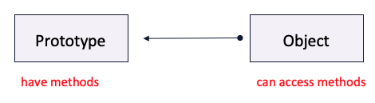
JavaScript | OOP
An Object is a unique entity that contains properties and methods.
For example, “a car” is a real-life Object, which has some characteristics like color, type, model and performs certain actions like driving.
The characteristics of an Object are called Properties in Object-Oriented Programming, and the actions are called methods.
Objects are everywhere in JavaScript, almost every element is an Object whether it is a function, array.
NOTE: A Method in JavaScript is a property of an object whose value is a function.

Slide 5
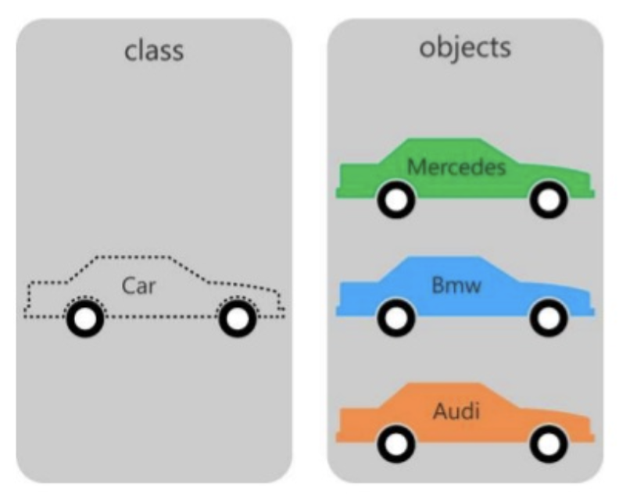
JavaScript | OOP – ES6
JavaScript classes, introduced in ECMAScript 2015, are primarily syntactical sugar over JavaScript’s existing prototype-based inheritance.
The class syntax is not introducing a new object-oriented inheritance model to JavaScript.
JavaScript classes provide a much simpler and clearer syntax to create objects and deal with inheritance.
NOTE: Class declaration are not hoisted. So, you must declare a class before you can use it to create objects.

Slide 6
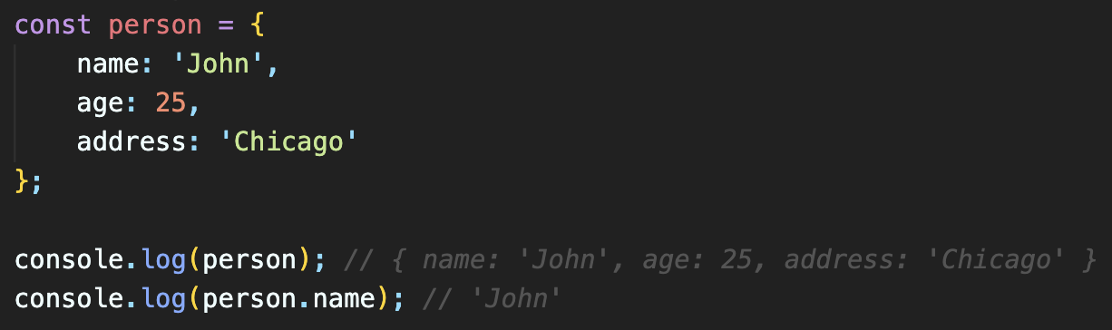
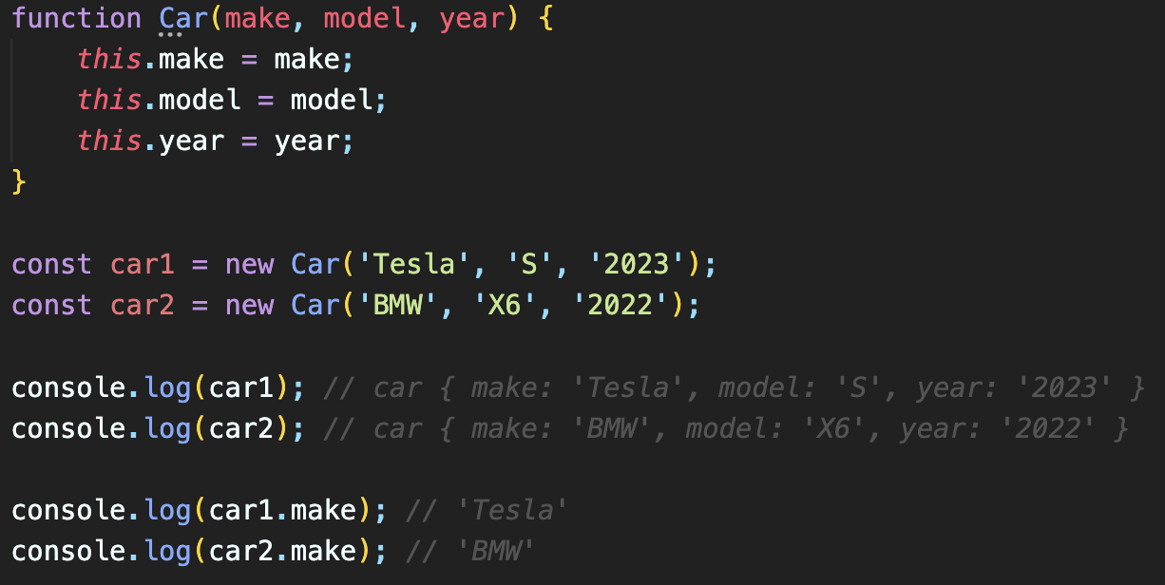
JavaScript Constructor | Before ES6
Creating an object with Object Literal
This could be preferred if you would only create one object but not useful when you need more objects with same properties.
Constructor can be used to create multiple objects from the same template, blueprint or prototype.
Creating an object with a constructor.

Slide 7
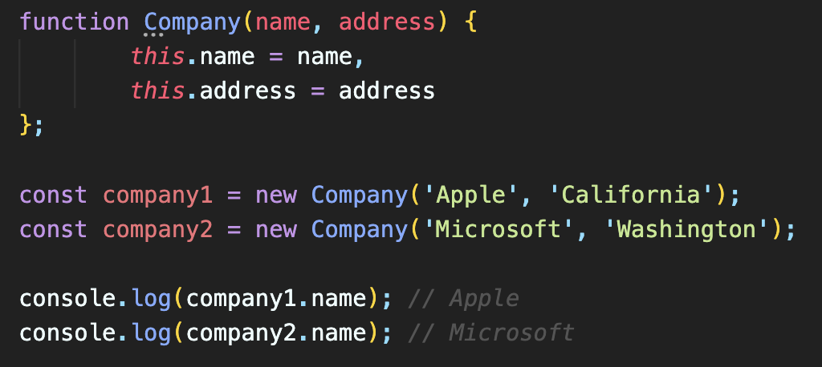
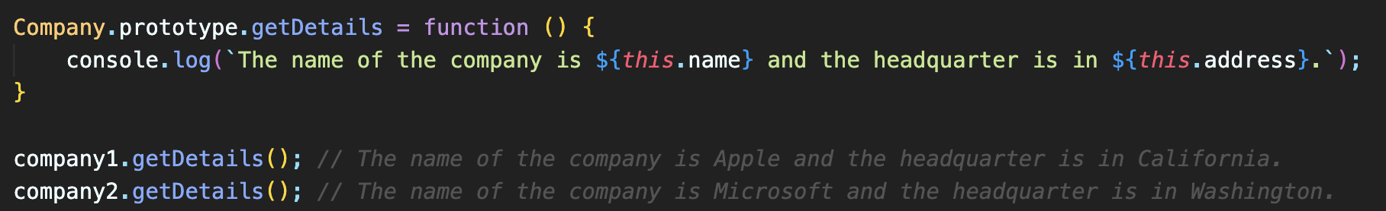
JavaScript Constructor | Adding a prototype function
Creating an object with a constructor.
Adding a prototype function to be used by all objects created with the constructor.
NOTE: This is considered as defining class in a Traditional Way before ES6.

Slide 8
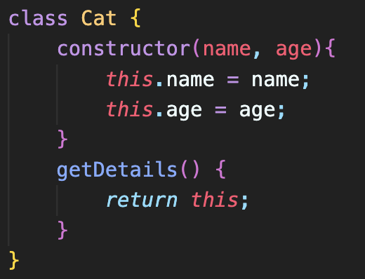
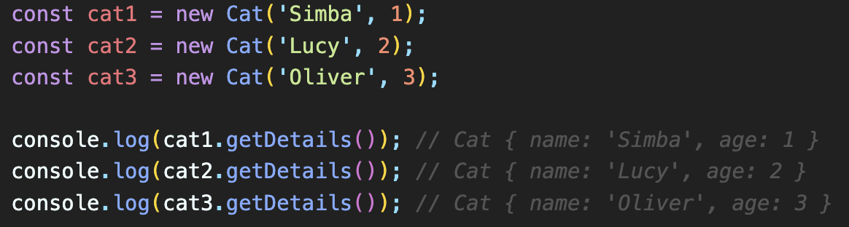
JavaScript Classes | After ES6
Defining a class with a constructor to be used as a template, blueprint or prototype.
Creating objects from the class (template, blueprint or prototype).

Slide 9
JavaScript Classes | What is a class?
Class is a blueprint or template from which objects are created.
We can think of the class as a sketch (prototype) of a car. It contains all the details about the engine, doors, windows, etc. Based on these descriptions we build the car. Car is the object.
Since many cars can be made from the same description, we can create many objects from the car class.

Slide 10
JavaScript Classes | How to create a class?
Syntax:
class className {
//data(properties) and methods(functions)
}
Example:
class Car {
//data(properties) and methods(functions)
}
Every class has its properties and methods.
Properties are known as states or fields.
Methods are functions of that class.
For example:
In real life, a car is an object.
The car has properties, such as brand and color.
And the car has methods, such as drive and brake.

Slide 11
JavaScript Classes | What is an Object?
Object is the instance of a class.
Class is a template or blueprint from which objects are created.
So, object is the instance (result) of a class.
EXAMPLE: if car is a class, then BMW can be an object of that class. BMW is known as instance of car class. Also, Audi is an instance of car class.
Class = Car
Object = BMW
Object = Audi

Slide 12
JavaScript Classes | How to create an object?
Assume we have a class as Car
class Car {
//data(properties) and methods(functions)
}
Then, we can create an object of Car class by using new keyword.
Example:
const mercedes= new Car();
Object is an instance of a class in programming languages.
Objects can be created by using new keyword.
We can create countless number of objects from the same class.
For example:
If car is a class, then hundreds of car objects can be created from that class.

Slide 13
JavaScript Class Members
Properties are used to define all the information of the objects of that class. These are used to store data.
Methods are also known as functions of the class and defines behaviors of the objects of that class.
Constructors are kind of special methods and enable us to create objects of the class.

