Slide 1


JavaScript OOP
OBJECT-ORIENTED PROGRAMMING

Slide 2
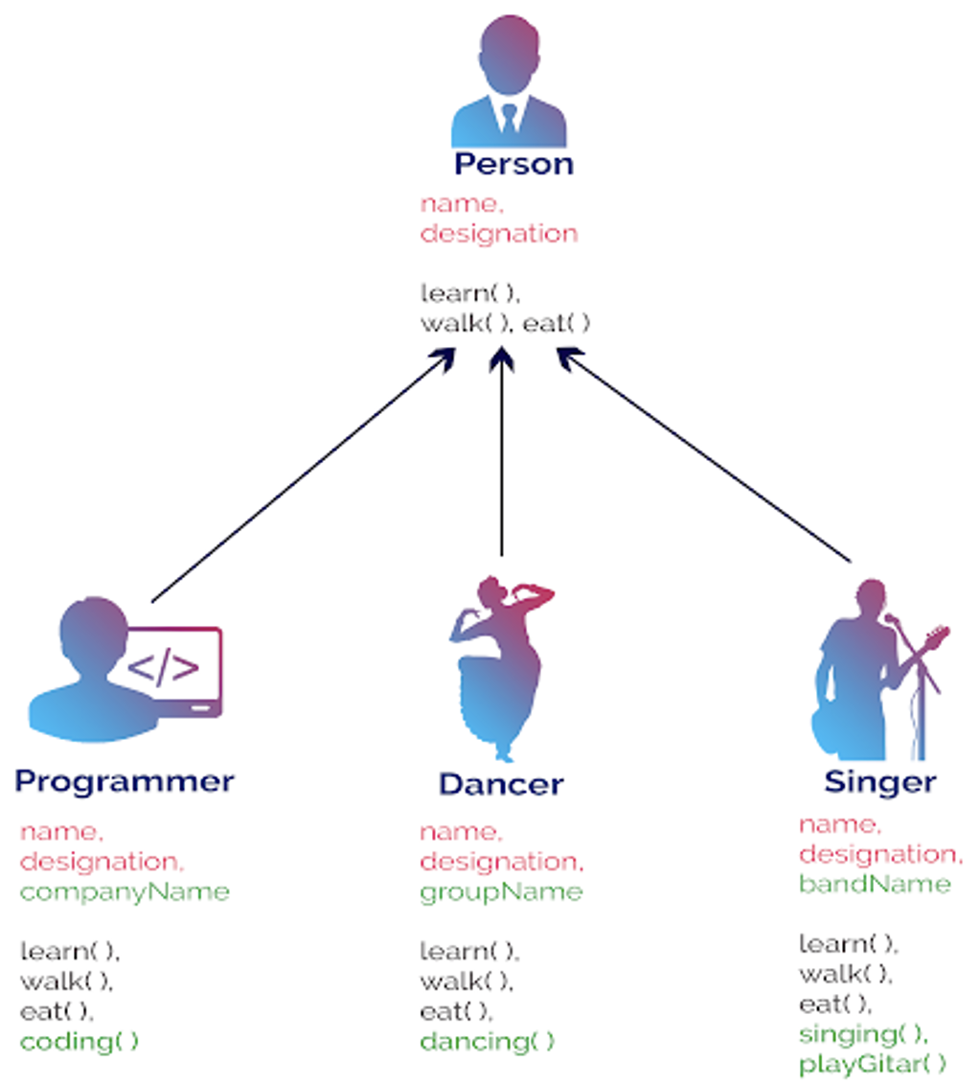
OOP | Inheritance
Inheritance in OOP is inheriting properties and methods from one object to another. This will create "inheritance concept".
In JavaScript, there are various methods to achieve inheritance.
Prototypal Inheritance: Every object in JavaScript has a prototype, and objects inherit properties and methods from their prototype.
Constructor/Class Inheritance (ES6): Using the extends keyword and super() constructor in ES6 classes.
Object.create(): Creating objects directly with Object.create() to establish inheritance.

Slide 3
Prototypal Inheritance – Before ES6
The Prototypal Inheritance is a feature in JavaScript used to add methods and properties in objects.
It is a method by which an object can inherit the properties and methods of another object.
We use a JavaScript prototype to add new properties and methods to an existing object constructor.
Then, we can tell our JS code to inherit properties from a prototype.

Slide 4
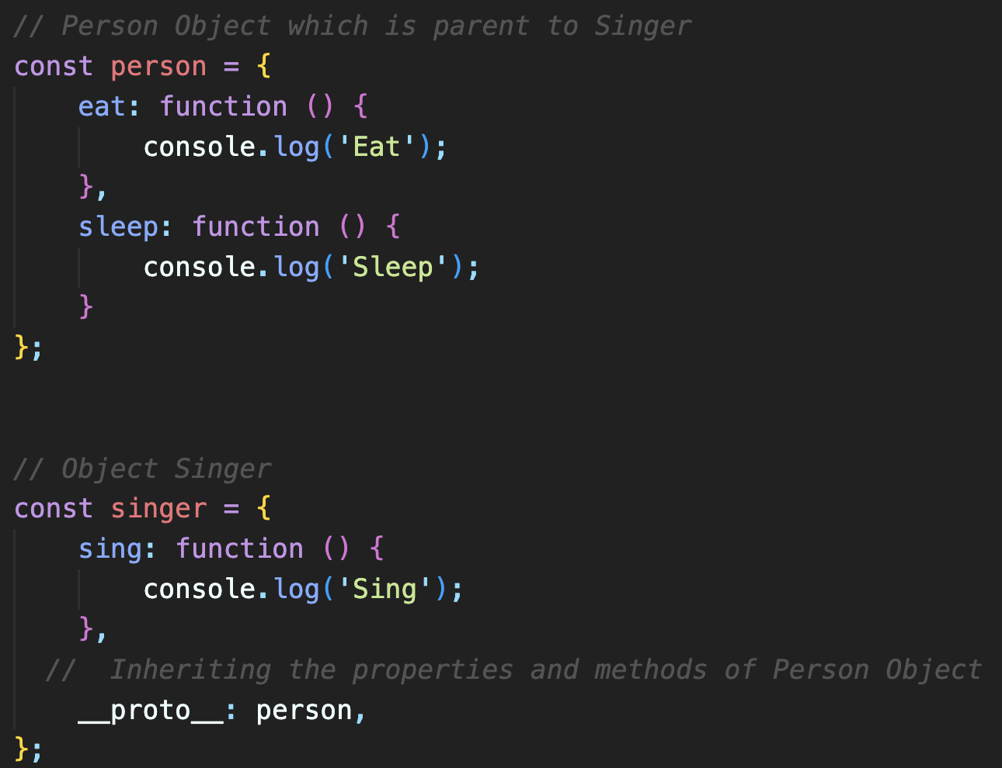
Prototypal Inheritance – Before ES6
Every object with its methods and properties contains an internal and hidden property known as [[Prototype]].
Traditionally, in order to get and set the [[Prototype]] of an object, we would use Object.getPrototypeOf and Object.setPrototypeOf.
Nowadays, in modern language, it is being set using __proto__.

Slide 5
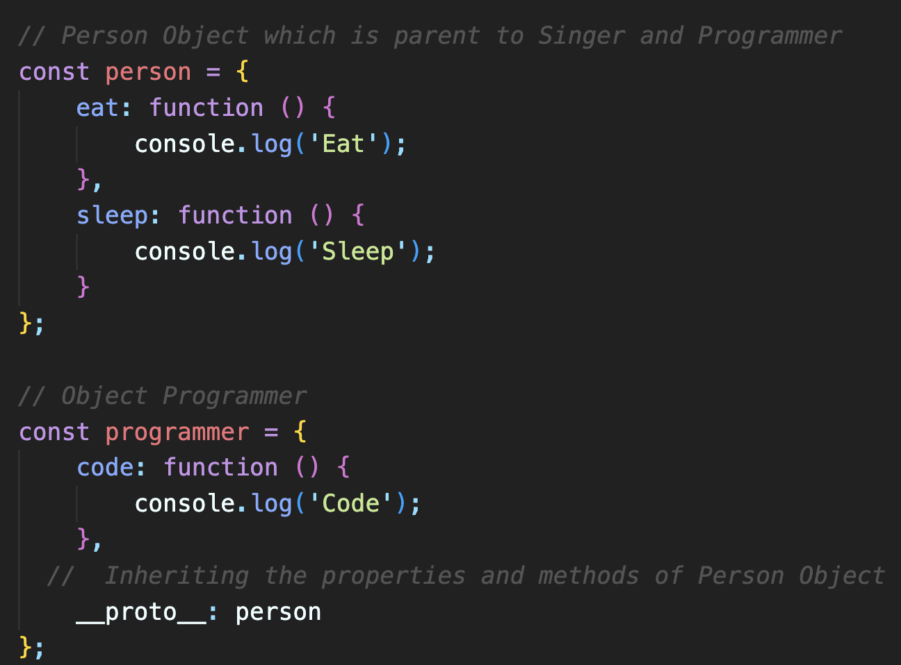
Prototype Chain
The prototype chain is a mechanism that allows objects to inherit properties and methods from other objects.
Every object can have exactly one prototype object.
That prototype object can also have a prototype object, and so on, creating a chain of inherited properties and methods

Slide 6
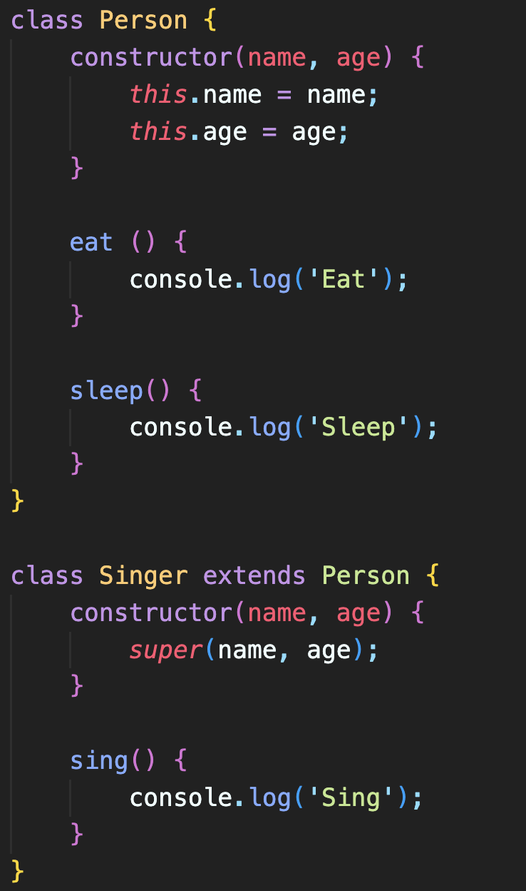
ES6 Class Inheritance
The entire idea of Inheritance is code reusability as it allows properties and functions of one object or class to be used by other objects or classes.
JavaScript added classes with ES6 and allows inheritance using extends keyword like other OOP languages.
subclass (child) - the class that inherits from super (parent) class
superclass (parent) - the class being inherited from sub (child) class

Slide 7
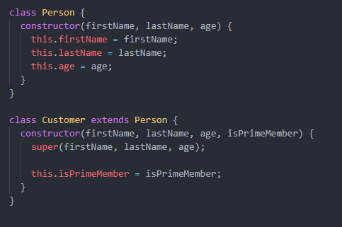
ES6 Class Inheritance – super() keyword
super is used to call the constructor on the parent object that is being inherited by the child.
It is used to avoid duplication of the parts of the constructor that are present in both the parent and child class.

Slide 8
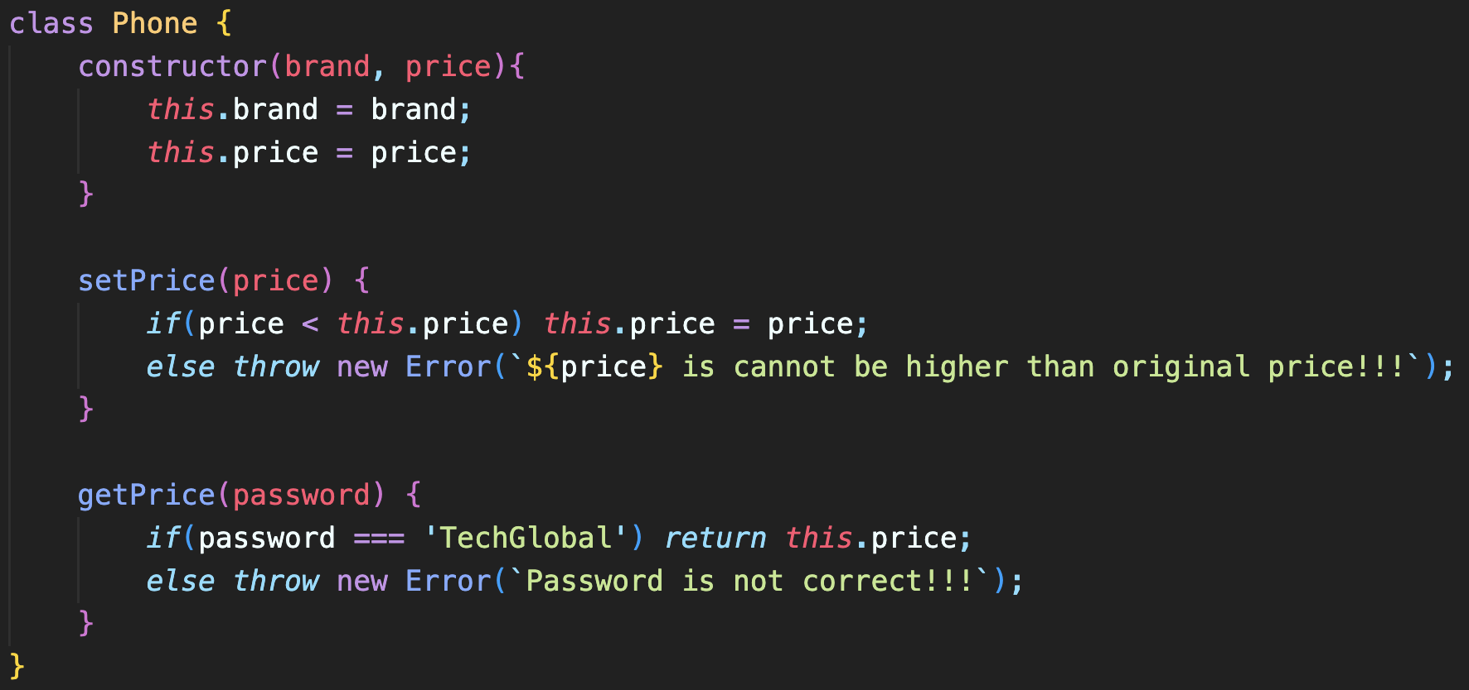
ES6 Class | getters and setters
ES6 Classes also allows you to use getters and setters.
It can be smart to use getters and setters for your properties, especially if you want to do something special with the value before returning them, or before you set them.
To add getters and setters in the class, use the get and set keywords.

Slide 9
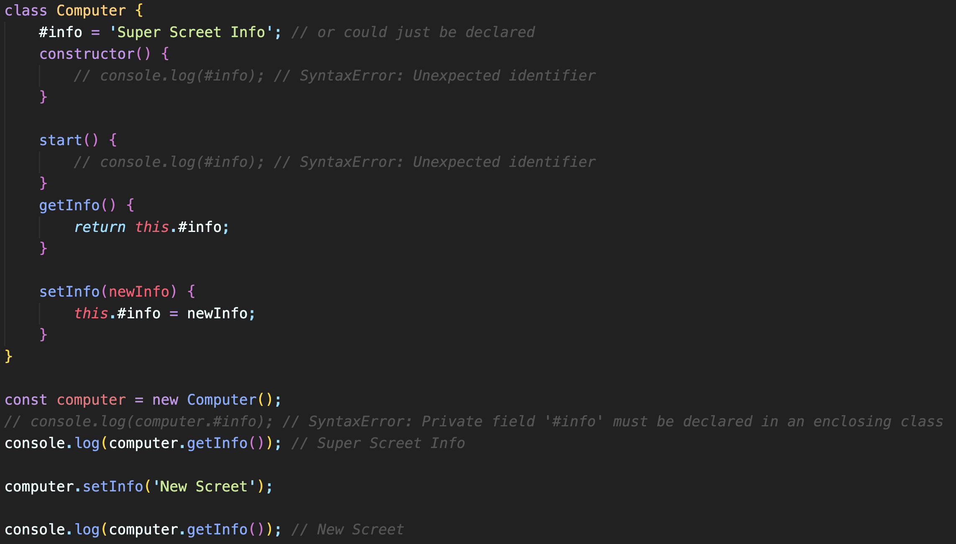
ES6 Property Encapsulation | private properties
The encapsulation is a OOP concept used to protect properties from being accessed directly.
It can be achieved in JS by creating private class properties using #.
Advantages:
Better control of properties
Read-only or write-only flexibility

Slide 10
ES6 Class | static properties & functions
The static members of a class can be declared with static keyword and accessed with the class name like {ClassName.propMethodName}.
The static members of a class cannot be accessed with an object of that class.

Slide 11
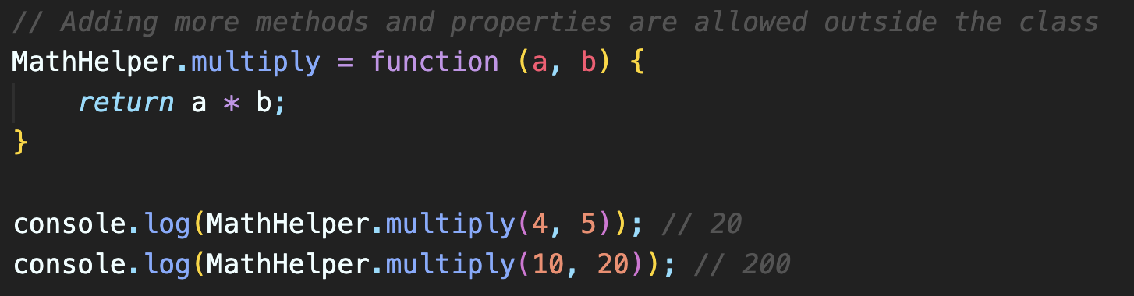
ES6 Class | static properties & functions
Programmer can add more static methods and properties outside the class.

Slide 12
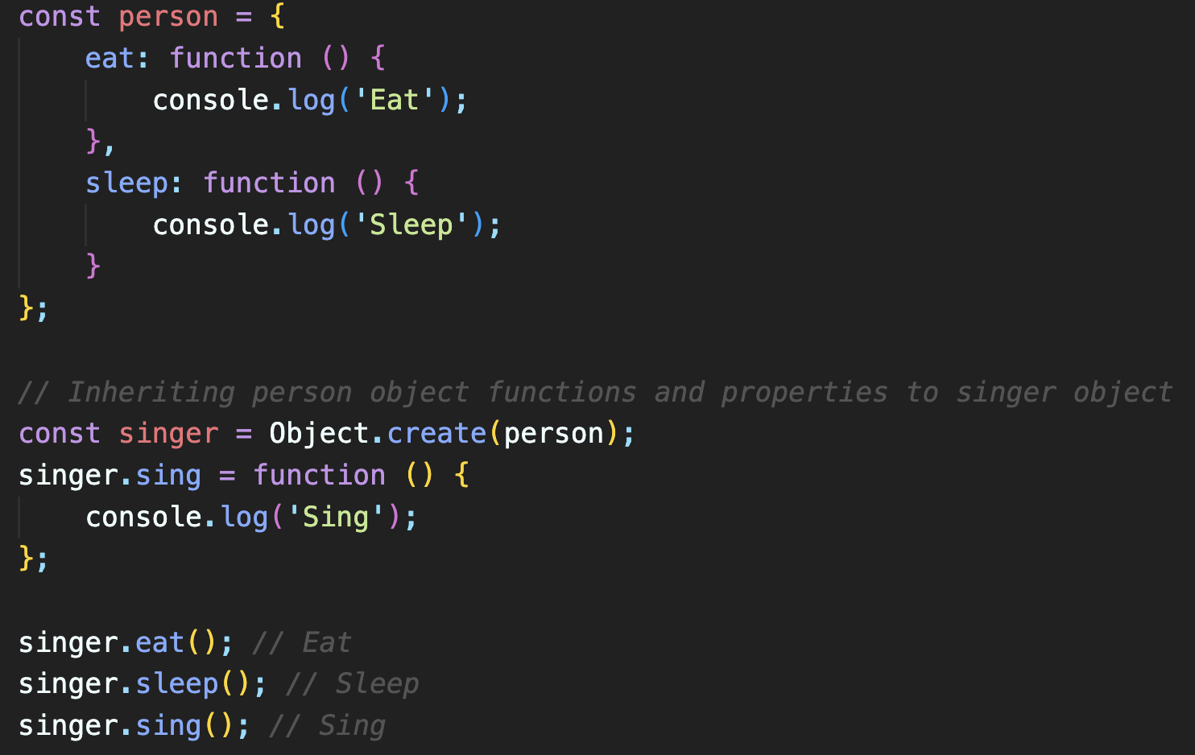
Object.create() Inheritance
JavaScript allows inheritance using Object.create() method.
This is easy to use and inherit one object property and functions to another object.

