Slide 1


Asynchronous JavaScript
CALLBACKS/PROMISES/ASYNC-AWAIT

Slide 2
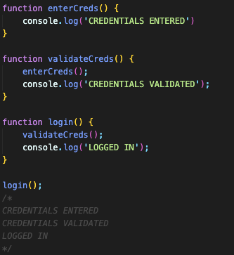
Call Stack
It is a mechanism for the JS interpreter to keep track of its place in a script that calls multiple functions.
It is simply keeping the track of what function is currently being run and what functions are called from within that function.
It works based on LIFO (last-in-first-out) principle.
NOTE: JavaScript is single-threaded language meaning it runs one program with its line at a time. You cannot run multiple threads at the same time trying to complete different tasks at the same time.
DEBUGGER:
We can use Developer Tools/Sources to add a break point and debug our code and understand the Call Stack better.

Slide 3
Asynchronous JavaScript
It refers to the ability of JavaScript to execute code that doesn't block the main thread of execution.
This allows for non-blocking operations like network requests, file reading/writing, timers, and user interactions, where the program doesn't have to wait for one operation to complete before moving on to the next one.
Asynchronous operations are crucial for building responsive and efficient web applications.
To handle asynchronous JavaScript, we use one or more of the following techniques;
Callbacks (old way)
Promises (preferred)
Async/Await (preferred)

Slide 4
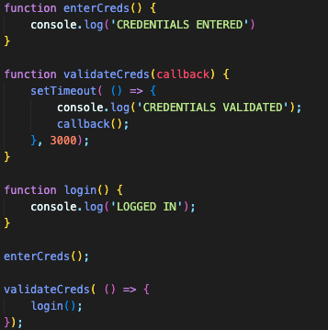
Asynchronous JavaScript - CallBacks
Callbacks are functions that you pass as arguments to another function and are executed once the asynchronous operation is complete.
Callbacks have been a traditional way to handle asynchronous code in JavaScript.

Slide 5
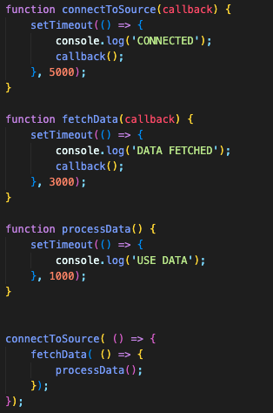
Nested CallBacks & CallBack Hell
It is a term used to describe a situation where multiple nested callback functions make the code structure difficult to read, understand, and maintain.
It typically occurs in asynchronous JavaScript code when you have many nested callback functions, each depending on the result of the previous one.
This can lead to code that looks like a pyramid or a deep indentation structure, hence the term "Pyramid of Doom”.

Slide 6
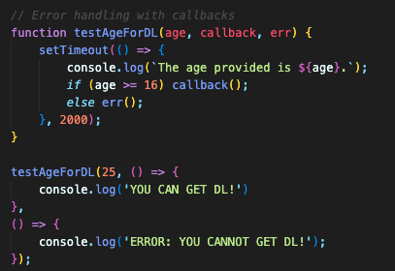
Error Handling with CallBacks
Error handling for callbacks in JavaScript is a crucial aspect of writing robust and reliable asynchronous code.
When using callbacks, especially in asynchronous operations, errors can occur at various stages.
Proper error handling ensures that your program can gracefully handle and recover from errors and prevents unexpected crashes.

Slide 7
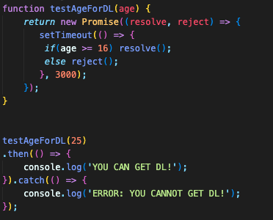
Asynchronous JavaScript - Promises
Promises are a more modern and structured way to handle asynchronous code.
They represent a value that might be available now, in the future, or never.
Promises provide methods like .then() to attach success and error handlers to execute when the asynchronous operation completes or fails.
States or Properties of Promise Object:
Pending: Initial state, neither fulfilled nor rejected.
Fulfilled: Meaning that the operation completed successfully, and a result is available.
Rejected: Meaning that an error occurred, and an error reason is available.

Slide 8
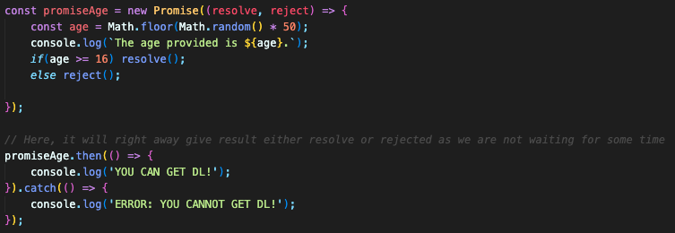
Asynchronous JavaScript - Promises
Promises can be chained together to represent a sequence of asynchronous operations.
Each .then() or .catch() call returns a new Promise, allowing you to compose complex asynchronous flows.

Slide 9
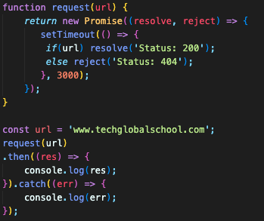
Error Handling with Promises
Promise States:
Promises can be in one of three states: pending, fulfilled, or rejected.
When a Promise is fulfilled, it means the asynchronous operation completed successfully.
When a Promise is rejected, it means an error occurred during the operation.
.then() and .catch():
You use the .then() method to handle the successful resolution of a Promise. It takes a success callback function as its argument.
You use the .catch() method to handle errors or rejections in a Promise. It takes an error callback function as its argument.

Slide 10
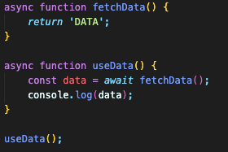
Asynchronous JavaScript – Async/Await
Async functions provide a way to write asynchronous code that looks more like synchronous code, making it easier to read and reason about.
We can use the async keyword before a function declaration and await inside that function to pause execution until a promise is resolved.
It is built on top of Promises and provides a more readable and synchronous-like syntax for working with asynchronous operations.

Slide 11
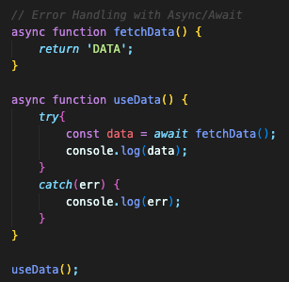
Error Handling with Async/Await
We can use try...catch blocks to handle errors in async/await functions, similar to synchronous code.
If a Promise passed to await is rejected, it will throw an error that can be caught using try...catch.

