Slide 1


JavaScript Arrays - Loops
ITERATING ARRAY ELEMENTS

Slide 2
JS Arrays - Iterations
We can use all the loops to iterate through array objects.
However, we will commonly use two types of loops
1. for loop
2. for-of loop
NOTE: We can also use the array.forEach() built-in function to iterate through array elements.

Slide 3
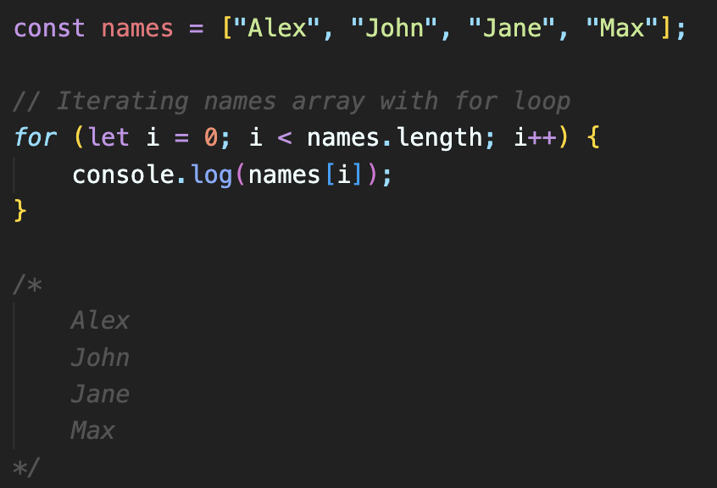
JS Arrays – For Loop
This is one of the most basic ways to iterate through an array.
You can initialize a loop counter (i) to 0, and you iterate as long as (i) is less than the length of the array.
Inside the loop, you access each element of the array using array[i].

Slide 4
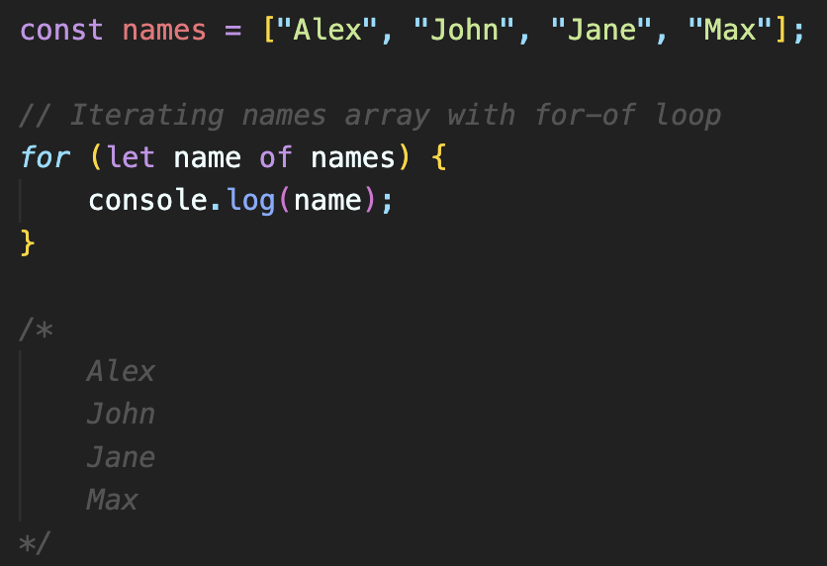
JS Arrays – For…of Loop
This is a cleaner and more readable way to iterate through an array, introduced in modern JavaScript.
You use the for...of loop to directly loop through the elements of the array without the need for an explicit index.

Slide 5
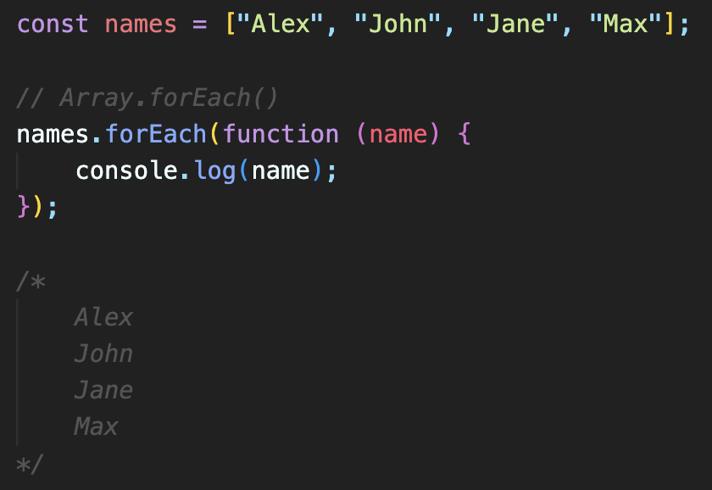
JS Arrays –forEach() function
The forEach() function is a higher-order function that you call on an array.
It takes a callback function as an argument, and this function is executed for each element in the array.
The callback function is passed the current element, the current index, and the entire array.
This method is useful for performing an action for each element, such as printing or modifying the values.
The example could be simplified using arrow function
names.forEach((name) => console.log(name));

