Slide 1
Lending Club Case Study
Santosh Kumar Ramarathnam
Vigneshwar Mohanasundaram

Slide 2
Recommendations
LC grading system to be improved and made representative on the quality of the loan instead of just the loan amount itself.
DTI should be considered strongly when approving higher loan amounts
Revolving credit utilization should be considered strongly when approving higher loan amounts

Slide 3
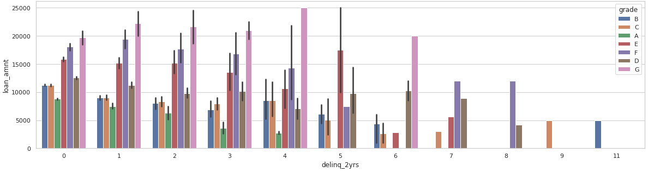
Analysis: delinquencies_2yrs
Past delinquencies are not a factor in the LC grade system. Grade C, B should not have higher # of delinquencies.
Past delinquencies beyond 3 should quickly become a factor in loan amount determination and not wait till 8. This has to be revised.

Slide 4
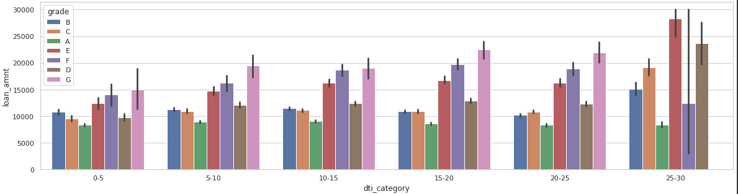
Analysis: DTI vs loan amount
As DTI increases, loan amount should ideally be much lower. This however is not the case.
The grading system is nearly irrelevant as to how it grades. The only correlation seems to be on the loan amount itself and not on the quality of the loan.

Slide 5
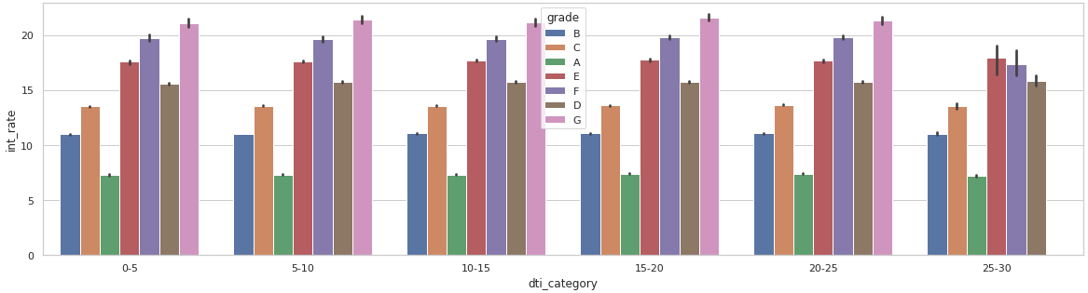
Analysis: int_rate vs DTI
Interest Rates are lowest for Grade A and highest for Grade G – however loans that are in 25-30 DTI are not graded G at all.
DTI in general should have an impact on the interest rates rewarding those borrowers who have a higher likelihood of repaying with lower interest

Slide 6
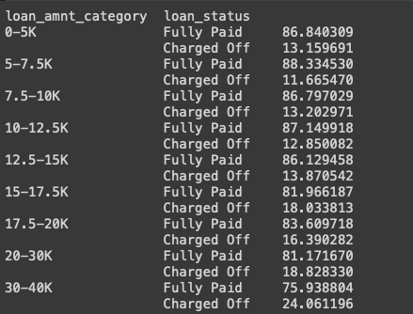
Analysis: Loan Amount Category
Higher the loan amount, greater the chances of the loan being charged off / written off.

Slide 7
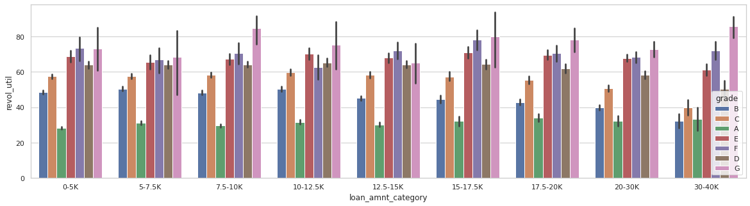
Analysis: Revolving Credit Utilization
When the revolving credit utilization is higher, we certainly do not want to approve higher loan amounts.

Slide 8
Approach Taken
Data Clean Up
Missing Values
Standardize formats
Replace Values
Introduce DTI category, Loan Amount category
Univariate Analysis over Charged Off Loans and Fully Paid Loans
Bivariate and Multi-Variate analysis over categorical variables in the data set

