Slide 1
Swapping

Slide 2
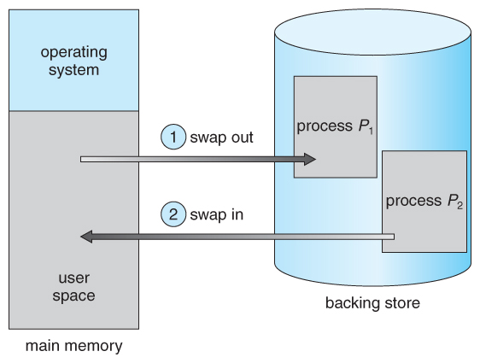
Swapping is the process whereby a page of memory is copied to the preconfigured space on the hard disk, called swap space, to free up that page of memory.

