Slide 1
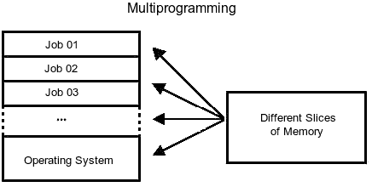
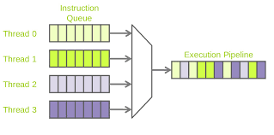
PROCESS
A process is defined as an entity which represents the basic unit of work to be implemented in the system. When a program is loaded into the memory and it becomes a process.
Processing types
MULTIPROGRAMMING:
In a multiprogramming system there are one or more programs loaded in main memory which are ready to execute.
MULTITHREADING:
Multithreading is the ability of a CPU to execute multiple processes or threads concurrently.

Slide 2

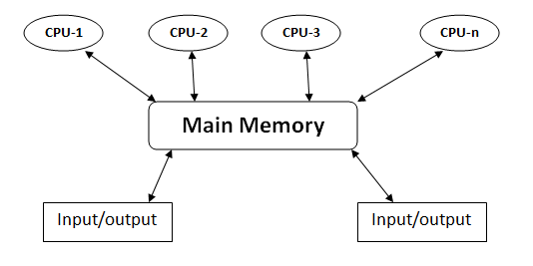
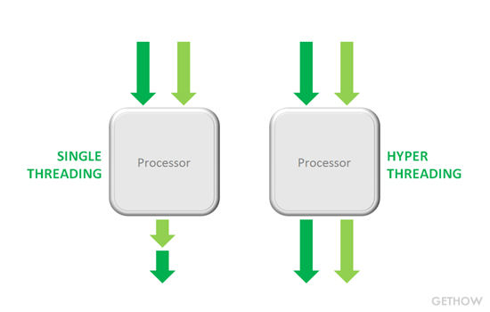
MULTITASKING:
Multitasking is the concurrent execution of multiple tasks over a certain period of time.
MULTIPROCESSING:
The term also refers to the ability of a system to support more than one processor or the ability to allocate tasks between them.
HYPER THREADING:
It allows a single microprocessor to act like two separate processors to the operating system and the application programs that use it.

Slide 3
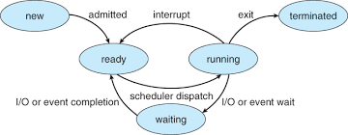
PROCESS STATES
New
Ready
Running
Waiting
Terminated or Exit

Slide 4
Virtual Address Space
A virtual address does not represent the actual physical location of an object in memory instead, the system maintains a page table for each process.
Working set:
The working set of a process is the set of pages in the virtual address space of the process that are currently resident in physical memory.
Page state:
Free: The page is neither committed nor reserved.
Reserved: The page has been reserved for future use.
Committed: Memory charges have been allocated from the overall size of RAM and paging files on disk.

Slide 5
Data execution prevention :
Data Execution Prevention (DEP) is a system-level memory protection feature that is built into the operating system which enables the system to mark one or more pages of memory as non-executable.
Memory Protection:
Memory that belongs to a process is implicitly protected by its private virtual address space.
For example, code pages in the address space of a process can be marked read-only and protected from modification by user-mode threads.

Slide 6
Memory limits for windows:
Windows version | Limits on x64
Windows 10 | 2TB
Windows 8 Enterprise | 512 GB
Windows 7 Enterprise | 192 GB
Windows Vista Enterprise | 128 GB
Windows XP | 128 GB
Virtual address space 64 bits

Slide 7
Paging
Paging is a method of writing data to, and reading it from, secondary storage for use in primary storage, also known as main memory.
Types of paging :

Slide 8
Thrashing:
Thrashing in computing is an issue caused when virtual memory is in use. It occurs when the virtual memory of a computer is rapidly exchanging data for data on hard disk, to the exclusion of most application-level processing.

Slide 9
Memory Pool
The memory manager creates the memory pools that the system uses to allocate memory. Memory pools are located in the region of the address space that is reserved for the system and mapped into the virtual address space of each process.
Types of Memory pool :
The nonpaged pool: It consists of virtual memory addresses that are guaranteed to reside in physical memory as long as the corresponding kernel objects are allocated.
The paged pool : It consists of virtual memory that can be paged in and out of the system.

