Slide 1
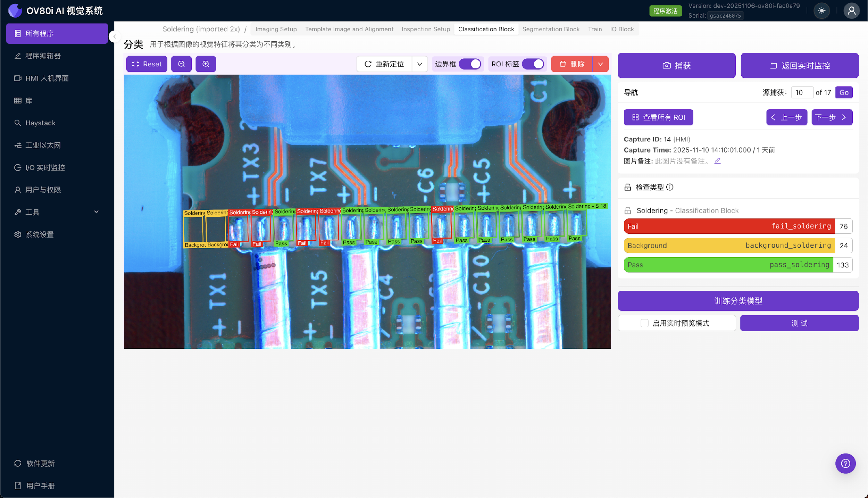
Step {{ step_no }}: Setup Template Image and Aligner
{{ setup_text }}

