Slide 1
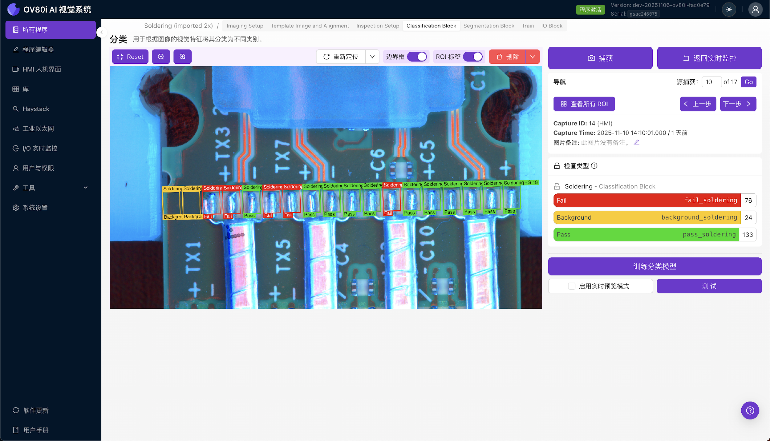
Step {{ step_no }}: Setup Camera and Lighting
{{ setup_text }}

