Slide 1
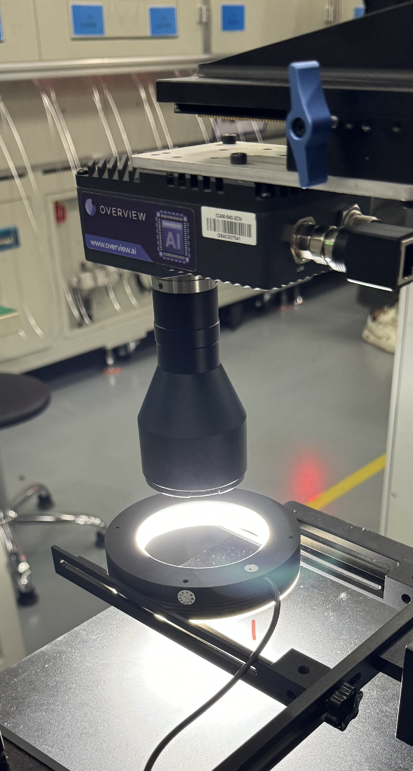




The OV80i
Designed for 10x Faster Installs. The truly all-in-one Deep Learning AI Vision System.
On-board Library and Root-Cause Analysis Tool (Haystack)
Imaging
8.3MP Color
Powerful Computing
Onboard Nvidia GPU
No software download needed
Industry Leading Accuracy. Built on reliable, proven hardware. No software downloads or special computer requirements. Easy setup, fast ramp-up for engineers and technicians. Rapid troubleshooting and maintenance.
No software licenses, no recurring fees.

