Slide 1
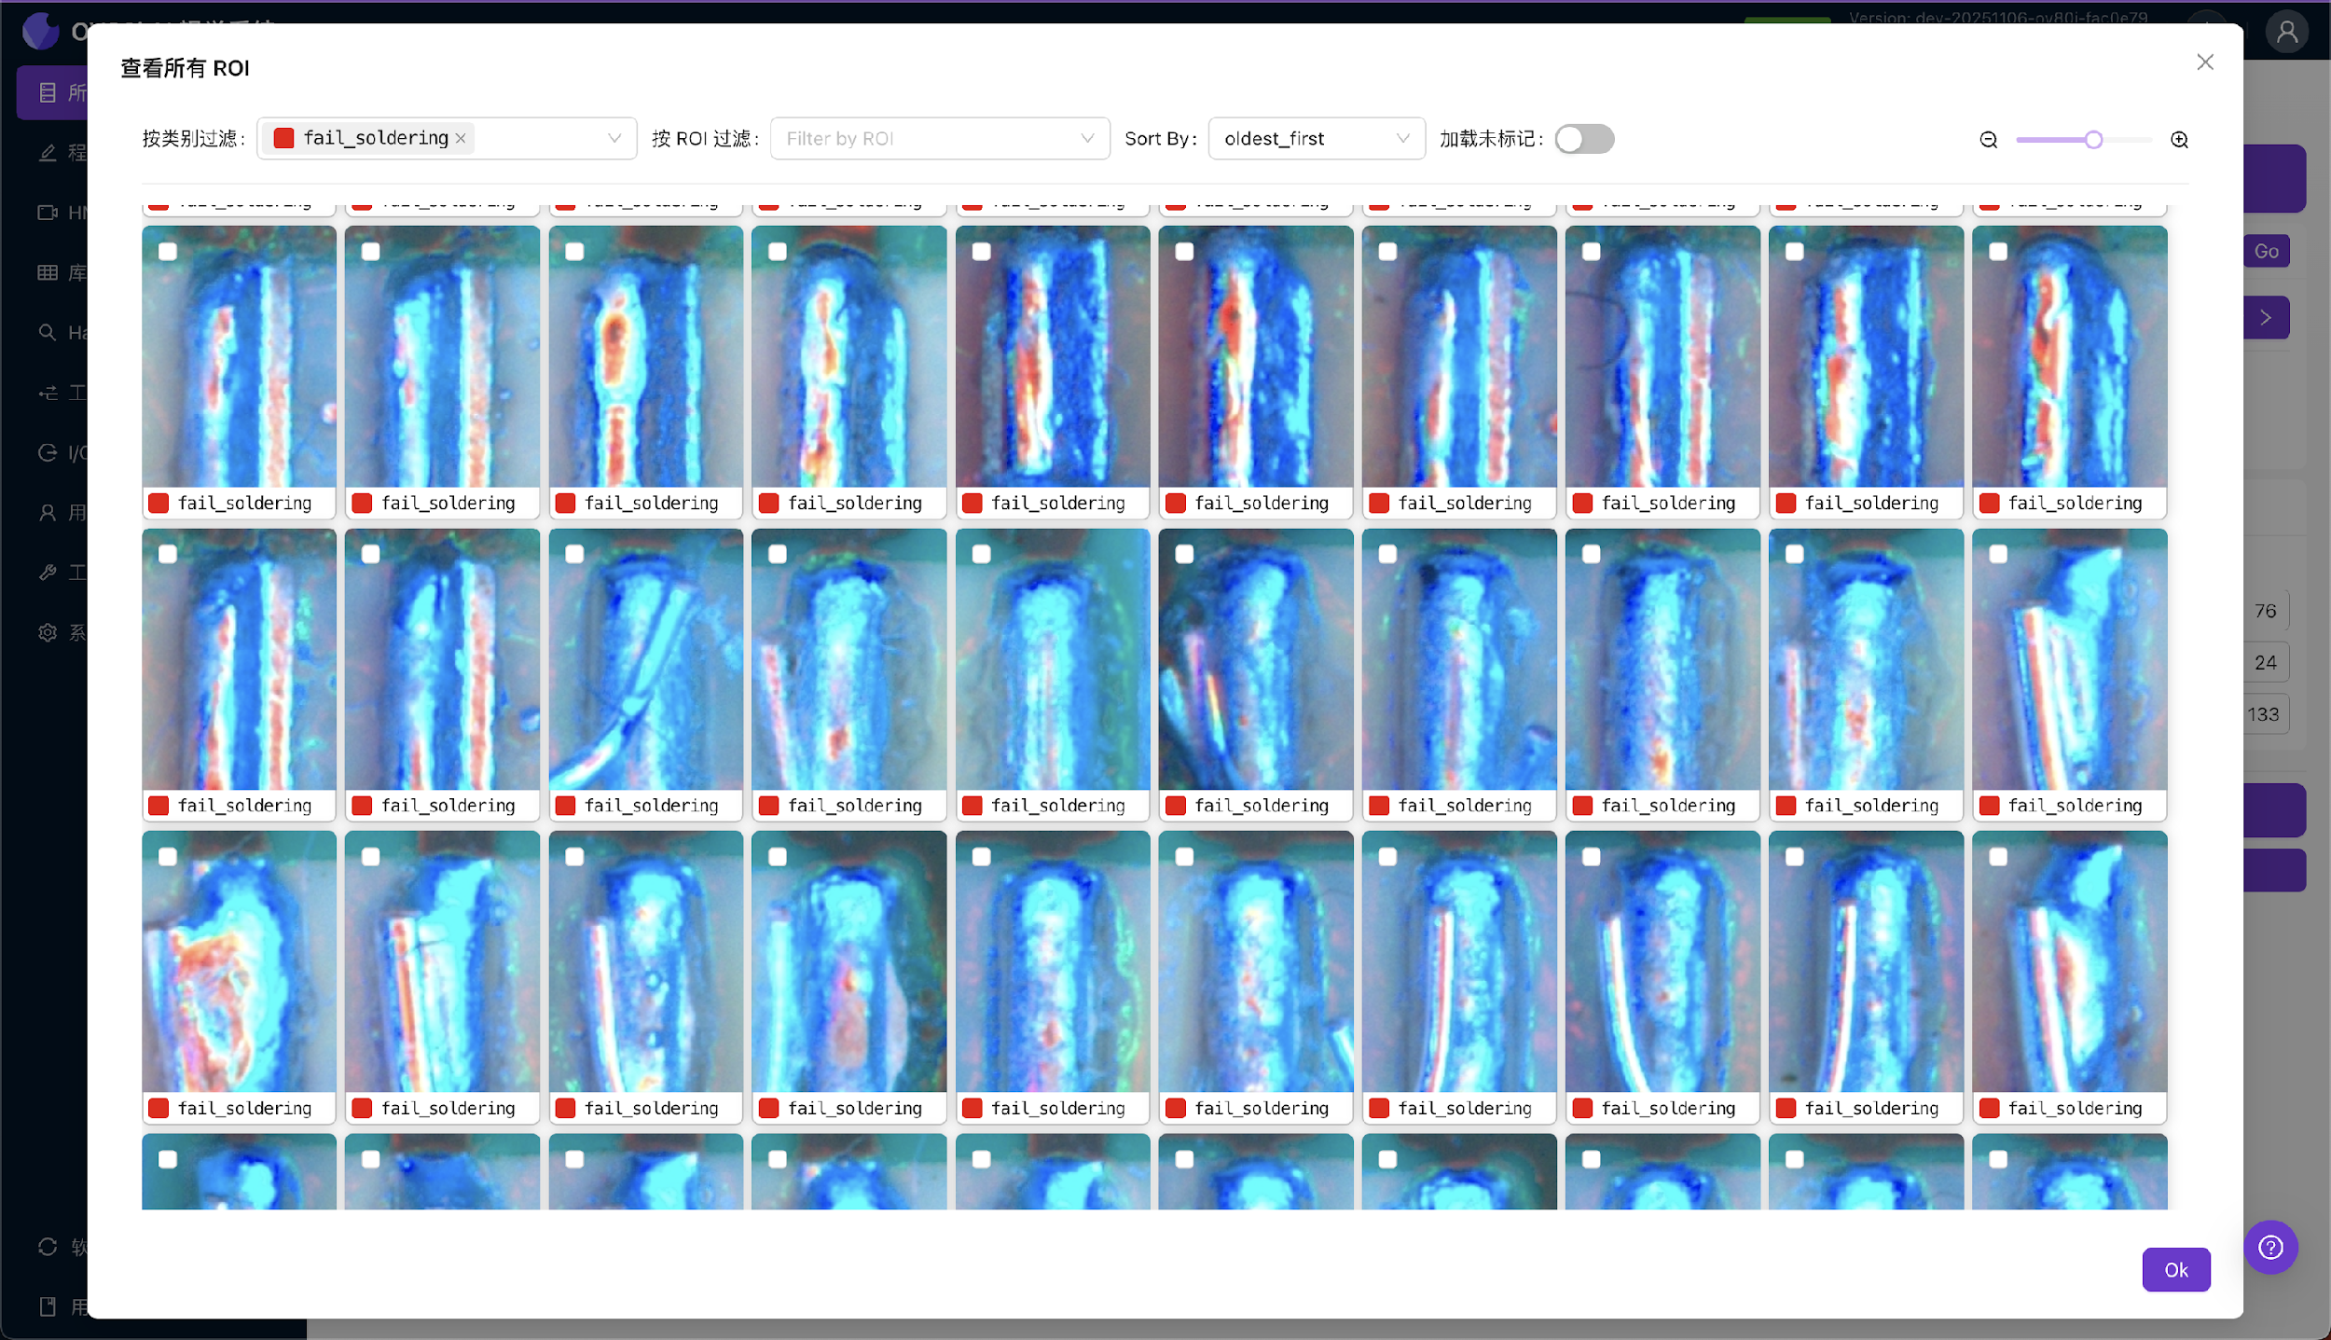
Step {{ step_no }}: Check classification dataset

