Slide 1

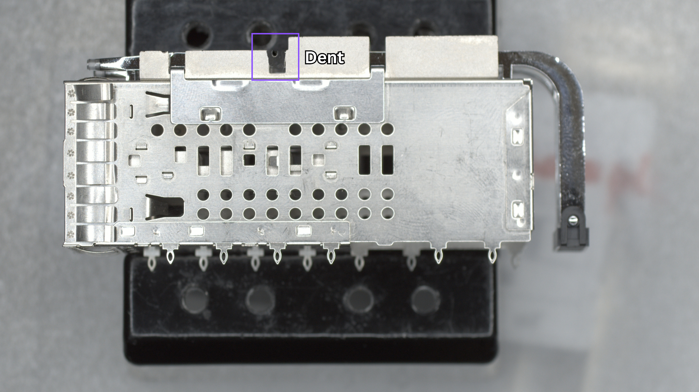
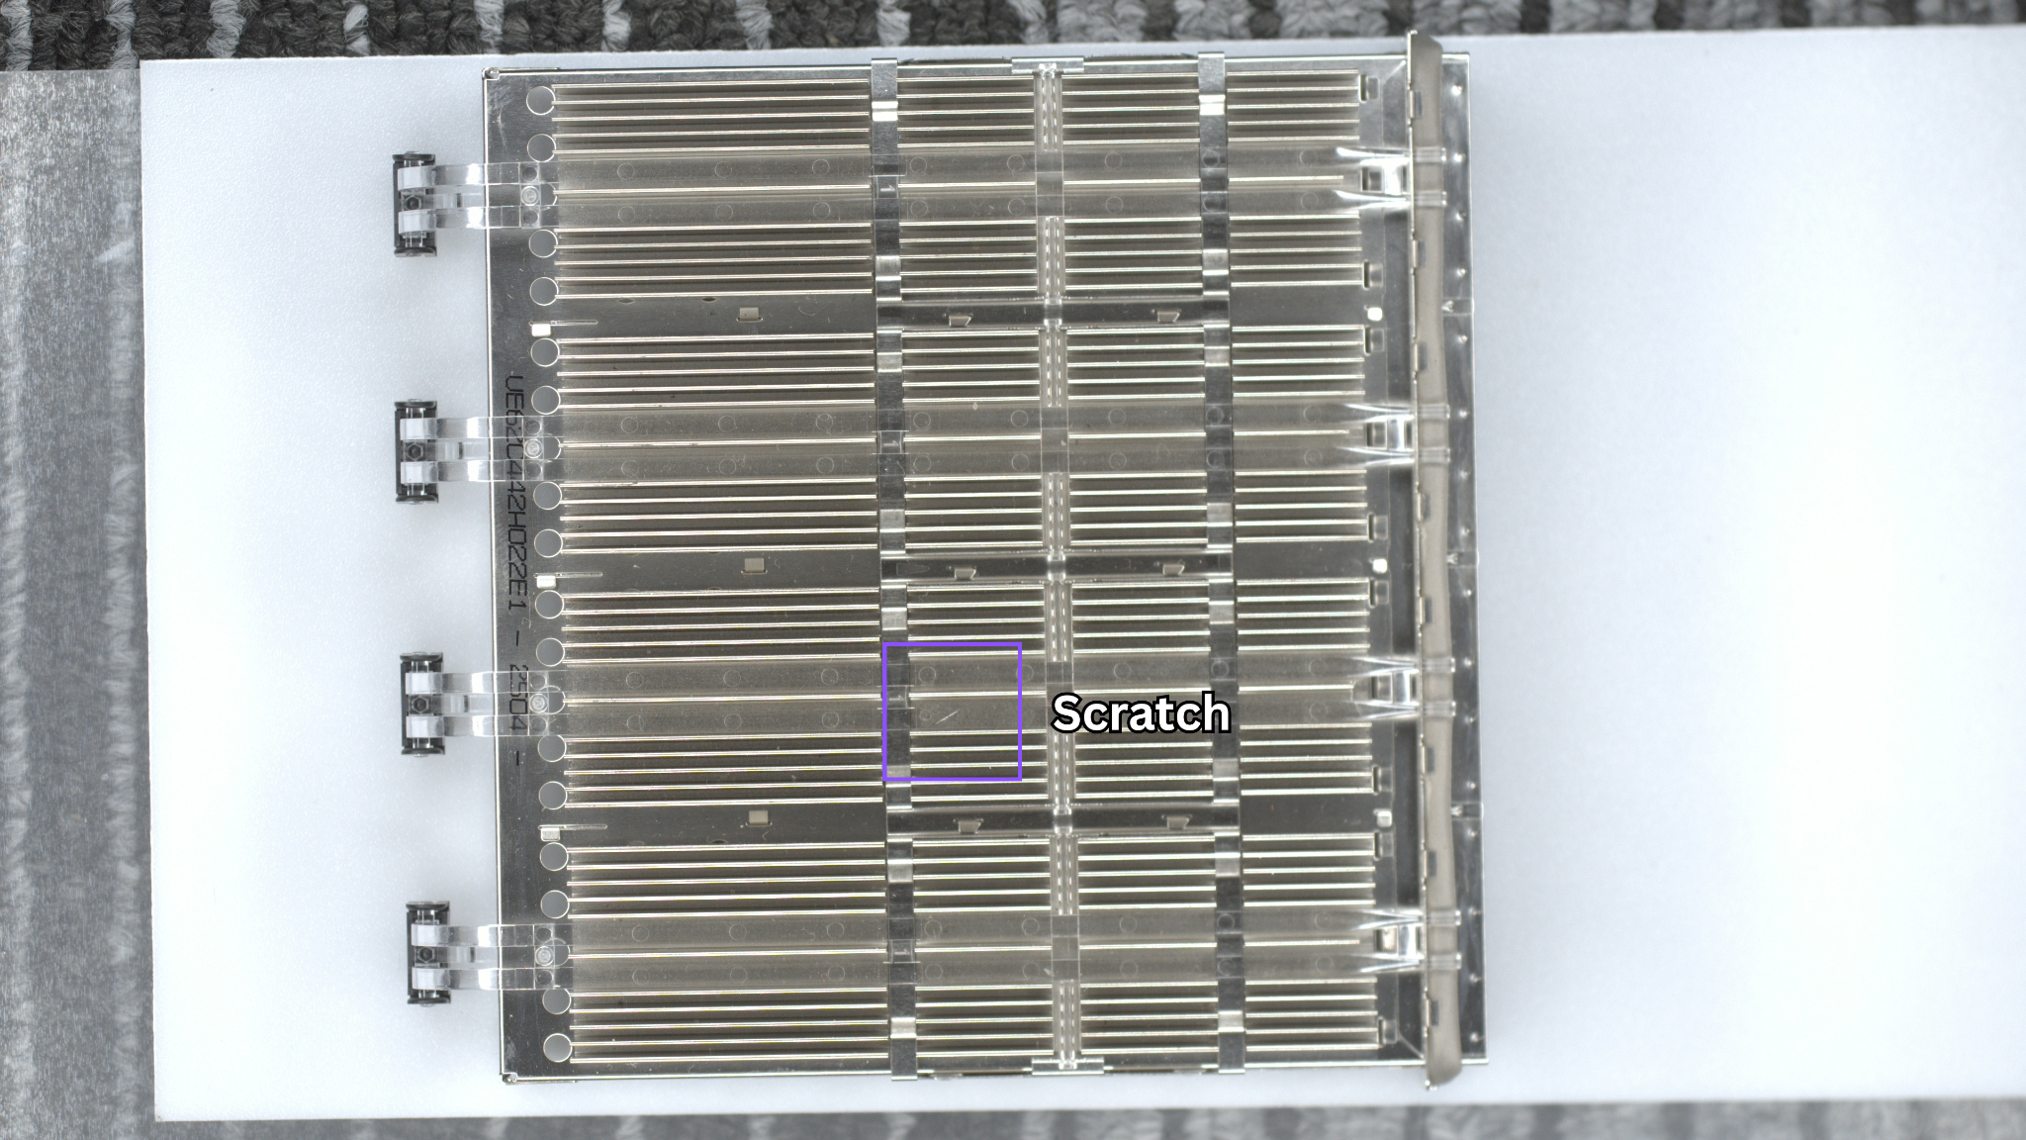
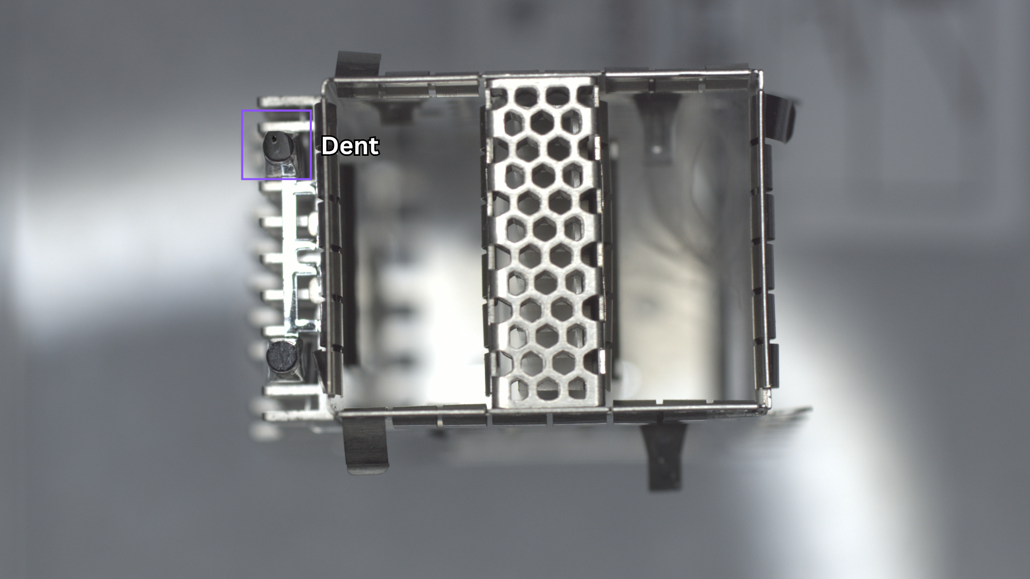
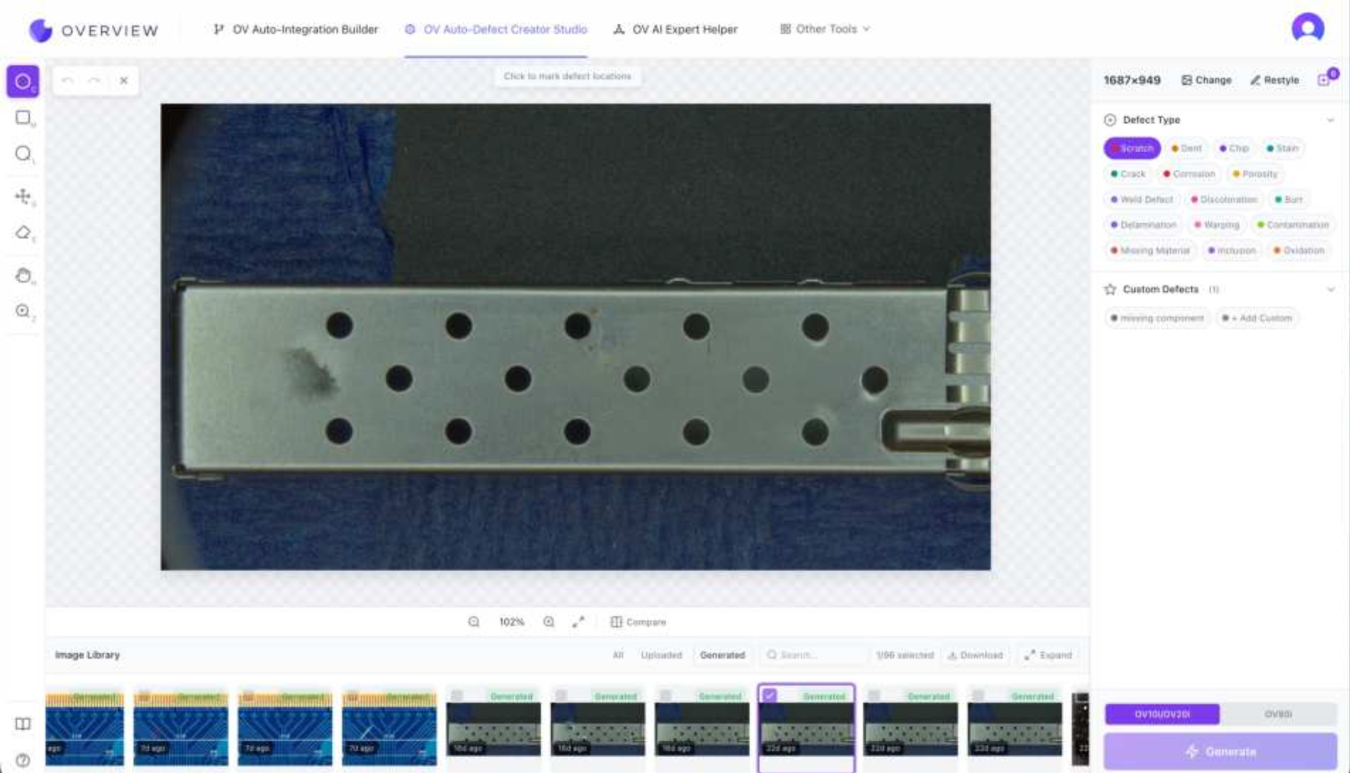
Can't wait for the rare defect? Generate it.
Synthetic defects, guided by your real ones. A 12.4× faster path from new SKU to production-ready inspection.
01
12.4×
Capture good parts
02
Generate defects
faster path from new SKU to production-ready inspection
03
Train & verify
09 / 15
Notes:
Defect Studio is the answer to the #1 objection: 'we don't have enough defect samples.' We generate them — synthetic but constrained, fine-tuned on the customer's good parts and spec. The generated defects look exactly like ones that could actually occur. Then we verify against a small real-defect library before going live. The samples on the right are actual synthetic outputs from Amphenol FCI's 300-SKU rollout — once a roadblock, now a 30-minute changeover.

