Slide 1

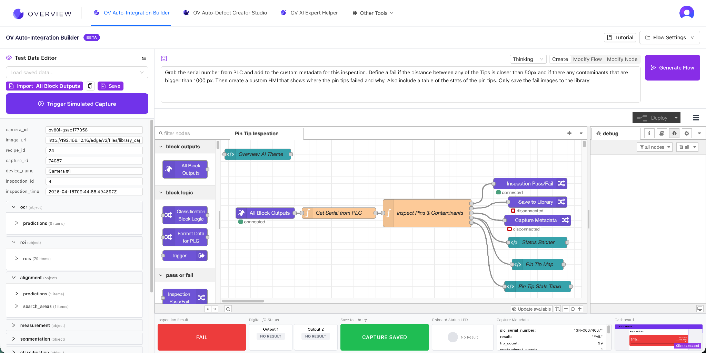
Integration built for everyone.
Controls engineers are some of the busiest people in the factory. Customize what works best for them, no code required.
Drag-and-drop logic
Anyone can author inspection logic without writing code.
PLC, MES, HMI
Bring real factory data into the camera and push results back out.
Custom dashboards
Generate the views and reports each engineer actually needs.
12

