Slide 1

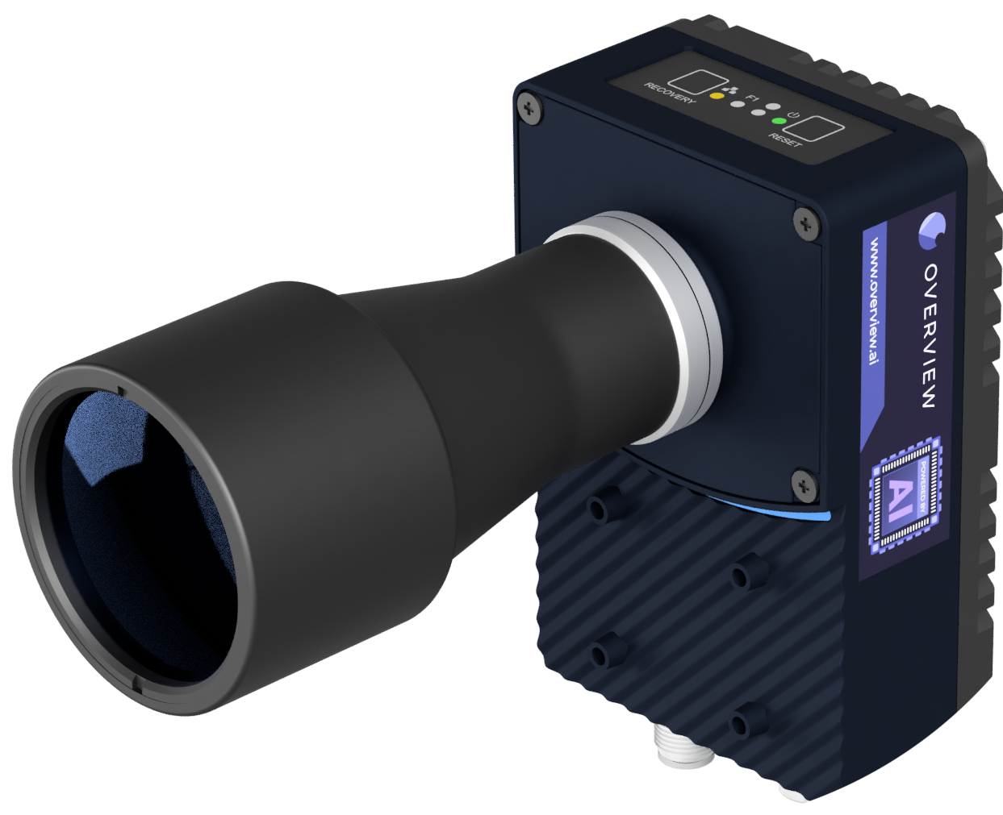
OV80i
{{ recipe_title }}

