Slide 1
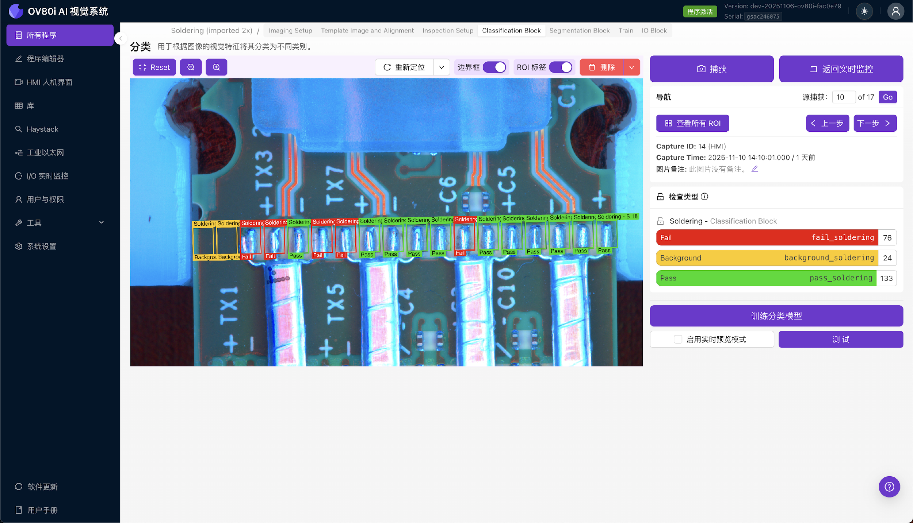
Step {{ step_no }}: Setup Inspection Regions
{{ setup_text }}

