Slide 1
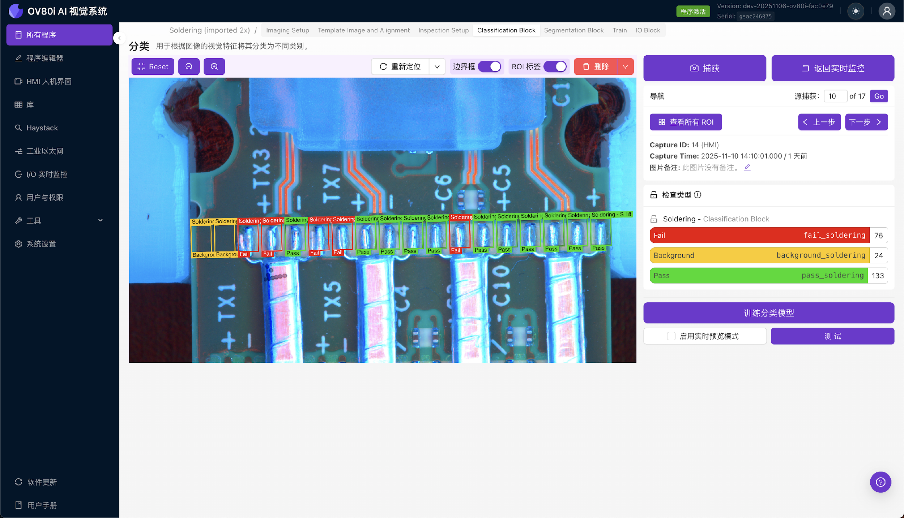
Step {{ step_no }}: Setup Segmenter inspection
{{ setup_text }}

