Slide 1

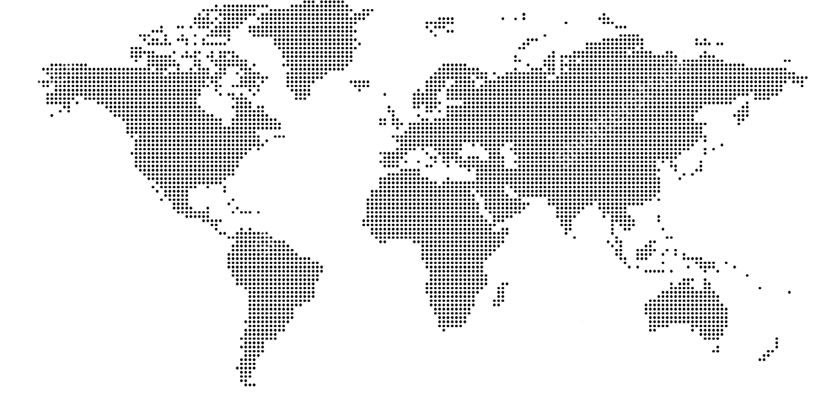
Remote personnel — Worldwide
Team &
Locations.
United States
Americas
Asia
Europe
San Francisco, CA
Columbus, OH
Nashville, TN
Seattle, WA
Iowa City, IA
Atlanta, GA
Charlotte, NC
Detroit, MI
Austin, TX
CDMX, MX
Guadalajara, MX
Hermosillo, MX
Curitiba, Brazil
Taipei, TW
Shanghai, CH
Nantong, CH
Shenzhen, CH
Haiyan, CH
Ha Noi, VN
Bengaluru, IN
Zurich, Switzerland
(844) 799-7044
1700 Montgomery St, Ste 221
San Francisco, CA 94111
United States
HQ in San Francisco, CA
14 / 15

