Slide 1
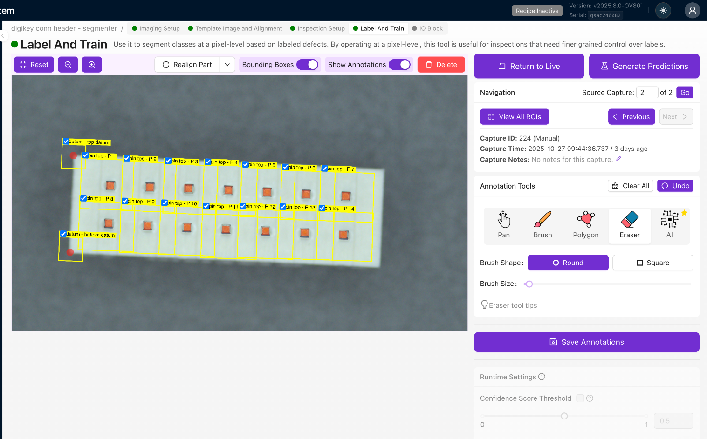
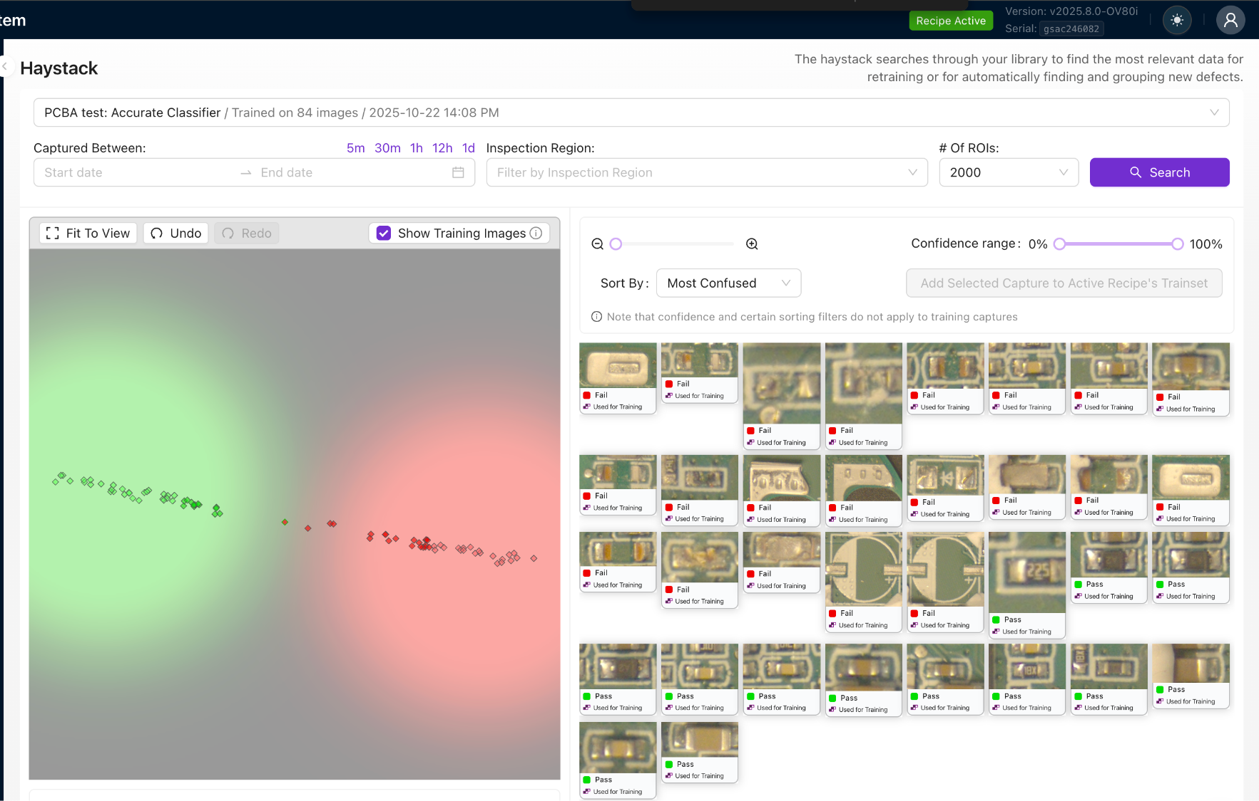

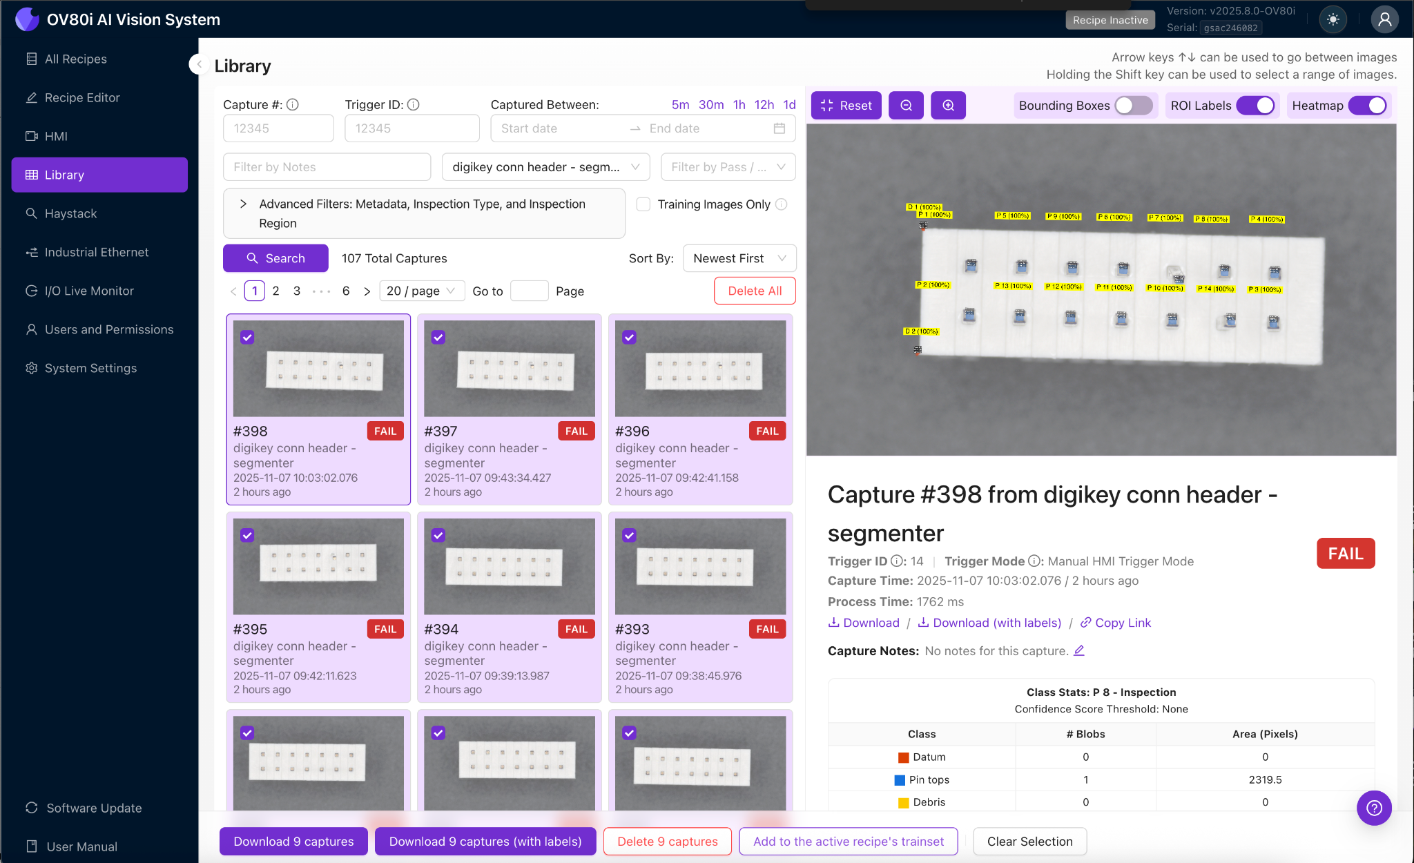
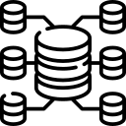
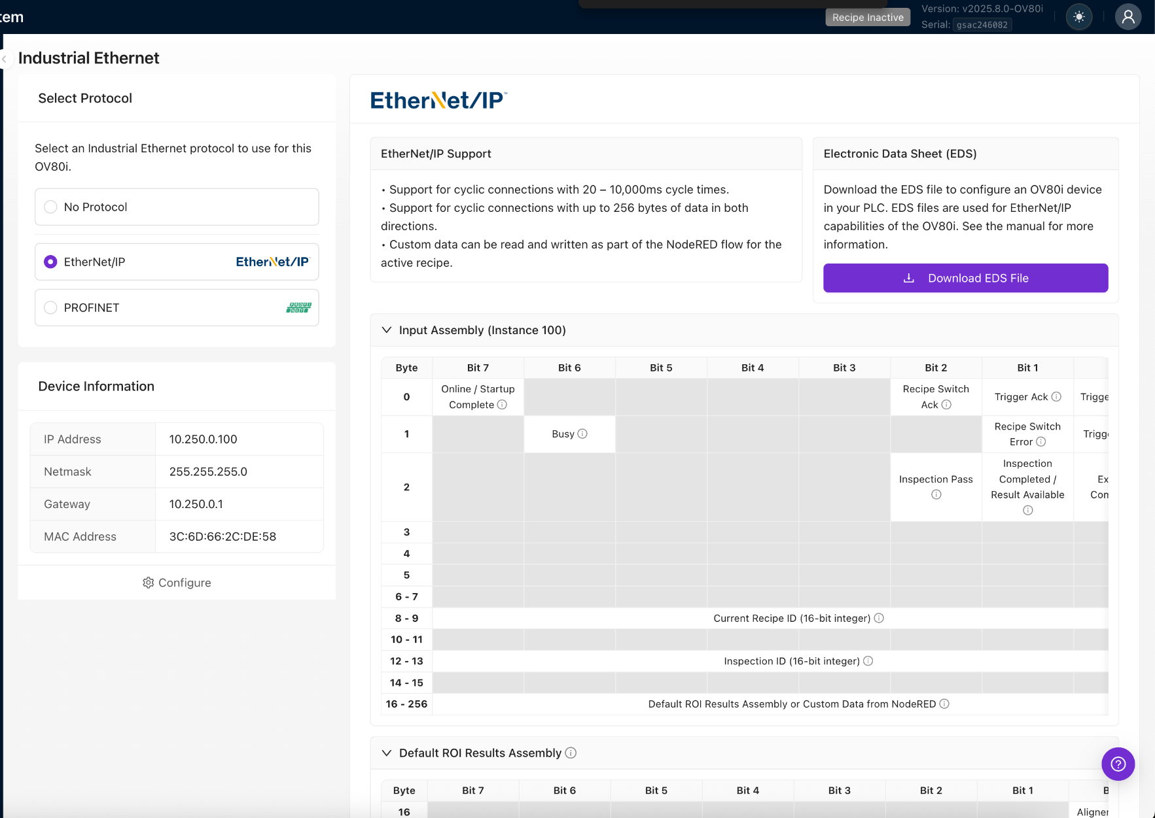

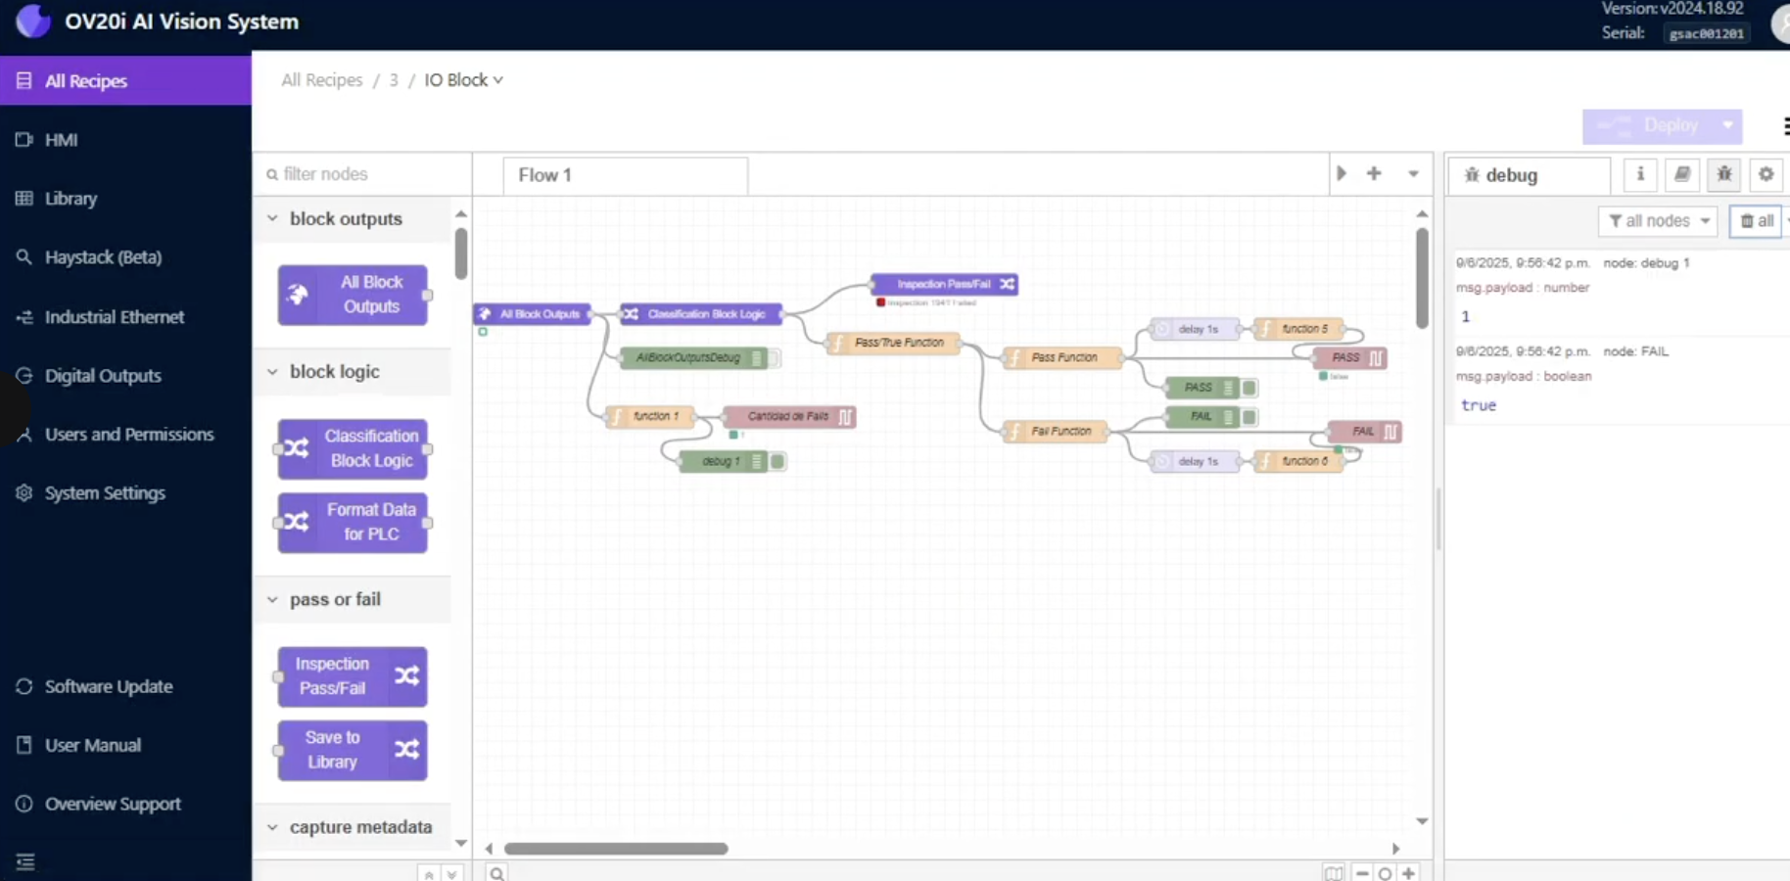


5 factors make us unique
NVIDIA-Powered On-device training
Run large AI models and retrain on the camera in minutes, to get unmatched accuracy and performance on subtle defects
Data-first with massive onboard storage
Labeling and training using JPEG for faster results and storage for weeks worth of production data (100k+ images)
Modern, browser-native tech stack
Access every camera instantly through a simple browser – no installs, no license keys, and no dedicated PC required
Root-cause, discovery defects, & continually improve
Use our proprietary haystack tool to easily surface outliers & new defect modes, and retrain models using real production data
Fully open automation platform (Node-Red + APIs)
Trigger, control, create dashboards, and customize everything with APIs & Node-RED, enabling PLC-level logic directly on the camera

