Slide 1

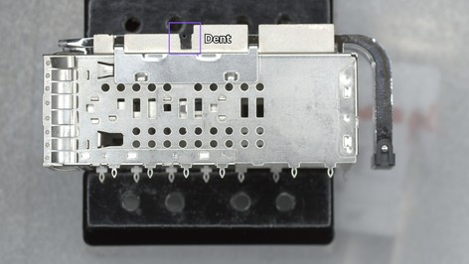
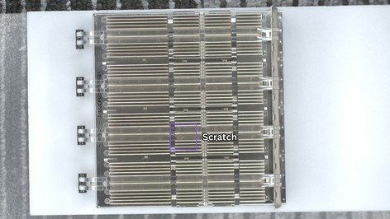
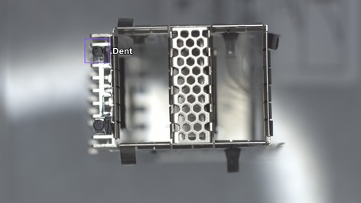
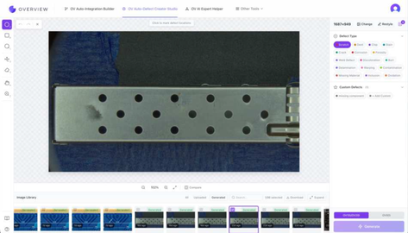
Can't wait for the rare defect? Generate it.
Synthetic defects, guided by your real ones. A 12.4× faster path from new SKU to production-ready inspection.
01
12.4×
Capture good parts
02
Generate defects
faster path from new SKU to production-ready inspection
03
Train & verify

