Slide 1
“Exploration, Explanation and Prediction in the world of Investing in Airbnb
Las Vegas”
Team 8
Tongyue Hu, Wanzhen Li, Tanmaya Pisal, Shashank Puthanveedu, Tianlin Xiao, Xinyu Zhao

Slide 2
“Kaggle Haggle”
Part I

Slide 3
The Kaggle Competition
Data preprocessing:
Dropped the text variables and some highly biased variables. We also dropped variables which had little or no significance based on business understanding.
Did mean and zero imputations to the variables which had NA but were significant from business point of view.
Created dummy variables using list variables.
Merged some factors in market and property type to avoid factor levels with only few observations.
Final model method and arguments:
Xgboost Model with below parameters nrounds = 100, max_depth = 7, eta = 0.3, gamma = 0, colsample_bytree = 0.4, min_child_weight = 2.25 and subsample = 1.
Main Variables:
review_scores_checkin, review_scores_rating, host_is_superhostTRUE, host_listings_count, review_scores_value, host_since, self_check_in, family_kids_friendly, minimum_nights, reviews, cleaning_fee, hot_waterTRUE, host_response_timewithin an hour, price, internet
AUC achieved: 0.94412 (30% of Test Data)

Slide 4
“AIrbnb in Las Vegas”
Part II

Slide 5
Understanding the Market
Airbnb is primarily a combination of Hospitality and Real estate Industry
Las Vegas is famous for its casino industry together with the hotel industry because most casinos are owned by the hotel.
42.5 Million people visiting Las Vegas in 2019 which was a million more than 2018
No Seasons! A thriving tourism market all year
113 Hotels with over 100,000 Beds
6000 Airbnb listings with around 15000 Beds
4782 listings have a low booking rate which is about 77% of the total listings
Notes:
Airbnb is primarily a combination of Hospitality and Real estate Industry
Las Vegas is famous for its casino industry together with the hotel industry because most casinos are owned by the hotel.
No Seasonality in the market as tourism flourishes in Las Vegas all year round.
Growing tourism industry with around 42.5 Million people visiting Las Vegas in 2019 which was a million more than 2018
Las Vegas has about 113 Hotels with over 100, 000 beds
Las Vegas has about 6000 AirBnb listings with about 15000 beds
Out of these 4782 listings have a low booking rate which is about 77% of the total listings
Competition, Supply, Demand, Regulation

Slide 6
Competition
Airbnb
10% of Visitors came to Vegas for a Business Convention. Airbnb misses out this chunk of visitors.
Sometimes, the condition of Airbnb is not as good as it shown on the web page.
Price is the advantage of Airbnb which materializes if you are travelling in large groups.
The Airbnb could have the advantage on the outdoor area like the Red Rock Canyon National Conservation Area.
Airbnbs are generally just bed and breakfast which provide a place to stay.
Hotels
Hotels have the business center and are located in the business district
Most of the hotels in Las Vegas are big brands in chain hotels like MGM, they have the reputation for comfortable room, fancy environment and professional service.
Price plays little role for small groups
The hotel has a comparable advantage in the Strip
Hotels offer complimentary services like, pool and casino access and entertainment shows
Notes:
Hotels
usually hotels do have the business center and located in the business district, and people can save time on the transportation
most of the hotels in Las Vegas are big brands in chain hotels like MGM, they have the reputation for comfortable room, fancy environment and professional service.
Price plays little role for small groups
The hotel has a comparable advantage in the Strip area
Hotels offer complimentary services like, pool and casino access and entertainment shows that make them a great choice for the traveller
Airbnb
10% of Visitors came to Vegas for a Business Convention. Airbnb misses out this chunk of visitors
Sometimes, the condition of Airbnb is not as good as it shown on the web page, which is under-expected.\
Price is the advantage of Airbnb which materializes if you are travelling in large groups.
the Airbnb could have the advantage on the outdoor area like the Red Rock Canyon National Conservation Area
Airbnbs are generally just bed and breakfast which provide a place to stay with not many other facilities

Slide 7
Supply Side (Houses)
Demand Side (Tourists)
Stable Real Estate Market
Median house price of $220K
1- year appreciation rate of 9%
Wide range of properties available from $19K to $21000K
86% stayed in a hotel
Mean age of tourists visiting Las Vegas was 45.1 Years
20% of them in the age group between 21-29
Average size of a group was 2.2 visitors
15% of the visitors bought a tour package for their trip
Notes:
Real estate market in Las Vegas is currently stable with a median house price of $220K and 1- year appreciation rate of 9%
There is a wide range of properties available from $19K to $21000K
Among visitors who stayed overnight in Las Vegas, 86% stayed in a hotel
Mean age of tourists visiting Las Vegas was 45.1 Years with 20% of them in the age group between 21-29
Average size of a group was 2.2 visitors
They stayed an average 4.4 days and 3.4 nights during the trip
15% of the visitors bought a tour package for their trip

Slide 8
Regulation
Las Vegas has a lot of regulations concerning short term rentals
A non-refundable $500 permit application fee on any would-be short-term rental operator
Limiting overnight guests to 12 or fewer per property
Denying such permits to any new Airbnbs within 660 feet of any existing listing
If a home has five or more bedrooms, owners must also keep a licensed security company on call to tackle complaints.
Most parts have declared short term rentals illegal.
But not all is lost,
AirBnB has been approved and is legal in the Las Vegas/Henderson market as of 10/14/2019 and since then there has been a steady boom in Airbnbs and also many people are interested in investing in the same.
Notes:
there are many jobs offered to local residents by these hotels or casinos. If the Airbnb take away the market from hotels, many people would lose their jobs, so to protect people not lose their jobs, it’s reasonable that local government want to limit the development of the Airbnb.

Slide 9
So is Airbnb a good investment option?
Advantages of Airbnb investment
Low cost of investment as compared to investing in the hotel industry
Operation and maintenance cost is also low
Competition is less fierce than the hotel industry and is not monopolized by few major players
Power of the Airbnb platform is a great advantage with network effects
Ease of disinvestment as selling a housing property at the right price is possible

Slide 10
“Now that we have a enough background let’s look at what the numbers say!”
Exploration

Slide 11
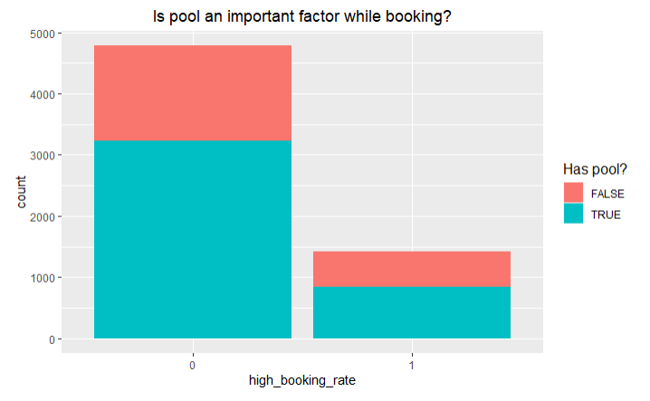
Does Having pool Lead to High booking rate?

Slide 12
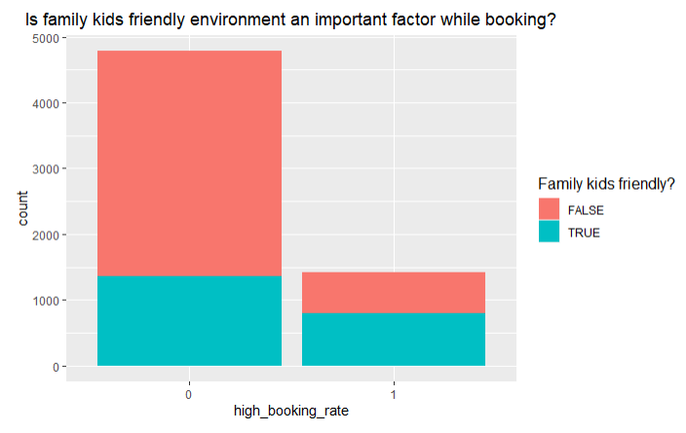
Does Being Family Friendly Lead to High booking rate ?

Slide 13
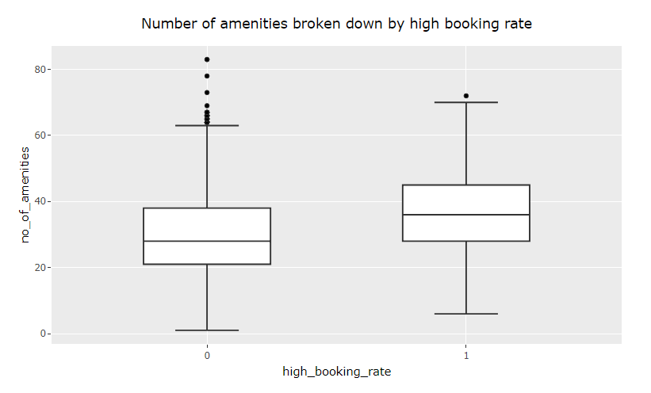
Does Having more amenities Lead to High booking rate ?

Slide 14
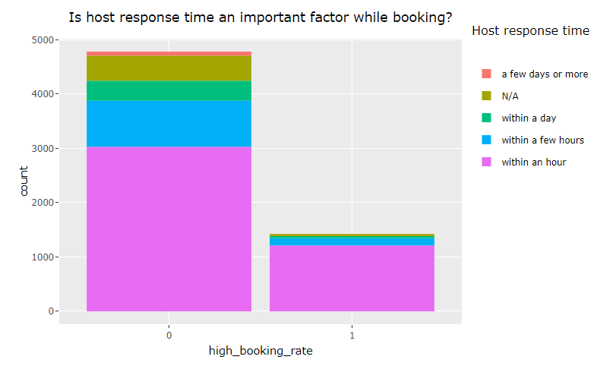
Does Being responsive Lead to High booking rate ?

Slide 15
“For the Investor who wants to buy a new property!”
Prediction

Slide 16
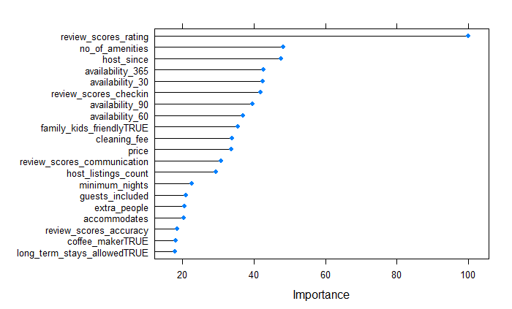
Important Factors
Based on the Bagged tree prediction model for predicting the probability of high booking rate for a new property we achieve an AUC of 0.914!

Slide 17
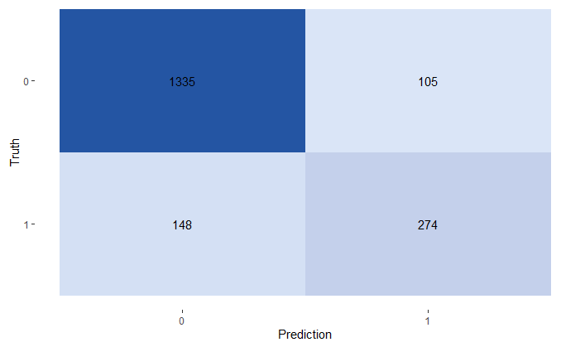
How to Classify a new property using this prediction model?
Accuracy: 86.41%
Sensitivity: 64.93%
Specificity: 92.71%
This is based on cut off 0.5 which enables a risk neutral decision

Slide 18
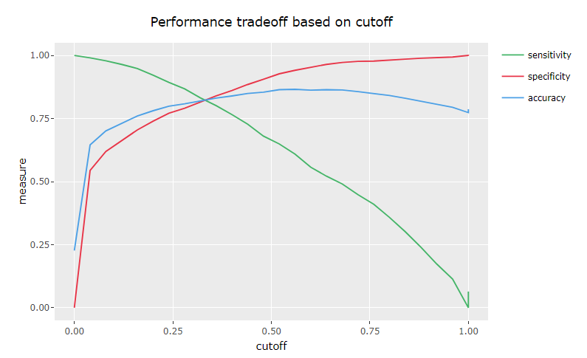
Revisiting Sensitivity and Specificity

Slide 19
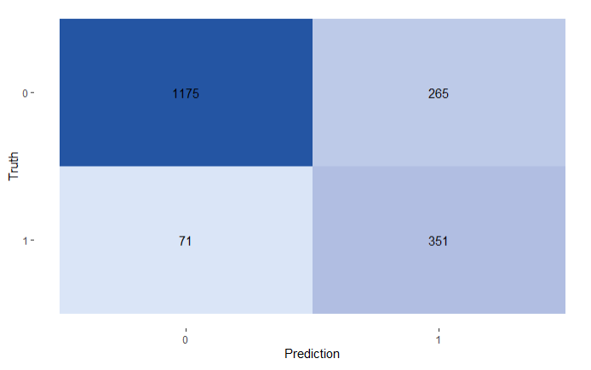
For a Risk Seeking Investor!
Accuracy: 81.95%
Sensitivity: 83.18%
Specificity: 81.60%
This is based on cut off 0.3 which enables a risk seeking decision

Slide 20
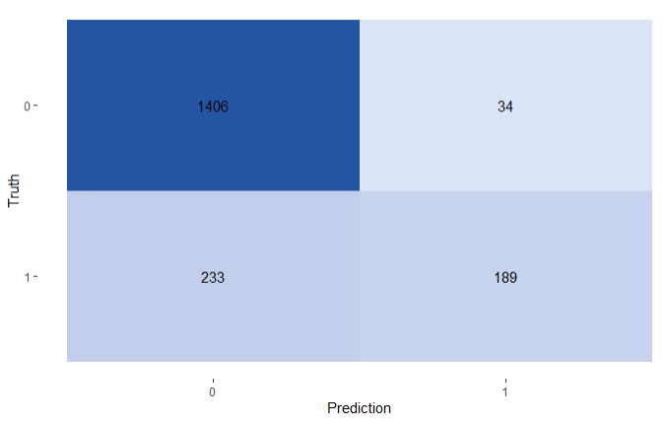
For a Risk Averse Investor!
Accuracy: 85.66%
Sensitivity: 44.79%
Specificity: 97.64%
This is based on cut off 0.7 which enables a risk averse decision

Slide 21
“For the Investor who is invested and wants to improve the booking rate”
Explanation

Slide 22
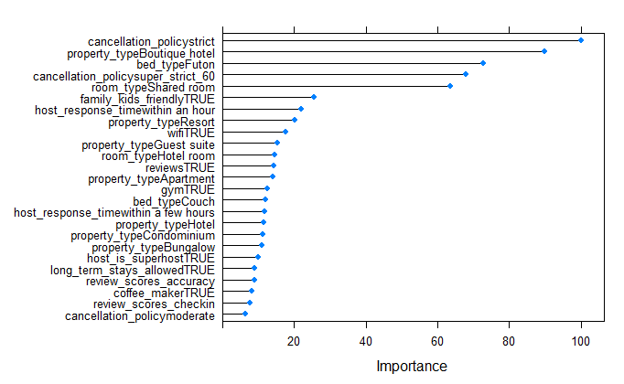
Important Factors
Based on Elastic Net model using Grid Search we get the below variable importance for existing properties,

Slide 23
How about a explanatory Logistic Regression?
Variables | Odds Ratio
review_scorces_accuracy | 1.5104
review_scores_checking | 1.9294
wifiTRUE | 2.0783
instant_bookingableTRUE | 1.6585
long_term_stays_allowedTRUE | 1.4681
refrigeratorTRUE | 1.8128
jumioTRUE | 1.2623
family_kids_friendlyTRUE | 3.8265
coffee_makerTRUE | 1.4367
laptop_friendly_workspaceTRUE | 1.5835

Slide 24
Conclusion
Though the Hotel industry is big and strong Airbnb could be the way to go for small investments!
Good Reviews and long list of amenities go a long way in making it successful
Focus on customer service and be family friendly in your offerings
Lower price for large groups is the best bet

Slide 25
THANKS!
Any Questions?
Team 8
Tongyue Hu, Wanzhen Li, Tanmaya Pisal,
Shashank Puthanveedu, Tianlin Xiao, Xinyu Zhao

Slide 26
References
Real estate trends in Las Vegas,
https://www.brownellteamrealtors.com/market-statistics/
https://www.fortunebuilders.com/las-vegas-real-estate-market-trends/
Tourism Demographics,
https://assets.simpleviewcms.com/simpleview/image/upload/v1/clients/lasvegas/2018_Las_Vegas_Visitors_Profile_Study_94443c1d-334f-4d0b-b997-5c8800f990b0.pdf
Market Research,
https://www.investopedia.com/articles/personal-finance/031815/hotels-vs-airbnb-vegas-visitors.asp
https://www.investopedia.com/articles/personal-finance/031815/hotels-vs-airbnb-vegas-visitors.asp
https://www.cntraveler.com/story/why-airbnb-cant-crack-las-vegas
https://www.fox5vegas.com/news/local/short-term-vacation-rental-market-booming-in-las-vegas-valley-pushing-out-buyers/article_afff7ee4-b8d5-11e9-a333-6f54592625b0.html

