Slide 1

Nelia1
[neli'ven]
Project Tracking

Slide 2
1.
Project Overview

Slide 3
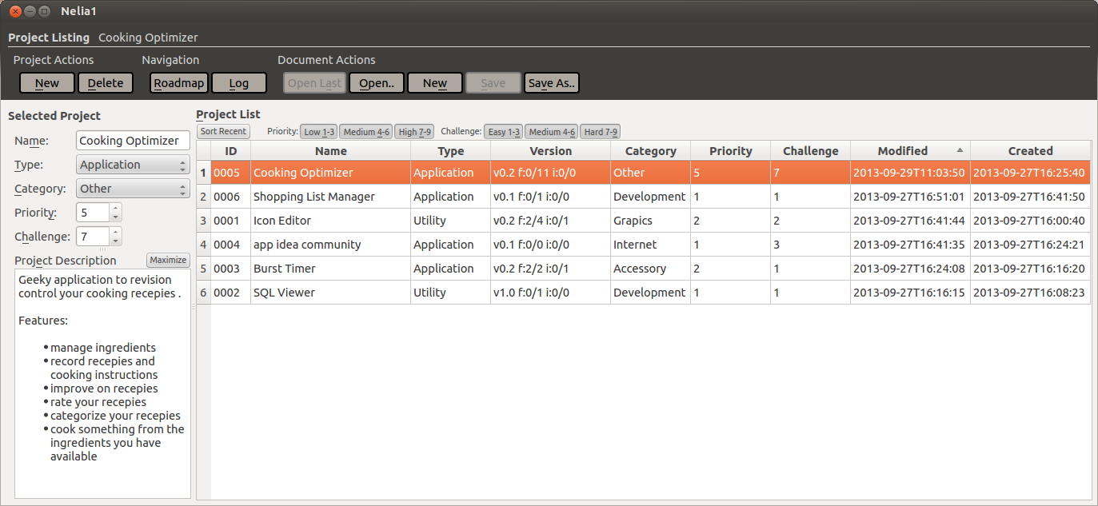
Nelia1
Project Overview

Slide 4
Nelia1
View Organization
Command and Navigation
Edit Attribtes
View and Select

Slide 5
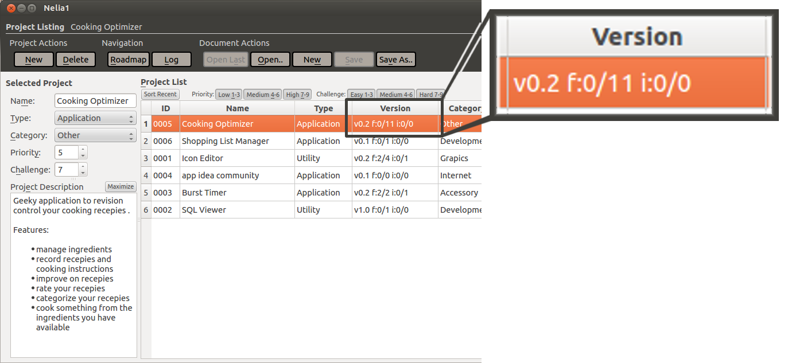
Nelia1
Project Overview
numbers from left to right:
major milestone
minor milestone
closed features in milestone
total features in milestone
closed issues in milestone
total issues in milestone

Slide 6
Nelia1
Project Overview
+ add new projects
⌕ view and filter projects
✓ select projects to access attributes, logs and roadmap
✍ edit project attributes: name, type, category, priority, challange, description
 create, save and load documents

Slide 7
2.
Project Logs

Slide 8
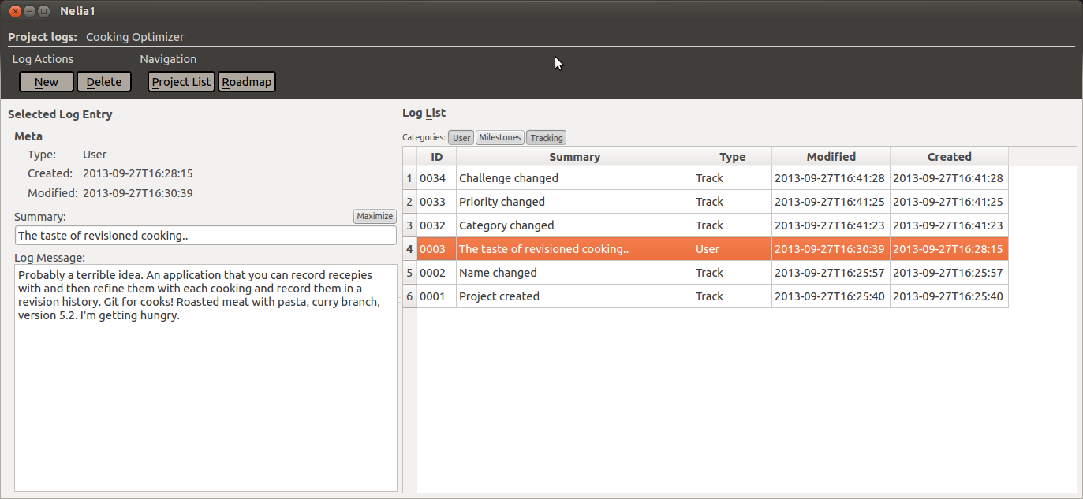
Nelia1
Project Logs

Slide 9
Nelia1
Project Logs
+ add new user logs
⌕ view and filter user, track and milestone logs
✍ edit user log attributes: summary, description

Slide 10
3.
Project Roadmap

Slide 11
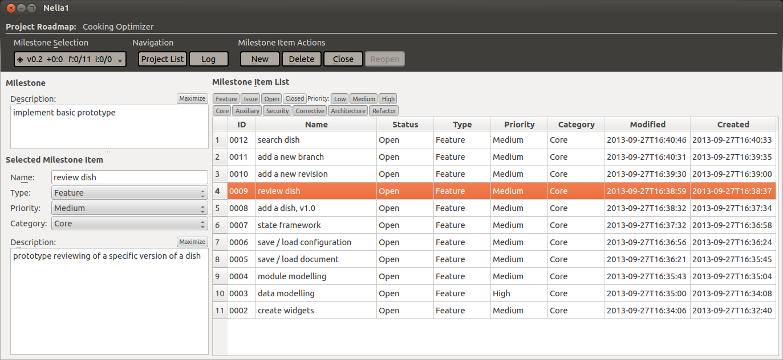
Nelia1
Project Roadmap

Slide 12
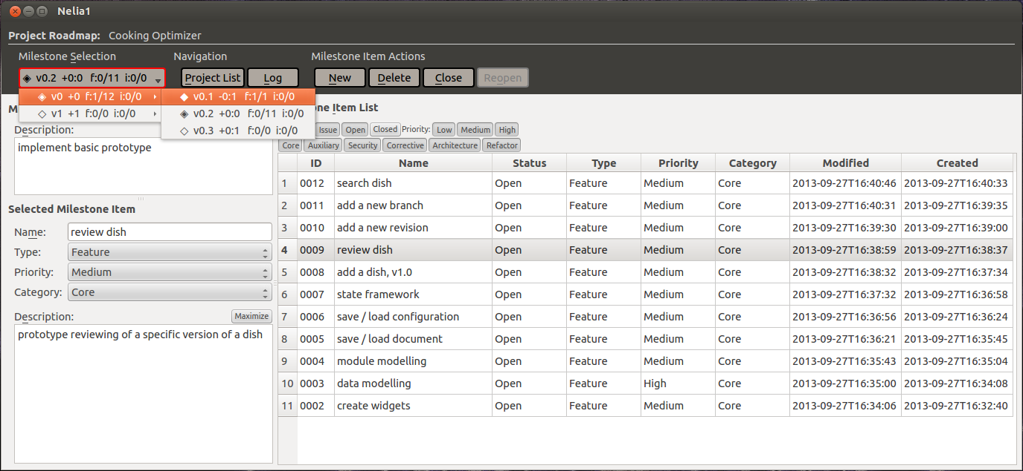
Nelia1
Milestone Selection Menubutton

Slide 13
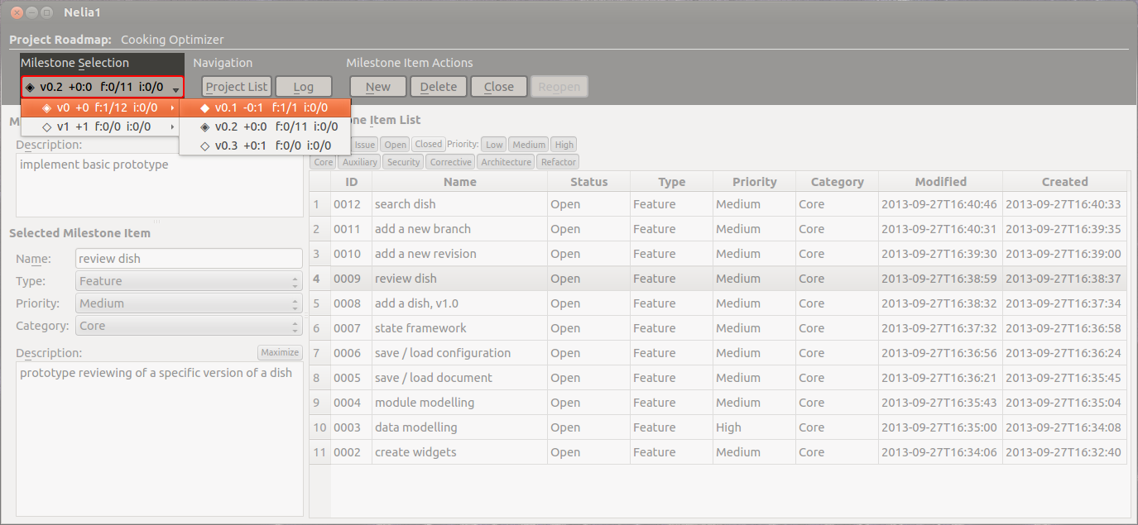
Nelia1
Milestone Selection Menubutton

Slide 14
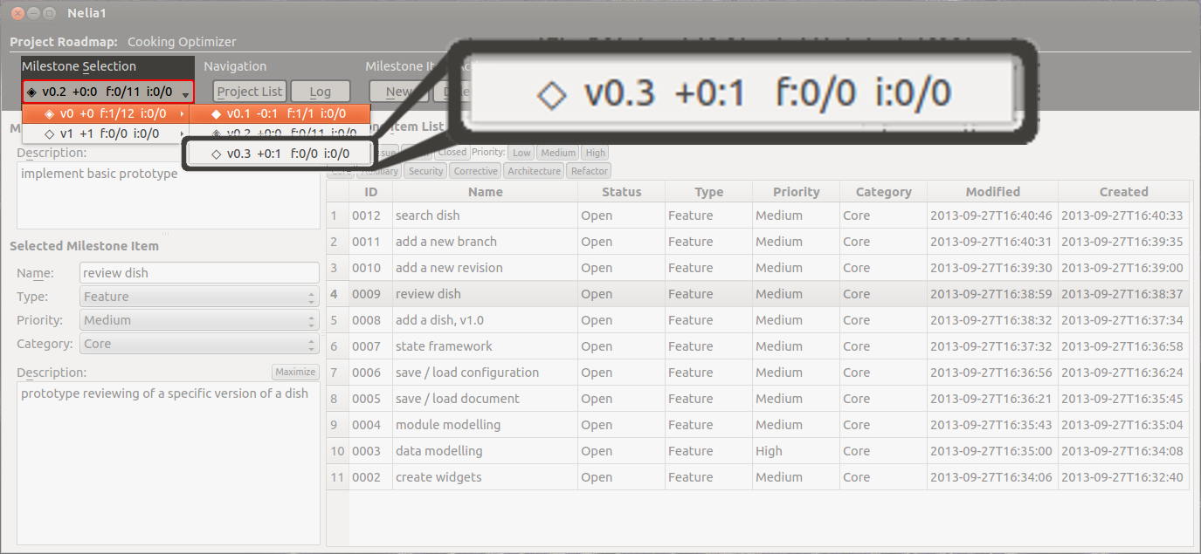
Nelia1
Milestone Selection Menubutton
diamond symbol types:
◆ : finalized milestone
◈ : active milestone
◇ : future milestone
numbers from left to right:
major milestone
minor milestone
major delta from active
sum of minor delta from active
closed features in milestone
total features in milestone
closed issues in milestone
total issues in milestone

Slide 15
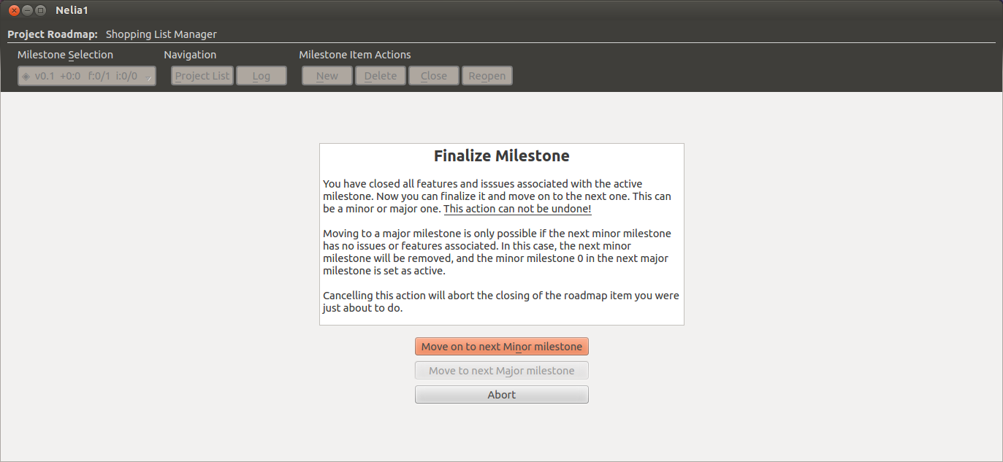
Nelia1
Milestone Selection Menubutton

Slide 16
Roadmap View
view and filter milestone items (features and issues)
select milestones
edit milestone description
create milestone items
edit milestone item attributes (type, priority, category, description)
close and reopen
finalize roadmap

Slide 17
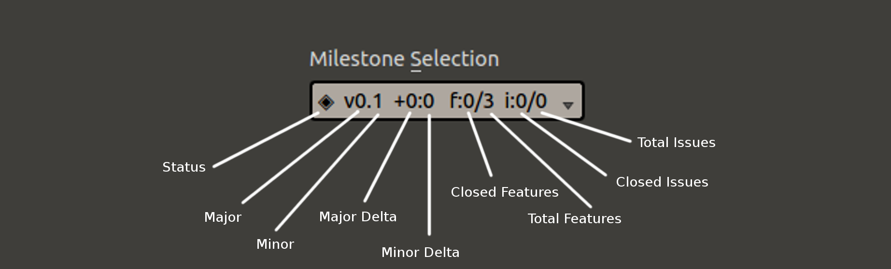
◆ - completed milestone
◈ - active milestone
◇ - future milestone
+3:15
-> 3 major milestones away
-> 15 minor milestones away from active one in total

Slide 18
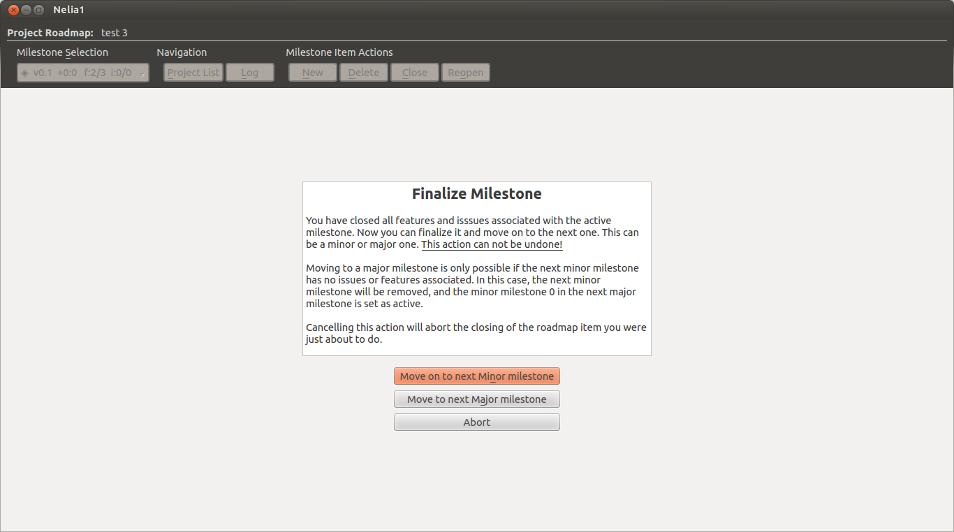

Slide 19
Sebastian Bartos
<seth.kriticos@gmail.com>

