Slide 1
Let's Code: TimeTrack #1
Introduction
What's a "Let's Code"?
What's TimeTrack?
Tooling

Slide 2
What's a "Let's Code"?
It's like a "Let's Play". Just.. Instead of playing a game, I design and code an open-source application!
Conception (why are we doing this?)
Design (what are we doing?)
Implementation and Testing (do it)
The code is published on Github. The location is in the footer. The commits are tagged with the series numbers, so you can browse through the individual states if you wish

Slide 3
What's TimeTrack?
Conception
I have been using KTimeTracker for some time. It's a nice application, but has a set of usability issues. TimeTrack aspires to be a new application that avoids the existing issues with careful design.
Motivation
  Use-case with KTimeTracker
  Issues that have been encountered

Slide 4
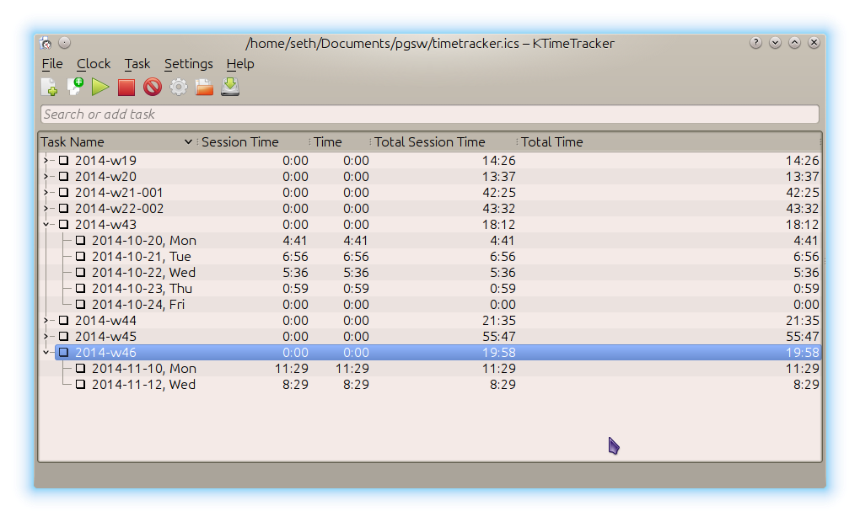
What's TimeTrack?
Motivation
Let's start with a quick look at KTimeTracker. It let's the user add tasks and sub-tasks. Start and stop tracking these through the GUI.
manual task creation
GUI is often hidden
  easy to forget
  takes long to find
obscure, hard coded save file location
tasks can be completed

Slide 5
What's TimeTrack?
Motivation
How do I use KTimeTrack?
open app
being annoyed that it opens the default location
close app and open it with correct file
create week entry
create weekday entry
start tracking (when I remember to visit the desktop)
stop tracking (when I remember to visit the desktop)

Slide 6
What's TimeTrack?
Motivation
Issues?
obscure, hard to configure startup datafile
manual time-section creation
bad time-section/project mapping
low status visibility
why does a time tracker need task completion? It's not a ToDo app..
messy user interface
bad data correction options

Slide 7
What's TimeTrack?
Solution
Based on the experiences and issues encountered, what's a usable UX?
SysTray indicator of tracking (lamp off or on)
Date and Project based tracking
Robust datastore with automatic saving
Easy datastore configuration
Easy project switching and declaration
Remember last project on startup
Evaluation Charts (sum of times, punchcard)
Single instance application
Easy external control (desktop hotkey on, off, toggle)

Slide 8
Tooling
Qt 5 (cross-platform application development framework)
QtCreator (Qt IDE)
LibreOffice
GIMP (image manipulation)
Konsole (terminal emulator)
Vim (text editor)
Kubuntu Linux/KDE (operating system, desktop)

