Slide 1

Song Recommendation Model
By: Sarah Kronheim, Carly Yiao and Brenda Wardhaugh

Slide 2


Overview
The aim of our project is to group songs by their characteristics in order to create a song recommendation program.
We also tried to predict the popularity and genre of songs based on their characteristics.

Slide 3

Dataset
Spotify dataset from Kaggle
Includes song characteristics such as key and tempo
Most metrics are binary or scaled between 0 and 1
Popularity, duration, loudness, and tempo have a wider scale
Explicit, key, time signature, and genre are categorical
Limitations
Consists only of data collected using the Spotify API
Biggest limitation is the genre metric
Does not account for songs with multiple genres
Size and format of the dataset
~100,000 songs, not grouped into playlists

Slide 4
Common Data Preprocessing
Each model has slightly different preprocessing steps
Common steps are:
Duplicates, songs with duration <= 0, and the track ID column were removed
Categorical data was encoded
Normalization was applied to all models separately

Slide 5
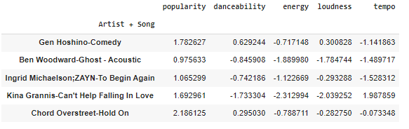
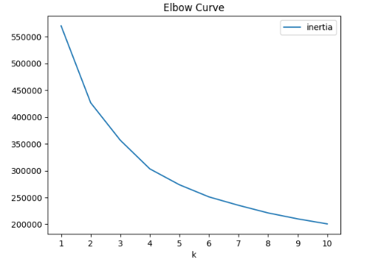
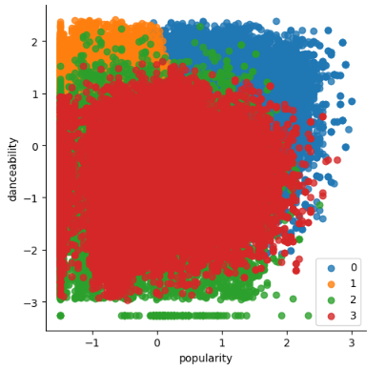
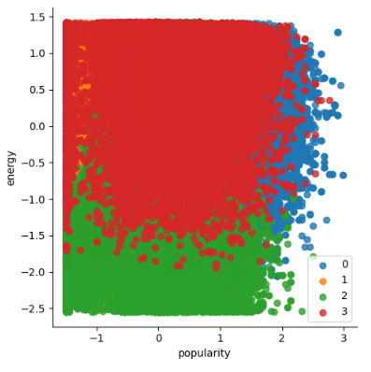
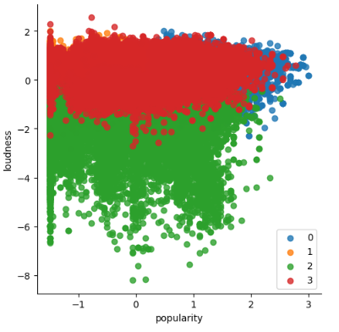
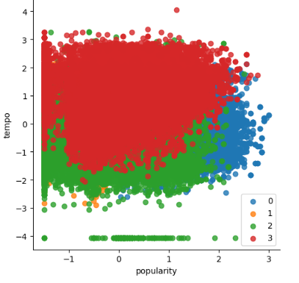
Unsupervised (K-Means)

Slide 6
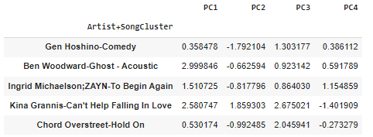
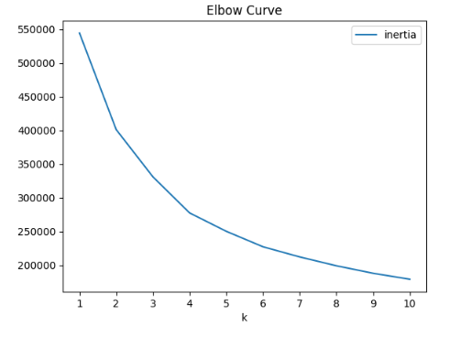
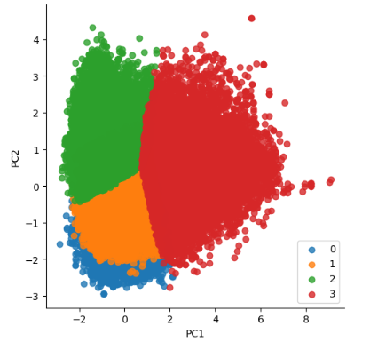
Unsupervised (K-Means)

Slide 7
Supervised (Neural Network) Popularity Prediction
Tested different bins – 4, 3, or 2
0 (Removed for 3-bin)
0 < popularity <= 30 (Removed for binary)
30 < popularity <= 60
60 < popularity
Condition | Accuracy | Loss
4 bins | 0.66 | 0.835
3 bins | 0.70 | 0.693
2 bins | 0.88 | 0.345
Tested different preprocessing
Normalization
StandardScaler
MinMaxScaler
Oversampling to reduce skew
Condition | Accuracy | Loss
StandardScaler | 0.88 | 0.345
MinMaxScaler | 0.87 | 0.319
Oversampling | 0.79 | 0.544
Tested different models
Regularization to reduce overfitting
Hyperparameter tuning
Condition | Accuracy | Loss
Regularization | 0.64 | 0.626
Tuning | 0.83 | 0.818

Slide 8
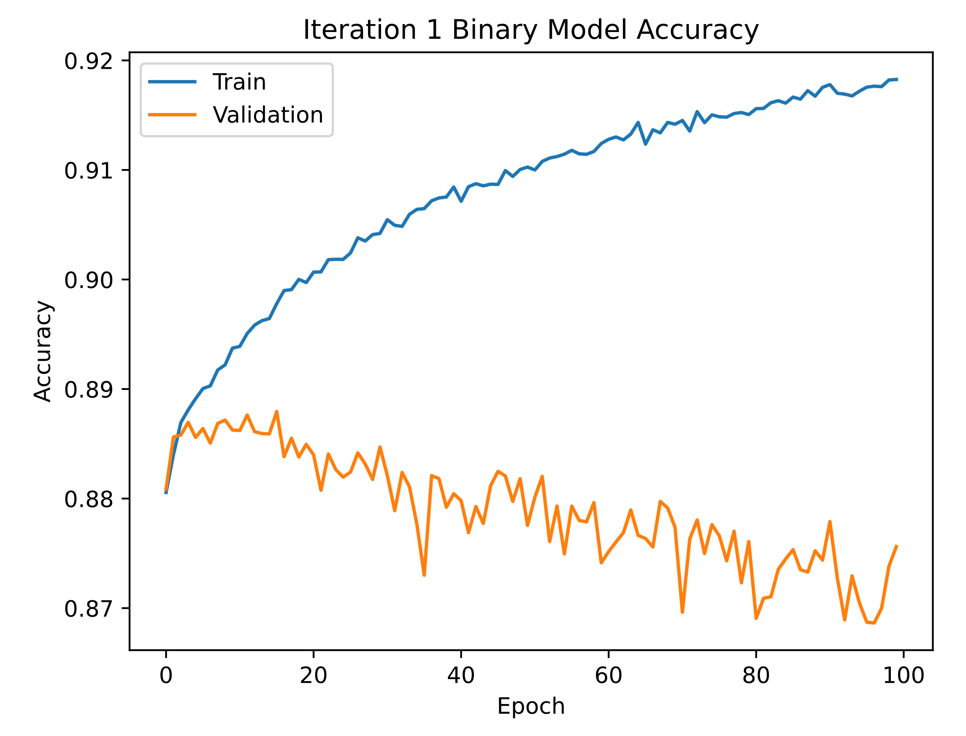
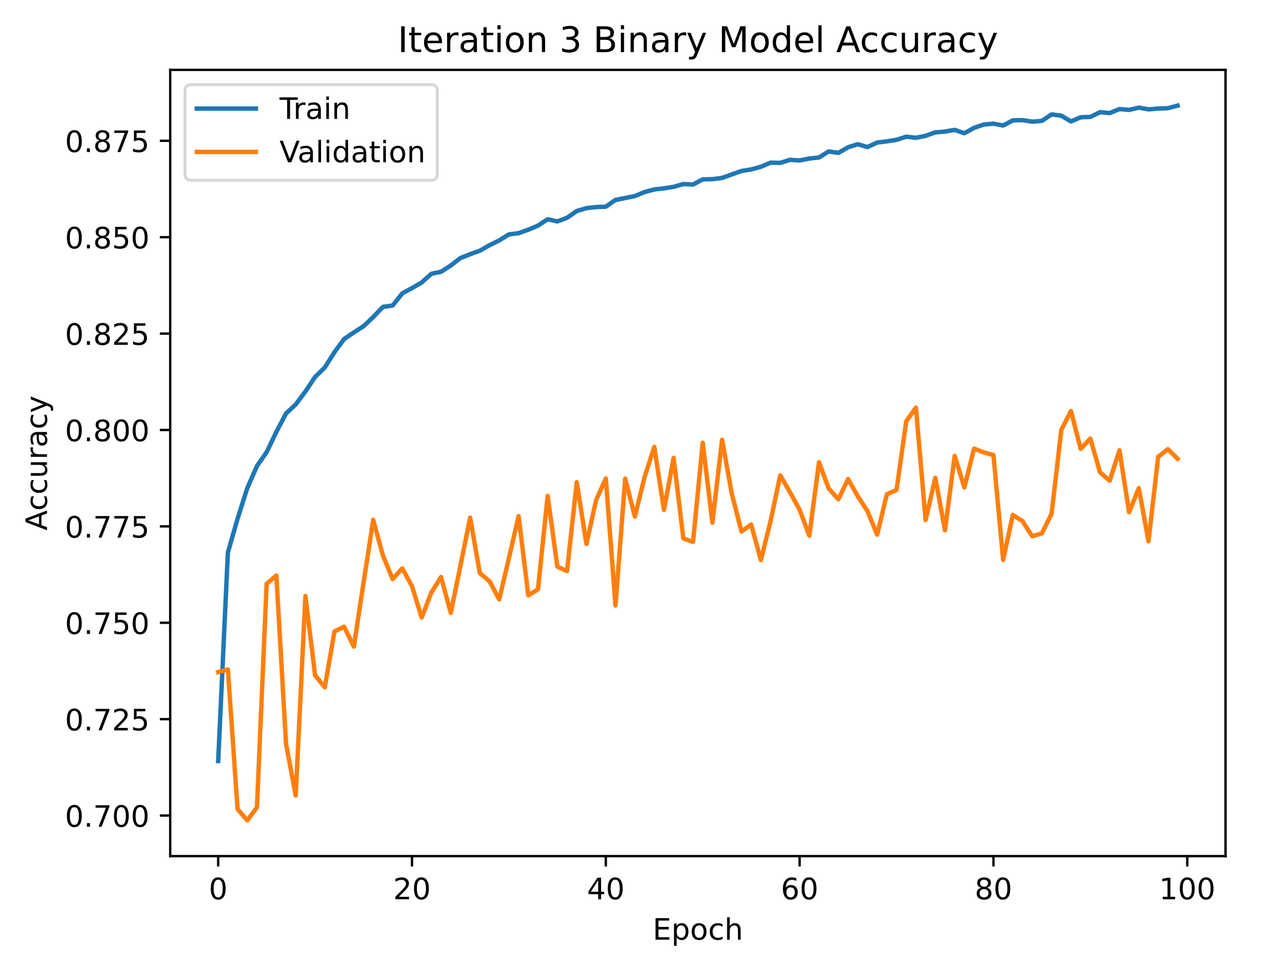
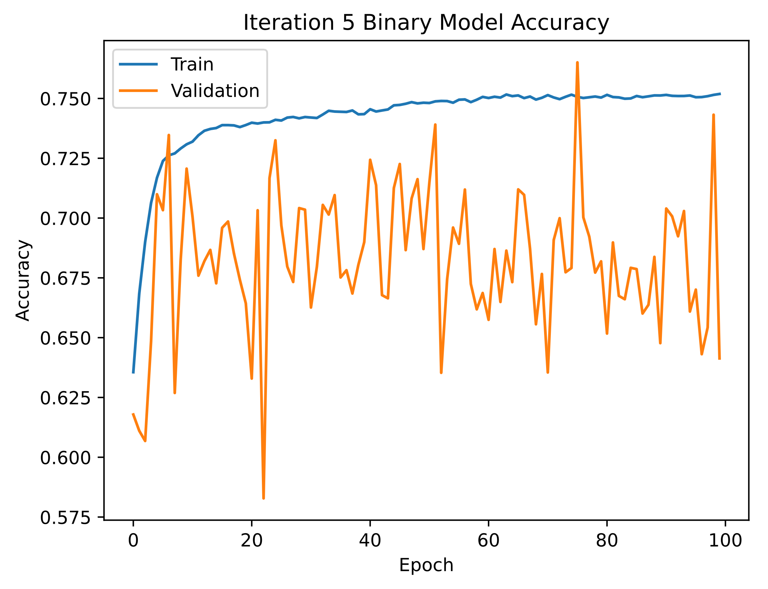
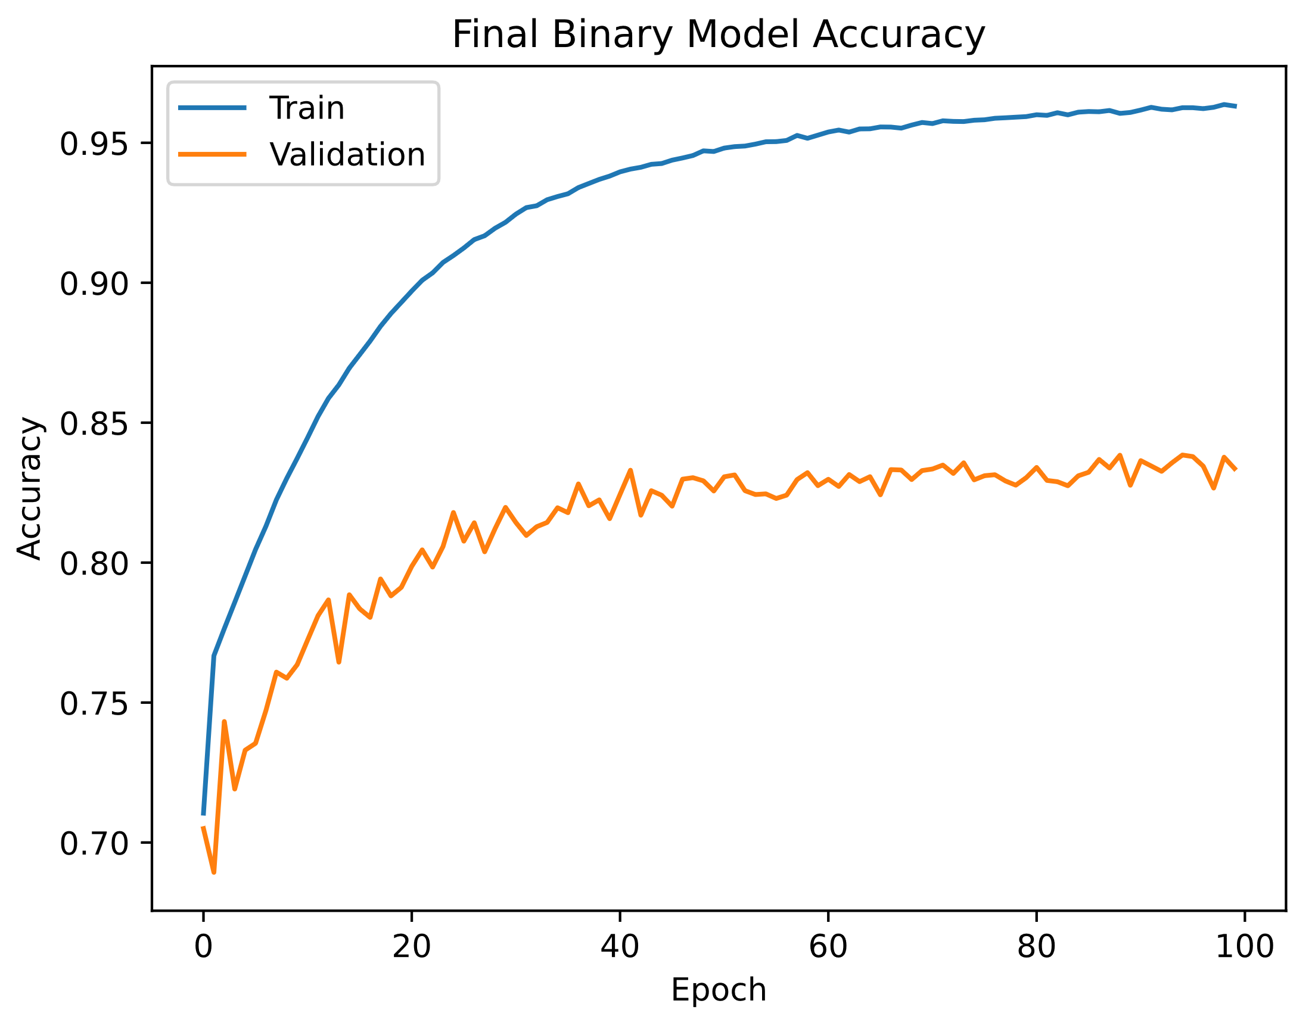
Supervised (Neural Network) Popularity Prediction
Binary Model
60 >= popularity
60 < popularity
Tested different preprocessing
Normalization
StandardScaler
MinMaxScaler
Oversampling to reduce skew
Tested different models
Regularization to reduce overfitting
Hyperparameter tuning

Slide 9
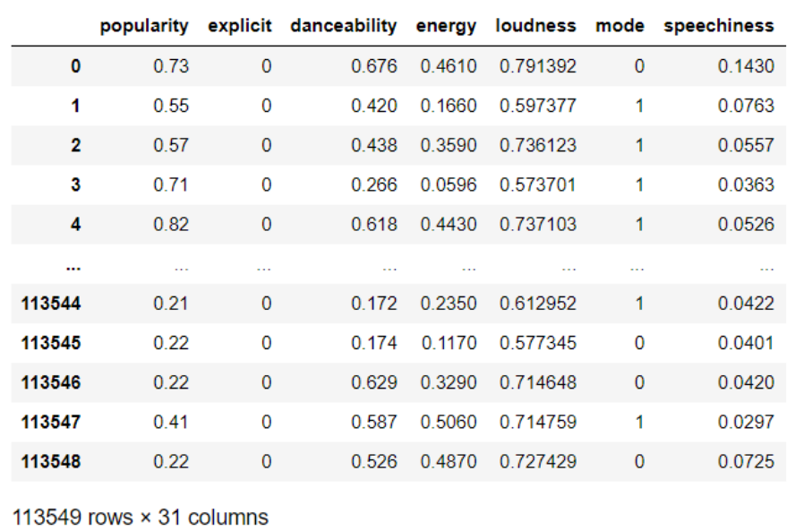
Supervised (Neural Networks)
Genre Prediction
Popularity - 0-1; This is a representation of the song's popularity
Explicit - 0/1;T/F This describes whether the lyrics are explicit
Danceability - 0-1; This describes how suitable a song is for dancing based on factors including tempo, beat strength, and overall regularity
Energy - 0-1; This is a perceptual measure of energy and activity in the song
Loudness - 0-1; This is the overall loudness of the song, in decibels (dB)
Mode - 0 or 1; This describes whether the song is in major or minor key - 0=minor key, 1=major key
Speechiness - 0-1; Measure of how much spoken word is present in a song
30 characteristics
114 genre

Slide 10
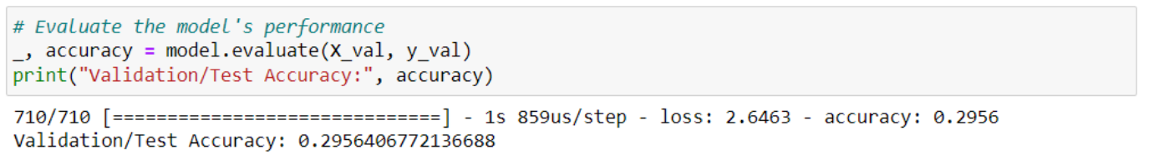
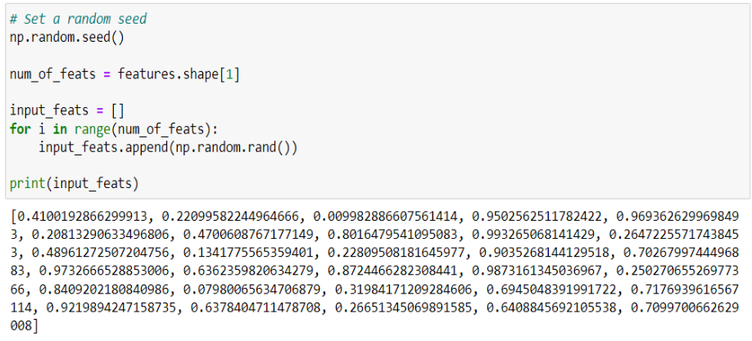
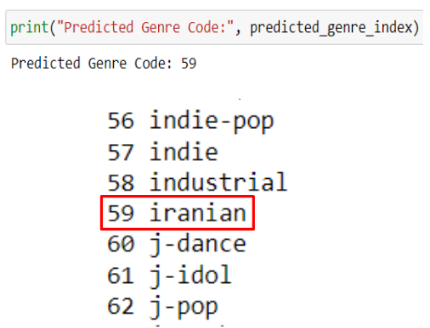
Supervised (Neural Networks)
Genre Prediction

Slide 11
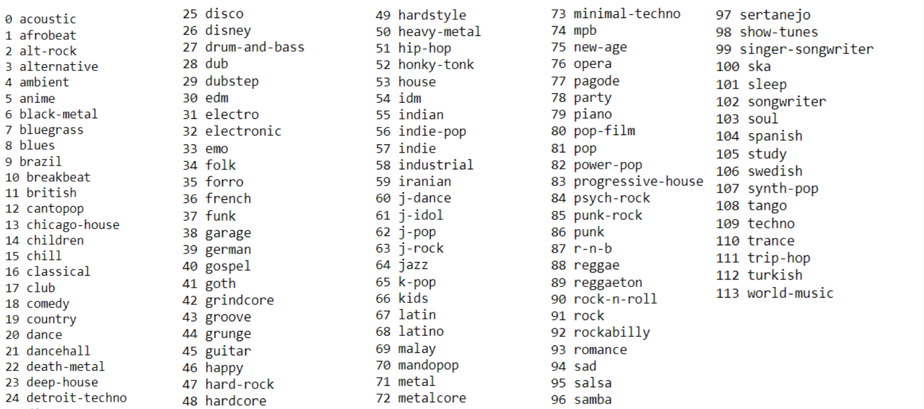
Supervised (Neural Networks)
Genre Prediction

Slide 12
Summary/Conclusion
K-Means Model
95% explained variance ratio
3D version of the K-means clusters for future experiment
Popularity Model
Final accuracy of 83%
Relatively accurate model
Genre Model
Some genres also have overlapping characteristics
Hard for the model to output only one accurate genre code

Slide 13
Thank you
Questions?

