Slide 1
Sentiment Analysis of Bangla Textual Movie Reviews Using Probabilistic Classifier Based on Machine Learning Approach
Presented by
Supervised by
Md. Rony Shaikh Student Id: 20151101013
Dept. of CSE
BSMRSTU
Md. Martuza Ahamad Lecturer
Dept. of CSE
BSMRSTU
S. M. Khalid Hasan Student Id: 20151101010
Dept. of CSE
BSMRSTU
Maloy Kumar Devnath Lecturer
Dept. of CSE
BSMRSTU
1
Notes:
6e28764d-41a8-4466-9355-ce181aad76e0

Slide 2
CONTENTS
Introduction
Motivation
Objectives
Related Works
Methodology
Experiments and Results
Contributions
Limitations
Future Work
Conclusion
Sentiment Analysis of Movie Reviews Using Probabilistic Classifier Based on Machine Learning Approach
2
Notes:
6e28764d-41a8-4466-9355-ce181aad76e0

Slide 3

Introduction
Sentiment Analysis is the task of identifying positive and negative opinions from the text.
o o
Predictive Model
Reviews
Sentiment
Input
Output
Figure-1. Sentiment Analysis process
Sentiment Analysis of Movie Reviews Using Probabilistic Classifier Based on Machine Learning Approach
3
Notes:
6e28764d-41a8-4466-9355-ce181aad76e0

Slide 4
Introduction (Cont’d)
To determine whether the expressed texts in bangla hold a sentiment of positive or negative.
The manual analysis of bangla textual movie reviews is quiet ridiculous and time consuming.
Hence it requires specialized automated system.
Sentiment Analysis of Movie Reviews Using Probabilistic Classifier Based on Machine Learning Approach
4
Notes:
6e28764d-41a8-4466-9355-ce181aad76e0

Slide 5
Motivation
A few works of Sentiment Analysis that is performed in Bangla language
Human can predict a document’s sentiment from high level features
To evaluate the performance of machine learning based Sentiment Analysis models
Opinion mining & to save time
Sentiment Analysis of Movie Reviews Using Probabilistic Classifier Based on Machine Learning Approach
5
Notes:
6e28764d-41a8-4466-9355-ce181aad76e0

Slide 6
Objectives
To provide a classification model that can automatically classify text into positive or negative.
To evaluate the audience feedback in certain movies.
To inform the audience about the film whether they watch the movie or not.
To achieve better accuracy than previous work.
Sentiment Analysis of Movie Reviews Using Probabilistic Classifier Based on Machine Learning Approach
6
Notes:
6e28764d-41a8-4466-9355-ce181aad76e0

Slide 7
Related Works
Reference Paper 1: Nayan Banik et al. [1] Evaluate Naïve Bayes and Support Vector Machines on Bangla Textual Movie Reviews.
Accuracy : The evaluation of their developed system has achieved 86% accuracy by using SVM and 83% accuracy by using Naïve Bayes.
Limitations :
The system considered only Bag-of words approach.
They have used only 800 data samples.
Sentiment Analysis of Movie Reviews Using Probabilistic Classifier Based on Machine Learning Approach
7
Notes:
6e28764d-41a8-4466-9355-ce181aad76e0

Slide 8
Related Works (Cont’d)
Reference Paper 2: Rumman Rashid Chowdhury et al. [2] Analyzing Sentiment of Movie Reviews in Bangla by Applying Machine Learning Techniques.
Accuracy : The evaluation of their developed system has achieved 88.90% accuracy by using SVM and 82.42% accuracy by using Long Short Term Memory (LSTM) classifier.
Limitations :
By using LSTM they achieved low accuracy that can be improved by using deep learning based models with adequate amount of data.
Sentiment Analysis of Movie Reviews Using Probabilistic Classifier Based on Machine Learning Approach
8
Notes:
6e28764d-41a8-4466-9355-ce181aad76e0

Slide 9
Methodology
Data Description
We have manually collected the bangla textual movie reviews from:
Facebook
YouTube
BMDB website
Figure-2. Data description
Figure-3. Description of training & testing data
Sentiment Analysis of Movie Reviews Using Probabilistic Classifier Based on Machine Learning Approach
9
Notes:
6e28764d-41a8-4466-9355-ce181aad76e0

Slide 10
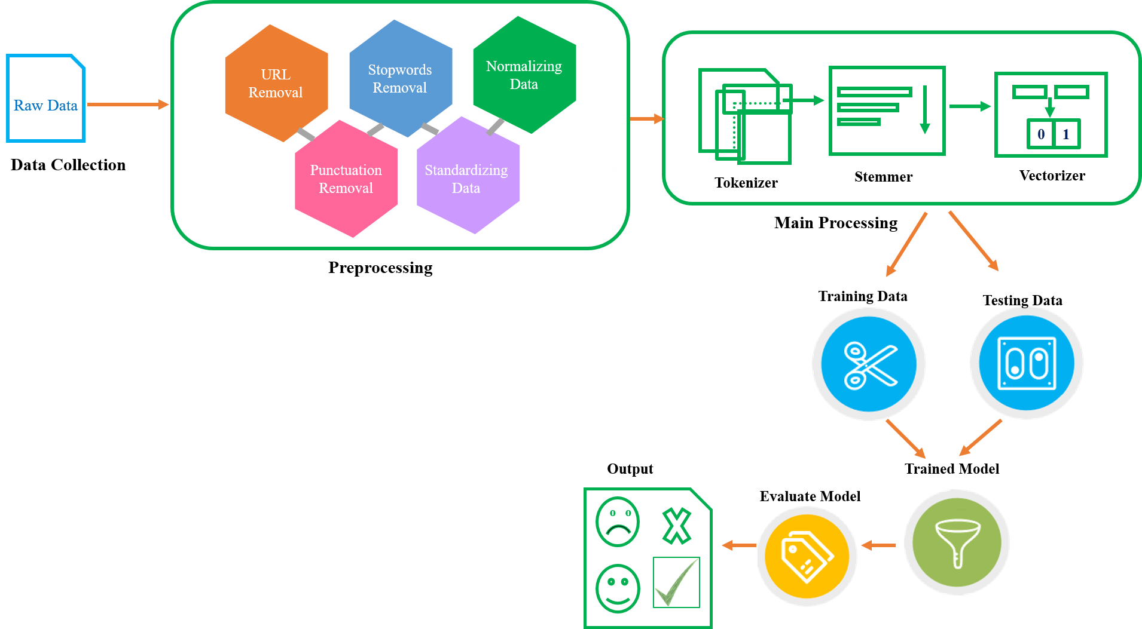
Methodology (Cont’d)
Proposed Model
Figure-4. Sentiment Analysis Evaluation Model
Sentiment Analysis of Movie Reviews Using Probabilistic Classifier Based on Machine Learning Approach
10
Notes:
6e28764d-41a8-4466-9355-ce181aad76e0

Slide 11
Experiments & Results
Used Methods in our experiment:
Decision Tree (DT)
Random Forest (RF)
Naïve Bayes (NB)
Gradient Boosting Machine (GBM)
Artificial Neural Network (ANN)
Sentiment Analysis of Movie Reviews Using Probabilistic Classifier Based on Machine Learning Approach
11
Notes:
6e28764d-41a8-4466-9355-ce181aad76e0

Slide 12
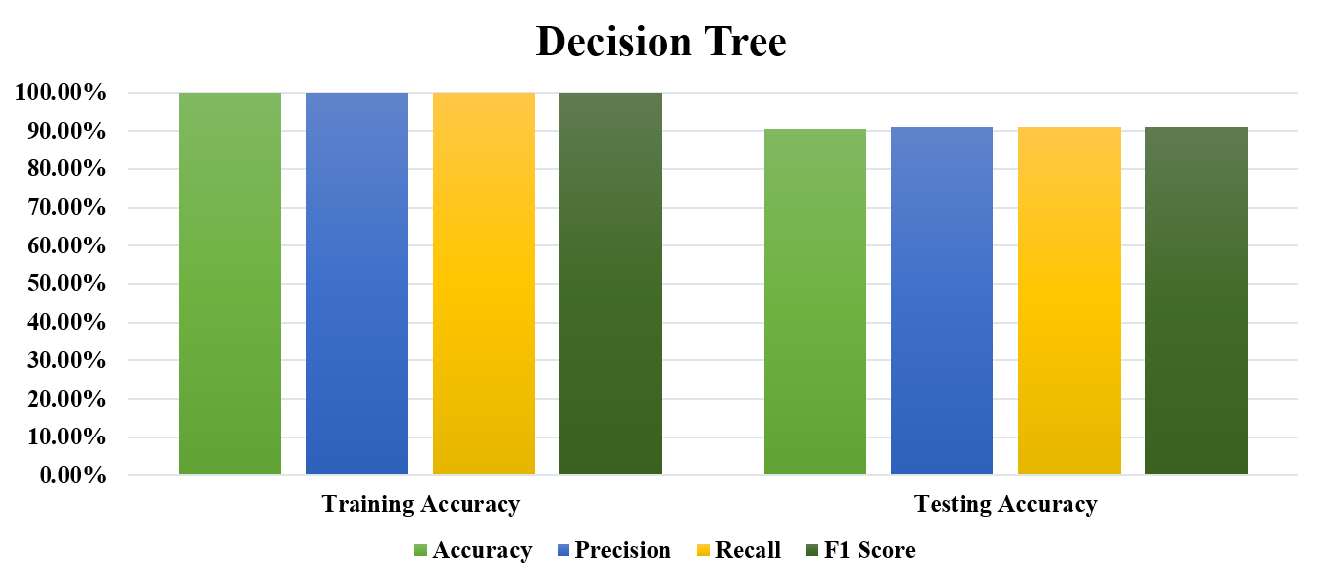
Experiments & Results (Cont’d)
Performance metrics and classification results of the Decision Tree Classifier:
 | Accuracy | Precision | Recall | F1 Score
Training Accuracy | 99.97% | 1.00 | 1.00 | 1.00
Testing Accuracy | 90.46% | 0.90 | 0.90 | 0.90
Table - 1. Performance metrics of the Decision Tree Classifier
Figure-5. Visualization of Classification Report using Decision Tree
Sentiment Analysis of Movie Reviews Using Probabilistic Classifier Based on Machine Learning Approach
12
Notes:
6e28764d-41a8-4466-9355-ce181aad76e0

Slide 13
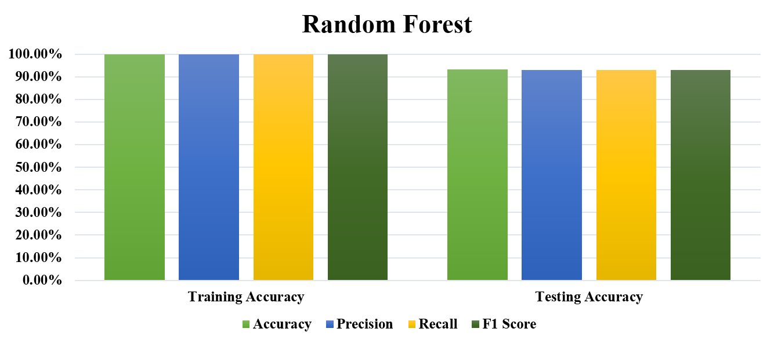
Experiments & Results (Cont’d)
Performance metrics and classification results of the Random Forest:
 | Accuracy | Precision | Recall | F1 Score
Training Accuracy | 99.97% | 1.00 | 1.00 | 1.00
Testing Accuracy | 92.23% | 0.92 | 0.92 | 0.92
Table - 2. Performance metrics of the Random Forest
Figure-6. Visualization of Classification Report using Random Forest
Sentiment Analysis of Movie Reviews Using Probabilistic Classifier Based on Machine Learning Approach
13
Notes:
6e28764d-41a8-4466-9355-ce181aad76e0

Slide 14
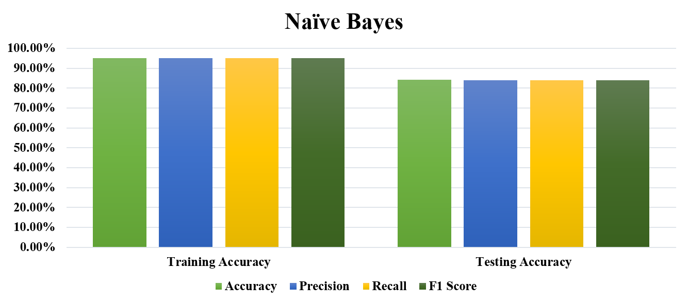
Experiments & Results (Cont’d)
Performance metrics and classification results of the Naïve Bayes:
 | Accuracy | Precision | Recall | F1 Score
Training Accuracy | 94.64% | 0.95 | 0.95 | 0.95
Testing Accuracy | 84.46% | 0.86 | 0.84 | 0.85
Table - 3. Performance metrics of the Naïve Bayes
Figure-7. Visualization of Classification Report using Naïve Bayes
Sentiment Analysis of Movie Reviews Using Probabilistic Classifier Based on Machine Learning Approach
14
Notes:
6e28764d-41a8-4466-9355-ce181aad76e0

Slide 15
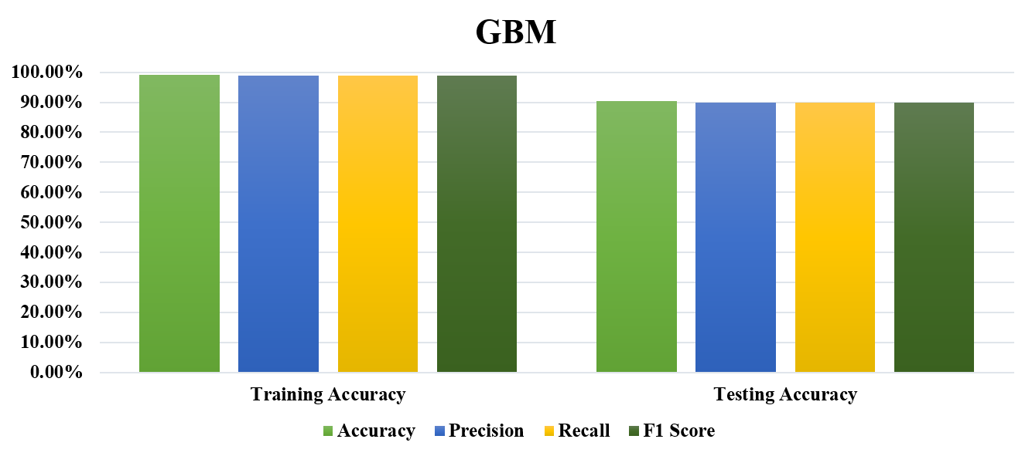
Experiments & Results (Cont’d)
Performance metrics and classification results of the Gradient Boosting Machine:
 | Accuracy | Precision | Recall | F1 Score
Training Accuracy | 98.64% | 0.99 | 0.99 | 0.99
Testing Accuracy | 91.61% | 0.92 | 0.92 | 0.92
Table - 4. Performance metrics of the Gradient Boosting Machine
Figure-8. Visualization of Classification Report using Gradient Boosting Machine
Sentiment Analysis of Movie Reviews Using Probabilistic Classifier Based on Machine Learning Approach
15
Notes:
6e28764d-41a8-4466-9355-ce181aad76e0

Slide 16
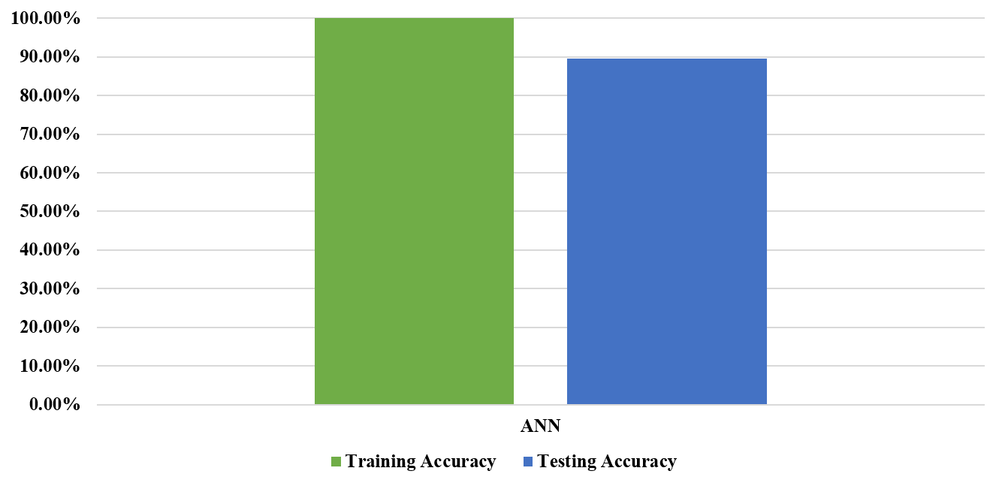
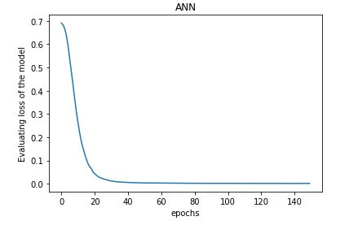
Experiments & Results (Cont’d)
Classification results of the Artificial Neural Network:
 | Training Accuracy | Testing Accuracy
ANN | 99.97% | 91.76%
Table - 5. Classification Results of ANN
Figure-9. Visualization of Classification Report using ANN
Figure-10. Loss of the Model Visualization
Sentiment Analysis of Movie Reviews Using Probabilistic Classifier Based on Machine Learning Approach
16
Notes:
6e28764d-41a8-4466-9355-ce181aad76e0

Slide 17
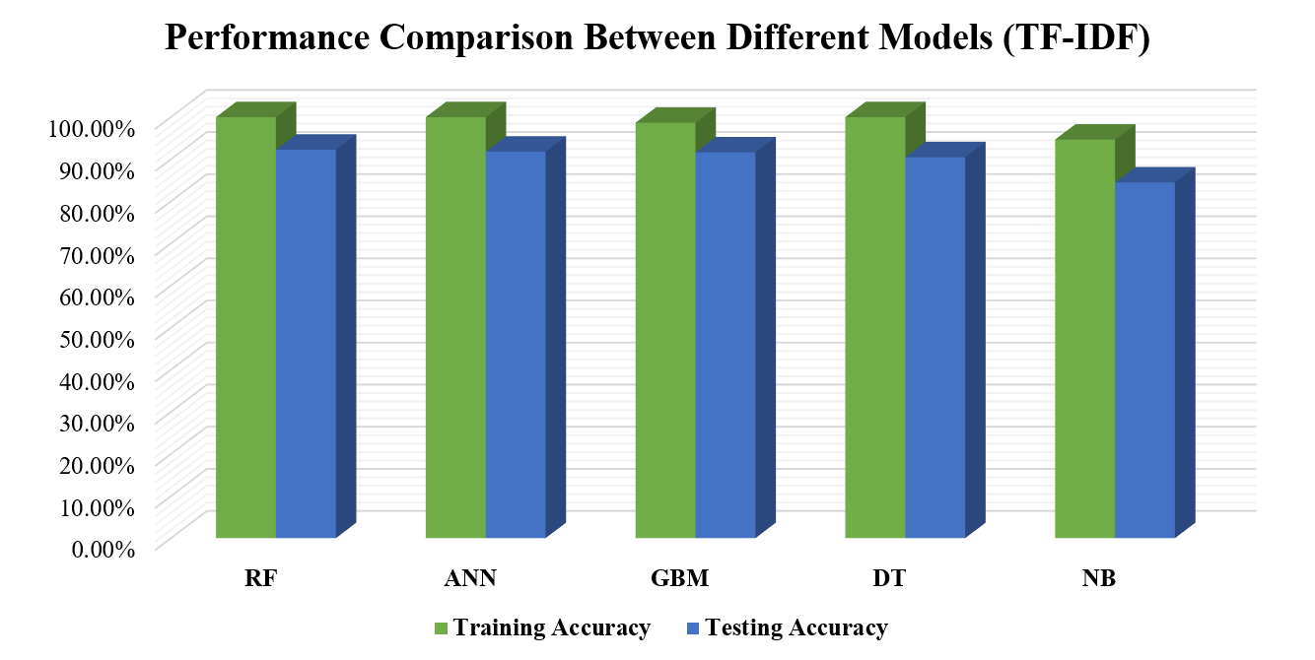
Experiments & Results (Cont’d)
Final Result: accuracy results of the five techniques (DT, RF, NB, GBM and ANN) are shown for training and testing accuracy
Classifier | Training Accuracy | Testing Accuracy
Random Forest | 99.97% | 92.23%
ANN | 99.97% | 91.76%
GBM | 98.64% | 91.61%
Decision Tree | 99.97% | 90.46%
Naïve Bayes | 94.64% | 84.46%
Table – 6. Performance comparison between different models
Figure-11. Visualization of performance comparison among different models
Sentiment Analysis of Movie Reviews Using Probabilistic Classifier Based on Machine Learning Approach
17
Notes:
6e28764d-41a8-4466-9355-ce181aad76e0

Slide 18
Contributions
We specializes in the sentiment analysis of movie reviews in Bangla language.
A deep learning based approach, Artificial Neural Network (ANN) has applied.
Random Forest, Decision Tree and GBM has also applied which is new to this field to analysis Bangla textual movie reviews.
This experiment explores the performance of machine learning models for sentiment analysis.
Sentiment Analysis of Movie Reviews Using Probabilistic Classifier Based on Machine Learning Approach
18
Notes:
6e28764d-41a8-4466-9355-ce181aad76e0

Slide 19
Limitations
The dataset used in this experiment was relatively small and less complex and linearly separable.
The experimented system is unable to detect the sentiment of some complex bangla sentences that contains both positive and negative sentiment at a time.
The Deep Learning based models have the potential to improve the current levels of performance if adequate amount of data can be provided.
Sentiment Analysis of Movie Reviews Using Probabilistic Classifier Based on Machine Learning Approach
19
Notes:
6e28764d-41a8-4466-9355-ce181aad76e0

Slide 20
Future Work
An abstractive method can be applied to detect the sentiment of some complex bangla sentences that contains both positive and negative sentiment at a time.
Semantic analysis of large data is required in this domain to explore better linguistic knowledge for sentiment extraction.
Sentiment Analysis of Movie Reviews Using Probabilistic Classifier Based on Machine Learning Approach
20
Notes:
6e28764d-41a8-4466-9355-ce181aad76e0

Slide 21
Conclusion
The experimented method used DT, RF, NB, GBM and ANN.
Random Forest perform better than the left four models.
Comparing with the previous work, the experimented method has achieved better accuracy.
This study will help the movie lovers to select the quality movies to watch as their entertainment.
Sentiment Analysis of Movie Reviews Using Probabilistic Classifier Based on Machine Learning Approach
21
Notes:
6e28764d-41a8-4466-9355-ce181aad76e0

Slide 22
References
[1] Banik, N., & Rahman, M. H. H. (2018). Evaluation of Naïve Bayes and Support Vector Machines on Bangla Textual Movie Reviews. 2018 International Conference on Bangla Speech and Language Processing (ICBSLP). doi: 10.1109/icbslp.2018.8554497.
[2] Chowdhury, R. R., Hossain, M. S., Andersson, K., & Hossain, S. (2019). Analyzing Sentiment of Movie Reviews in Bangla by Applying Machine Learning Techniques. 2019 International Conference on Bangla Speech and Language Processing (ICBSLP). doi: 10.1109/iciev.2019.8858545.
[3] Jagdale, R. S., Shirsat, V. S., & Deshmukh, S. N. (2018). Sentiment Analysis on Product Reviews Using Machine Learning Techniques. Cognitive Informatics and Soft Computing Advances in Intelligent Systems and Computing, 639–647. doi: 10.1007/978-981-13-0617-4_61
[4] Pang, B., & Lee, L. (2008). Opinion Mining and Sentiment Analysis. Foundations and Trends® in Information Retrieval, 2(1–2), 1–135. doi: 10.1561/1500000011
[5] Augustyniak, L., Kajdanowicz, T., Kazienko, P., Kulisiewicz, M., & Tuliglowicz, W. (2014). An Approach to Sentiment Analysis of Movie Reviews: Lexicon Based vs. Classification. Lecture Notes in Computer Science Hybrid Artificial Intelligence Systems, 168–178. doi: 10.1007/978-3-319-07617-1_15
Sentiment Analysis of Movie Reviews Using Probabilistic Classifier Based on Machine Learning Approach
22
Notes:
6e28764d-41a8-4466-9355-ce181aad76e0

Slide 23
Thank You
Notes:
6e28764d-41a8-4466-9355-ce181aad76e0

