Slide 1

2301648 Architecture of Deep learning

Slide 2
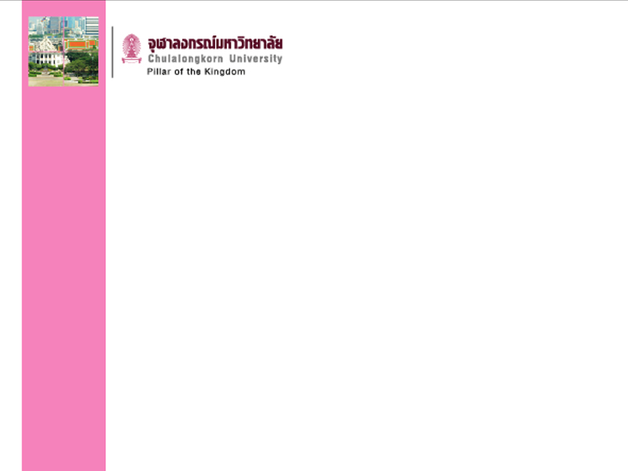
Outline
Big data
AI-ML-DL
History of DL
DL model
Topics

Slide 3
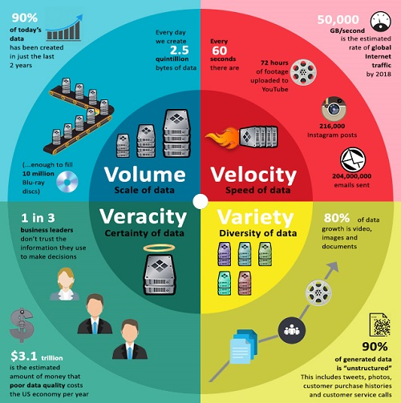
Big Data 4V
https://www.crewmachine.com/how-ai-and-machine-learning-changing-digital-landscape/

Slide 4
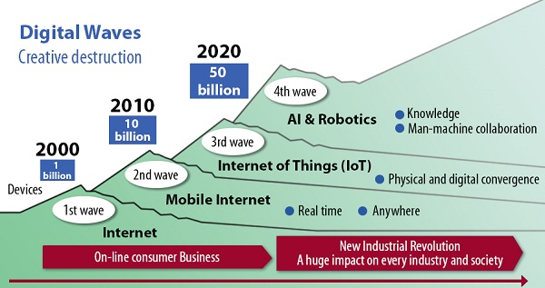
Digital Waves
https://www.crewmachine.com/how-ai-and-machine-learning-changing-digital-landscape/

Slide 5
AI → ML → DL
Artificial Intelligence (1950s) – Giving intelligence to machine
Machine Learning (1980s) – realizing artificial intelligence (speech recognition, image recognition, playing go, dialogue)
Deep Learning (2006) – for machine learning for higher prediction accuracy
  A powerful class of machine learning model
  Modern reincarnation of artificial neural network
  Collection of simple, trainable mathematical functions

Slide 6
History of DL
1958: Rosenblatt’s Perceptron algorithm
1969: Minksky showed Perceptron could not solve the XOR problem, connectedness, parity.
1986: Rumelhart developed Backpropagtion algorithm to train neural network
Mid 90’s: Cortes and Vapnik published paper on Support Vector Machines
2006: Hinton and Salakhutdinov proposed using Restricted Blotzmann Machine for pre-train Deep Neural Network
2007: Fei-Fei Li’s ImageNet assembling a databse of 14 million labled images (Data drives learning)

Slide 7
History of DL
2011: Microsoft explored Speech recognition and IBM’s Watson
2014: Google acquired DeepMind, combing deep learning and reinforcement learning
2016: DeepMind’s AlphaGo defeated world champion Lee Sedol

Slide 8
DL Application
Google: 2011 launched deep-learning focused project. 2014 bought DeepMind with AlphaGo.
Microsoft: strong in speech-recognition and translation
Facebook: translate user posts in more than 40 languages
Baidu: for speech recognition, translation, photo search and self-driving car project

Slide 9
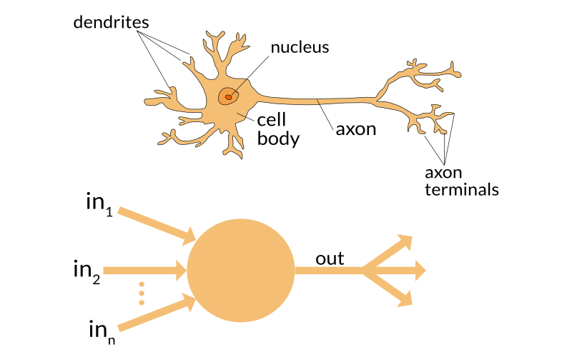
DL model
Perceptron: Axons send signals to other cells while dendrites receive them.

Slide 10
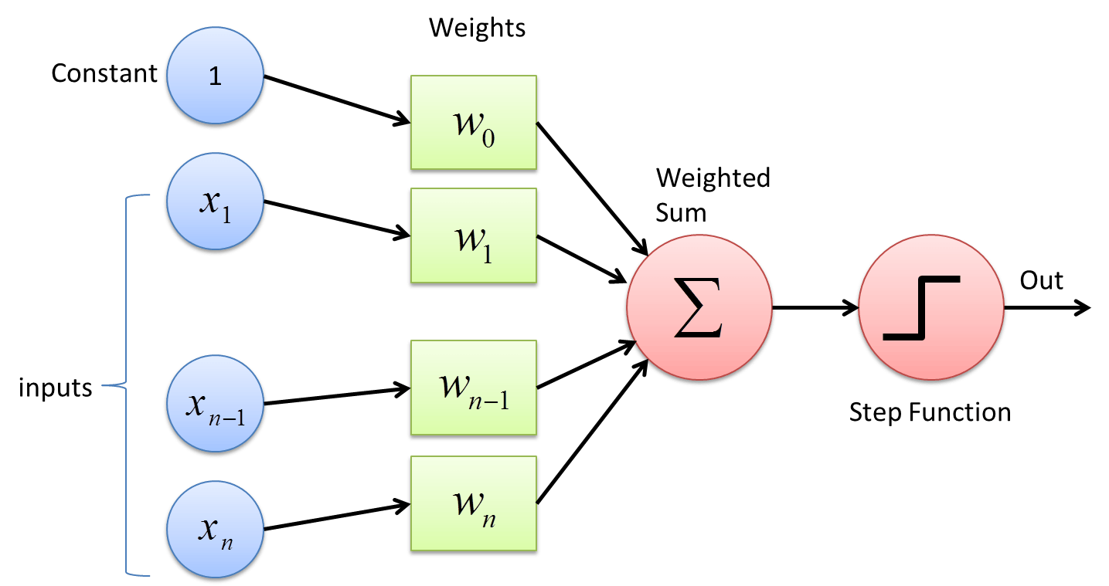
Neural network
Weights are the important elements in neural network model.

Slide 11
ML vs. DL
Rules Based System
Input
Hand designed
Program
Output
Classic Machine Learning
Input
Hand designed
Features
Map from
Features
Output
Deep Learning
Input
Sample
Features
Layers of abstract features
Map from
Features
Output

Slide 12
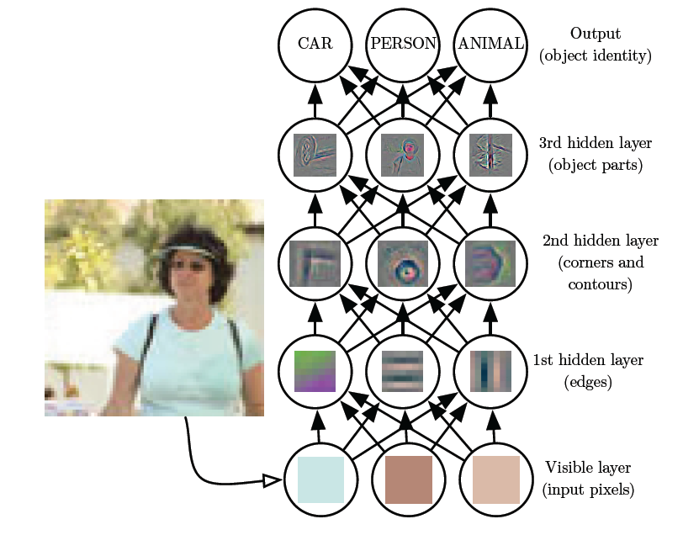
DL model

Slide 13
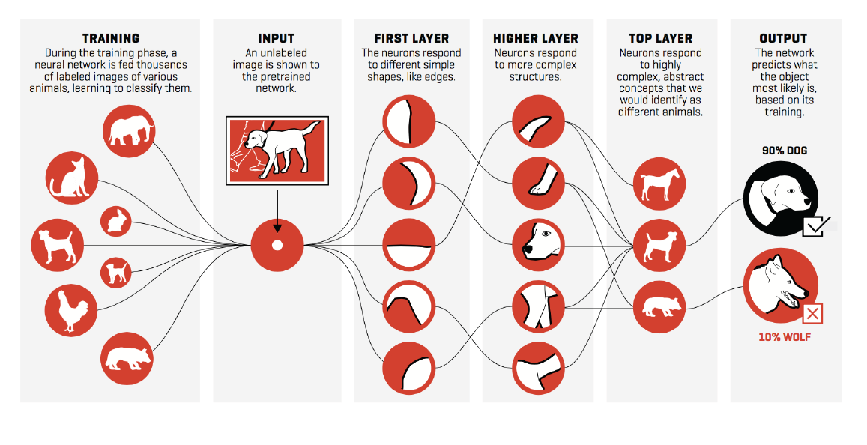
DL model

Slide 14
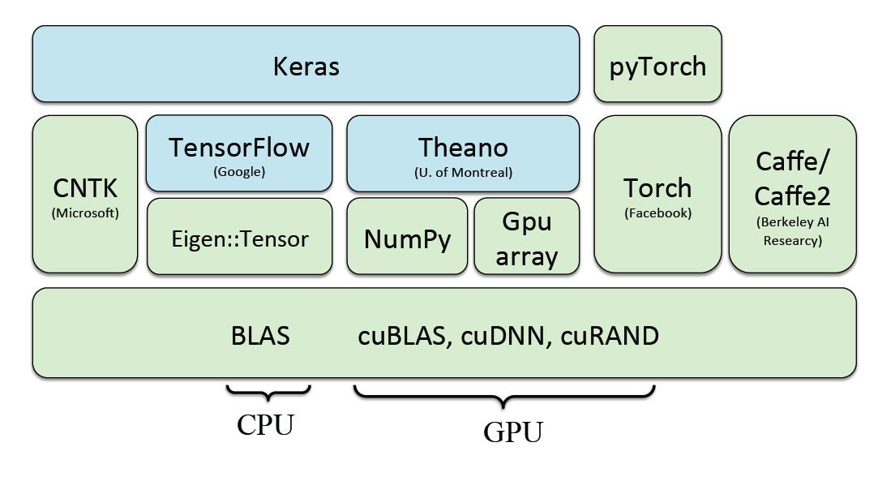
DL software

Slide 15
Topics
Introduction to deep learning
Background: Ndarray, linear algebra, probability, automatic differentiation
Implementation of a linear regression and a logistic regression
Softmax regression and regularization
Perceptron and multilayer perceptron
Convolutional neural network
Architecture of CNNs:Alexnet, VGG
Recurrent neural network
Nonlinear optimization
Gradient descent and stochastic gradient descent

Slide 16
Register 2301648
Contact me
Assoc. Prof. Krung Sinapiromsaran
MHVH 1208/6
254 Phayathai Road, Pathumwan,
Bangkok Thailand. 10330
https://math.sc.chula.ac.th/faculty/krung-s/
Email:Krung.S@chula.ac.th
Phone:02-218-7123

