Slide 1
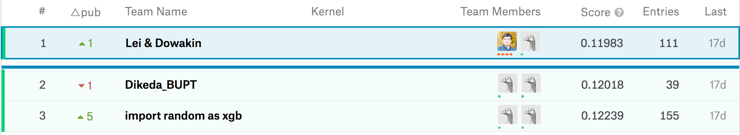
First place solution
iMaterialist Challenge (Furniture) at FGVC5

Slide 2
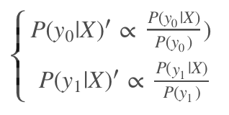

Solution
Finetuning models pretrained on ImageNet
SeNet 154
Densenet 161 + 201
Dpn 92
12 Test Time Augmentation
Probability calibration
Geometric Mean
Inception v4
5 crops + original
*
No Flip + Horizontal flip
Inception Resnet v2
Xception
ResneXt
SE Resnet 101 + 152
https://github.com/skrypka/imaterialist-furniture-2018
NasNet
Notes:
Pipeline:
Finetuning 11 models pretrained on ImageNet
Get 12 predictions from every model (5 crops + original) * (horizontal flip + no flip)
Geometric mean of all 11 models * 12 TTA predictions
Probability calibration
Argmax to predict one class

Slide 3
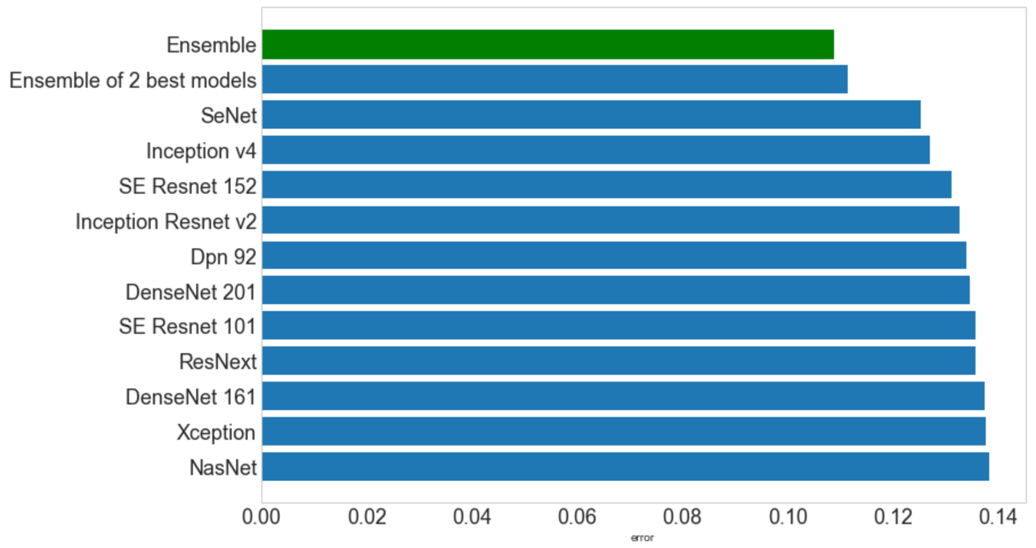
Effectiveness of diverse models
Notes:
Score individual models versus geometric mean of all of them on validation set

Slide 4
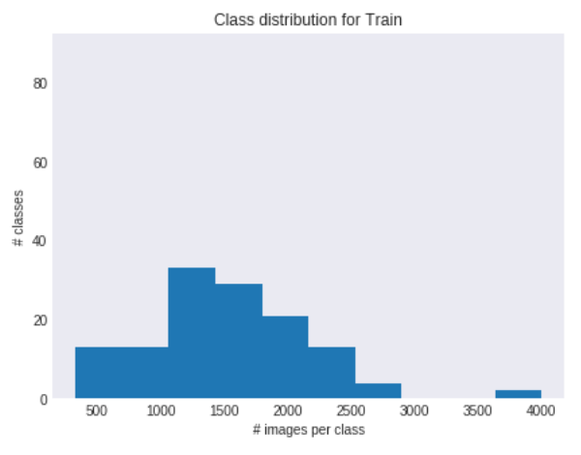
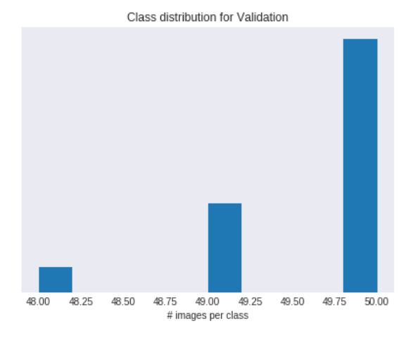
Probability calibration
In train dataset some classes has 4,000 images and some only 500
Test dataset is balanced
In theory we could:
Oversample / undersample
Set some weights to loss function
But it was hard to balance underfitting for overrepresentation classes and overfitting to underrepresentation
Instead in training we ignored the problem. And after calibrated probability.

Slide 5
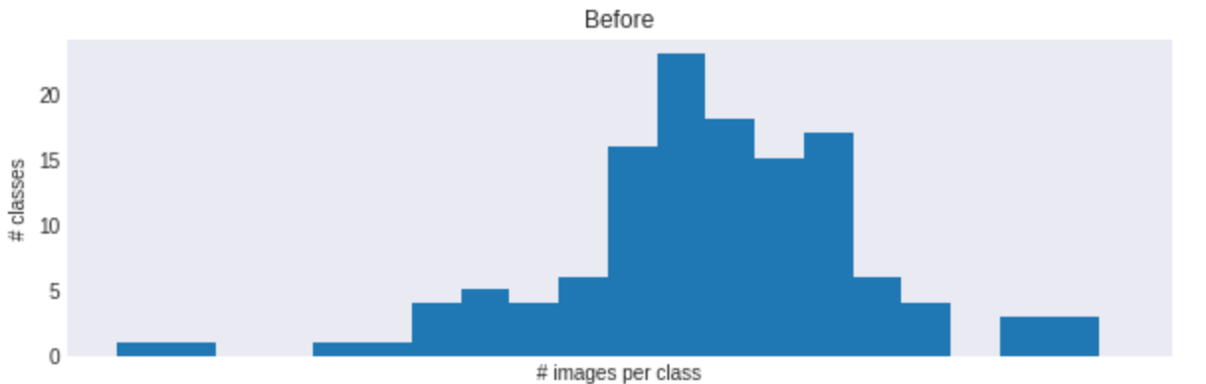
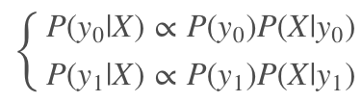
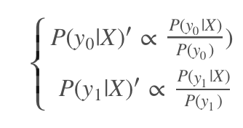
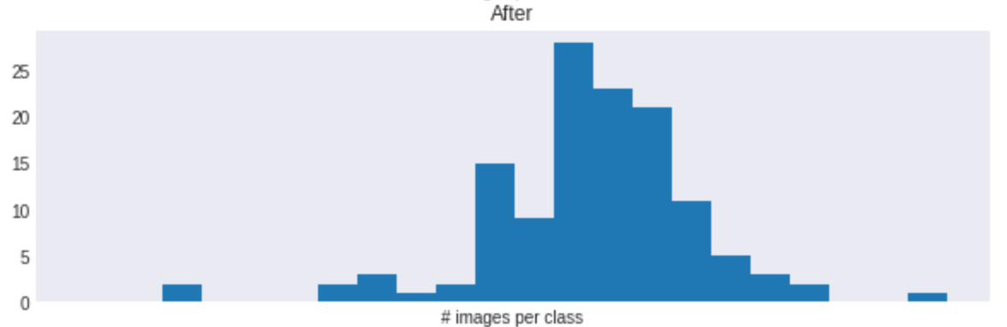
Probability calibration
Prediction from model P(y0|X) has information about class distribution in train P(y0)).
For balanced test we need to remove the prior by dividing by class proportion in train dataset
Notebooks with details https://www.kaggle.com/dowakin/probability-calibration-0-005-to-lb

Slide 6
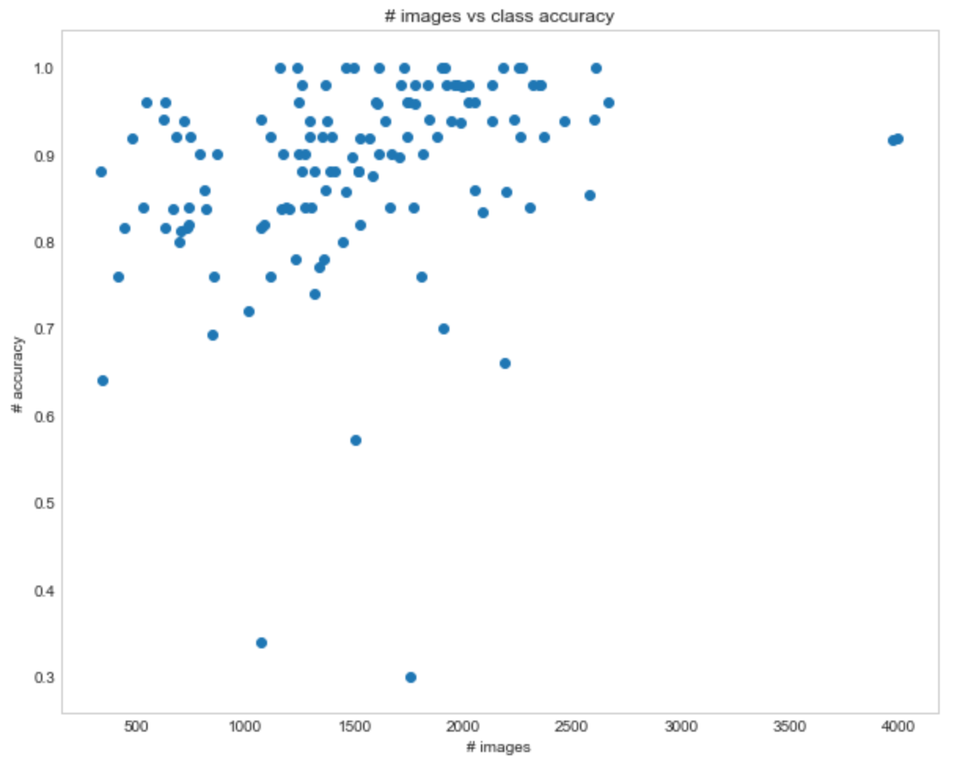
Why accuracy is only 90%?!?
label 4
label 15
label 63
Notes:
Despite a lot of models we only got about 90% accuracy. And it has obvious some correlation with number of images per class. But also we can see high variance here.
Also some labels has extremely low accuracy - like label 15, 63, 4.
From confusion matrix it’s hard to distinguish labels 4, 15, 63 and a few others.

Slide 7
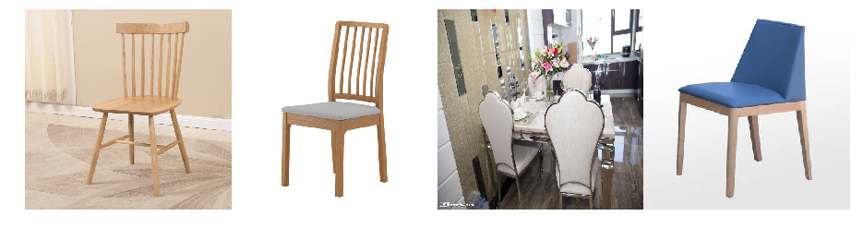
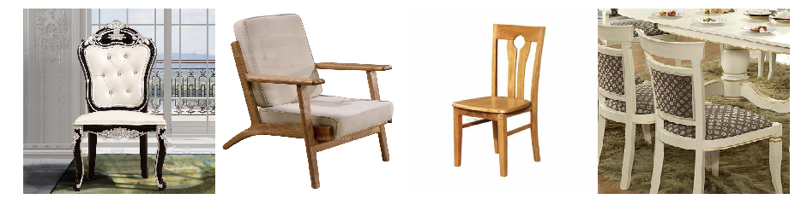
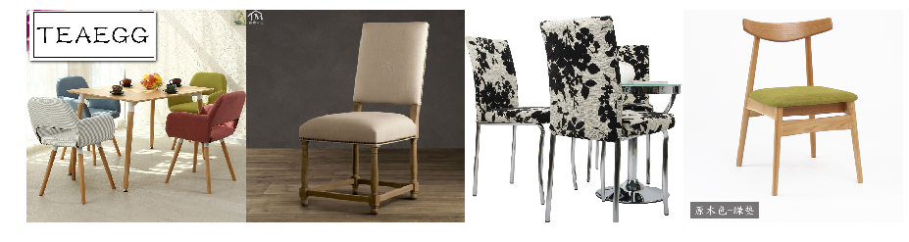
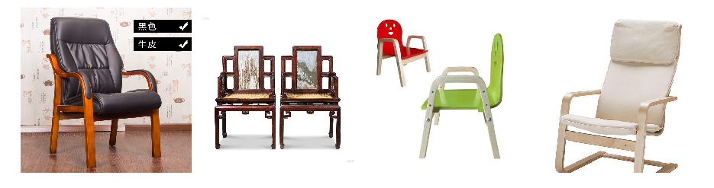
Why accuracy is only 90%?!? - CHAIRS!
Class 63
Class 15
VS.
Class 29
Class 4
Notes:
All of the most confused classes are about chairs. We don’t know labels, but I’d guess it’s like ‘office chair’, ‘kitchen chair’, ‘fancy chair’, ‘restoran chair’ - and it’s extremely hard to label and later predict correct class.

