Slide 1
DEEP LEARNING TO CLASSIFY RECEIPTS
DATASCIENCE PROGRAMMING PROJECT
UNIVERSITY OF SOUTH FLORIDA
NOVEMBER 2019
Srikrishna Krishnarao Srinivasan
Indra Reddy Gayam
Jashwant Gottipati

Slide 2
PROJECT DESCRIPTION
Receipts are used to document, for example business expenses
Some exceptions such as Alcohol spend are manually identified
Our project uses Deep Learning technique to classify receipts
We have taken the case of MILK vs No-MILK receipts
In the future, this can be extended to other categories like Alcohol

Slide 3
PROJECT APPROACH
Deep Learning
Future Work Identification
Dataset Identification
Data Pre- processing
Receipts of Publix and Walmart
Receipts with Milk and without Milk
Real receipts gathered and photographed
Online receipts downloaded
Crop receipts from background noise
Identify Bounding boxes
Augment receipts from 50 to 2000 artificially
Train a Deep Learning Neural Network
Address the problems of Overfit
Evaluate the model
Improve the accuracy by applying hyper-parameters tuning
Identify the solutions to further improve the model

Slide 4
CHALLENGES FACED AND LEARNINGS
Extracting Text from Receipt is comparatively easier
OpenCV + OCR(Tesseract)
Training a model to learn the presence of a text is far more challenging
Deep Neural Nets requirement of large amount of data (10,000+)
Text size, font, position, orientation, fading in receipts
Format of text different in each brand receipt

Slide 5
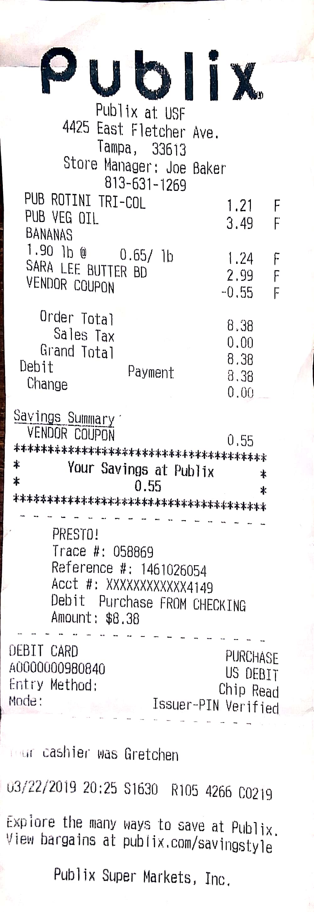
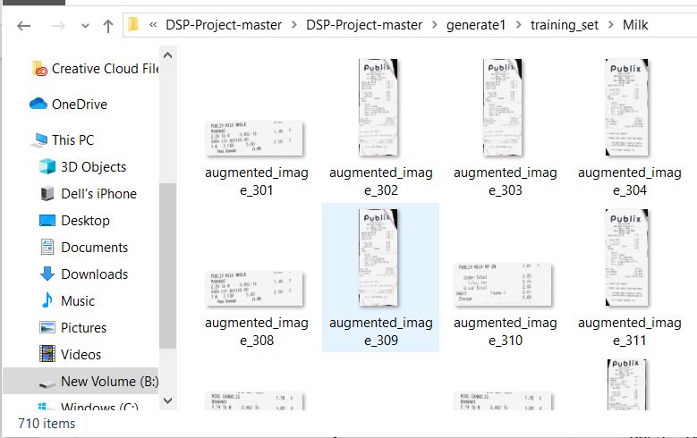
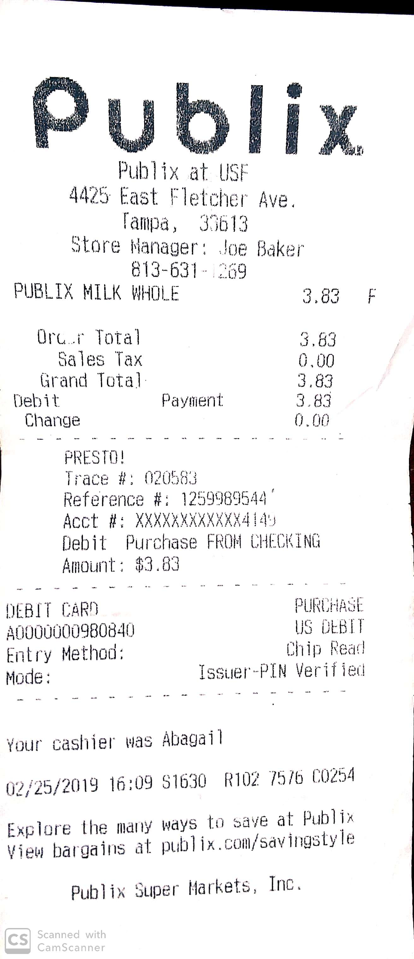
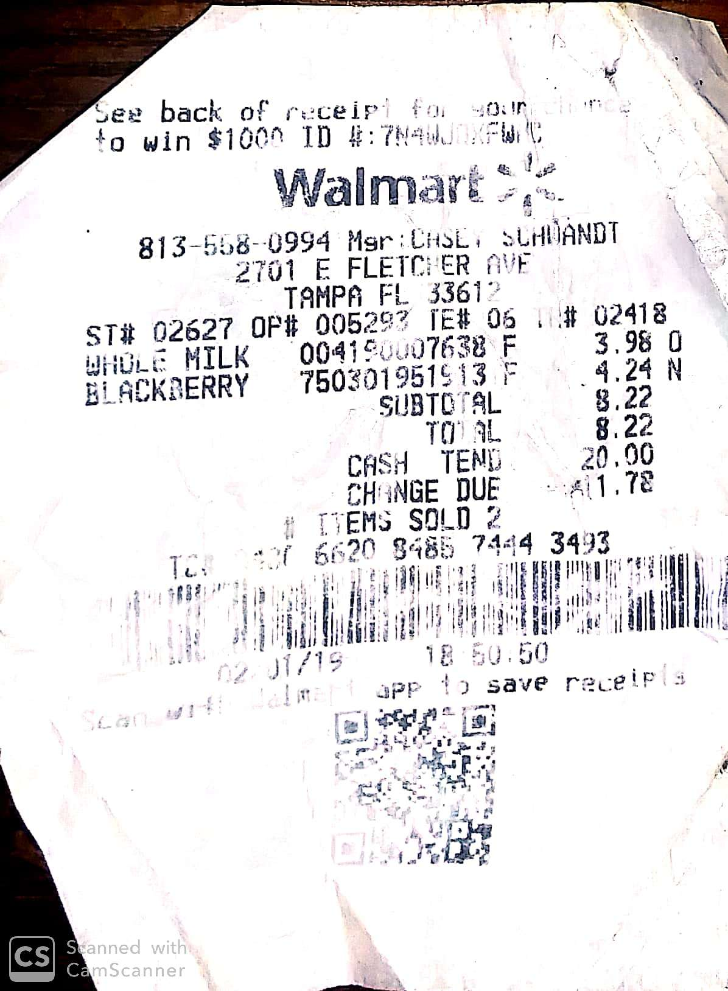
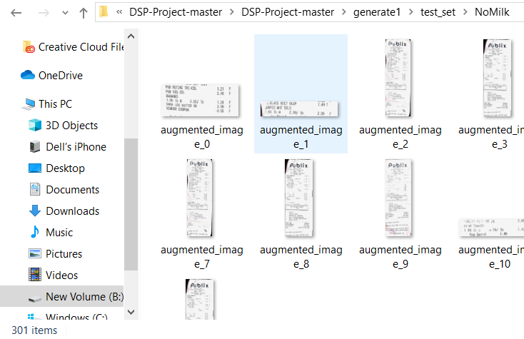
RECEIPTS SAMPLES

Slide 6
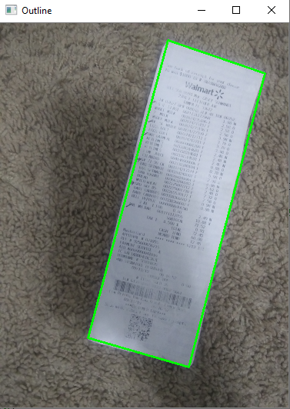
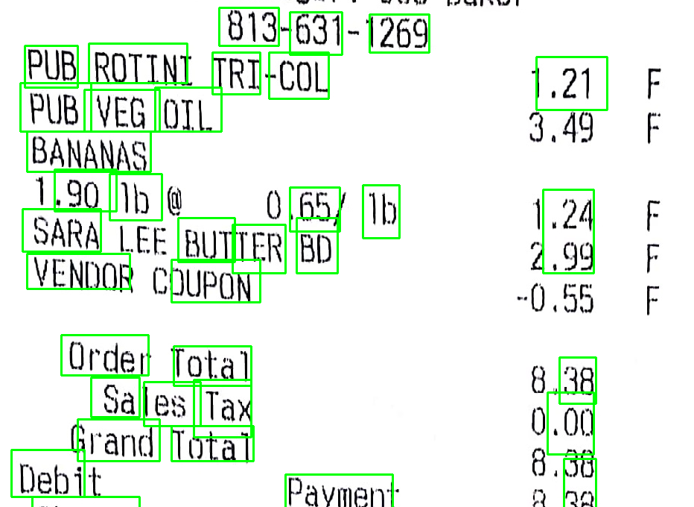
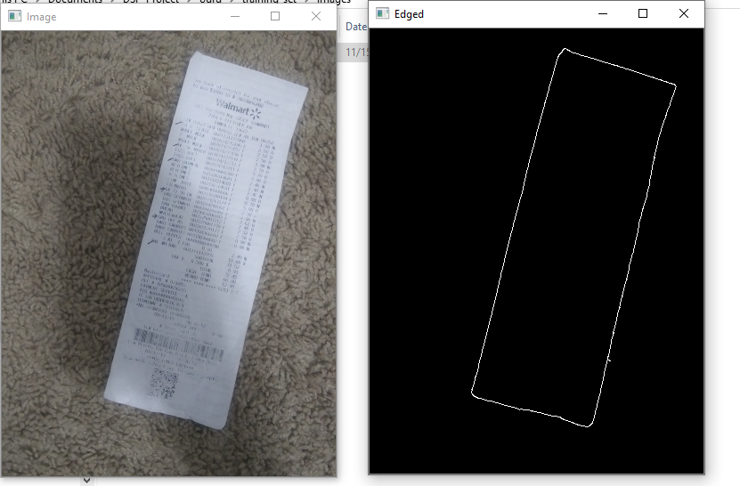
RECEIPTS PREPROCESSING

Slide 7
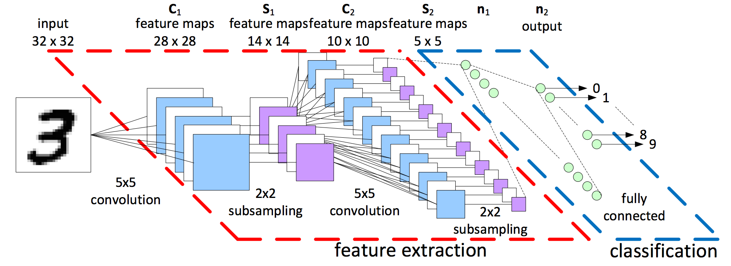
DEEP LEARNING
ARCHITECTURE
CNN design begins with feature extraction and finishes with classification
Feature extraction is performed by alternating convolution layers with subsampling layers
Classification is performed with dense layers followed by a final softmax layer
For image classification, this architecture performs better than feed forward neural network

Slide 8
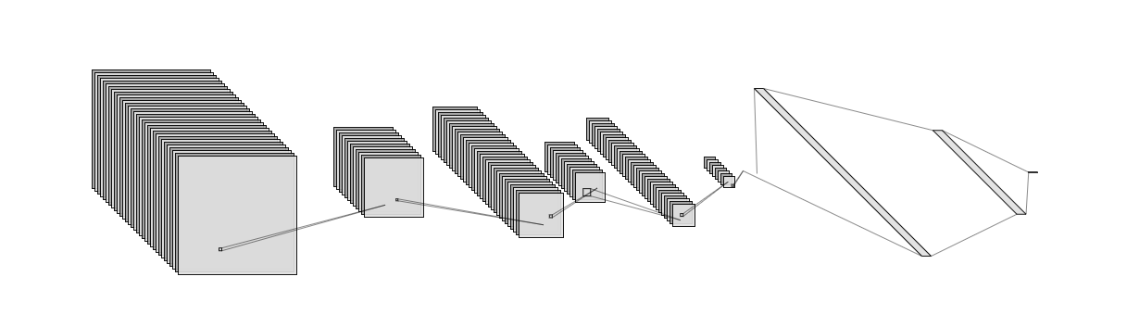
DEEP LEARNING
ARCHITECTURE
OUR MODEL
# Step 1 - Convolution
classifier.add(Conv2D(32, (3, 3), input_shape = (128, 128, 3), activation = 'relu’))
#32 Feature maps (slabs), 3x3 convolution, 128x128 image input size
# Step 2 - Pooling
classifier.add(MaxPooling2D(pool_size = (2, 2)))
# Step 3 - convolutional layer
classifier.add(Conv2D(32, (3, 3), activation = 'relu'))
# Step 4 - Pooling
classifier.add(MaxPooling2D(pool_size = (2, 2)))
# Step 5 - convolutional layer
classifier.add(Conv2D(32, (3, 3), activation = 'relu'))
classifier.add(MaxPooling2D(pool_size = (2, 2)))
# Step 6 - Flattening
classifier.add(Flatten())
# Step 7 - Full connection
classifier.add(Dense(units = 128, activation = 'relu’))
#Step 8 – Dense layer
classifier.add(Dense(units = 1, activation = 'sigmoid’))
#classifier.add(Dense(units = 128, activation = 'elu'))
#classifier.add(Dense(units = 1, activation = 'softmax’))
Compilation of Classifier
opt=tf.keras.optimizers.Adam(lr=0.001)
classifier.compile(optimizer = opt, loss = 'binary_crossentropy', metrics = ['accuracy'])

Slide 9
PYTHON NOTEBOOK

Slide 10
FUTURE WORK
1. Use the techniques discussed in this paper to improve the accuracy of the machine learning
Focus Enhanced Scene Text Recognition with Deformable Convolutional Neural Network https://arxiv.org/pdf/1908.10998v2.pdf
2. Use the bounding boxes and feed into CNN to focus learn the text in bounding boxes
THANK YOU

