Slide 1


Baldrige Data
Analysis of Work Focus Category
Criteria Evaluation
Reconciling Criteria Over Time

Slide 2
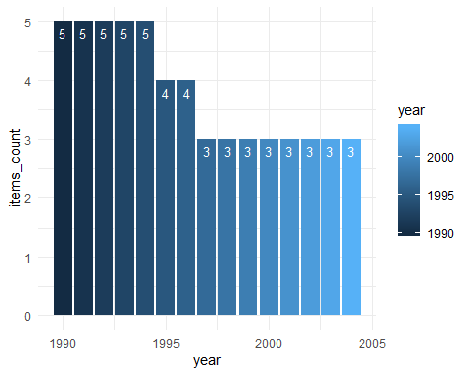
Baldrige Categories
The number of items in Workforce Focus category by year
Leadership
Strategic Planning
Customer Focus
Measurement Information and Analysis
Workforce Focus

Slide 3
Workforce Focus Over Years
Number | 1990 | 1995 | 1997 | 2003
1 | Human Resource Management | Human Resource Planning and Evaluation | Work Systems | Work Systems
2 | Employee Involvement | High performance work systems | Employee Education, Training and Development | Employee Learning and Motivation
3 | Quality Education and Training | Employee Education Training and Development | Employee Well Being and Satisfaction | Employee Well Being and Satisfaction
4 | Employee Recognition and Performance Measurement | Employee Well being and Satisfaction | dropped | dropped
5 | Employee Well-being and morale | dropped | dropped | dropped

Slide 4
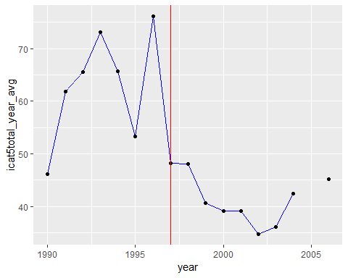
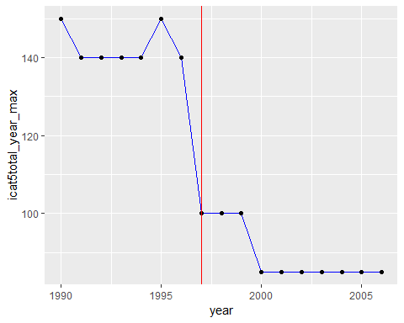
icat5total average and icat5max over years

Slide 5
Hypothesis: The Scoring for Category 5 Workforce Focus was easier after 1997
lm(formula = icat5total ~ year_before_1997, data = df)
Residuals: Min 1Q Median 3Q Max -53.272 -11.062 0.833 12.530 62.728 Coefficients: Estimate Std. Error t value Pr(>|t|) (Intercept) 41.0621 0.9045 45.40 <2e-16 *** year_before_19971 19.2100 1.2247 15.69 <2e-16 ***
Residual standard error: 20.21 on 1096 degrees of freedom Multiple R-squared: 0.1833,
Adjusted R-squared: 0.1826 F-statistic: 246.1 on 1 and 1096 DF
p-value: < 2.2e-16
lm(formula = icat5total ~ year_before_1997 + I(icat5total - icat5max), data = df)
Residuals: Min 1Q Median 3Q Max -40.577 -2.117 -0.590 2.932 16.551 Coefficients: Estimate Std. Error t value Pr(>|t|) (Intercept) 81.00751 0.56206 144.12 <2e-16 *** year_before_19971 49.00437 0.55544 88.23 <2e-16 *** I(icat5total - icat5max) 0.87271 0.01006 86.77 <2e-16 *** Residual standard error: 7.203 on 1095 degrees of freedom Multiple R-squared: 0.8963
Adjusted R-squared: 0.8961 F-statistic: 4732 on 2 and 1095 DF,
p-value: < 2.2e-16
Hypothesis Conclusion: Due to Significant p-values, it is true that it was easier to score after 1997, even after adjusting for max value

