Slide 1
⚡ MOHARIAR ⚡
RI Online Collection Automation System
Designed by: SUSHANT

Slide 2
What is MOHARIAR?
🎯 PURPOSE
Automates bulk processing of land revenue collection entries
on Odisha Land Revenue Portal
✅ KEY BENEFITS
• Process 100+ khatas without manual intervention
• Auto-save PDFs with organized folder structure
• Handle multiple villages simultaneously
• Real-time progress tracking with color-coded statistics
• 95%+ success rate with smart retry mechanism
⏱️ TIME SAVINGS
• Manual: 3-5 minutes per khata
• MOHARIAR: 8-12 seconds per khata
• Result: 20x FASTER!

Slide 3
System Requirements
💻 SOFTWARE REQUIREMENTS
• Windows 7 / 10 / 11
• Google Chrome Browser (latest version)
• Odisha Land Revenue Portal credentials
• Stable internet connection
📦 WHAT'S INCLUDED
• MOHARIAR.exe (standalone executable - no Python needed)
• This User Guide (PDF format)
• Welcome & Completion sound notifications
• Excel template for bulk upload
• Auto-organized PDF session folders

Slide 4
Key Features
🌟 CORE AUTOMATION FEATURES
✅ WebDriverWait Technology - Smart adaptive delays (40-50% faster)
✅ CDP PDF Generation - Direct browser PDF creation (95%+ reliable)
✅ Session Folders - Auto-organized by date and village
✅ Excel Integration - Bulk upload khata lists with mobile numbers
✅ Multiple Credentials - Save and switch between user profiles
✅ Session History - Quick access to last 10 processing sessions
📊 VISUAL & USER EXPERIENCE
🟢 Color-coded live statistics (Success/Already Paid/Errors/PDFs)
🎯 Real-time progress tracking with ETA countdown
📄 Automatic PDF merge (per village + master file)
🔔 Windows toast notifications on completion
🎵 Sound alerts for important events

Slide 5
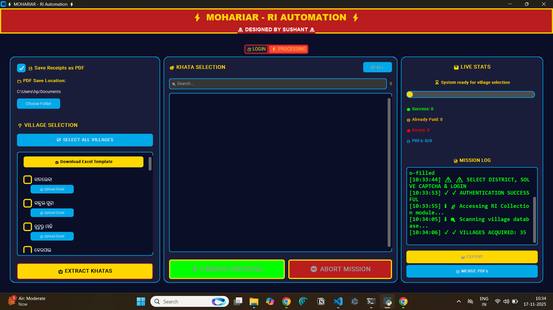
User Interface Overview
[INSERT SCREENSHOT: Full application window showing 3-panel layout]
THREE-PANEL DESIGN:
├─ LEFT (30%): Village Selection with Select All / Clear All
├─ MIDDLE (40%): Khata Selection with search & per-village controls
└─ RIGHT (30%): Live Stats, Progress Bar, and Mission Log

Slide 6
Getting Started (First Time Setup)
STEP 1: Launch MOHARIAR.exe
  • Double-click the executable file
STEP 2: Enter Default Mobile Number
  • Enter 10-digit mobile number (used as default)
STEP 3: Click '🔐 Initialize System'
  • Chrome browser will open automatically
STEP 4: Login Manually (one-time setup)
  • Select your District from dropdown
  • Enter User ID and Password
  • Solve the captcha puzzle
  • Click Login button
STEP 5: System auto-navigates to RI Collection module
STEP 6: Ready to process! ✅

Slide 7
Basic Workflow (Standard Processing)
1️⃣ SELECT VILLAGES
  • Check boxes next to desired villages, OR
  • Click 'Select All Villages' button
2️⃣ EXTRACT KHATAS
  • Click '📥 Extract Khatas' button
  • System scans each selected village
  • All available khatas are displayed
3️⃣ SELECT KHATAS
  • Use search box to filter (optional)
  • Check individual khatas, OR
  • Use 'Select All' button per village
4️⃣ ENGAGE PROTOCOL
  • Click '⚡ Engage Protocol' button
  • Watch real-time progress with color-coded stats
  • PDFs auto-save to session folder
5️⃣ COMPLETION
  • View final statistics
  • Click 'Open Folder' to see PDFs
  • Export results to Excel if needed

Slide 8
Excel Bulk Upload Feature
📥 UPLOAD KHATA LISTS VIA EXCEL
STEP 1: Download Template
  • Click 'Download Excel Template' button
  • Opens: Khata_Template.xlsx
STEP 2: Fill Template
  • Column A: Khata Number (required)
  • Column B: Mobile Number (optional - 10 digits or blank)
STEP 3: Upload Per Village
  • Check the village checkbox
  • Click 'Upload Excel' button next to that village
  • Select your filled Excel file
  • Repeat for other villages if needed
STEP 4: Process
  • Click 'Extract Khatas' to verify data
  • Click 'Engage Protocol' to process
✅ Supports: .xlsx and .csv formats
⚠️ Mobile: 10 digits or leave blank (uses default)

Slide 9
PDF Management & Organization
📁 SESSION FOLDER STRUCTURE:
rr20251117_1430/ ← Session ID (date_time)
├── VillageName1/
│ ├── VillageName1_101.pdf
│ ├── VillageName1_102.pdf
│ └── VillageName1_14_23.pdf ← Slash sanitized (14/23 → 14_23)
├── VillageName2/
│ └── VillageName2_201.pdf
├── VillageName1_MERGED.pdf ← Per-village merged PDF
└── ALL_RECEIPTS_MERGED.pdf ← Master merged PDF
📊 PDF FEATURES:
✅ Auto-save during processing (CDP technology - no dialogs)
✅ Organized by village in subfolders
✅ Auto-merge at completion (per village + master)
✅ 'Open Folder' button for quick access
✅ Manual 'Merge PDFs' available anytime

Slide 10
Live Statistics (Color-Coded)
[INSERT SCREENSHOT: Right panel showing color-coded statistics]
📊 REAL-TIME STATUS DISPLAY:
🟢 Success: X (Green - successfully processed)
🟡 Already Paid: X (Yellow - skipped, no retry)
🔴 Errors: X (Red - failed after 3 retries)
📄 PDFs: X/Y (Blue - saved/total)
Progress Bar: Shows percentage complete
⏰ ETA: Estimated time remaining (updates live)
Current Status: Shows which khata is processing

Slide 11
Multiple Credentials Feature
👥 PROFILE MANAGEMENT
SAVE MULTIPLE USER PROFILES:
• Profile 1: User_RTO
• Profile 2: User_Backup
• Profile 3: User_District2
FEATURES:
✅ Encrypted storage (secure credentials)
✅ Quick profile switching via dropdown
✅ Add / Edit / Delete profiles
✅ Auto-remembers last used profile
USAGE:
1. Login once with credentials
2. Check 'Remember credentials' checkbox
3. Next time: Select profile from dropdown
4. System auto-fills User ID & Password
5. Just solve captcha and login!

Slide 12
Session History Feature
📜 RECENT SESSIONS (Last 10)
QUICK ACCESS DROPDOWN:
├─ rr20251117_1430 (350 khatas, 2h 15m ago)
├─ rr20251116_0945 (125 khatas, Yesterday)
├─ rr20251115_1620 (89 khatas, 2 days ago)
└─ ... (up to 10 sessions)
FEATURES:
✅ Quick folder access with one click
✅ Shows: Date, Time, Khata count, Time ago
✅ Auto-sorts by date (newest first)
✅ Stores session metadata (villages processed, stats)
KEYBOARD SHORTCUT:
Press Ctrl+H to view session history dropdown

Slide 13
Troubleshooting Common Issues
❓ COMMON ISSUES & SOLUTIONS
Issue: Chrome won't launch
→ Close all Chrome windows and try again
Issue: Login fails / captcha error
→ Solve captcha manually, system waits automatically
Issue: Khata dropdown appears empty
→ System auto-waits up to 5 seconds for dropdown to populate
Issue: PDFs not saving
→ Check session folder path, ensure sufficient disk space
Issue: 'Already Paid' appears multiple times
→ This is normal - system detected and skipped correctly
Issue: Some khatas show error status
→ Check error_log.txt for detailed error messages
→ System automatically retries failed khatas 3 times
⚠️ IF PORTAL CRASHES:
• Note the last successfully processed khata
• Close and restart MOHARIAR
• Uncheck already-processed khatas
• Resume processing from next khata

Slide 14
Keyboard Shortcuts ⌨️
SPEED UP YOUR WORKFLOW:
Ctrl + S → Start / Engage Protocol
Ctrl + E → Export Results to Excel
Ctrl + O → Open Current Session Folder
Ctrl + H → View Session History
Ctrl + Q → Stop Processing (abort)
Ctrl + M → Merge PDFs Manually
Ctrl + ? → Open Help Guide (this presentation)
NAVIGATION:
Space → Toggle current checkbox selection
Enter → Confirm dialog boxes
Esc → Close dialog boxes
TIPS:
• Shortcuts work throughout the application
• Case-insensitive (Ctrl+s or Ctrl+S both work)
• Most dialogs can be closed with Esc key

Slide 15
Technical Architecture 🔧
TECHNOLOGY STACK:
├─ GUI: CustomTkinter 5.2.2 (Modern dark theme)
├─ Automation: Selenium WebDriver 4.16.0
├─ Smart Delays: WebDriverWait (adaptive timing)
├─ PDF Generation: Chrome DevTools Protocol (CDP)
├─ PDF Merging: PyPDF2 3.0.1
├─ Excel Processing: Pandas 2.1.0 + OpenPyXL 3.1.2
└─ Notifications: win10toast (Windows toast popups)
KEY INNOVATIONS:
✅ WebDriverWait - Waits only as long as needed (40-50% faster)
✅ CDP printToPDF - Direct browser PDF generation (no print dialogs)
✅ JavaScript Alert Handler - Detects alerts before page interaction
✅ Smart Retry - 3 attempts with exponential backoff (5s, 15s, 30s)
✅ Khata Sanitization - Handles special chars (/ → _)
PERFORMANCE:
• Old method: 21s per khata (fixed delays)
• MOHARIAR: 8-12s per khata (adaptive delays)
• PDF Success Rate: 95%+
• Already-Paid Detection: 100% accurate

Slide 16
⚡ THANK YOU! ⚡
MOHARIAR v2.0
👨‍💻 Designed by: SUSHANT
📅 November 2025
🙏 Thank you for using MOHARIAR!
Questions? Feedback? Suggestions?
Feel free to reach out!

