Slide 1
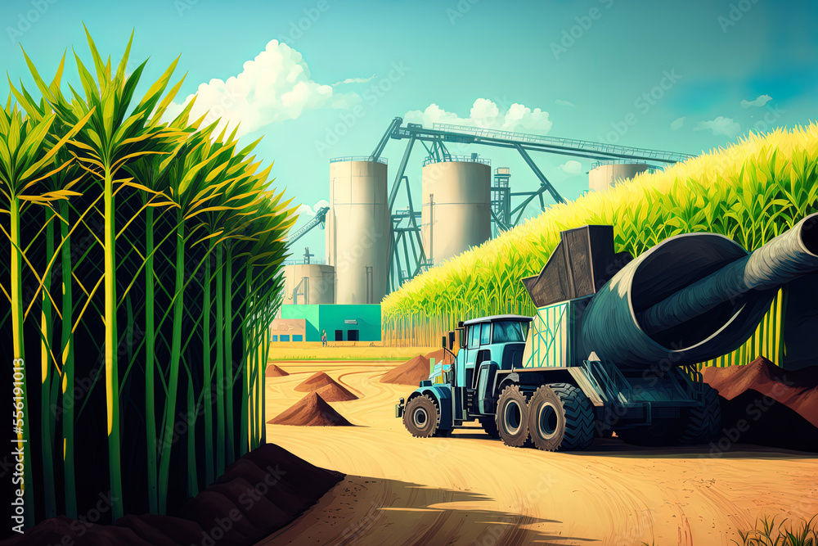
Lanka Sugar Company
(Pelwatte)
Sahan Kaushalya
University College Of Jaffna
2023/11/10

Slide 2
Contents
01
Quality
Control
02
Unloader
03
Pre Mill
04
Mills
05
Boiler

Slide 3
Contents
01
Quality
Control
02
Unloader
03
Pre Mill
04
Mills
05
Boiler

Slide 4
Contents
01
Quality
Control
02
Unloader
03
Pre Mill
04
Mills
05
Boiler

Slide 5
Contents
01
Quality
Control
02
Unloader
03
Pre Mill
04
Mills
05
Boiler

Slide 6
Contents
01
Quality
Control
02
Unloader
03
Pre Mill
04
Mills
05
Boiler

Slide 7
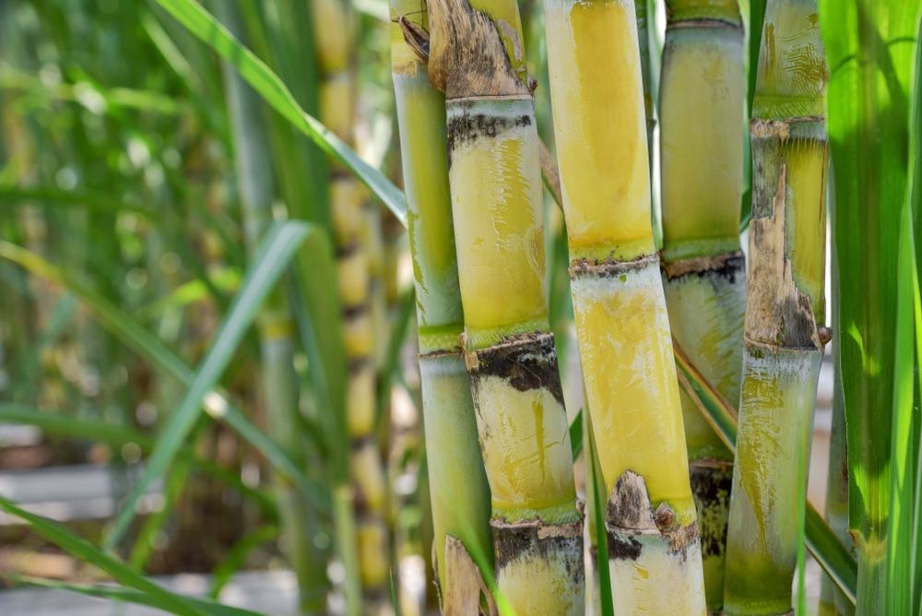
01 Quality Control

Slide 8
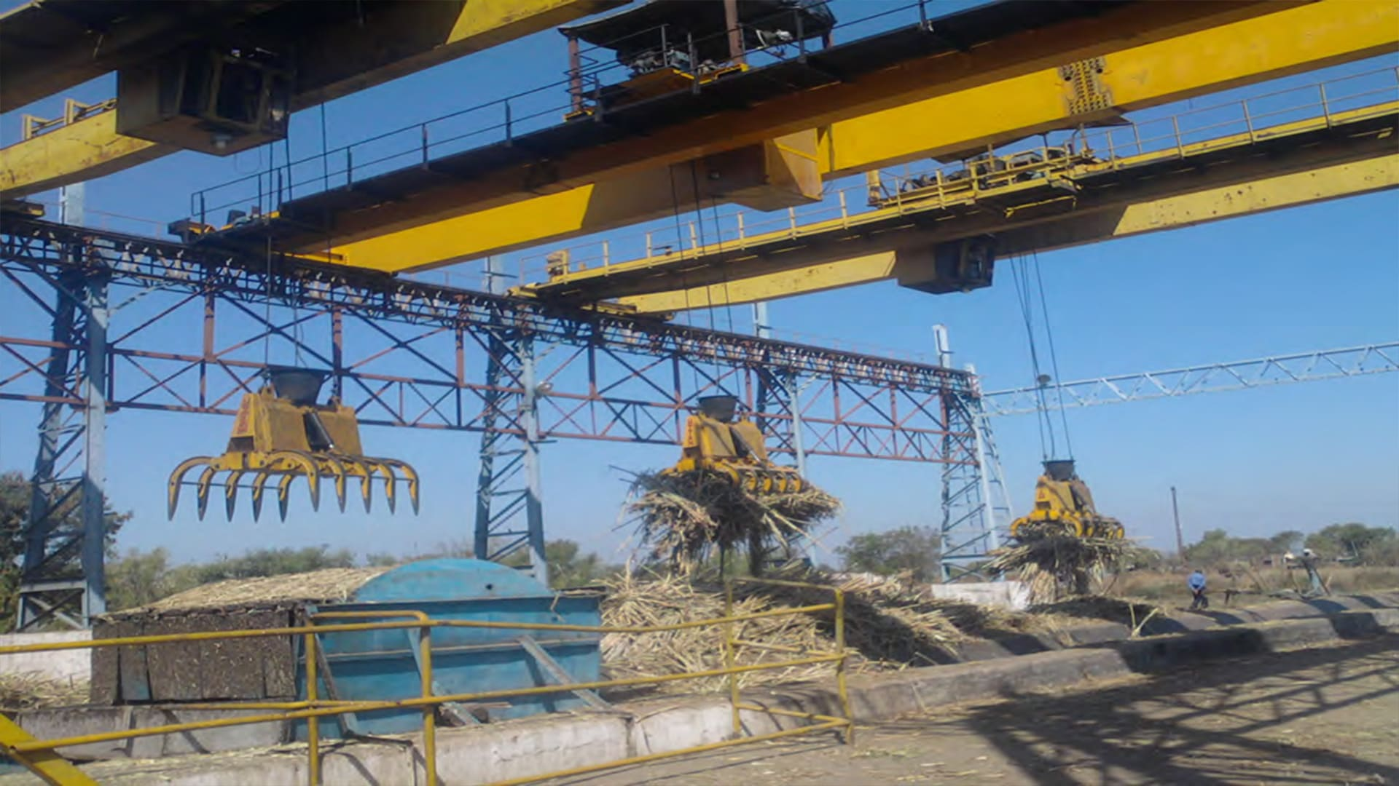
02 Unloader

Slide 9
03 Pre Mill

Slide 10
04 Mills

Slide 11
05 Boiler

Slide 12


