Slide 1

PROJECT FOR PRODUCT DEVELOPMENT-1 Presentation on
Analysis of Equivalent Skin Model with Battery-Less Cardiac pacemaker using improved mppt controller Session: 2025-26
Presented by, ADARSHA NATIA – 2311O330 AMIT KUMAR SAHOO - 23110338 AMITESH KUMAR SAMAL- 23110339 ANUBHAB GHOSH- 23110341 6th sem, Branch-ECE | Under the guidance of: MR.SUSHANTA KUMAR SAHU ASSISTANT PROFESSOR
School of Electronic Sciences Odisha University of Technology and Research
27-04-2026

Slide 2
Outline
Introduction
Literature Survey
Problem statement
System Model
Flowchart of work (PPD-1)
Experimental Setup
Working Principle
Results And Discussion
Inferences
Future Work
References
Project for Product Development-1 Group No. 19
27-04-2026

Slide 3
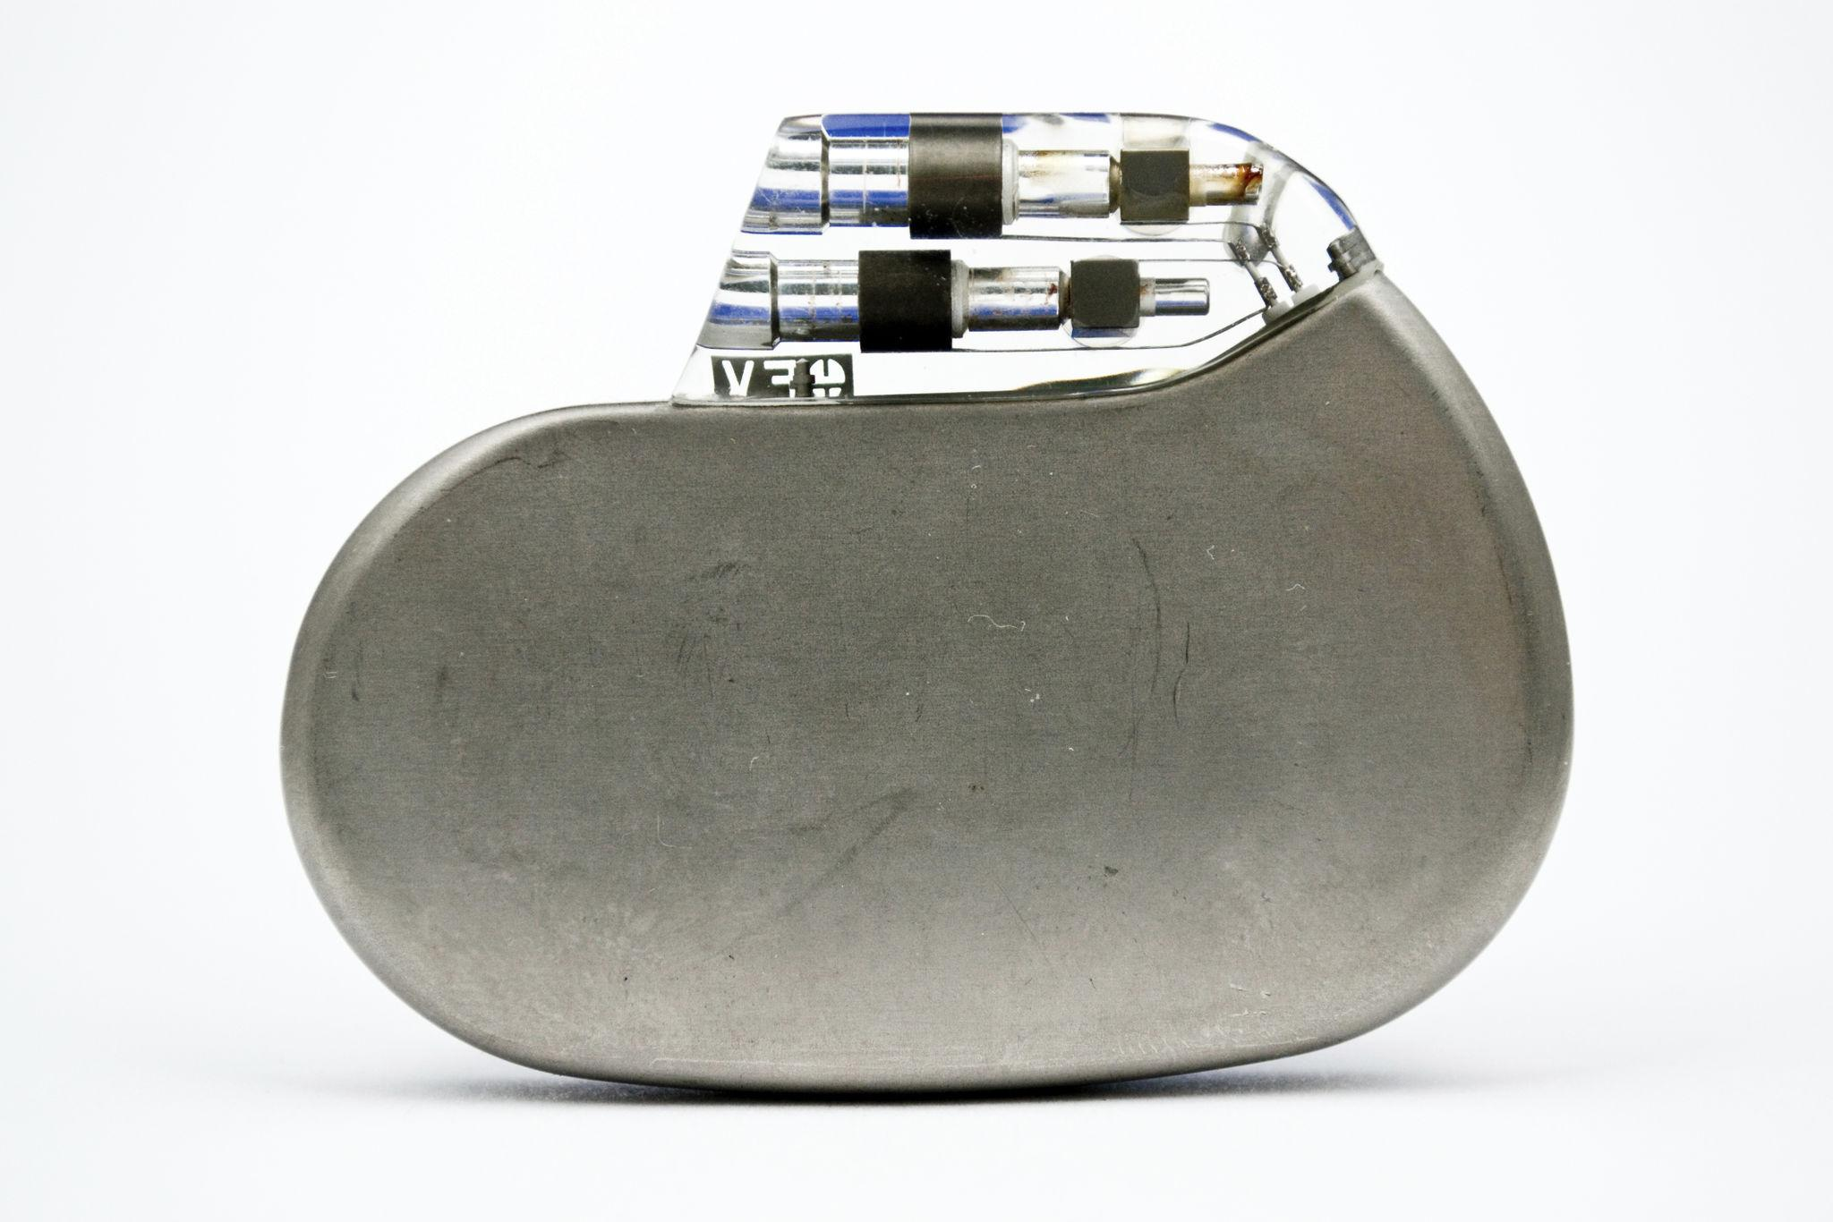
INTRODUCTION
Content:
Cardiac pacemakers regulate heart rhythm
Conventional pacemakers use batteries
Battery life: 8–10 years → requires surgery
Need for battery-less solutions
Energy harvesting as an alternative
Motivation:
Frequent surgeries increase risk
High medical cost
Limited battery life
Need for continuous and reliable power
Project for Product Development-1 Group No.19
27-04-2026

Slide 4
Literature survey
Author(s) | Year | Method / Technique | Key Contribution | Limitations
Munna Khan et al. | 2020 | Voltage-based MPPT | Achieved continuous power (10–25 mW) for biomedical devices | Limited efficiency under dynamic conditions
Andreas Haeberlin et al. | 2018 | Solar-powered pacemaker | Demonstrated feasibility of subcutaneous PV energy harvesting | Dependent on light availability
M. V. Tholl et al. | 2019 | Subdermal solar model | Analyzed energy generation through skin layers | Efficiency varies with skin properties
Lin Dong et al. | 2021 | Piezoelectric & triboelectric harvesting | Converted mechanical energy from heart motion | Low power output consistency
Adrian Zurbuchen et al. | 2017 | Heartbeat-driven harvesting | Developed motion-based pacemaker powering system | Complex implementation
Various Researchers | 2015–2023 | AI-based MPPT (PSO, GWO, AOA) | Improved tracking accuracy and convergence speed | High computational complexity
Project for Product Development-1 Group No.19
27-04-2026

Slide 5
Problem statements
PV output is unstable (depends on irradiance & temperature)
Nonlinear behaviour makes MPPT tracking difficult
Traditional MPPT:
Slow response
Oscillations
Leads to inefficient and unreliable power
Need:
Fast & efficient MPPT
Stable power for pacemaker operation in both variable and constant irradiance condition.
Project for Product Development-1 Group No.19
27-04-2026

Slide 6
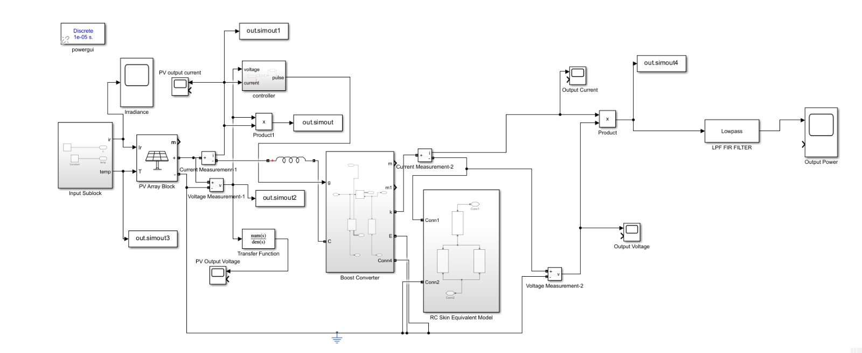
SYSTEM MODEL
FIG.1-SIMULINK MODEL
Project for Product Development-1 Group No.19
27-04-2026

Slide 7
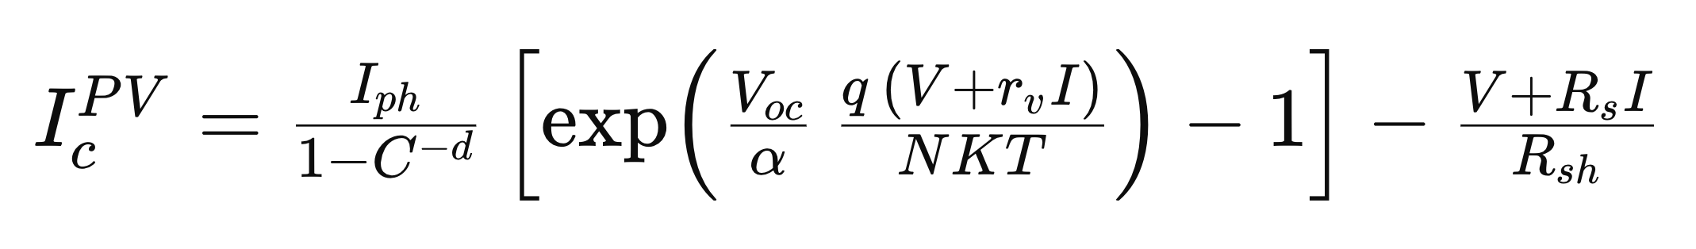
System model
Photovoltaic (PV) System Modeling-
PV cell converts light energy into electrical energy.
Modeled using current source, diode, Rs and Rsh.
Exhibits nonlinear V–I characteristics.
Maximum Power Point (MPP) varies with irradiance.
Requires MPPT for efficient power extraction.
PV Output Current Equation:
where, Iph – photocurrent; I – output current;
q = 1.6×10⁻¹⁹ C (electron charge); T – cell temperature;
N – ideality factor; Rs – series resistance;
Rsh – shunt resistance; Voc – open-circuit voltage;
α – temperature coefficient; K – Boltzmann constant;
C – coefficient; rv – parallel resistance; V – thermal voltage.
Project for Product Development-1 Group No.19
27-04-2026

Slide 8
System model
FOPID Controller
Fractional Order Proportional–Integral–Derivative (FOPID) controller
Extension of conventional PID with fractional orders (λ, μ)
Provides additional tuning flexibility
Improves dynamic response and system stability
Reduces overshoot and steady-state error
Used in MPPT loop for efficient power control
Control law:
Where,
U(t) – Controller output E(t) – Error signal Kp – Proportional gain Ki – Integral gain Kd – Derivative gain D – Fractional differ-integral operator λ – Order of integration μ – Order of differentiation
Project for Product Development-1 Group No.19
27-04-2026

Slide 9
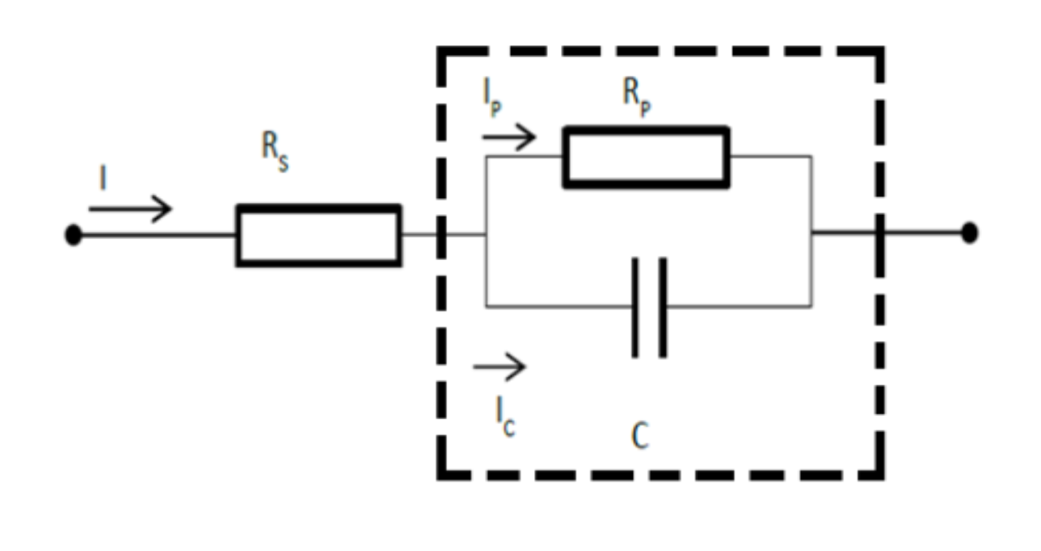
System model
Skin Equivalent Model
Skin layers modeled as:
Epidermis → High resistance
Dermis → Moderate resistance
Subcutaneous layer → Low resistance
Human skin behaves as a bio-electrical medium
Modeled using RC equivalent circuit
Components:
R (Resistance) → ionic conduction in tissues
C (Capacitance) → cell membrane storage effect
Represents frequency-dependent impedance
Helps analyze:
→Power loss through tissue
→Voltage drop across layers
Enables realistic simulation of implant environment
FIG.2-RC skin equivalent model
Project for Product Development-1 Group No. 19
27-04-2026

Slide 10
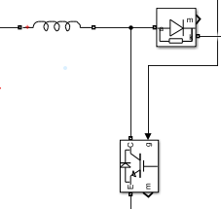
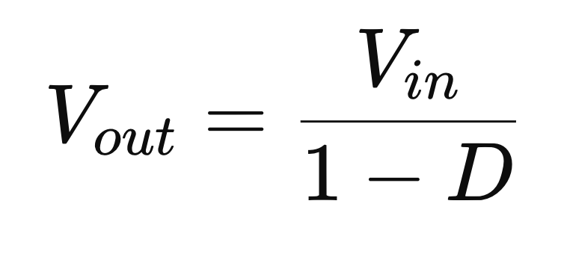
System model
DC–DC Boost Converter
Used to step up low voltage obtained from the photovoltaic (PV) system.
Consists of inductor, diode, switch (MOSFET), and capacitor.
Operates based on switching principle (ON and OFF states).
Output voltage is controlled using duty cycle (D).
Higher duty cycle results in higher output voltage.
Provides regulated and continuous output for pacemaker operation.
The relationship between input and output voltage is given by:
where D is the duty cycle of the switching signal.
MPPT using Arithmetic Optimization Algorithm (AOA)
Ensures operation at Maximum Power Point (MPP)
Adjusts duty cycle of boost converter
Improves efficiency, accuracy, and stability
The algorithm operates in four major stages:
• Initialization of controller parameters
• Fitness evaluation based on power error
• Exploration phase for global search
• Exploitation phase for local optimization
FIG.3-DC-DC Booster circuit
Project for Product Development-1 Group No.19
27-04-2026

Slide 11
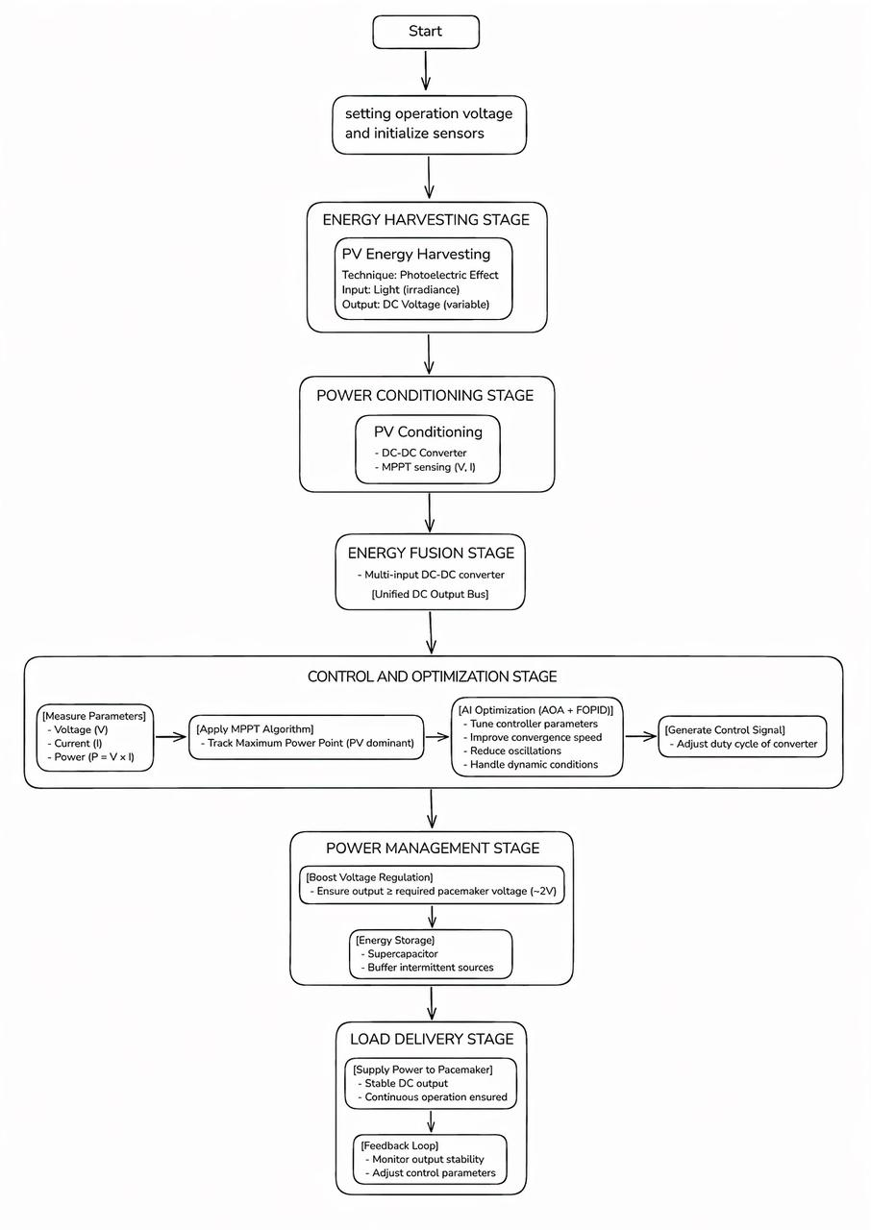
Flowchart of work (PPD-1)
Project for Product Development-1 Group No.19
27-04-2026

Slide 12
Experimental Setup
System designed and simulated using MATLAB/Simulink
Photovoltaic (PV) cell modeled as energy source
DC-DC boost converter used for voltage step-up
MPPT controller implemented using AOA algorithm
FOPID controller used for improved control performance
Skin equivalent model included (RC circuit)
Pacemaker modeled as load
Parameters set based on standard PV characteristics
System tested under constant irradiance conditions
Project for Product Development-1 Group No.19
27-04-2026

Slide 13
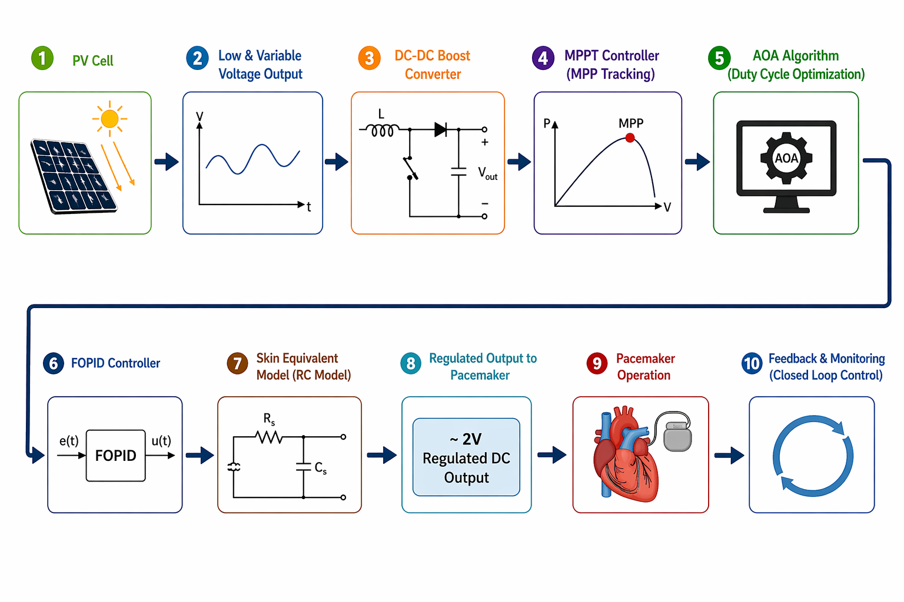
WORKING PRINCIPLE
PV cell converts incident light into electrical energy
→ The photovoltaic cell absorbs light (mainly near-infrared) and converts it into electrical energy using the photoelectric effect.
Generated voltage is low and variable
→ The PV output voltage is small and fluctuates depending on irradiance and temperature conditions.
DC-DC boost converter steps up the voltage
→ The boost converter increases the low input voltage to a higher level suitable for pacemaker operation.
MPPT controller tracks Maximum Power Point (MPP)
→ The controller continuously monitors voltage and current to ensure operation at maximum power point.
Project for Product Development-1 Group No.19
27-04-2026

Slide 14
WORKING PRINCIPLE
AOA algorithm optimizes duty cycle
→ Arithmetic Optimization Algorithm dynamically adjusts the duty cycle for optimal power extraction.
FOPID controller improves stability and response
→ It minimizes error, reduces oscillations, and enhances dynamic performance of the system.
Energy passes through skin equivalent model
→ The RC model simulates electrical impedance of human tissue and analyzes power transfer.
Regulated output supplied to pacemaker
→ A stable voltage (~2V) is delivered to ensure reliable pacemaker functioning.
Feedback ensures continuous and stable operation
→ System continuously monitors output and adjusts parameters for consistent performance under varying conditions.
Project for Product Development-1 Group No.19
27-04-2026

Slide 15
Results and Discussion
The proposed system performance is analyzed under constant irradiance conditions (750 W/m²).
Output Voltage: ~2.8 V
Output Power: ~0.0115 W (11.5 mW)
System reaches steady-state quickly with minimal fluctuations .
MPPT ensures maximum power extraction.
AOA + FOPID controller improves stability, convergence speed, and reduces oscillations.
Provides stable and reliable output for pacemaker operation.
Project for Product Development-1 Group No.19
27-04-2026

Slide 16
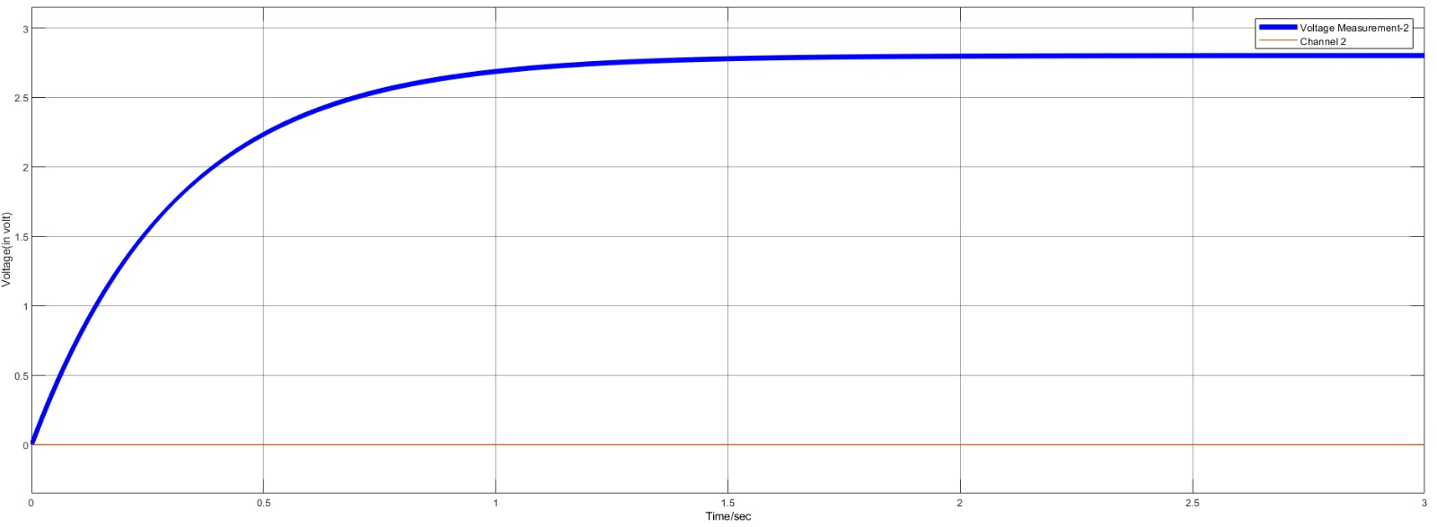
RESULTS
FIG.4-Time Response of PV Voltage with MPPT Control
Project for Product Development-1 Group No.19
27-04-2026

Slide 17
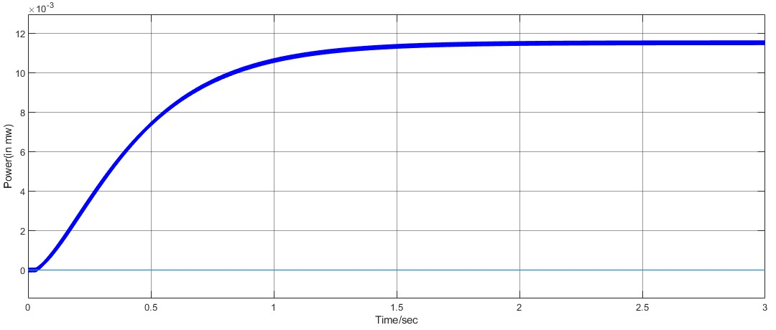
RESULTS
FIG.5-Time Response of Output Power using MPPT-Controlled Boost Converter
Project for Product Development-1 Group No.19
27-04-2026

Slide 18
INference
The battery-less cardiac pacemaker using photovoltaic energy harvesting is feasible and effective.
The equivalent skin model enables realistic analysis of energy transfer through biological tissue.
The AOA-based MPPT combined with FOPID ensures efficient power extraction.
The system maintains stable operation under constant and varying irradiance conditions.
Sufficient and continuous power is achieved for pacemaker operation.
The system eliminates the need for battery replacement, reducing surgical risks.
Project for Product Development-1 Group No.19
27-04-2026

Slide 19
Future Scope
The current work focuses on the design and simulation of a photovoltaic-based battery-less cardiac pacemaker under constant irradiance conditions. Further improvements can be carried out in the following areas:
Multi-source Energy Harvesting: Integration of additional energy sources such as thermoelectric (TEG) and piezoelectric generators along with PV to improve reliability and ensure continuous power supply.
Hardware Implementation: Development of a real-time hardware prototype to validate the simulation results and analyze practical performance.
Variable Irradiance Analysis: Extension of the system to operate efficiently under varying irradiance conditions, ensuring stable performance in real-world environments.
Project for Product Development-1 Group No.19
27-04-2026

Slide 20
References
[1] A. Kumar, M. Kumar, and R. Komaragiri, “Design of a biorthogonal wavelet transform based R-peak detection and data compression scheme for implantable cardiac pacemaker systems,” Journal of Medical Systems, vol. 42, no. 6, pp. 1–12, 2018.
[2] A. Kumar, R. Komaragiri, and M. Kumar, “Design of efficient fractional operator for ECG signal detection in implantable cardiac pacemaker systems,” International Journal of Circuit Theory and Applications, vol. 47, no. 9, pp. 1459–1476, 2019.
[3] M. I. Elnaggar et al., “An optimized Mamdani FPD controller design of cardiac pacemaker,” Health Information Science and Systems, vol. 7, no. 1, pp. 1–18, 2019.
[4] C. Liu et al., “An effective sandwiched wireless power transfer system for charging implantable cardiac pacemaker,” IEEE Transactions on Industrial Electronics, vol. 66, no. 5, pp. 4108–4117, 2018.
[5] S. M. Noor, E. John, and M. Panday, “Design and implementation of an ultralow-energy FFT ASIC for processing ECG in cardiac pacemakers,” IEEE Transactions on Very Large Scale Integration (VLSI) Systems, vol. 27, no. 4, pp. 983–987, 2018.
Project for Product Development-1 Group No.19
27-04-2026

Slide 21


