Slide 1
API Test automation application
DEVELOPMENT TEAM: Group 16
CLIENT TEAM: Group 10

Slide 2
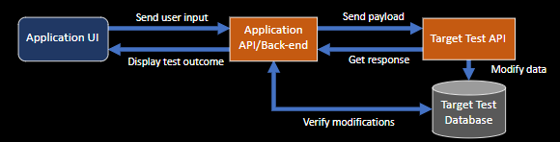
Summary
A dynamic API testing application.
User will provide all the details like Database connection, API and change in the database details.
Based on the test case inputs given by the user
Send payload and check response
Verify database changes

Slide 3
PROJECT DASHBOARD stats
Total number of tasks: 39
Task completed by each individual
Saifuddin Shaik: 8
Shubham Mishra: 10
Vatsal Jain: 10
Jagbir Singh: 4
Raj Patel: 8

Slide 4
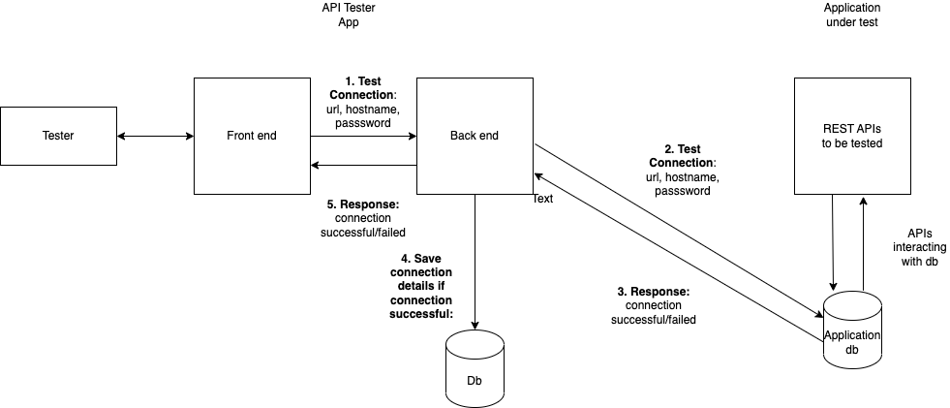
Test connection

Slide 5
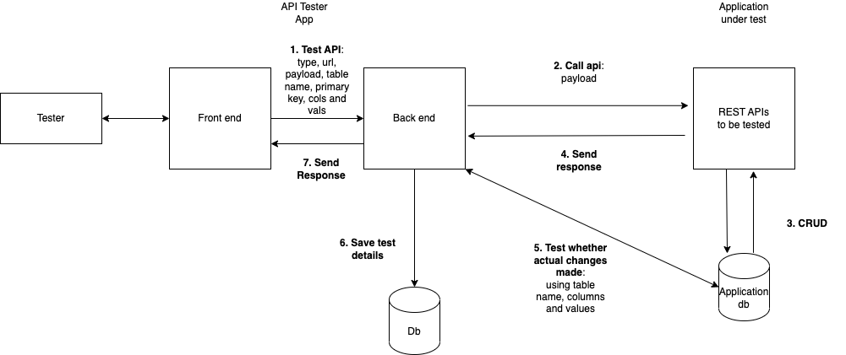
Test apis and database

Slide 6
PROJECT Status
Goals | Achieved?
Functionality to send payload to API and get response​ | Yes
Ability to configure database connectivity​ | Yes
Ability to verify database changes after payload sent | Yes
Full streamlined testing automation functionality​ | Yes
Complete responsive UI for the application​ | Yes

Slide 7
OUR PROGRESS AFTER MID-TERM REVIEW
Create UI component for adding a test case
Test execution of POST, GET, and DELETE (UI and API).
Display list of all test cases (UI and API).
Display results of Test case (UI).
Make unit test case coverage to minimum 80%.
Deployment of Application (UI and backend)

Slide 8
Learning outcomes
Complete software development lifecycle.
Learn React and Spring Boot concept at advance level.
Software development tools like Version Control Systems(GitLab), Virtual Machine, Deployment tools(CI/CD).
Writing clean code and removing code smells using various refactoring techniques.
SOLID design principles.

