Slide 1
Welcome

Slide 2
Samsung S25 Pricing Structure

Slide 3
Introduction
This presentation explains the code that calculates pricing, discounts, and taxes for the Samsung S25.

Slide 4
Purpose of the code
The code is designed to calculate the total cost for purchasing Samsung S25 smartphones based on user input. It incorporates various factors such as quantity, discounts, and GST.

Slide 5
Key variables defined
Key variables include the base price of the Samsung S25, GST percentage, and the number of items the customer wishes to purchase. It logs user inputs and outputs detailed billing information.

Slide 6
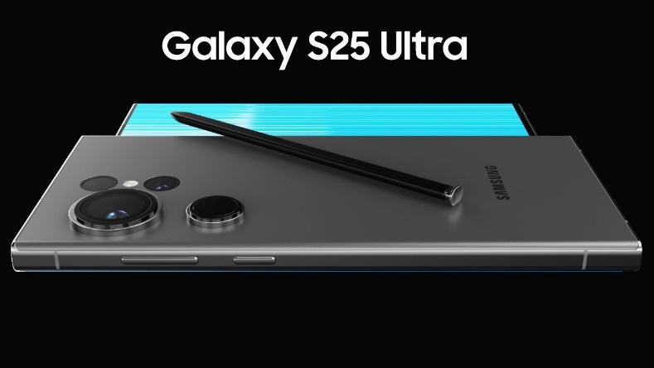
User input and interaction
The code prompts the user to input the number of Samsung S25 devices they wish to purchase.This interaction is crucial as it determines the applicable discounts and the final pricing structure.

Slide 7
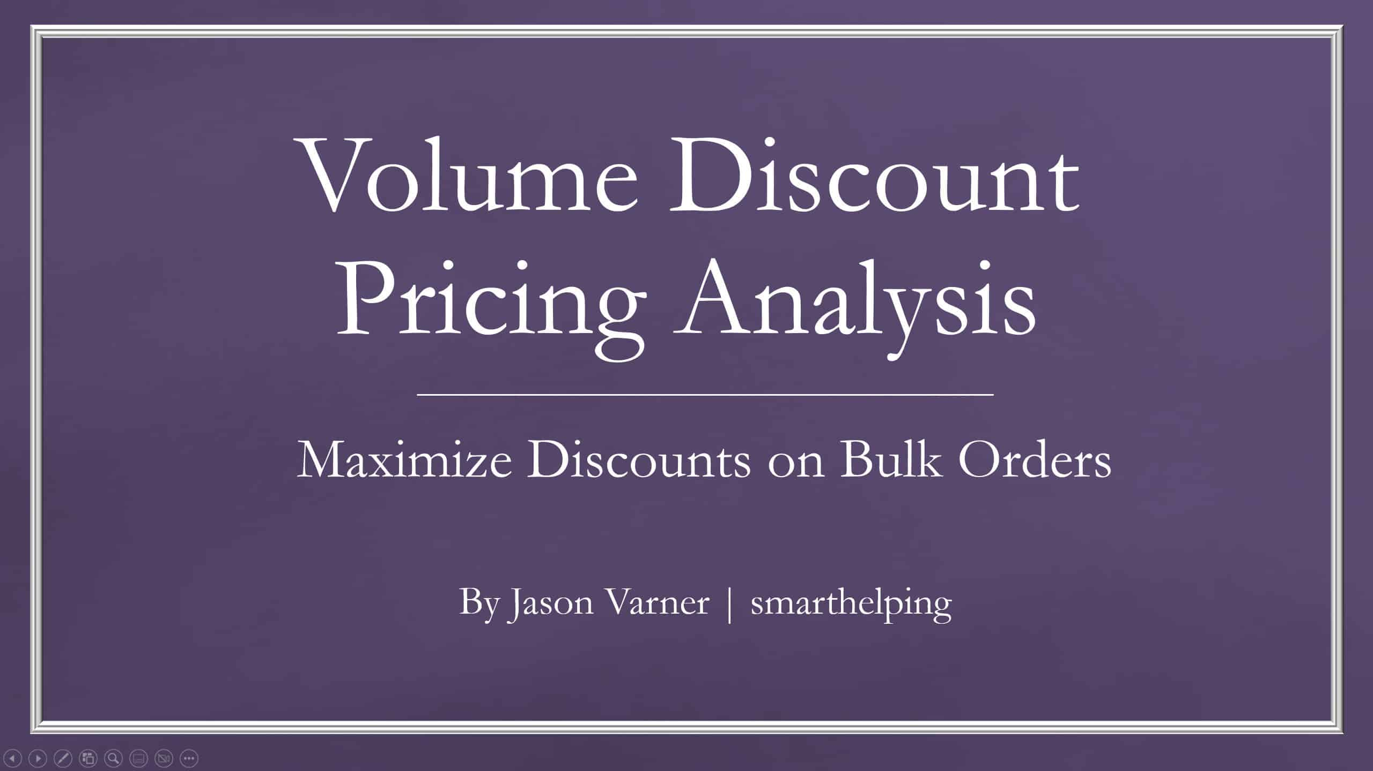
Discount structure explained
Discounts are tiered based on the number of devices purchased. Depending on the quantity, discounts range from 2% to 24%, incentivizing bulk purchases to enhance sales.

Slide 8
GST calculation process
The Goods and Services Tax (GST) is calculated as 18% of the total price, split evenly between SGST and CGST. Each of these components contributes 9%, ensuring compliance with tax regulations.

Slide 9
Final cost computation
The final cost includes the subtotal after applying discounts, along with the calculated SGST and CGST. The total payable amount is then presented to the customer, providing a clear breakdown of charges.

Slide 10
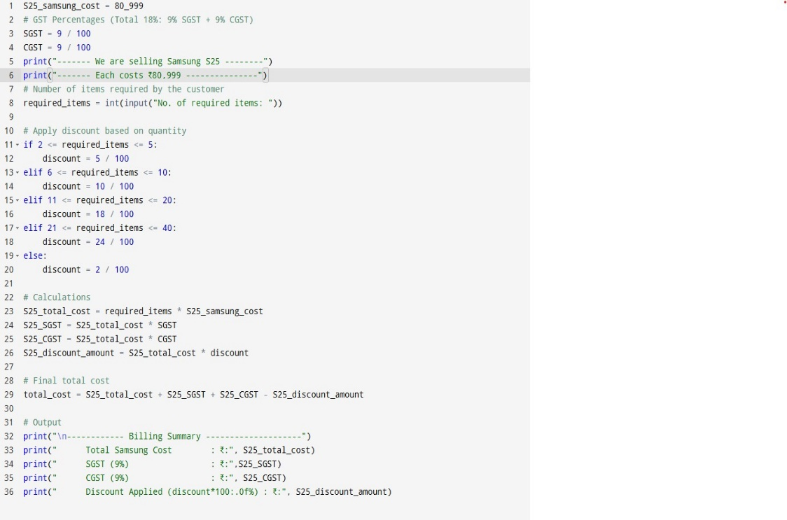
Code of back end

Slide 11
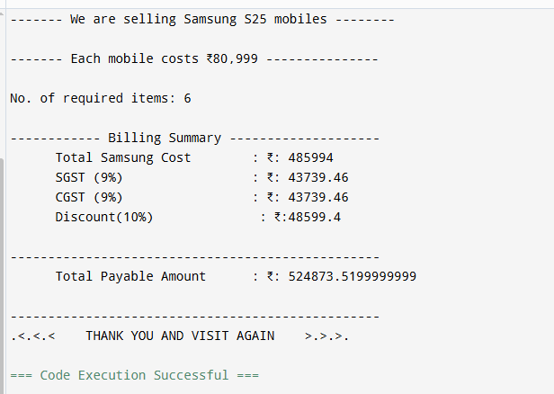
Code simple output

Slide 12
Conclusions
In summary, this code effectively encapsulates the sales process for the Samsung S25, integrating user interaction, discount calculations, and tax computations to present a comprehensive billing summary.

Slide 13
Thank you!
Do you have any questions?
Visit to us :99867xxxx
Please keep this slide for attribution

