Slide 1
IBM University Engagement Project Submission
“Exploring the Power of Agentic AI with IBM Granite and LangFlow”

Slide 2

Project Tile – [RAG-Based Educational Admission Agent]
Domain of Project – [ Education / Artificial Intelligence]
Student Name | Recent Passport Photo | Email ID | Mobile number [WhatsApp]
SHAIK SAMEER |  | shaiksameerkhit@gmail.com | 7893908003

Slide 3
Problem Statement -
Problem Statement : College Admission Agent
The Challenge
The College Admission Agent is an AI-powered chatbot developed using RAG technology to simplify the admission process. It retrieves admission details such as eligibility, fees, courses, and FAQs from official sources and provides accurate real-time responses to students. The system improves accessibility, reduces manual inquiries, and uses IBM Granite with IBM Cloud Lite services for intelligent response generation.
The Objective
The main objective of this project is to develop an AI-powered College Admission Agent using RAG technology to provide accurate and real-time admission information to students. The system aims to simplify the admission process, reduce manual inquiries, and improve accessibility using IBM Granite and IBM Cloud Lite services:

Slide 4
Technology Used
Tech Stack (Mandatory)
HTML, CSS, JavaScript – Frontend
Python, Flask – Backend
LangChain, RAG – AI Framework
IBM Granite – Large Language Model
FAISS – Vector Database
IBM Cloud Lite – Cloud Platform
IBM Watsonx.ai – AI Integration
VS Code – Development Environment
Git & GitHub – Version Control

Slide 5
Proposed Solution -
Proposed Solution: RAG Based Educational Admission Agent
The proposed system is an AI-powered College Admission Agent developed using Retrieval-Augmented Generation (RAG) and IBM Granite models to assist students with admission-related queries. The system retrieves information such as eligibility criteria, fee details, course information, and admission procedures from institutional documents and databases.
Using FAISS vector database and LangChain, the chatbot performs semantic search and generates accurate real-time responses through IBM Granite LLM. The solution reduces manual inquiries, improves accessibility, and provides an efficient and user-friendly admission support system using IBM Cloud Lite services.

Slide 6
Langflow component Used -
1)Chat Input – Accepts user queries
2)Text Splitter – Splits large documents into chunks
3)Embedding Model – Converts text into vectors
4)FAISS Vector Store – Stores embeddings
5)Retriever – Retrieves relevant information
6)IBM Granite LLM – Generates intelligent responses
7)Chat Output – Displays final response to users

Slide 7
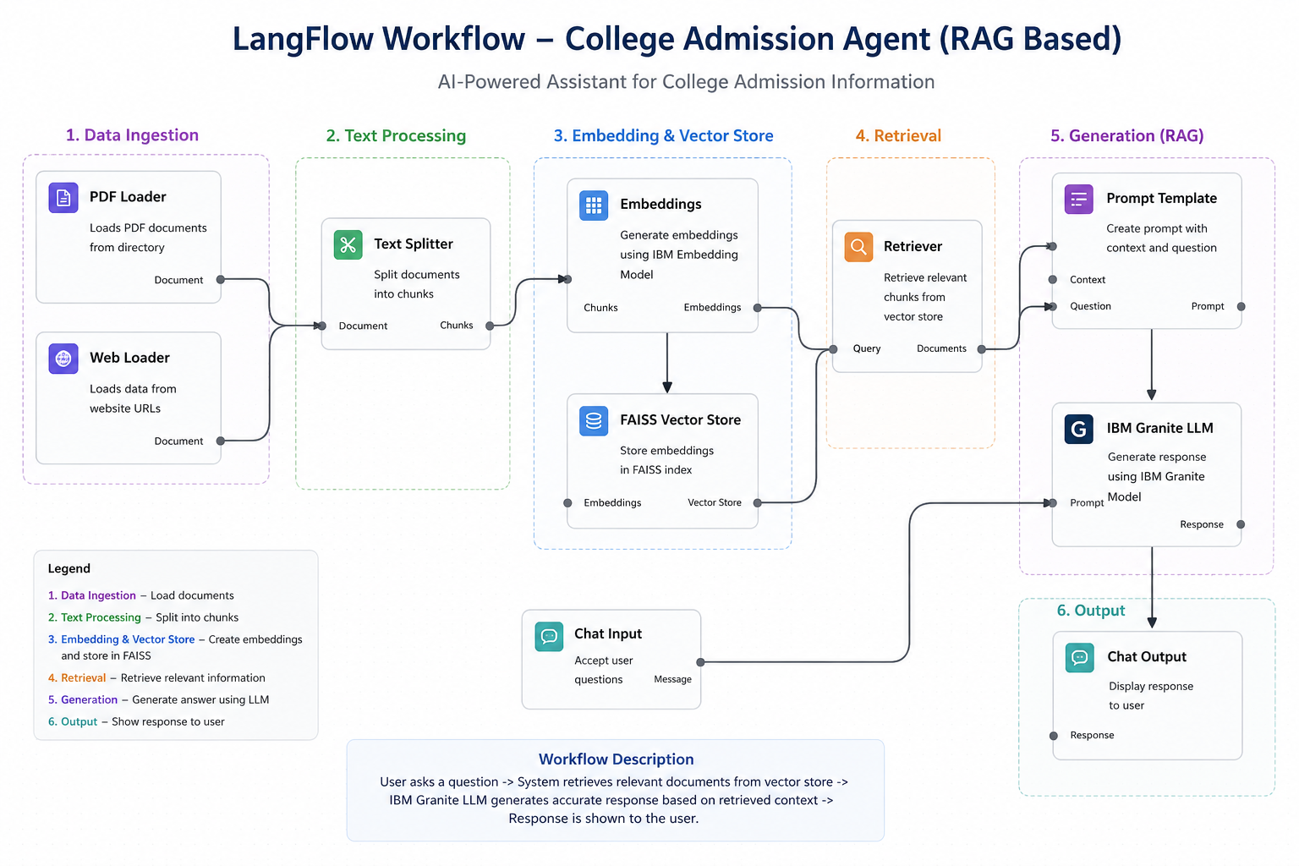
Langflow workflow -

Slide 8
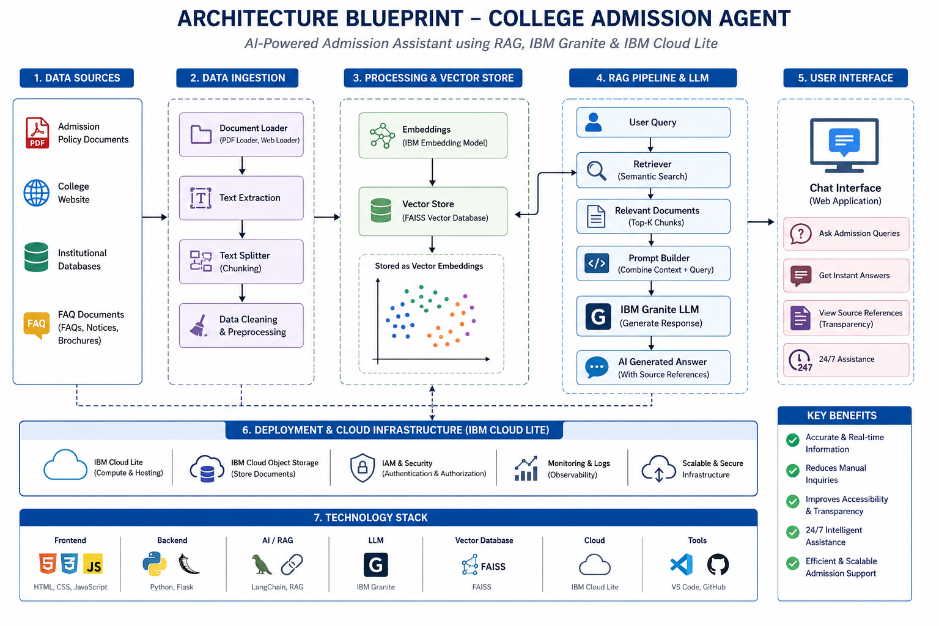
Architecture blueprint -

Slide 9
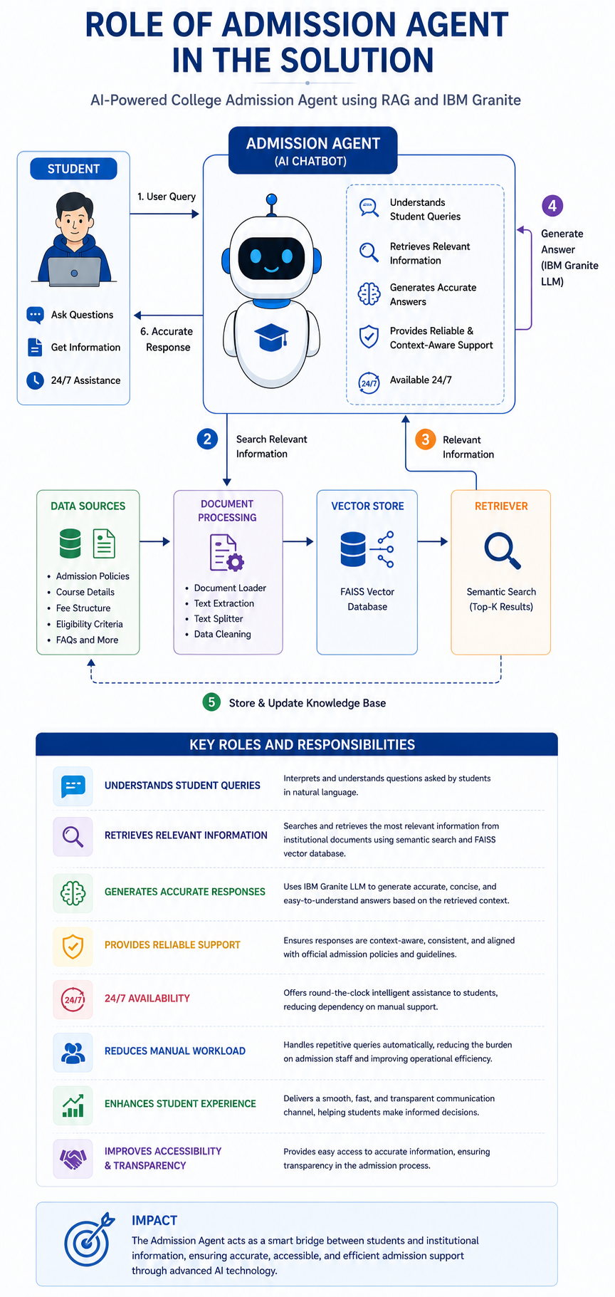
Role of Admission Agent in the Solution
Role of Admission Agent in the Solution
The Admission Agent acts as the intelligent core component of the proposed solution, designed to assist students throughout the college admission process. It uses Retrieval-Augmented Generation (RAG) technology along with IBM Granite models to provide accurate, real-time, and context-aware responses to student queries. The system understands questions asked in natural language and retrieves the most relevant information from institutional databases and official admission documents.
The Admission Agent helps students by providing information related to eligibility criteria, fee structures, course details, admission procedures, important deadlines, scholarships, and frequently asked questions. Using semantic search and FAISS vector database, the system quickly retrieves relevant content and generates reliable responses through IBM Granite Large Language Models.
The agent also reduces the manual workload of admission staff by automating repetitive inquiries and providing 24/7 intelligent support. It improves accessibility, transparency, and efficiency in the admission process while ensuring a better user experience for prospective students. The AI-powered assistant acts as a smart bridge between students and institutional information systems, making admission guidance faster, easier, and more efficient.

Slide 10
Technology Used
Langflow platform -For designing and orchestrating multi-agent workflows visually
IBM Grainte model - ibm-granite-3-2-8b – For natural language understanding, reasoning, and personalization
IBM Cloud – It provides the infrastructure to build, deploy, and scale the Nutrition Agent efficiently. IBM Cloud enables a reliable, secure, and scalable environment for deploying the Nutrition Agent.
RAG– RAG to fetch real data first, then generate intelligent answers, making the Nutrition Agent more trustworthy and effective.
IBM Watsonx.ai - For model deployment, embeddings, and AI governance
Vector Database (FAISS/Chroma) – For RAG-based nutritional data retrieval

Slide 11
Novelty and Uniqueness
The project introduces an AI-powered College Admission Agent using RAG technology and IBM Granite models to provide accurate, intelligent, and real-time admission assistance. The system combines semantic search, vector databases, and cloud-based AI services to improve accessibility, efficiency, and transparency in the admission process.
Intelligent Assistance-
Provides accurate and real-time admission support using AI.
RAG Technology-
Uses Retrieval-Augmented Generation for reliable and context-aware responses.
IBM Granite Integration-
Generates intelligent and human-like responses using IBM Granite models.
Semantic Search-
Uses FAISS vector database for fast and efficient information retrieval.
Reduced Manual Workload-
Automates admission inquiries and improves efficiency.
24/7 Support-
Provides continuous admission guidance anytime.
Cloud-Based Deployment-
Uses IBM Cloud Lite and Watsonx.ai for secure AI deployment.
Enhanced Student Experience-
Improves accessibility, transparency, and user interaction.

Slide 12
Git Hub Link
Github URL – GITHUB_REPOSITORY
·
·
·

Slide 13
Future Scope
1. Multilingual and Voice Support –
The system can be enhanced with multilingual chatbot functionality and voice-based interaction to support students from different regions and languages. This will improve accessibility and user experience.
2. Advanced Student Services –
Future improvements can include WhatsApp integration, student login portals, admission tracking, and AI-based course recommendation systems for better personalized guidance and automation.
·
·
·

Slide 14


