Slide 1
QoS-Separated Robot Traffic Model
Final Results — Completed 192/192-Run Factorial Campaign
Control / Sensor / Video over WiFi Mesh + LTE / 5G NR
Sheikh Sayed Bin Rahman
PIC Lab, Kyushu Institute of Technology (KIT) · 2026

Slide 2
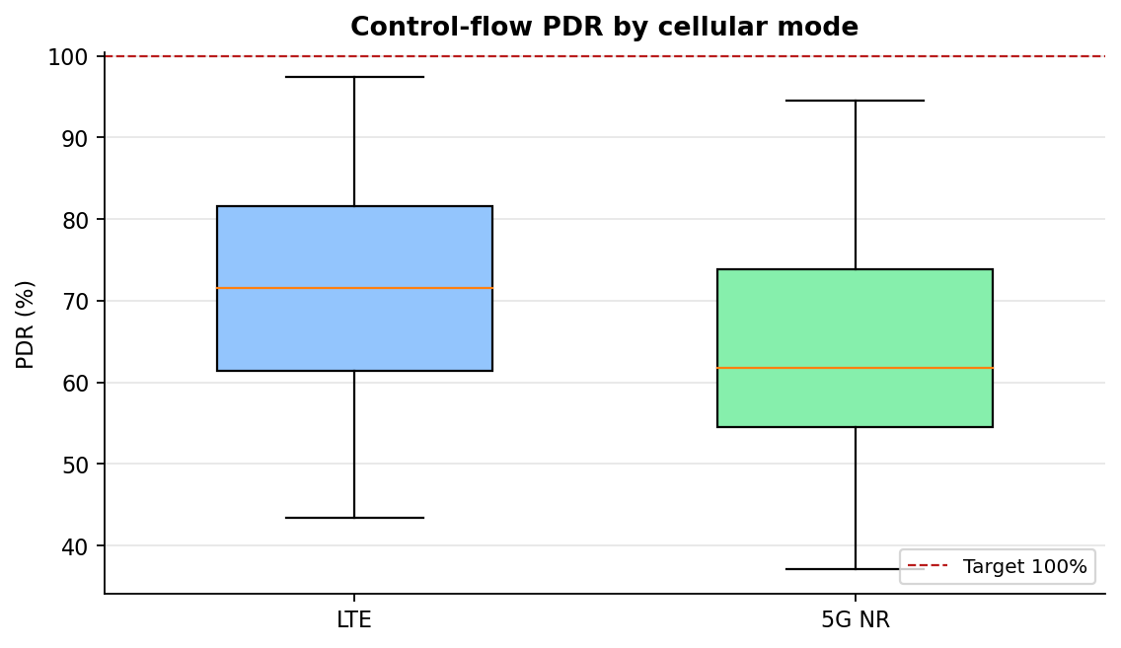
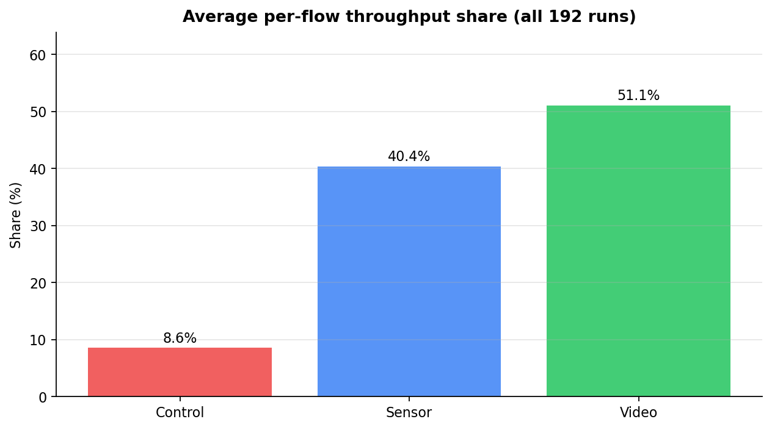
Campaign Overview
2 cellular modes × 2 hotspot bands × 4 STA counts × 4 payloads × 3 seeds = 192 runs
Traffic model (3 flows, DSCP-marked)
Matrix
Flow | Transport | DSCP | Target
Control | UDP, 1024B/50ms | EF | P99 ≤ 50ms; 0% loss
Sensor | TCP | AF31 | Delay ≤ 200ms; loss < 5%
Video | TCP | AF41 | Delay ≤ 500ms; loss < 10%
Factor | Levels
Cellular mode | LTE, NR
Hotspot band | 2.4GHz, 5GHz
STA count | 5, 10, 15, 20
Payload | 10KB, 50KB, 1MB, 2MB
Seeds | 7, 8, 9
Completed | 192 / 192
All 192 runs completed successfully. A WiFi association crash (stale management frame during multi-AP roaming) found mid-campaign was patched in ns-3's sta-wifi-mac.cc before this final data was collected.
Sheikh Sayed Bin Rahman | PIC Lab, Kyushu Institute of Technology (KIT) | 2026

Slide 3
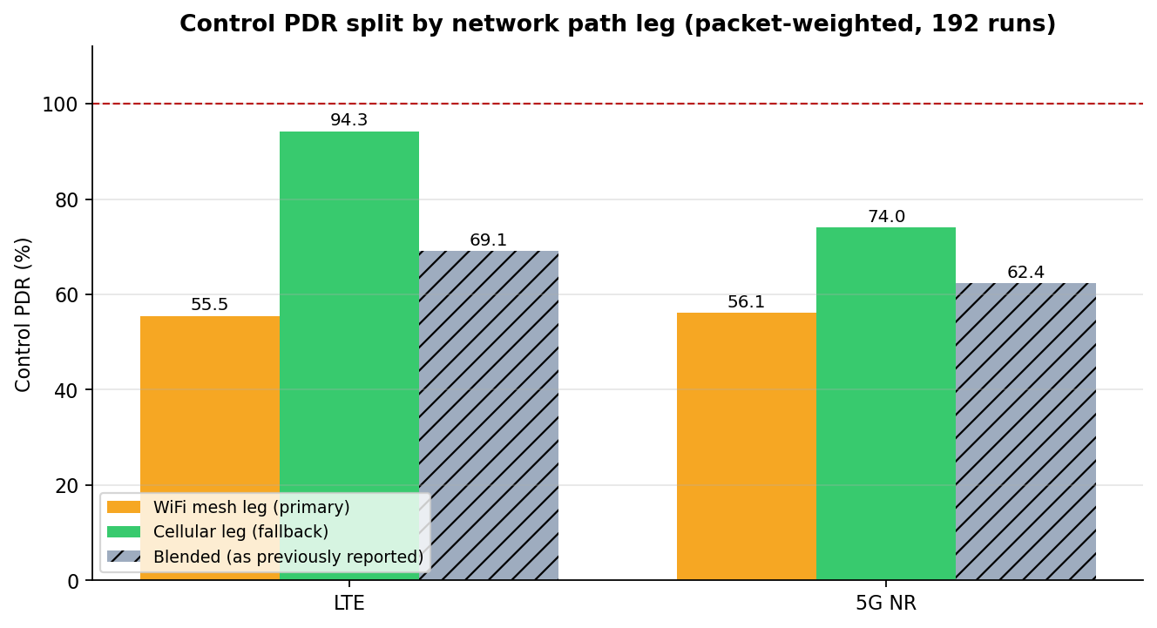
1. Headline Result: Two Legs, Not One Average
The mesh primary leg and cellular fallback leg behave very differently — blending them hid that
Control PDR — WiFi mesh leg (LTE)
Control PDR — WiFi mesh leg (NR)
Control PDR — cellular leg (LTE)
Control PDR — cellular leg (NR)
55.5%
56.1%
94.3%
74.0%
below spec
below spec
meets target
meets target
The cellular fallback leg meets the Control-flow requirement; the WiFi mesh primary leg does not. Earlier progress decks quoted one blended figure that averaged both legs together and attributed the weakness to the hybrid design as a whole — the actual limiting factor is the mesh primary leg specifically (mesh association / route maintenance, scoped as the August enhancement item), not the switching mechanism.
Sheikh Sayed Bin Rahman | PIC Lab, Kyushu Institute of Technology (KIT) | 2026

Slide 4
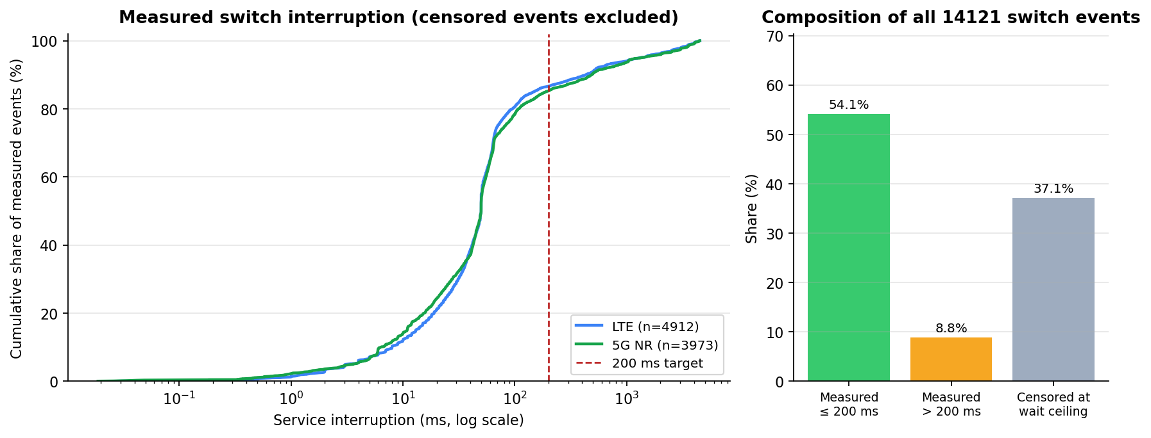
2. Switch Recovery: Fast in the Majority of Cases
Measured vs. censored interruption timing across all 192 runs
Metric | Value
Total switch samples | 14121
Recovered within 200ms | 54.1% (8885 measured, 5236 censored)
Median / P90 measured interruption | 50 ms / 462 ms
Control restored within ±1s (§3.3 continuity) | 78.5% of 14121 events
Switching transients are not what cost the Control flow its packets — sustained primary-path outages between switches are. The scenario's 5s wait ceiling censors 37.1% of interruption samples, so the upper tail of the recovery-time distribution isn't fully observable from this campaign.
Sheikh Sayed Bin Rahman | PIC Lab, Kyushu Institute of Technology (KIT) | 2026

Slide 5
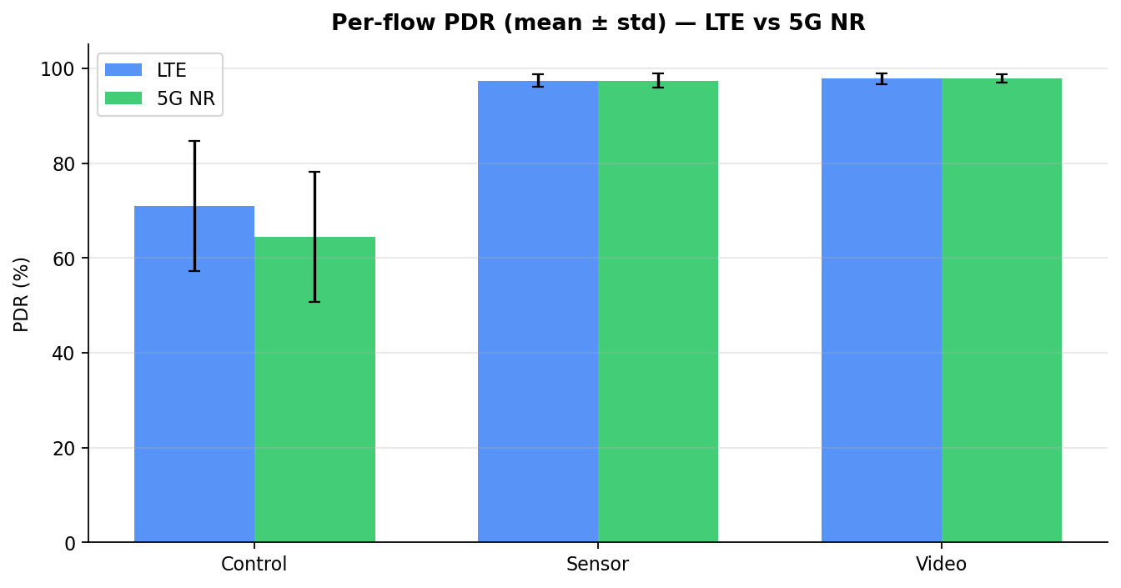
3. Per-Flow QoS Summary (All Runs)
Blended across WiFi and cellular legs — see slide 1 for the leg split that matters for Control
Flow | PDR | Loss | P99 delay | Tput share | Target
Control | 67.7% | 32.25% | 310.5 ms | 8.6% | ≤50ms, <0% loss
Sensor | 97.4% | 2.61% | 204.5 ms | 40.4% | ≤200ms, <5% loss
Video | 97.8% | 2.16% | 158.9 ms | 51.1% | ≤500ms, <10% loss
Caveat: Sensor and Video PDR (~97%) overstates primary-path availability — both are TCP flows whose sockets never migrate to the cellular leg. TCP retransmission turns an outage into reduced throughput rather than recorded loss, so they can't be used to judge path health the way Control (UDP) can.
Sheikh Sayed Bin Rahman | PIC Lab, Kyushu Institute of Technology (KIT) | 2026

Slide 6
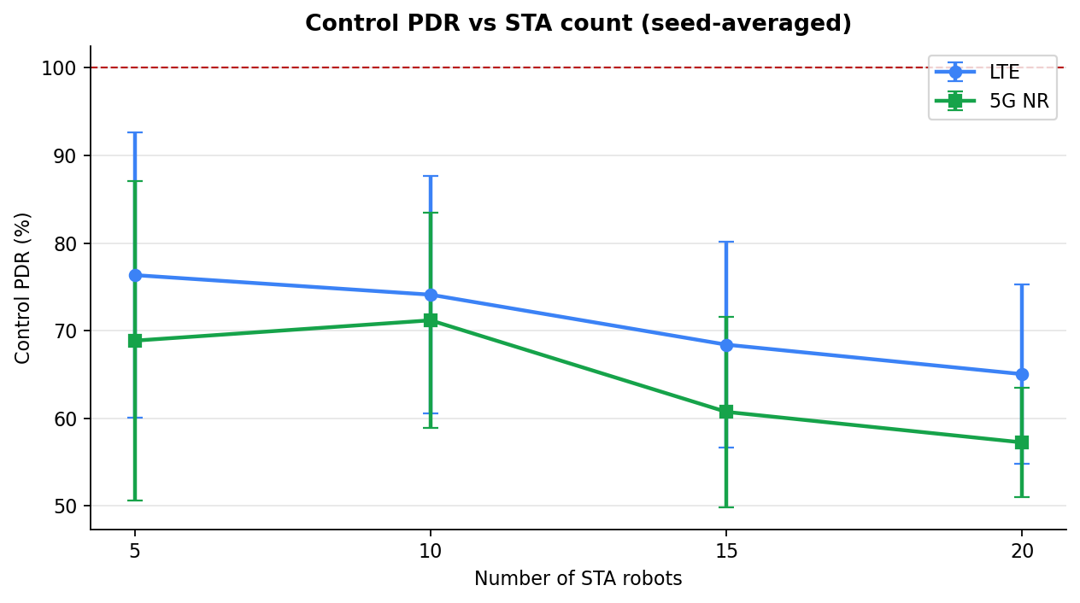
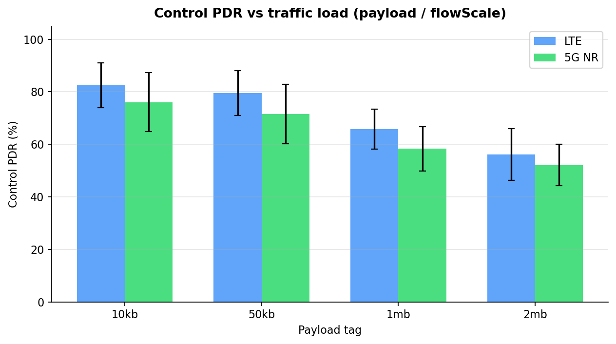
4. Control PDR Sensitivity: STA Count & Payload
New this campaign — full factorial sweep vs. the single representative run in earlier progress decks
Sheikh Sayed Bin Rahman | PIC Lab, Kyushu Institute of Technology (KIT) | 2026

Slide 7
5. Compliance with the Enhancement Plan (§3)
Named deviations from traffic_qos_report.md §9 — disclosed, not hidden
Requirement | Status | Note
Control: UDP, 1024B/50ms | Met
Sensor: TCP, 100KB/200ms bursts | Deviation | Runs as continuous stream; burstiness not reproduced
Video: separate flow IDs, DSCP | Met
Video: 1-10 Mbps band (§3.1) | Deviation | Below range at 10KB/50KB payload (96/192 runs)
RSSI threshold −58dBm (§4.2.2) | Deviation | Campaign used −80dBm/3dB — deferred to Aug item
Control PDR before/after switch (§3.3) | Partial | Leg split used as proxy; true per-event log not emitted
All deviations are named in the final report rather than smoothed over. Threshold alignment and Sensor/Video traffic-shape fixes require re-running the 192-run matrix and are scoped to the August enhancement item, not silently deferred.
Sheikh Sayed Bin Rahman | PIC Lab, Kyushu Institute of Technology (KIT) | 2026

Slide 8
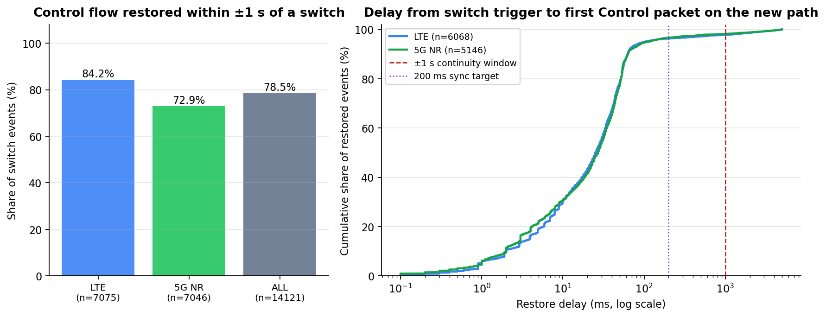
6. Key Findings & Next Steps
What the completed 192-run campaign shows, and what's still ahead
Findings
1. The switching mechanism works: once on the fallback, Control PDR is 94.3%
(LTE) / 74.0% (NR) — a radio-side question, not a switching-logic failure.
2. The WiFi mesh primary leg is the limiting factor (55.5% / 56.1% Control PDR),
not the hybrid design overall. Mesh association/route maintenance is the
August enhancement item.
3. Switch recovery is fast in the majority of cases (54.1% within 200ms, median
50ms measured); sustained primary-path outages cost more than the switch
transient itself.
4. Sensor/Video TCP PDR (~97%) cannot be used to judge path health — sockets
never migrate, so TCP retransmission masks outages as reduced throughput.
5. STA count and payload both affect Control PDR and timeout rate — the 192-run
factorial matrix was necessary; single-seed anecdotes were not sufficient.
Next steps (August enhancement item):
• Align RSSI threshold to −58dBm and classify Intra-Mesh HO events
• Fix Sensor (bursty 100KB/200ms) and Video (1-10Mbps floor) traffic shape
• Improve mesh association/route maintenance to close the primary-leg gap
Sheikh Sayed Bin Rahman | PIC Lab, Kyushu Institute of Technology (KIT) | 2026

