Slide 1
WiFi Mesh Internal Handover Modeling
Intra-Mesh HO Classification & Guard Timer (Enhancement Plan Section 4)
August Deliverable
Sheikh Sayed Bin Rahman
PIC Lab, KIT · 2026

Slide 2
The Problem
Section 4.1: Intra-Mesh HO events aren't modeled, so a momentary RSSI dip can be misread as real coverage loss
• 4 mesh APs are fixed in place; a STA roaming AP-to-AP within the
same WiFi mesh (Intra-Mesh Handover) wasn't explicitly modeled
• A momentary RSSI drop during that handover could falsely trigger
a WiFi -> cellular switch
• Field measurements show Intra-Mesh HO interruptions of 0.1-0.5s --
but the simulation risked misclassifying these as full cellular
switches, mixing two very different kinds of latency together
Goal: tell the two apart, and add a Guard Timer that gives a
momentary post-handover RSSI dip time to recover before committing
to a cellular switch.
Sheikh Sayed Bin Rahman | PIC Lab, KIT | 2026

Slide 3
Approach
Sections 4.2.1-4.2.3: classify, then guard
Step | What was built
Classification (4.2.2) | New `type` field in switch_log: intra_mesh / wifi_to_cell / cell_to_wifi
Detection (4.2.1) | Hooked into existing AssocRequest/DeAssoc callbacks; only counts a handover while WiFi is the STA's actual serving path (not background radio noise)
Coverage radius (4.2.1a) | New `apCoverageRadiusM` parameter
Boundary-crossing scenario (4.2.1b) | New `boundary` robotType: STAs walk directly between two adjacent APs
Guard Timer (4.2.3) | Suppresses the RSSI-based cellular trigger for 0.5s after an Intra-Mesh HO
Comparison (4.2.3) | 160 paired runs (Guard Timer off vs on), 3 network conditions, 0 failures
Sheikh Sayed Bin Rahman | PIC Lab, KIT | 2026

Slide 4
A Finding Along the Way: The Boundary Scenario Mostly Failed
And that failure is itself useful information
At -58dBm with APs 200m apart, each AP's reliable range is only ~80m --
leaving a real ~40m dead zone. Only 1 of 8 STAs completed a clean handover;
the rest dropped to cellular in the gap instead.
• The deliberately-designed scenario (asked for in 4.2.1b) was built exactly as specified
• It revealed a genuine AP-placement limitation rather than providing a clean test bed
• This directly serves the plan's section 4.3 goal: "comparison basis for AP placement
optimization (adjusting coverage overlap)" -- an unplanned but real contribution
• The main Guard Timer study instead used the existing organic mobility patterns
(gaussmarkov/patrol/transport/work), which produce genuine handovers at a real,
if less frequent, rate
Sheikh Sayed Bin Rahman | PIC Lab, KIT | 2026

Slide 5
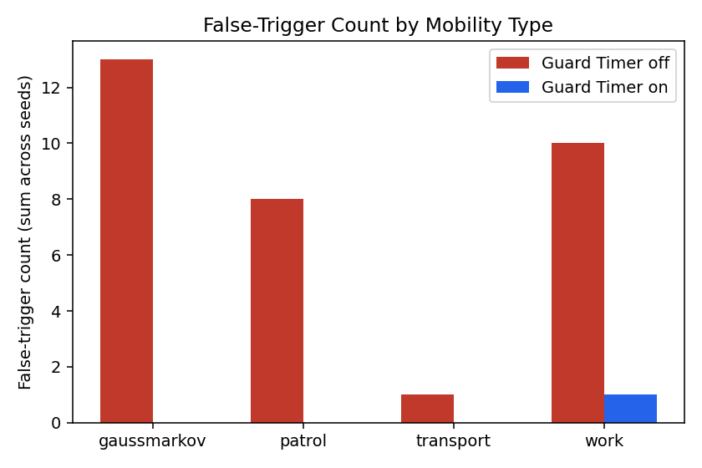
Headline Result
LTE, STA=10 -- 10 seeds x 4 mobility types, 80 paired runs
False triggers (off)
False triggers (on)
Reduction
Switch volume change
32
1
96.9%
+2.5%
4.3% of switches
0.1% of switches
false-trigger suppression
negligible side effect
"False trigger" = a WiFi->cellular switch within 0.5s after an Intra-Mesh HO for the same STA -- exactly the failure mode section 4.1 describes. The Guard Timer only suppresses the RSSI component of the decision; PDR-based and stale-RSSI triggers are unaffected, so a genuinely failing connection still switches, just possibly a fraction of a second later.
Sheikh Sayed Bin Rahman | PIC Lab, KIT | 2026

Slide 6
Cross-Check: Does It Generalize?
5 seeds x 4 mobility types each, checking cellular mode and STA count
Condition | False triggers (off -> on) | Reduction
LTE, STA=10 (baseline) | 32 -> 1 | 96.9%
NR, STA=10 | 14 -> 0 | 100%
LTE, STA=20 | 25 -> 1 | 96%
All three conditions land in the same 96-100% range. This supports the Guard Timer's benefit being a general property of the mechanism -- a WiFi-side RSSI phenomenon largely independent of cellular mode or STA count -- rather than an artifact of the one configuration first tested.
Not yet cross-checked: hotspot band (2.4 vs 5GHz) and payload/traffic load. Also, only one Guard Timer duration (0.5s, the plan's specified value) was tested -- the plan asks for that specific value, not a duration sweep, so this wasn't pursued further.
Sheikh Sayed Bin Rahman | PIC Lab, KIT | 2026

Slide 7
Compliance with the Enhancement Plan (Section 4)
Named deviations disclosed, not hidden
Requirement | Status | Note
4.2.1a: Parameterize AP coverage radius | Done
4.2.1b: Deliberate boundary-crossing scenario | Done | Revealed a real AP coverage-gap finding (see slide 4)
4.2.1: Log Intra-Mesh HO via Assoc/DeAssoc callbacks | Done | Two real bugs found & fixed along the way
4.2.2: Classification scheme (type field) | Done | -55dBm return threshold matches plan exactly (-58+3dB hysteresis)
4.2.3: Guard Timer + false-trigger comparison | Done | 96.9-100% reduction across 3 conditions, 160 runs
intra_mesh_ho.cc (named file) | Deviation | Implemented within traffic_qos.cc instead (same pattern as Item 1)
switch_log_v2.csv (named file) | Deviation | Format is v2 (type field); filename still wifi-hybrid-switch_log.csv
guard_timer_report.pdf | Delivered | Exact filename match
Sheikh Sayed Bin Rahman | PIC Lab, KIT | 2026

