Slide 1
IDEA & TECHNOLOGY PROPOSAL
Automatic WiFi Mesh–Cellular
Failover for Robot Fleets
RSSI/PDR-fused, session-preserving handover that keeps multi-robot
construction fleets connected below a 200 ms coordination budget.
< 200 ms
20
LTE & 5G
802.11s
sync budget
robots scaled
dual fallback
WiFi mesh
PIC Lab · Kyushu Institute of Technology · 2026
Notes:
Good morning, and thank you for the time. I want to introduce a technology that solves a specific but fast-growing problem: keeping a whole team of construction robots reliably connected, all the time, without anyone touching the network. It's an automatic WiFi-mesh-to-cellular failover system that keeps robots coordinated under a 200-millisecond budget. I'll cover the idea, how it works, and where it's headed.

Slide 2
CONTENTS
What this deck covers
01
02
03
The Problem
Our Solution
Core Technology
Why one network isn't enough on a jobsite
A self-switching hybrid network
RSSI/PDR fusion & make-before-break
04
05
06
Architecture
Handover Logic
Differentiators
One service IP over two paths
Sense · Decide · Act · Record
What sets this apart
07
08
09
Validation
Market & Model
Roadmap
What Phase 1 has proven
Opportunity and revenue
Simulation to commercialization
RSSI/PDR WiFi Mesh–Cellular Failover
PIC Lab · KIT
02
Notes:
Here's the path: the problem, our solution and the core technology, the architecture, how a handover works, what sets us apart, what we've validated, the market and business model, and the roadmap.

Slide 3
01 · THE PROBLEM
No single network keeps a fleet coordinated
Construction sites now run teams of robots that must act as one coordinated system — demanding near-real-time sync under 200 ms. Neither on-site network delivers that alone.
WiFi MESH
CELLULAR
WITHOUT SEAMLESS SWITCHING
Fast & cheap to deploy
+
Covers the whole site
Fleet loses coordination mid-task
Active TCP sessions drop, forcing full retries
…but fades fast behind concrete and steel.
…but slower and costly to rely on continuously.
Manual network reconfiguration needed
Safety-critical operations interrupted
THE INSIGHT
Use WiFi where it's strong, cellular where it isn't — and switch fast enough that
the robot never notices. That fusion beats either technology on its own.
RSSI/PDR WiFi Mesh–Cellular Failover
PIC Lab · KIT
03
Notes:
Construction sites increasingly run teams of robots that must act as one coordinated system, and that needs near-real-time sync under 200 milliseconds. No single network delivers that: a WiFi mesh is fast and cheap but fades behind concrete; cellular covers the whole site but is slower and costly to lean on. And when a link drops, the fleet loses coordination, sessions die, and safety-critical work stops. Our insight: use WiFi where it's strong, cellular where it isn't, and switch fast enough that the robot never notices.

Slide 4
02 · OUR SOLUTION
A network that switches itself
Each robot keeps one continuous identity; a hybrid controller silently decides which link carries its traffic.
◆
⇄
✓
≈
Always connected
Seamless failover
Per-robot assurance
Technology-neutral
One stable network identity per robot — the system picks the link, never the operator.
Traffic slides to cellular as WiFi fades and back as it recovers — session intact.
Every switch is measured and logged against the 200 ms target, per robot.
The identical controller runs over LTE or 5G NR — no redesign per site.
DELIVERED AS
① Embedded switching module inside the robot's existing network gateway
② Operator-facing connectivity-assurance layer for fleet-wide reliability reporting
RSSI/PDR WiFi Mesh–Cellular Failover
PIC Lab · KIT
04
Notes:
So we built a network that switches itself. Each robot keeps one continuous identity, and a hybrid controller decides which link carries its traffic. That gives four things: always connected, seamless failover with the session intact, per-robot assurance against the latency target, and it's technology-neutral across LTE or 5G. We deliver it as an embedded gateway module plus an operator-facing assurance layer.

Slide 5
03 · CORE TECHNOLOGY
How the controller decides
A hybrid path controller re-evaluates every robot every 0.5 s.
TUNED PARAMETERS
Dual-signal fusion
RSSI trigger
−80 dBm
Blends EWMA-smoothed RSSI with a 1 s sliding-window PDR — so a momentary radio dip alone never triggers a switch.
Hysteresis gap
+3 dB → −77 dBm
Hysteresis
PDR floor
0.90
Return-to-WiFi threshold sits 3 dB above the leave threshold and must hold for 2 checks — no oscillation at the edge.
Return checks
2 consecutive
Staleness guard
Staleness timeout
3 s
If no WiFi frame is heard for > 3 s, failover fires anyway — catching slow fades the thresholds would miss.
Eval interval
0.5 s
Make-before-break
Interruption goal
< 200 ms
The new route is installed before the old one is dropped, so an active TCP session survives the handover.
RSSI/PDR WiFi Mesh–Cellular Failover
PIC Lab · KIT
05
Notes:
Here's the engine. The controller rechecks every robot twice a second, on four principles. First, dual-signal fusion — it blends smoothed RSSI with a one-second packet-delivery ratio, so a momentary dip alone never triggers a switch. Second, hysteresis — the return threshold sits 3 dB above the leave threshold and must hold for two checks, so it never oscillates. Third, a staleness guard — no WiFi frame for three seconds forces failover. And fourth, make-before-break routing, so a live TCP session survives.

Slide 6
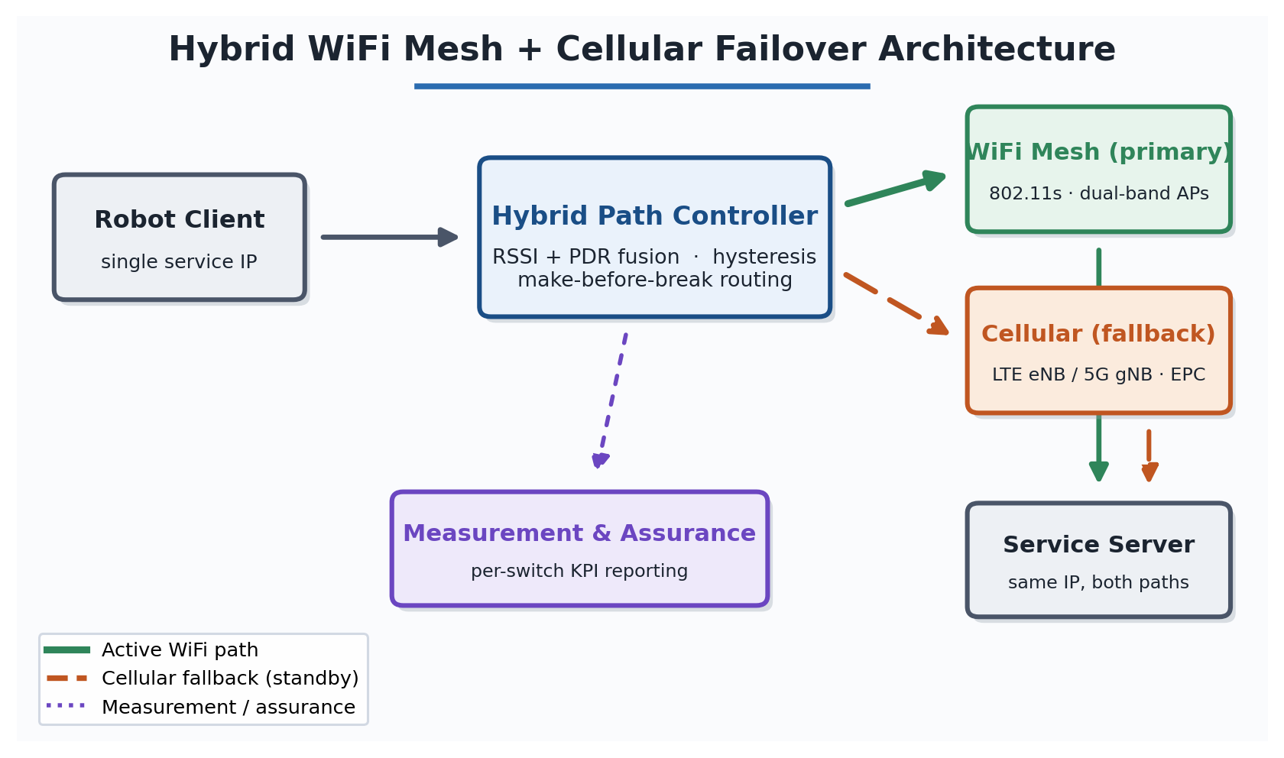
04 · ARCHITECTURE
One service IP, two paths
AT A GLANCE
4-node 802.11s mesh
Dual-band APs (5 GHz ac + 2.4 GHz n), one SSID for roaming.
Single macro cell
LTE 2.0 GHz or 5G NR 3.5 GHz at site center.
Shared service IP
Both paths reach the same address — handover is a routing change, not a reconnect.
Building-aware loss
One propagation model across WiFi, LTE & 5G — like-for-like.
400 × 400 m site
7 fixed concrete buildings, 30 m tall field.
RSSI/PDR WiFi Mesh–Cellular Failover
PIC Lab · KIT
06
Notes:
The key trick is one service IP over two paths — a four-node 802.11s mesh and a single LTE or 5G cell. Because both paths lead to the same destination address, a handover is just a routing change, not a reconnection — which is why sessions survive. And one building-aware propagation model runs across all links, so the comparison is like-for-like.

Slide 7
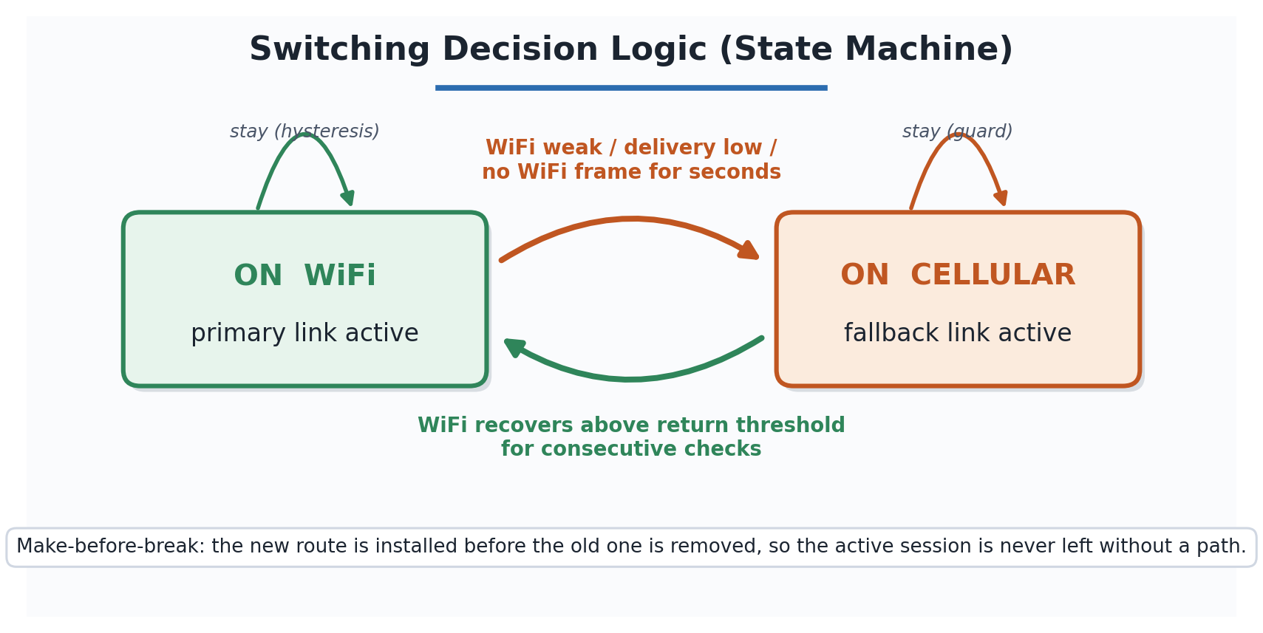
05 · HANDOVER LOGIC
Sense → Decide → Act → Record
1
SENSE
›
2
DECIDE
›
3
ACT
›
4
RECORD
RSSI, PDR & time since last frame
Thresholds + hysteresis
Make-before-break reroute
Log switch & measure gap
TWO-STATE CONTROLLER
DECISION RULES
RSSI < −80 dBm and PDR < 0.90
→ Cellular
No WiFi frame for 3 s
→ Cellular
RSSI > −77 dBm for 2 checks
→ WiFi
Signal hovering at the edge
Hold
Asymmetric by design: easy to leave WiFi, hard to return — biased toward the preferred link.
RSSI/PDR WiFi Mesh–Cellular Failover
PIC Lab · KIT
07
Notes:
Every cycle the controller does four things: sense, decide, act, and record the switch with its interruption. The rules are deliberately asymmetric — easy to leave WiFi, hard to return — so it favors the preferred link without ever flapping.

Slide 8
06 · DIFFERENTIATORS
Why this stands apart
◆
Joint, environment-tuned switching
◷
A measurable latency guarantee
Reasons over signal AND delivery, with hysteresis tuned to real propagation — validated on real AP profiles (TP-Link EAP225, Netgear Orbi 960, ASUS ZenWiFi XT8), not idealized radios.
Reports a quantified per-switch interruption against a < 200 ms budget — the number a robotics customer actually needs, not just aggregate throughput.
⇄
Head-to-head LTE vs. 5G NR
✓
Session-preserving by design
Evaluates both cellular technologies in the same fallback role and topology — a direct comparison few public studies offer for construction robotics.
Make-before-break routing keeps live TCP sessions alive, holding interruption in the millisecond range instead of a socket-timeout retry.
RSSI/PDR WiFi Mesh–Cellular Failover
PIC Lab · KIT
08
Notes:
Four things set us apart. One — joint, environment-tuned switching on both signal and delivery, validated on real access-point hardware. Two — a measurable latency guarantee: a quantified per-switch interruption against a 200-millisecond budget, the number a robotics customer actually cares about. Three — a genuine head-to-head of LTE versus 5G, which almost no public study offers here. And four — it's session-preserving by design.

Slide 9
07 · VALIDATION
What Phase 1 has proven
PHASE 1 · COMPLETE (MAR 2026)
NS-3 comparison of WiFi Mesh + LTE vs. WiFi Mesh + 5G NR across multiple seeds and node counts.
✓
Controller validated
✓
Measurement pipeline
✓
Scaled to 20 robots
RSSI/PDR hybrid controller implemented and verified in NS-3.
Per-switch interruption, RSSI time-series & PDR windows logged to CSV.
All mobile clients switched automatically in both directions.
✓
Latency target met
✓
Reliable return path
✓
Real hardware profiles
Every client held < 200 ms end-to-end across all runs.
Cellular → WiFi recovery confirmed, not just outbound failover.
Tuned against TP-Link, Netgear & ASUS AP characteristics.
Not yet field-tested on hardware. Further simulation runs planned to strengthen the statistical basis.
RSSI/PDR WiFi Mesh–Cellular Failover
PIC Lab · KIT
09
Notes:
This isn't just a concept. Phase 1 is complete: a full NS-3 comparison of WiFi-plus-LTE against WiFi-plus-5G across multiple seeds and node counts. The controller is validated, and we scaled to twenty mobile robots that all switched automatically in both directions — every client under 200 milliseconds, with reliable return to WiFi. Honest caveat: no hardware field test yet, and more simulation is planned.

Slide 10
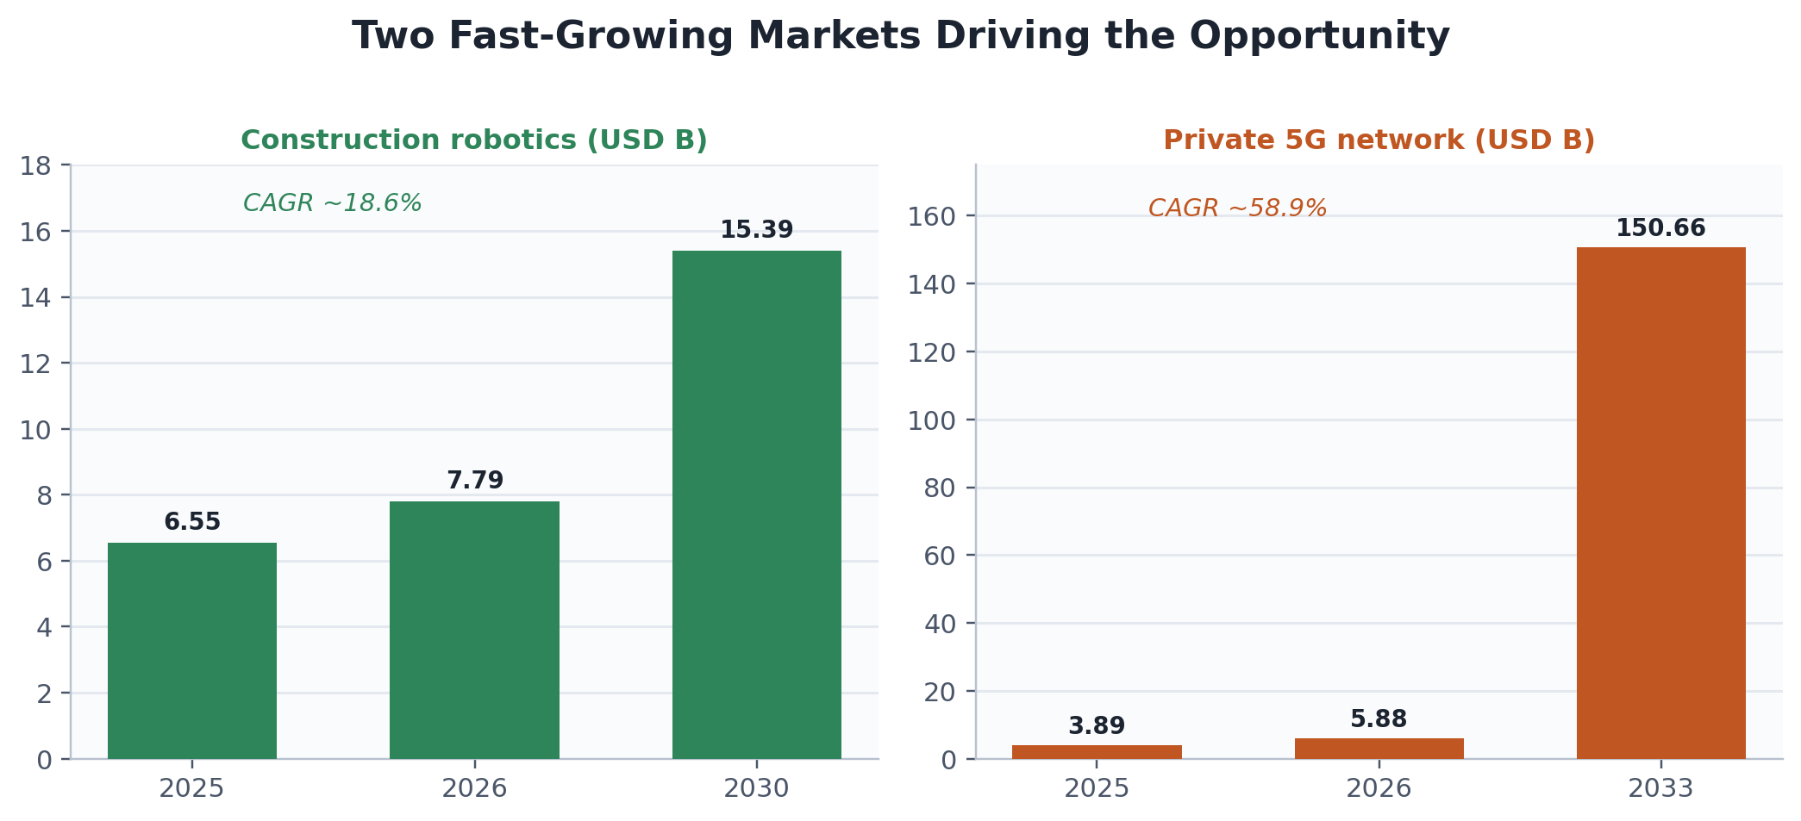
08 · MARKET & MODEL
A large, fast-growing opportunity
THREE REVENUE STREAMS
IP licensing
Per-unit royalty / annual fee to robot & gateway makers.
Early
Assurance subscription
Recurring per-site / per-robot reliability dashboards.
Recurring
Integration fees
One-time technology-transfer with telecom integrators.
Project
Construction robotics
~18.6% CAGR
$15.39B by 2030
Demand driver: the US alone needed ~546,000 more construction workers in 2023 — mirrored in Germany, Japan & Korea.
Private 5G networks
~58.9% CAGR
$150.66B by 2033
RSSI/PDR WiFi Mesh–Cellular Failover
PIC Lab · KIT
10
Notes:
We sit at the intersection of two fast-growing markets. Construction robotics heads toward fifteen billion dollars by 2030, and private 5G toward a hundred and fifty billion by 2033. The driver is real: the US alone needed roughly 546,000 more construction workers in 2023, with the same shortage in Germany, Japan, and Korea. We monetize three ways — IP licensing, a recurring assurance subscription, and one-time integration fees.

Slide 11
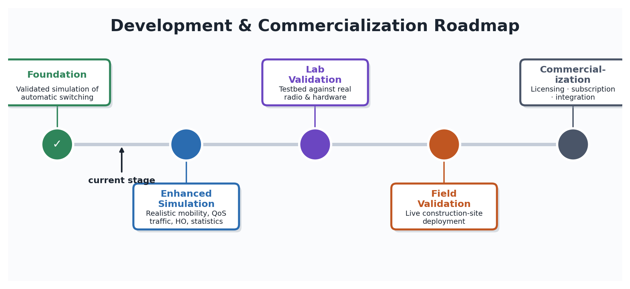
09 · ROADMAP
From simulation to the field
COMPLETE
IN PROGRESS
PLANNED
PLANNED
Foundation
Enhanced sim
Lab validation
Field trial
Simulation of the controller + measurement pipeline.
Waypoint mobility, QoS traffic, mesh handover, more seeds.
Confirm behavior on a real radio/hardware testbed.
Prove seamless failover & < 200 ms on a live site.
Commercialization (1–3 yrs): IP filing → license controller to gateway makers & integrators → connectivity-assurance service.
RSSI/PDR WiFi Mesh–Cellular Failover
PIC Lab · KIT
11
Notes:
The foundation is done. We're now in enhanced simulation: realistic waypoint mobility, QoS traffic, mesh handover modeling, and more statistical rigor. Then lab validation on a hardware testbed, then a field trial on a live site. Commercially, over one to three years: file the IP, license the controller, and layer the assurance service on top.

Slide 12
IN SUMMARY
Keeping robot fleets connected —
without anyone noticing the switch.
1
Dual-signal RSSI + PDR fusion with hysteresis — no false or oscillating switches.
2
Make-before-break routing keeps live TCP sessions alive through every handover.
3
< 200 ms interruption met across all tested scenarios, scaled to 20 robots.
4
Rare head-to-head LTE vs. 5G NR evaluation for construction robotics.
5
Phase 1 validated in simulation; lab and field trials mapped out.
6
Clear path to market: IP → licensing → connectivity-assurance service.
PIC Lab · Kyushu Institute of Technology
Idea & Technology Proposal · 2026
Notes:
To sum up — the point is keeping robot fleets connected without anyone noticing the switch. We fuse two signals with hysteresis, preserve live sessions through make-before-break, hit the sub-200-millisecond target with up to twenty robots, and did the rare direct LTE-versus-5G comparison. Phase 1 is validated and the path to market is clear. Thank you — I'd be glad to take your questions.

