Slide 1
IDEA & TECHNOLOGY PROPOSAL
Automatic WiFi Mesh–Cellular
Failover for Robot Fleets
RSSI/PDR-fused, session-preserving handover that keeps multi-robot
construction fleets connected below a 200 ms coordination budget.
< 200 ms
20
LTE & 5G
802.11s
sync budget
robots scaled
dual fallback
WiFi mesh
PIC Lab · Kyushu Institute of Technology · 2026
Notes:
Good morning, and thank you for the time. Our technology keeps a whole team of construction robots reliably connected, automatically, under a 200-millisecond budget — no one ever has to touch the network. Let me show you the idea, how it works, and where it's headed.

Slide 2
THE PROBLEM
No single network keeps a fleet coordinated
Jobsite robots must act as one coordinated system — demanding sub-200 ms sync. Neither on-site network delivers that alone.
WiFi MESH
CELLULAR
WITHOUT SEAMLESS SWITCHING
Fast & cheap to deploy
+
Covers the whole site
Fleet loses coordination mid-task
Active TCP sessions drop, forcing retries
…but fades fast behind concrete and steel.
…but slower and costly to rely on continuously.
Manual network reconfiguration needed
Safety-critical operations interrupted
THE INSIGHT
Use WiFi where it's strong, cellular where it isn't — and switch fast enough that
the robot never notices. That fusion beats either technology on its own.
RSSI/PDR WiFi Mesh–Cellular Failover
PIC Lab · KIT
02
Notes:
Jobsite robots must act as one coordinated system, and that needs sub-200 millisecond sync. No single network delivers it: a WiFi mesh is fast and cheap but fades behind concrete; cellular covers the whole site but is slower and costly to lean on. When a link drops, the fleet loses coordination, sessions die, and safety-critical work stops. Our insight: use each network where it's best, and switch so fast the robot never notices.

Slide 3
OUR SOLUTION
A network that switches itself
WHAT THE OPERATOR GETS
THE CONTROLLER — RE-EVALUATES EVERY ROBOT EVERY 0.5 s
Always connected
One stable identity per robot — the system picks the link.
Dual-signal fusion
Smoothed RSSI + 1 s packet-delivery ratio — a momentary dip alone never switches.
Seamless failover
Hysteresis
Slides to cellular as WiFi fades and back — session intact.
Return threshold +3 dB above leave, held for 2 checks — no oscillation.
Per-robot assurance
Staleness guard
Every switch measured against the 200 ms target.
No WiFi frame for 3 s forces failover — catches slow fades.
Technology-neutral
Make-before-break
Identical controller over LTE or 5G NR.
New route installed before old drops — live TCP survives.
Delivered as an embedded gateway module + an operator-facing connectivity-assurance layer.
RSSI/PDR WiFi Mesh–Cellular Failover
PIC Lab · KIT
03
Notes:
So we built a network that switches itself. Each robot keeps one identity while a controller picks the link — giving always-on connectivity, seamless failover, per-robot assurance, and support for both LTE and 5G. The engine rechecks every robot twice a second. It fuses RSSI with packet delivery so a momentary dip won't switch, uses hysteresis so it won't oscillate, a three-second staleness guard for slow fades, and make-before-break routing so a live TCP session survives.

Slide 4
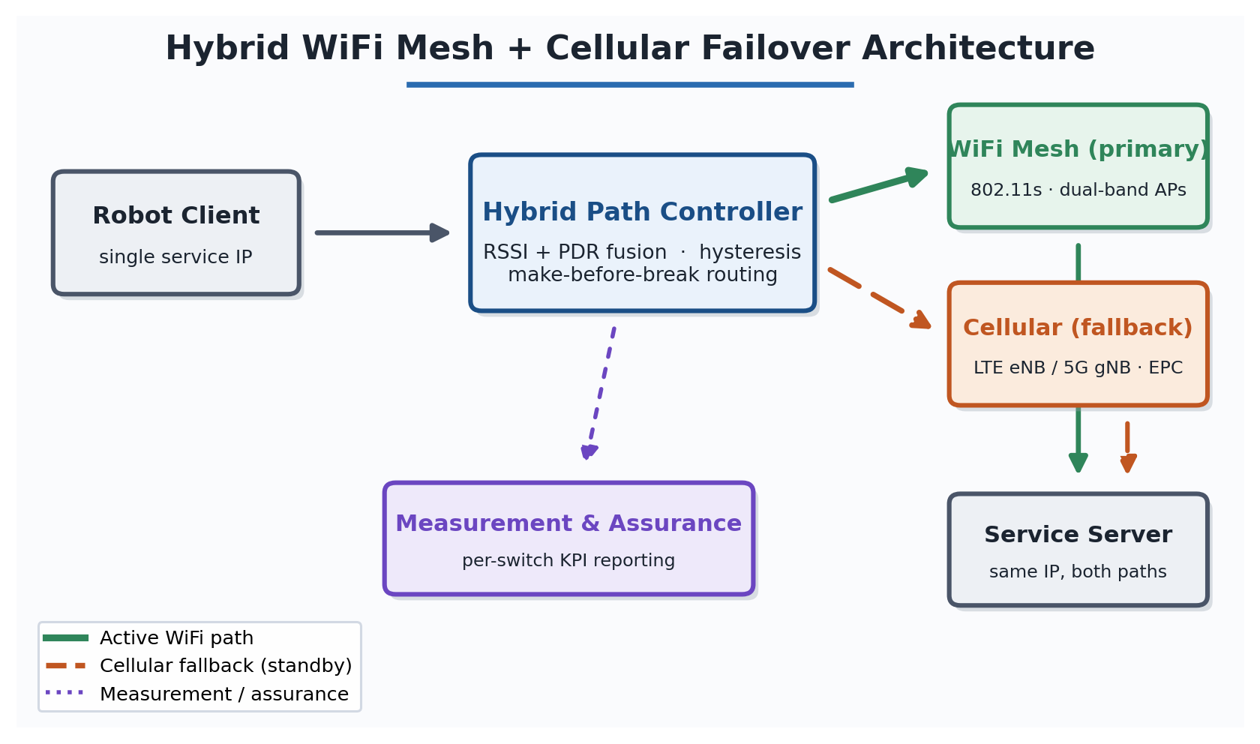
ARCHITECTURE & HANDOVER
One service IP, two paths
SENSE → DECIDE → ACT → RECORD (every 0.5 s)
RSSI < −80 dBm and PDR < 0.90
→ Cellular
No WiFi frame for 3 s
→ Cellular
RSSI > −77 dBm for 2 checks
→ WiFi
Signal hovering at the edge
Hold
Both paths reach the same address → a handover is a routing change, not a reconnection, so sessions survive.
Asymmetric by design: easy to leave WiFi, hard to return — biased to the preferred link, never flapping.
RSSI/PDR WiFi Mesh–Cellular Failover
PIC Lab · KIT
04
Notes:
The key trick is one service IP over two paths — a WiFi mesh and one LTE or 5G cell. Because both reach the same address, a handover is a routing change, not a reconnection, so sessions survive. Every half-second it senses, decides, acts, and records. The rules are deliberately asymmetric — easy to leave WiFi, hard to return — so it favors the preferred link without ever flapping.

Slide 5
DIFFERENTIATORS
Why this stands apart
◆
Joint, environment-tuned switching
◷
A measurable latency guarantee
Signal AND delivery, tuned to real propagation — validated on real AP profiles (TP-Link, Netgear, ASUS), not idealized radios.
A quantified per-switch interruption against a < 200 ms budget — the number a robotics customer actually needs.
⇄
Head-to-head LTE vs. 5G NR
✓
Session-preserving by design
Both cellular technologies in the same fallback role and topology — a direct comparison few public studies offer.
Make-before-break keeps live TCP alive — interruption in the millisecond range, not a socket-timeout retry.
RSSI/PDR WiFi Mesh–Cellular Failover
PIC Lab · KIT
05
Notes:
Four things set us apart: joint signal-and-delivery switching validated on real hardware; a measurable per-switch latency guarantee against 200 milliseconds; a rare direct LTE-versus-5G comparison; and session preservation by design.

Slide 6
VALIDATION
What Phase 1 has proven
PHASE 1 · COMPLETE (MAR 2026)
NS-3 comparison of WiFi Mesh + LTE vs. WiFi Mesh + 5G NR across multiple seeds and node counts.
✓
Controller validated
✓
Scaled to 20 robots
✓
Latency target met
RSSI/PDR hybrid controller verified in NS-3.
All mobile clients switched automatically both ways.
Every client held < 200 ms end-to-end, all runs.
✓
Reliable return path
✓
Measurement pipeline
✓
Real hardware profiles
Cellular → WiFi recovery confirmed, not just outbound.
Per-switch interruption, RSSI & PDR logged to CSV.
Tuned against TP-Link, Netgear & ASUS AP characteristics.
Not yet field-tested on hardware. Further simulation planned to strengthen the statistical basis.
RSSI/PDR WiFi Mesh–Cellular Failover
PIC Lab · KIT
06
Notes:
This isn't just theory. Phase 1 is complete — a full NS-3 comparison scaled to twenty robots, all holding under 200 milliseconds, with reliable return to WiFi. The honest caveat: no hardware field test yet.

Slide 7
MARKET, MODEL & ROADMAP
Opportunity and the path forward
Construction robotics
ROADMAP
~18.6% CAGR
$15.4B by 2030
COMPLETE
Foundation
Private 5G networks
~58.9% CAGR
IN PROGRESS
Enhanced simulation
$150.7B by 2033
REVENUE: IP licensing · assurance subscription · integration fees
PLANNED
Lab validation
Driver: the US alone needed ~546,000 more construction workers in 2023 — echoed in Germany, Japan & Korea.
PLANNED
Field trial
Commercialization (1–3 yrs): file IP → license the controller → add the assurance service.
RSSI/PDR WiFi Mesh–Cellular Failover
PIC Lab · KIT
07
Notes:
The opportunity is large: construction robotics heads toward fifteen billion dollars by 2030 and private 5G toward a hundred and fifty billion by 2033, driven by real labor shortages. We monetize through licensing, a subscription, and integration fees. Foundation is done, enhanced simulation is underway, then lab and field trials.

Slide 8
IN SUMMARY
Keeping robot fleets connected —
without anyone noticing the switch.
1
Dual-signal RSSI + PDR fusion with hysteresis — no false or oscillating switches.
2
Make-before-break routing keeps live TCP sessions alive through every handover.
3
< 200 ms interruption met across all tested scenarios, scaled to 20 robots.
4
Rare head-to-head LTE vs. 5G NR evaluation for construction robotics.
5
Phase 1 validated in simulation; lab and field trials mapped out.
6
Clear path to market: IP → licensing → connectivity-assurance service.
PIC Lab · Kyushu Institute of Technology
Idea & Technology Proposal · 2026
Notes:
Bottom line — we keep robot fleets connected without anyone noticing the switch. It's validated in simulation and the path to market is clear. Thank you — I'm happy to take questions.

